Slide 1
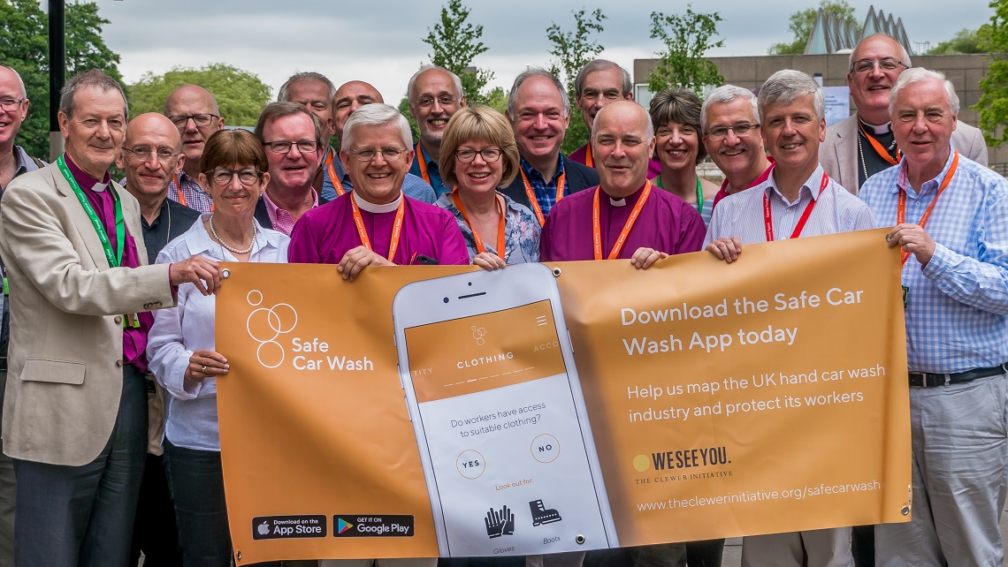
The Safe Car Wash app
An update since the release of the Safe Car Wash app Report

Slide 2
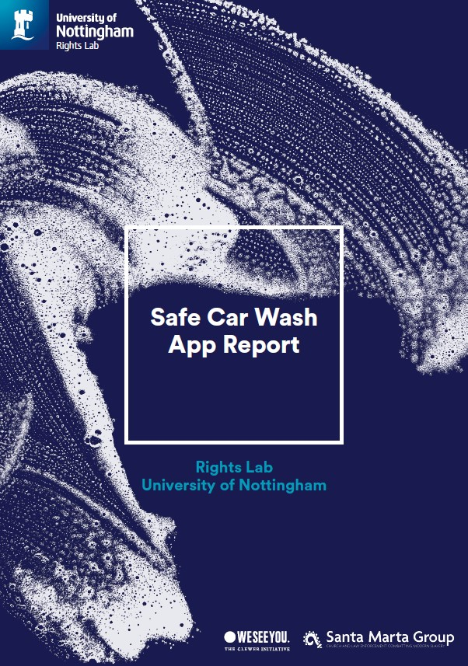
The Safe Car Wash App Report
The report was written by the University of Nottingham’s Rights Lab
They took the data from the app between 26th June and 3rd December 2018 and analysed the reports
41% of hand car washes showed a likelihood of modern slavery
48% said workers did not have access to protective clothing
14% saw the signs of workers living on site

Slide 3
Engagement with the app
12,133 people have downloaded the Safe Car Wash app
4000 since 7th April
4130 reports have been submitted
1040 since 7th April
All data as of 12th April 2019
App was launched on 26th June 2018

Slide 4
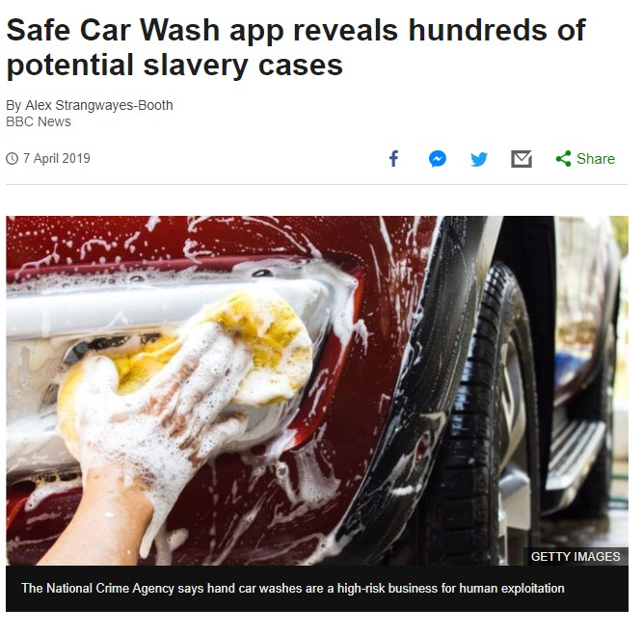
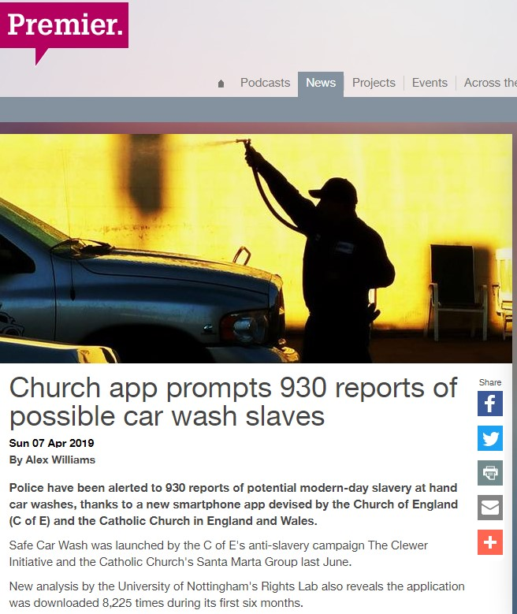
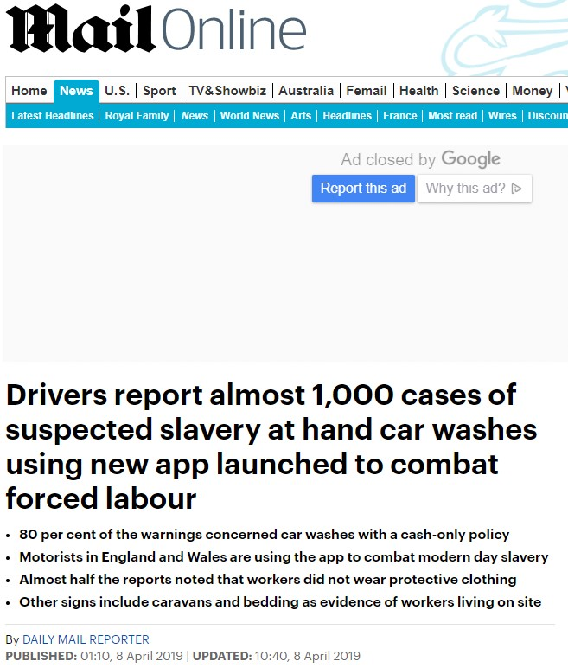
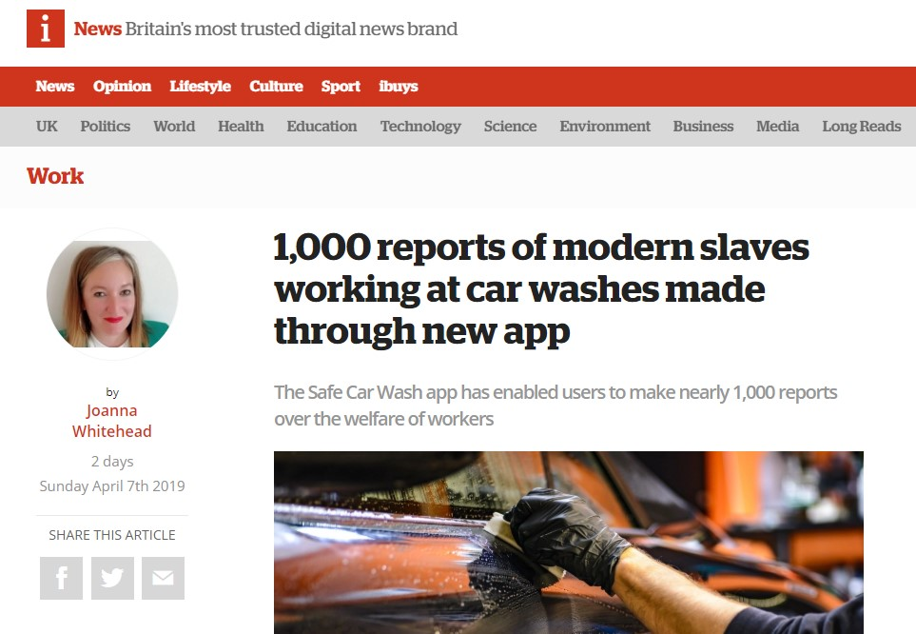
Media coverage
The BBC covered the launch of the report into the app’s results on radio, online and television
It was covered by a further 6 national outlets, multiple local ones, trade and Christian press

