Slide 1
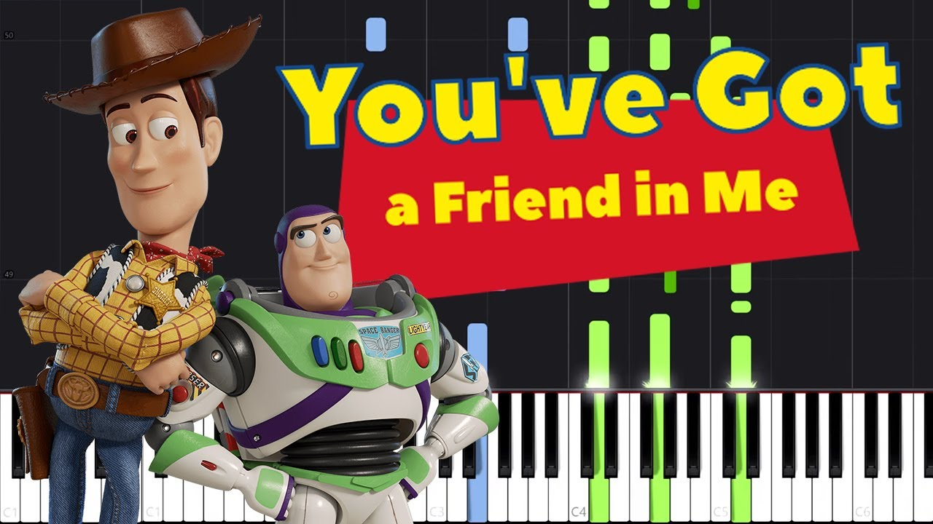

Slide 2
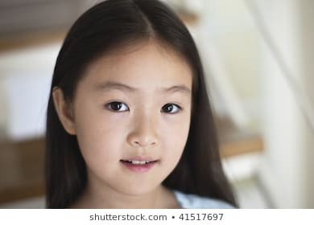
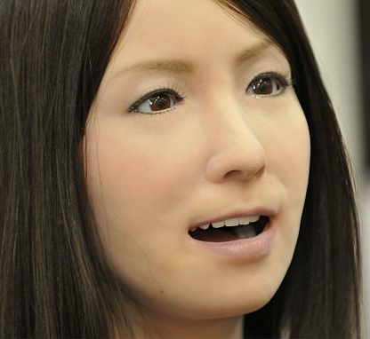

Slide 3
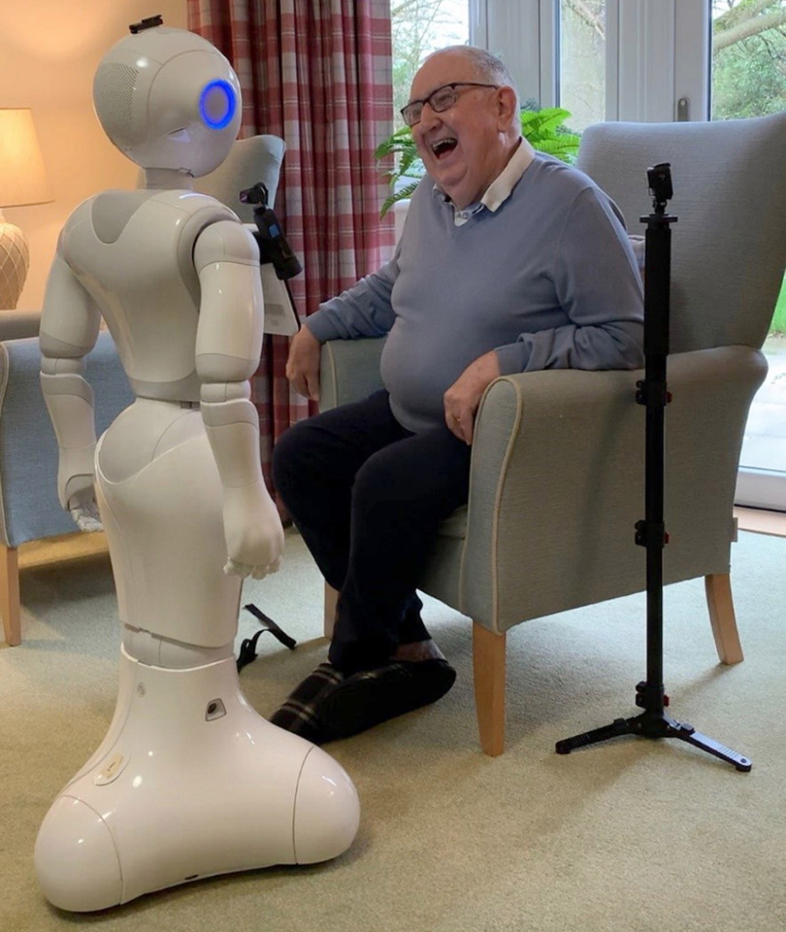

Slide 5
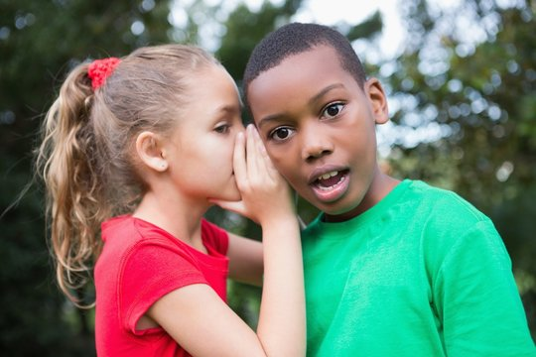
What would happen if….
Your best friend shared your secret with somebody else?

Slide 6
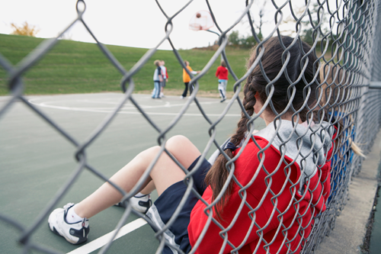
What would happen if….
Your best friend left you out of a game?

Slide 7
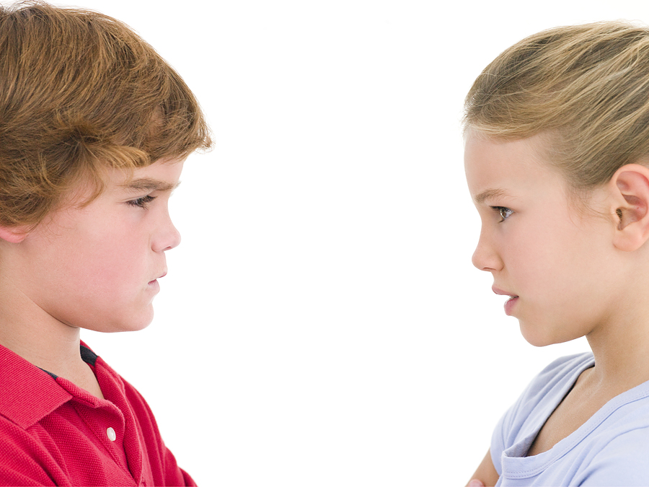
What would happen if….
Your best friend lied to you?

Slide 8
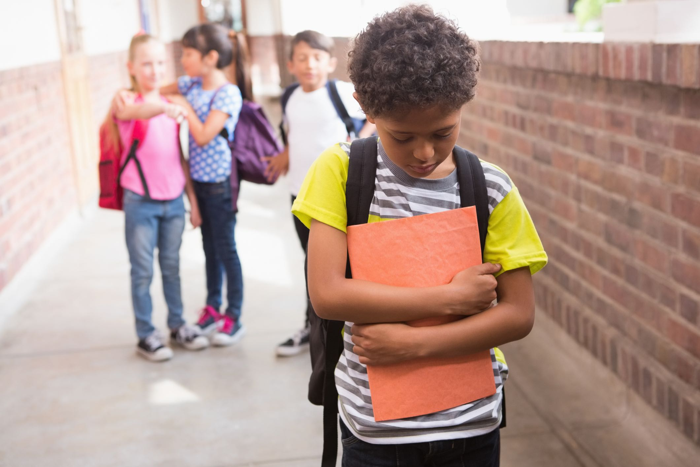
What would happen if….
Your best friend called you an unkind name?

Slide 9
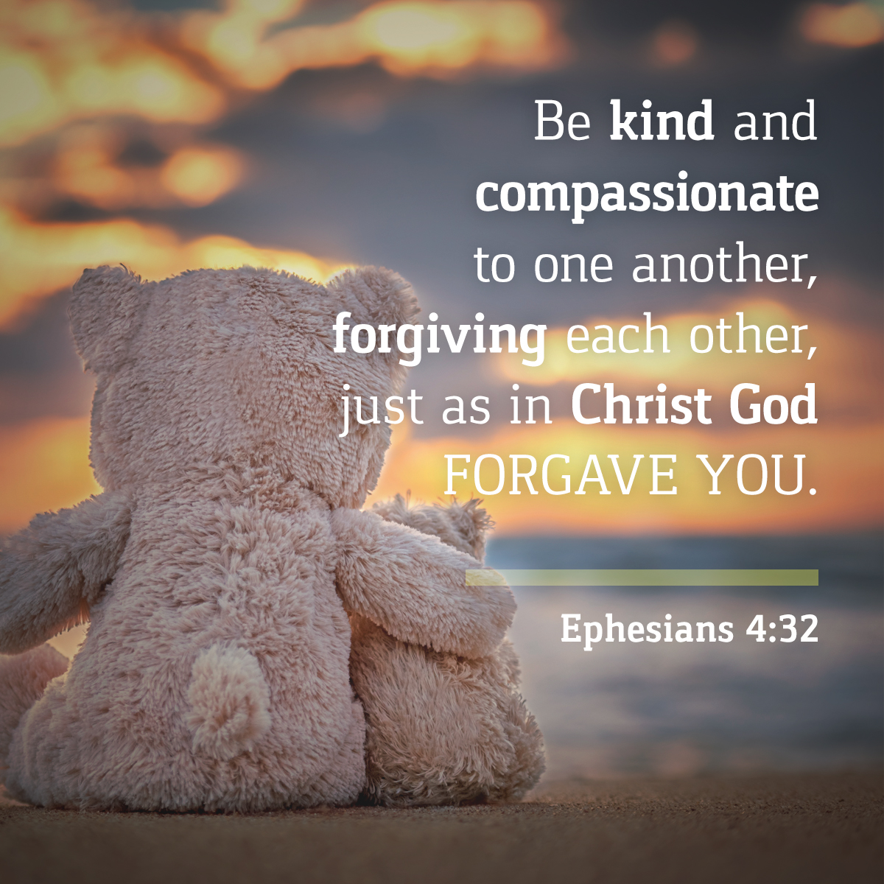

Slide 10
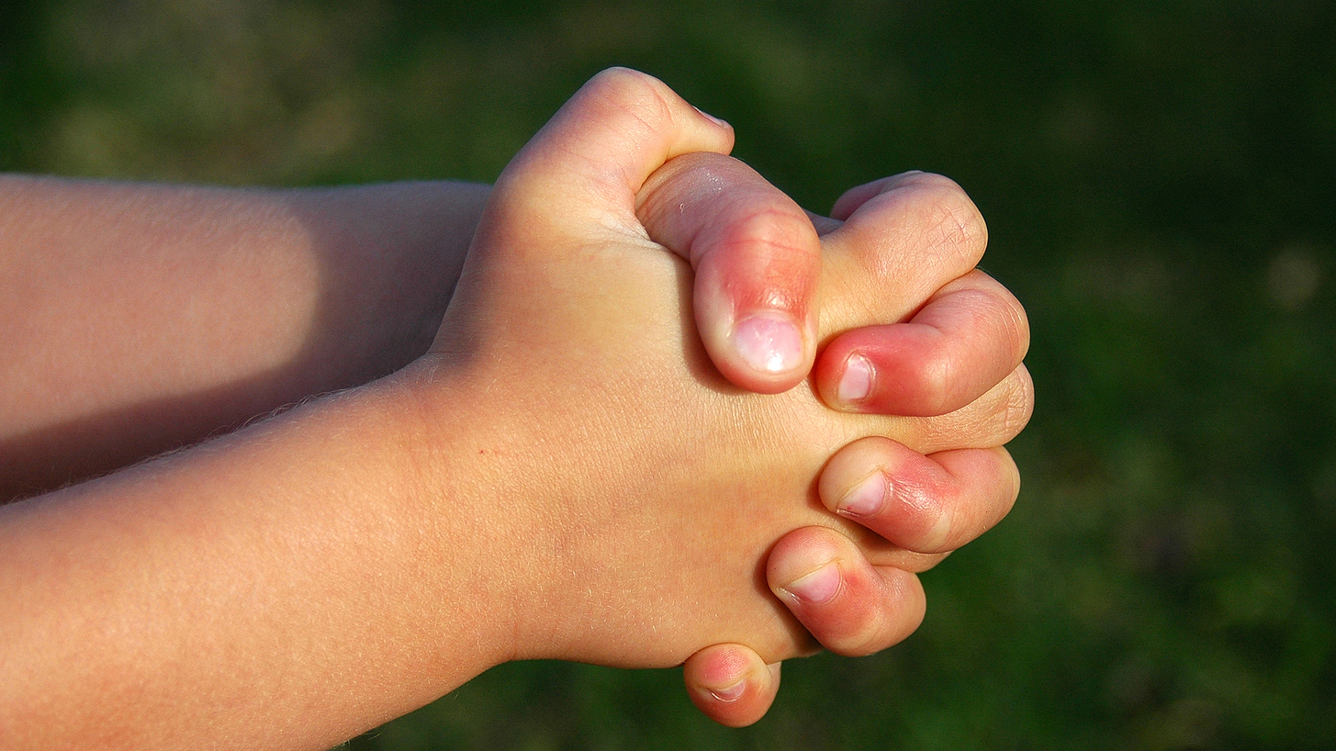
Dear God,
Thank you for our friends.
For the fun we have together
and the good times.
We’re sorry for the times
when we let each other down.
Please help us to forgive each other
and to put things right
when we need to.
Amen.

