Slide 4
“Don’t Judge others.”
Matthew 7: 1

Slide 5
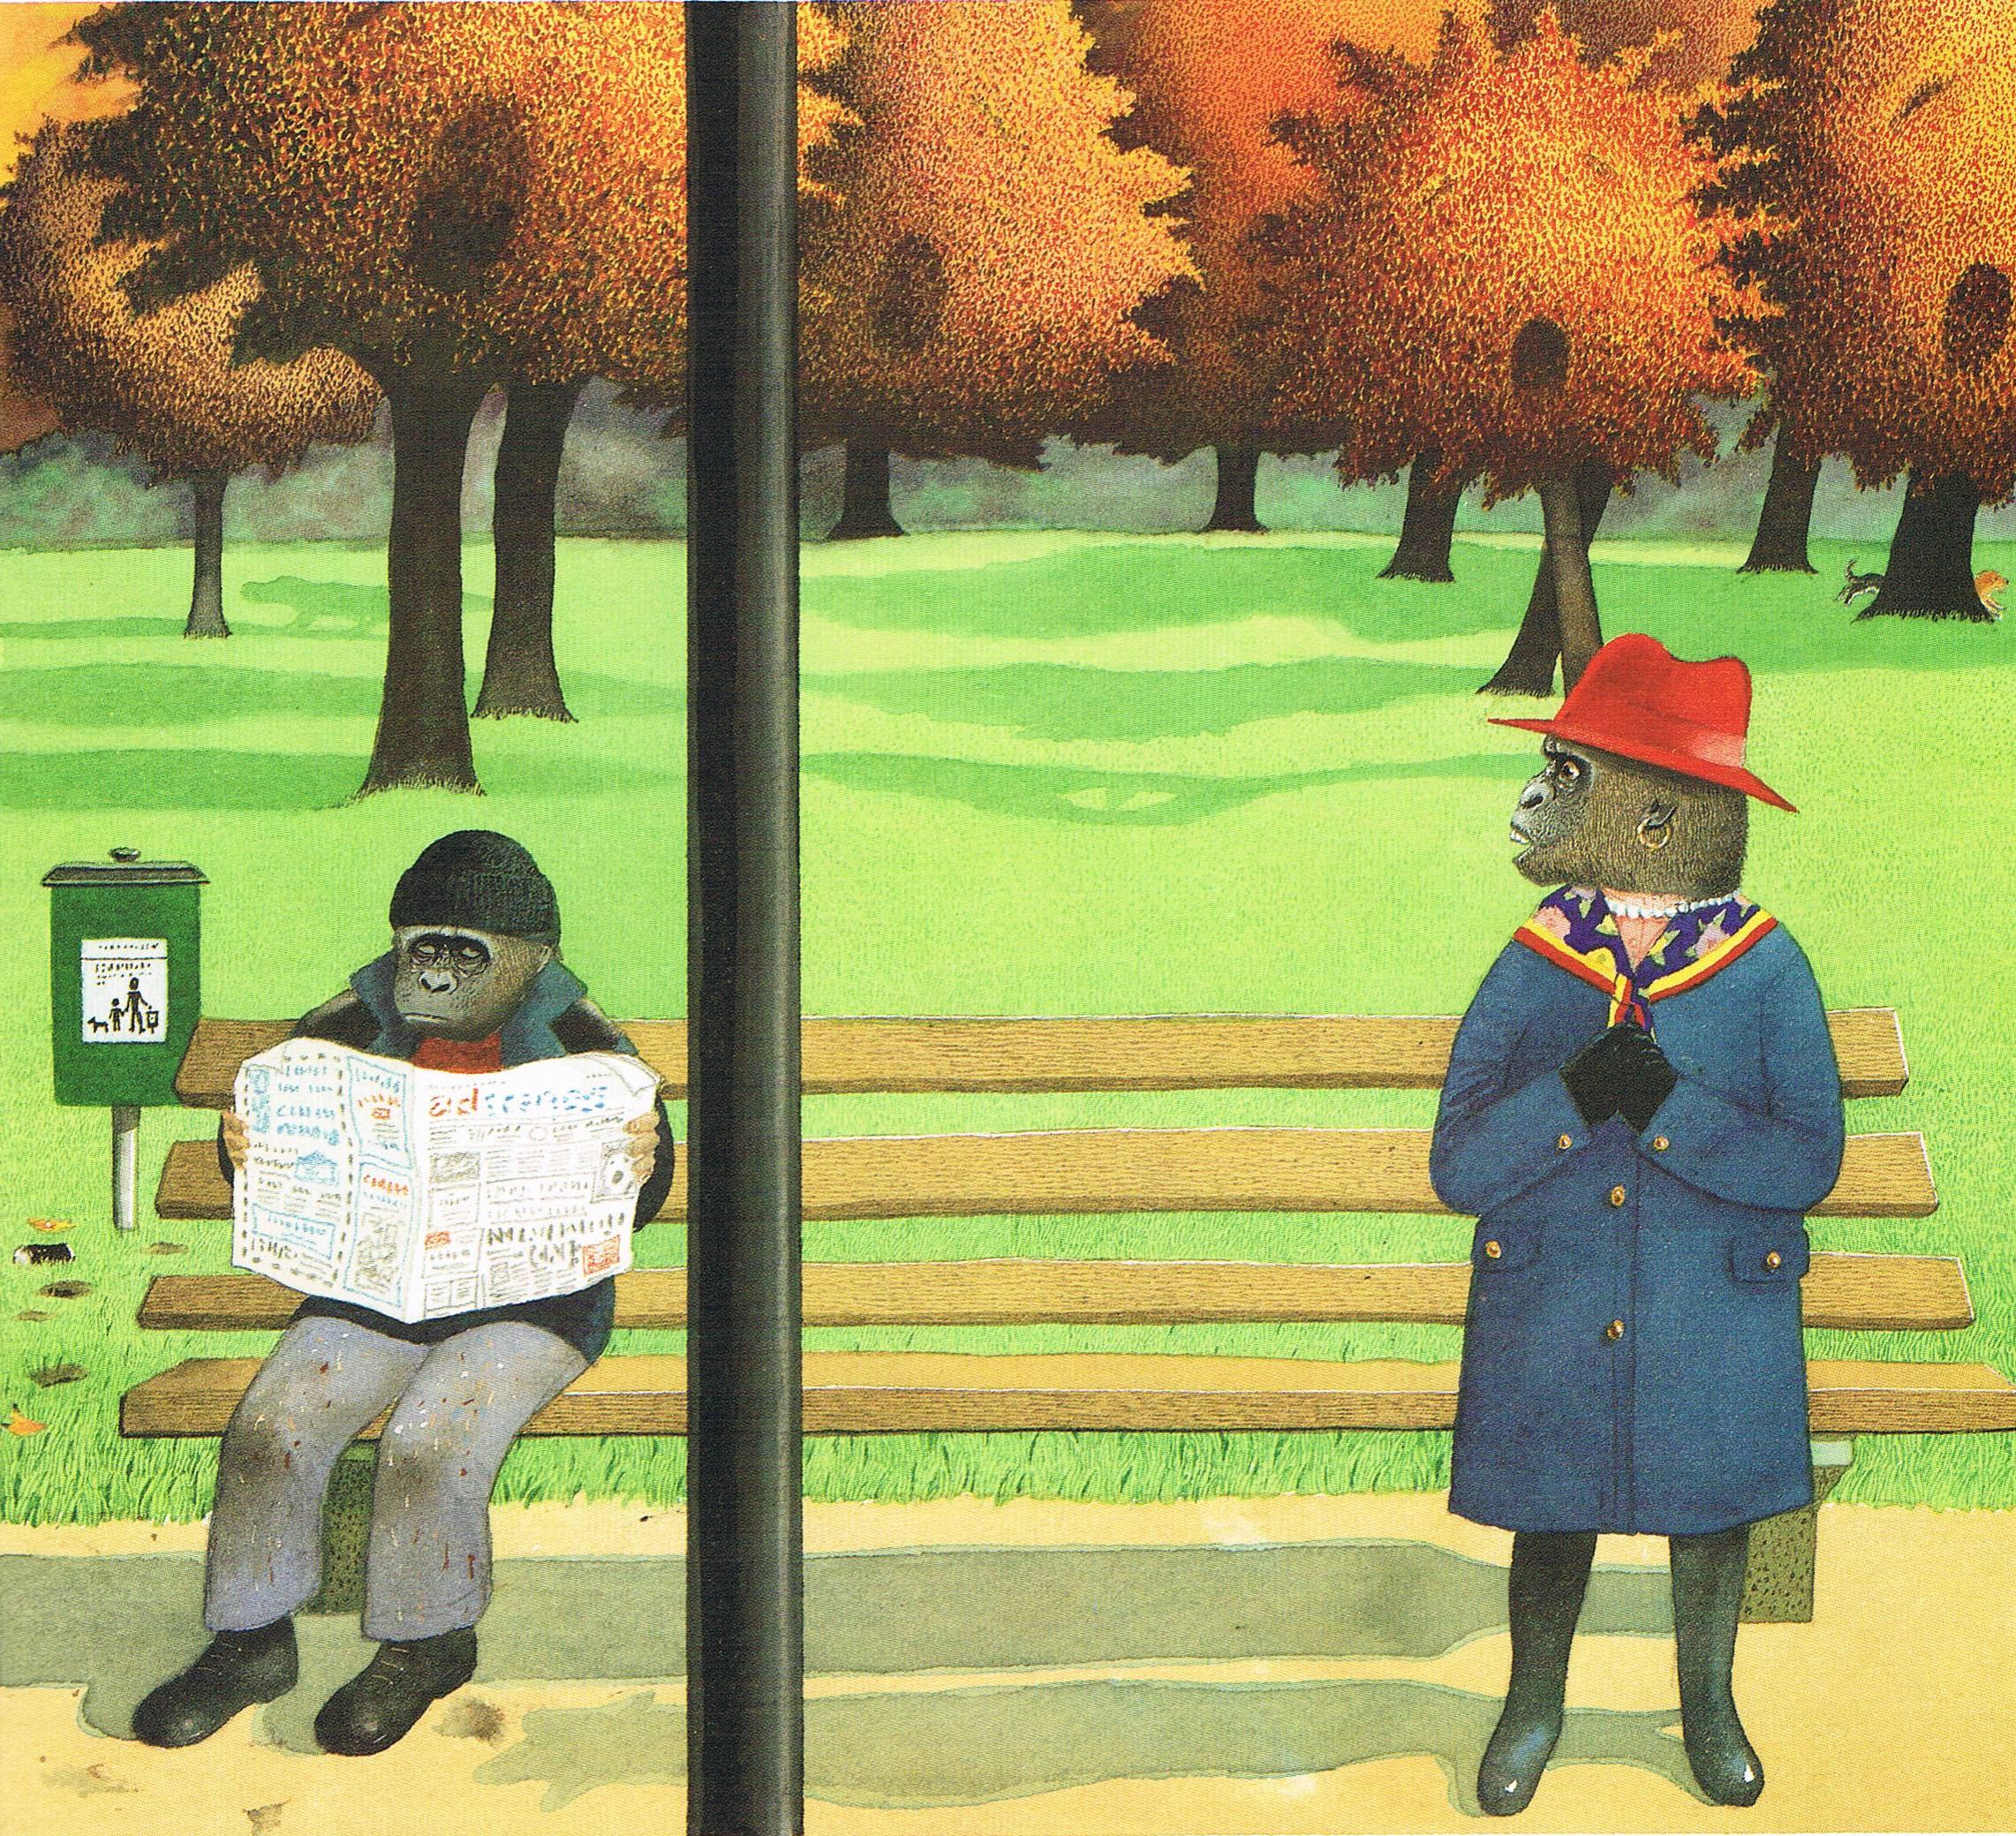
“You’ve got to have a bit of hope, haven’t you?”

