Slide 1
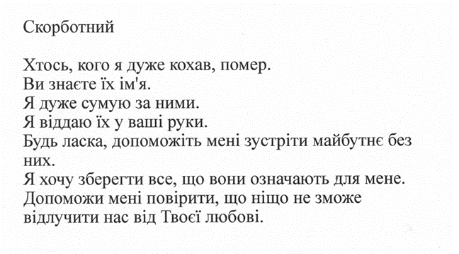
Grieving
Someone whom I love dearly has died.
You know their name.
I miss them so much.
I place them into your hands.
Please help me to face the future without them.
I want to hold on to all that they mean to me.
Help me to trust noting can separate us from your love.

Slide 2
Feeling sad or anxious
God, I am in a really dark place.
Life is very hard and painful just now.
I am really struggling.
Please help me.
Give me courage and strength to face each day.
Thank you that even in dark times I need not feel alone because you are there with me.

Slide 3
Looking for God
Dear God
I don’t know you, but the idea of prayer is making me think.
I want to discover more about you.
Help me to sense you near me,
Not just when I am in the peace and beauty which I feel and see now,
But in my everyday life.

Slide 4
Being thankful
Dear God
Thank you for all the good things in my life, big and small.
Thank you for the people who care about me.
Thank you for the beauty of the world – the birds, the trees, the sky.
Thank you for everything that makes me who I am or helps me to grow as a person.

