Slide 1
How many legs has the elephant got?

Slide 2
How many animals can you see?

Slide 3
Which side of the bar in the middle is darker?

Slide 4
Are the horizontal lines parallel?

Slide 5
Which of the vertical lines is longer?

Slide 6
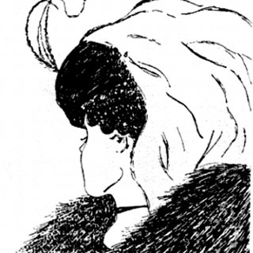
How many people can you see?

Slide 8
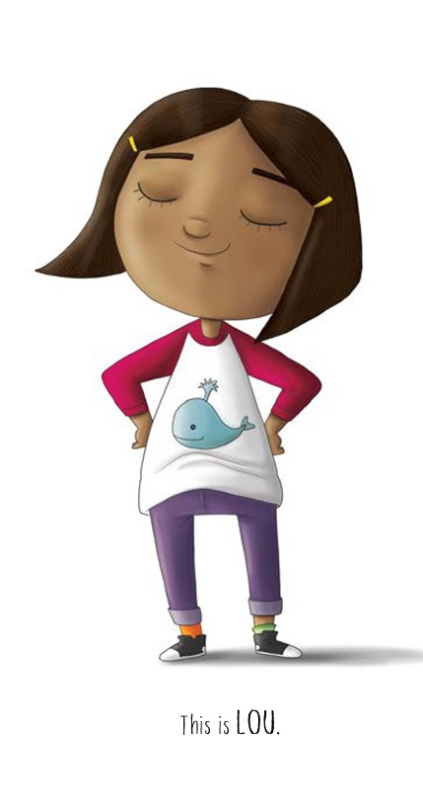
What sort of person is Lou?
How do you know?
How does she feel about climbing the tree? Why?
What happens when she tries to climb the tree?
How does she react?

Slide 9
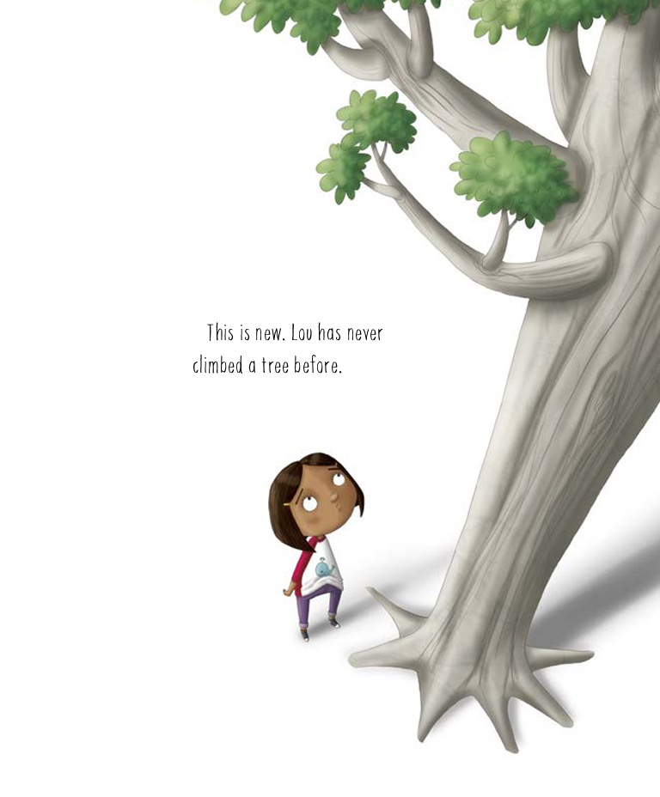
What advice would you give Lou?
What do you think happens next?

Slide 10
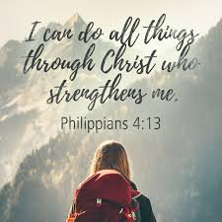

Slide 11
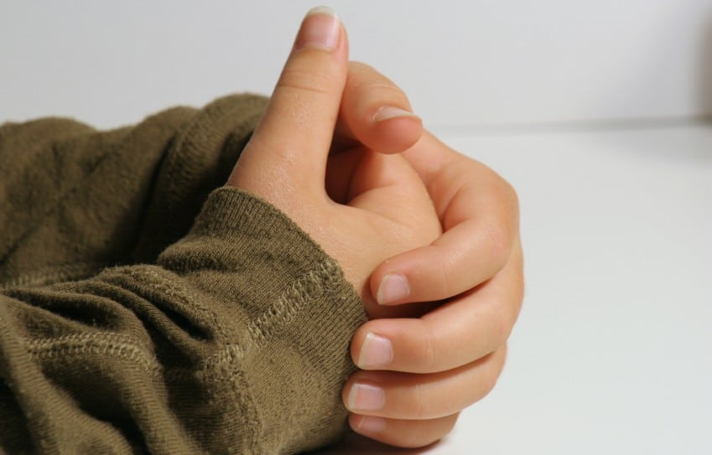
Dear God,
Thank you that you promise to help us when we find things difficult.
Please help us to see things in a positive way and not give up when we find things hard.
Help us to encourage other people, like Lou’s friends did in the story.
Amen.

