Slide 1
Click here for a link to the story being told on YouTube.
Who else thinks that they can’t draw?

Slide 2
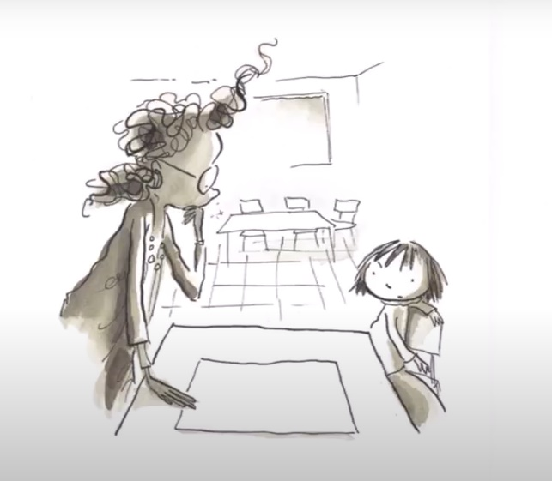
How did the teacher react to Vashti’s problem?
How did it help? Why do you think this worked?
How do we feel when someone criticises us?

Slide 3
The Bible often refers to the encouragement of others as a very important thing. Here are two examples from the New Testament, written at a time when Christian communities were experiencing difficult times:

Slide 4
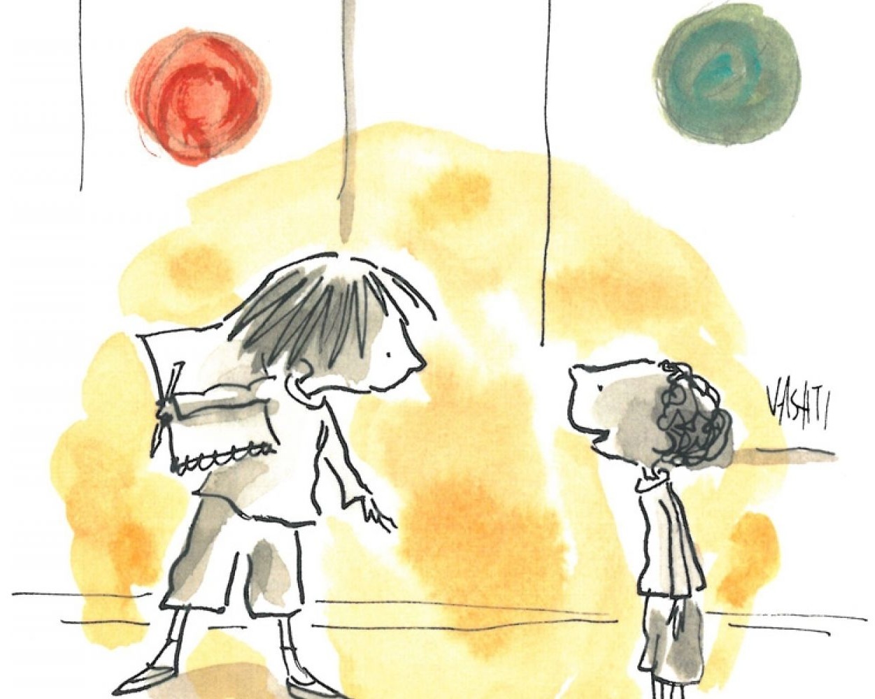
How do we feel when we are encouraged?
What impact could it have on our school community if we all felt encouraged?
What does constructive criticism mean?
How can we help ourselves to acknowledge our weaknesses in a positive way?
Do you know someone who is a good example to follow?

Slide 5
Dear Lord
Thank you that you are a God of love and encouragement.
Help us to be a school community that is the same. Give us the strength to be supportive even when we do not feel like it or find it hard.
Help us to acknowledge when we could improve and view as a positive challenge whilst we strive to make the most of the gifts and talents with which we have been blessed.
Let your light shine through all of us,
In Jesus’ name, Amen

