Slide 1
2024 Budget for Diocesan Synod
4th November 2023

Slide 2
2023 Update
Results to end of September show deficit on general fund of £378k.
Forecast deficit to end of 2023 is £235k
Income
Parish share has been collected totalling £3.14m – under collection of £515k to end of September
85.9% collection rate compared to budget to end of September
75% of parishes are expected to pay in full by end of year
Expect collection rate by end of year 84.8%/£4,346k
Lowest Income Community Funding from Church Commissioners has increased by c£18k
Benefact Trust income is expected to decrease by c£14k (received in October)
Rental income has started to reduce as further clergy appointments have been made, or properties have been held vacant for planned appointments but remains above the budgeted level
Investment income has benefitted from increased interest rates although the economic climate is impacting investment returns

Slide 3
2023 Update
Expenditure
Clergy headcount below budget - £440k underspend on remuneration to end of September
Catch up of property repairs and increasing costs post COVID – housing overspent by £234k to end of September
Part of this is will be covered from designated reserves
Increase to Safeguarding team headcount resulting from DSAP recommendations – overspent by £37k to end of September
Other expenditure lines have remainder largely consistent with budget expectations

Slide 4
National View
Recent feedback present at Inter-diocesan Finance Forum suggests significant deficits forecast by majority for 2023 with greater challenges for 2024
PDBF projected deficit is lower than many dioceses
Diocesan Finance review has been instigated – PDBF part of the pilot
Information is expected to feed into the next Triennium of funding (2026-2028)

Slide 5
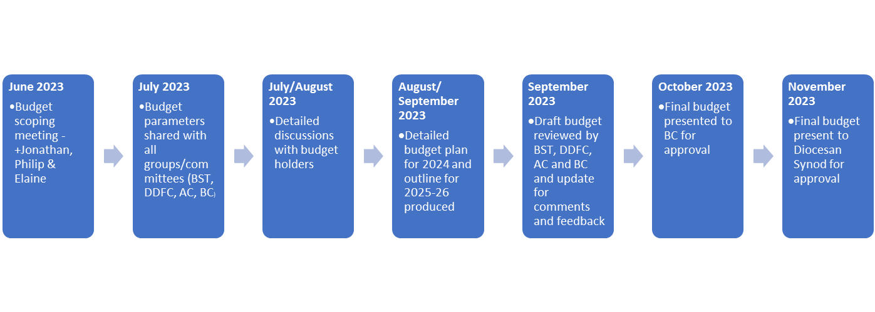
Budget Process

Slide 6
Budget Overview 2024
The budget has been prepared with the following key drivers:
Parish share has been increased by 5% (with an amended base point)
Focus will be on increasing parish share collection rates from the current level. The impact of three collection rates (95%, 92% and 88%) have been presented
Cost of living allowances of 5% have been awarded to all stipendiary clergy and lay staff (in line with the increase to National Minimum and National Benchmark Stipends)
Recruitment of stipendiary clergy will continue into key posts as highlighted in deanery plans and agreed with the relevant Archdeacons
The budget is underpinned by investment into children’s and youth work and discipleship to support ministry in all areas. These areas of support feature across the deanery plans
Inflationary increases of around 5% have been applied to other expenses

Slide 7
Budget Summary and Comparisons
Parish share collection rates and impact
on budgeted result are as follows:
95% collection rate
Deficit of £741k
92% collection rate
Deficit of £898k
92% collection rate
Deficit of £414k
88% collection rate Deficit of £1,107k

Slide 8
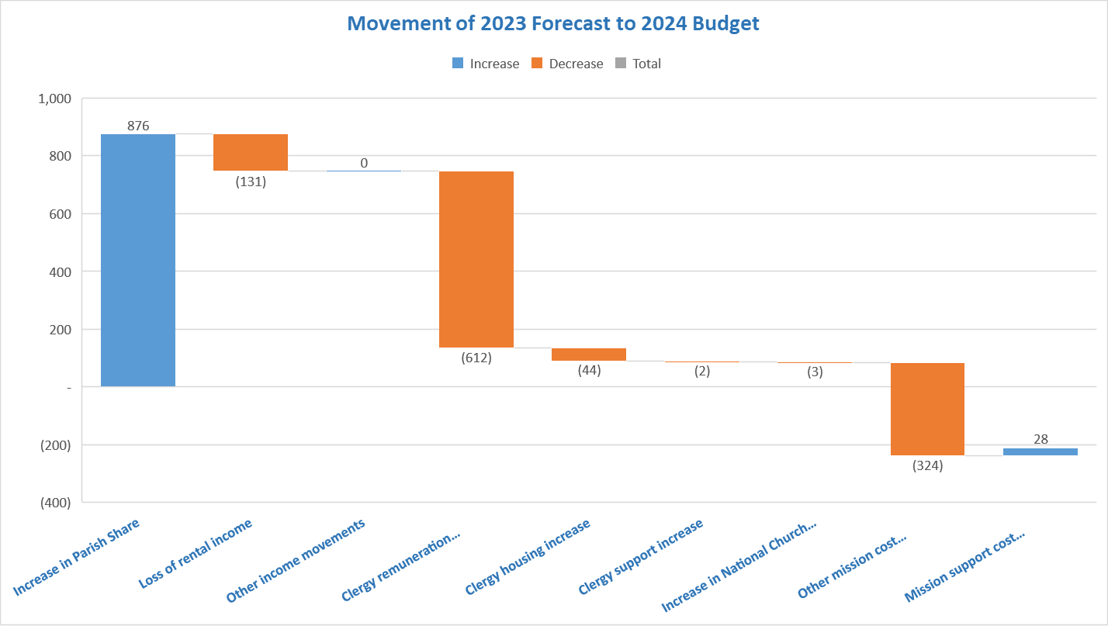
Movements Between 2023 Forecast and 2024 Budget

Slide 9
Mission Support Costs
Mission Support costs including diocesan office costs, IT, legal and registrar and finance costs account for 12.4% of the total budgeted costs
Costs that relate to supporting parishes have now been moved to parish support costs leading to the reduction in diocesan office costs and increase in parish support costs

Slide 10
Projection 2023-2025

Slide 11
Expectations for 2025-26
Clergy appointments and associated costs stabilise
Parish share review complete; improvement in collection rates
Inflation stabilises so lower increases to costs seen but still need to recoup previous increases from parish share as no uplift in 2023
Improvement in investment income returns as inflation and impact on markets stabilises
Agreement with Cuddesdon ended so no duplication of costs for training
IT costs reduce as complete Sharepoint project and move away from Remote Desktop environment

Slide 12
How can we sustain a deficit
General reserves
Designated reserves
Available cash & deposit balances
Identifying additional funding and opportunities for collaboration
Review of restricted funds
Total turn for permanent endowments

