Slide 1
2023 Annual Report and Accounts and 2024 Financial Update for Diocesan Synod
15th June 2024

Slide 2
Audit Overview
Audit has been completed by Haysmacintyre
Unmodified audit opinion
No new control issues
No adjustments made to the numbers
Notes:
Audit was completed in mid-March by Haysmacintyre
They will be issuing an unmodified audit report – this means that there are no areas of work they haven’t been able to complete, nothing they disagree with and they are comfortable that the Diocese is a going concern – it has sufficient financial resources to continue for 12 months from now
No new control issues have been identified which means they are comfortable we have sufficient robust procedures in place
There are a couple of items carried over from last year which relate to the IT controls, specifically blocking of email attachments for certain files types or penetration testing of systems to identify any weaknesses and vulnerabilities. Procedures are being followed up to address this.
No audit adjustments were identified. A small amount of income (£10k) has been received in 2024 for parochial fee income but this is below the materiality level that the auditors use and so they have flagged this but not requested any change to the numbers. We are looking at our processes to make sure we can track where fee income may be missing and make sure we receive it all moving forward.

Slide 3
2023 Annual Report and Accounts:
Key points – General Fund
Total Income: £6,767,749 (2022: £6,780,051)
Total Expenditure: £7,457,377 (2022: £6,924,494)
Balance: Deficit £689,628 (deficit £144,443)
Notes:
Slide shows a summary of the position on the general fund only (lifted from page 22 of the statutory accounts)
Income has fallen by £13k compared to 2022 – mainly the impact of pressures on parish share which fell by £91k, offset by an increase in investment income resulting from the increased interest rates and the recovery of the investment markets resulting in slightly higher investment returns compared to 2022.
Expenses have increased by £533k. Clergy stipends and allowances were increased by 6% from April 2023 and headcount increased towards the end of the year as the numbers of clergy appointments increased. Clergy housing also saw a large increase driven by inflationary pressures on costs, and an increase in the levels of works, especially post COVID catch up of quinquennial works and appointment works to get properties ready for appointments.
This has led to a deficit of £690k prior to any revaluations

Slide 4
General Fund – budget reconciliation:
Variations from General Fund Budget to Final Accounts
* The budgeted deficit was based on the assumption 100% collection of parish share was achieved.
NB transfers are shown separately in the statutory accounts
Notes:
This slide demonstrates how the actual results on the general fund compared to the budget for 2023 before any transfers are made
Our budgeted deficit of £5k was based on the assumption of a collection rate of 100% of parish share; we also acknowledged this would be challenge and the following scenarios were included
98% - £107k deficit
92% - £414k deficit
87% - £670k deficit
Our actual collection rate was 84.4%
Other income variations included an increase in rental income compared to budget as appointments were anticipated earlier in the year and the clergy headcount increased at a slower pace than anticipated. There was also the benefit of some increases in rental rates due to movements in the housing market
Investment income was slightly below budget due to the reduction in cash over the course of the year as result of the deficit, however this was offset in part by the additional interest income as interest rates increased throughout 2023
Clergy costs were underspent as clergy headcount remained below the budgeted level throughout the year, however significant appointments were made
The overspend on clergy housing represents a catch up from COVID, increasing costs on planned works and a high level of works to prepare properties for appointments being made. £315k of these costs have been reimbursed from a designated fund which was set aside for budgeted works that couldn’t be completed due to COVID.

Slide 5
2023 Annual Report and Accounts:
Key points – Revaluations
2023 saw recovery of investment valuations – increase of £1.438m across all funds
Property valuations stabilised – increase of £510k compared to £6.9m in 2022
Pension schemes continue to remain in surplus, no further valuation movements
Notes:
Investment valuations increased by £1.438m across all funds as the investment markets stabilized after significant deficits during 2022. During 2023 a proportion of investments held in the CCLA property portfolio had been transferred to shares to reduce the impact of the property market on the overall portfolio; there is a 6 month notice period to withdraw from this fund.
Diocesan properties were revalued in line with the policy – 20% of the holding was formally revalued. As there were no large changes, it was not necessary to reflect the movement across the remaining 80% and so there has not been such a large uplift as last year (no cash flow impact, simply increases the size of the reserves on our balance sheet on page 23 of the accounts, something that we cannot realise). 2022 figures also included the revaluation of glebe land which hadn’t been revalued for several years and so was a one-off large increase – there was no movement in the land values for 2023

Slide 6
2023 Annual Report and Accounts:
Summary of movements in reserves – all funds
*NB brackets for the net movement in funds for the year represents a deficit
Notes:
This slide summarises the movements in all funds as shown on page 22 of the accounts and demonstrates that before any revaluations we were in a deficit position – largely due to the expenditure through the general and designated funds.
The large transfer from designated funds reflects the repayment of the Coronavirus Business Interruption loan – repayment was accelerated during the year and with the final balance being cleared in December. This means the diocese has no debt finance.

Slide 7
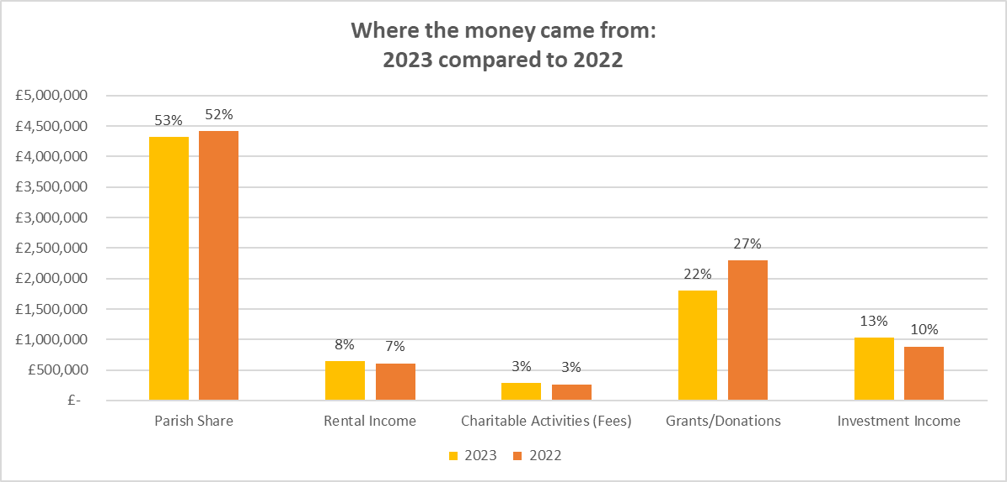
Where did the money come from?
Notes:
The chart shows the total cash received for each income type and also the proportion of the total income this represents. This includes income across all funds.
The largest movement relates to grants and donations. This includes grants such as SDF income, LINC funding and RME funding for training costs for ordinands
Reasons for the reduction are:
2022 included hardship grant income from national church for clergy and energy grants for parishes – no such income during 2023
SDF reducing due to one project coming to an end
Ordinand training costs now being paid directly by national church from September so lower grant amount being received but also lower costs paid out

Slide 8
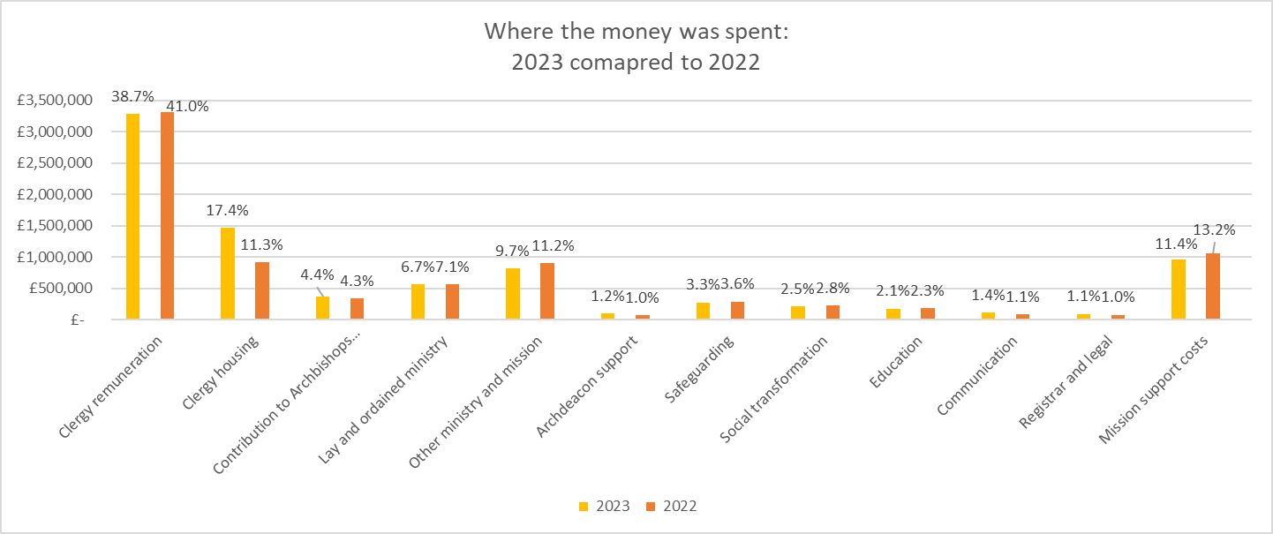
Where did the money go?
Notes:
The chart again shows the total amount spent and the proportion of total expenditure for each category of costs, again across all funds.
As previous mentioned there was significant pressure on housing costs during the year and they increased significantly as a proportion of total costs.
Clergy remuneration costs reflect the small increase in headcount due to the appointments during the year, and also the 6% stipend uplift which was award from April 2023 (which exceeded the recommendation from the national Remuneration and conditions of service committee of 5%)

Slide 9
Questions and discussion –
2023 Statutory Accounts

Slide 10
Overview of 2024 Finances to end of April
Notes:
Detailed management report for April has been circulated and also the separate report showing the position regarding parish share up to the end of May. The following slides look at some of the headline figures.

Slide 11
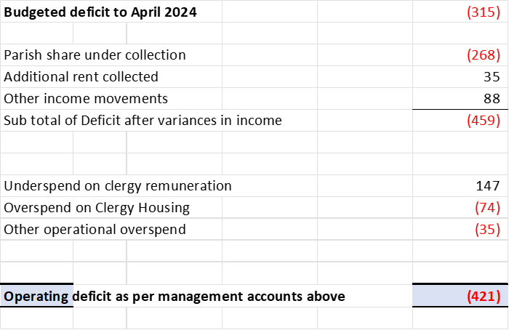
Results year to date compared to budget
Notes:
The budgeted deficit of £315k for the first 4 months of the year assumes full parish share recovery however we included three alternative scenarios in the 2024 budget (88%, 92%, and 95%).
Parish share and clergy remuneration are covered in more detail on later slides
Other income includes investment income which is running above budget due to the ongoing high interest rates (budget levels had expected to start seeing a reduction)

Slide 12
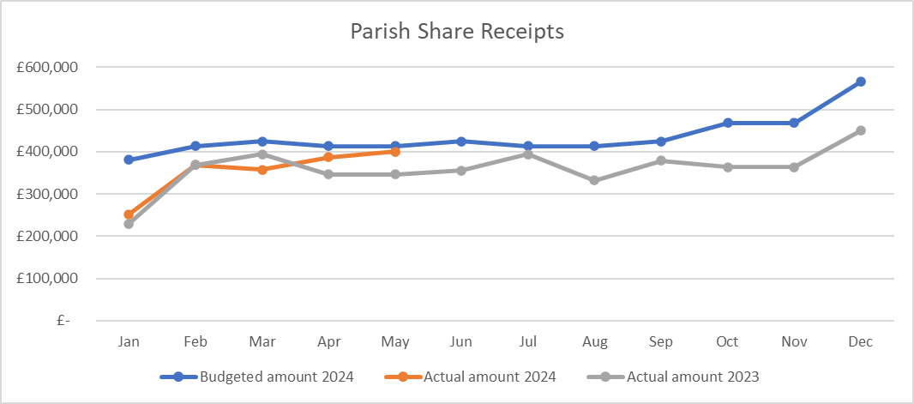
Parish Share
Notes:
Parish share is following the historic trends and £40k higher than 2023 year to date. A large proportion of parishes will pay an equal amount for 12 months but there are many parishes that pay in other ways (10 months, quarterly
Regular reviews of the collections for each parish are taking place and where parishes are behind or haven’t contributed we are engaging with them to understand why

Slide 13
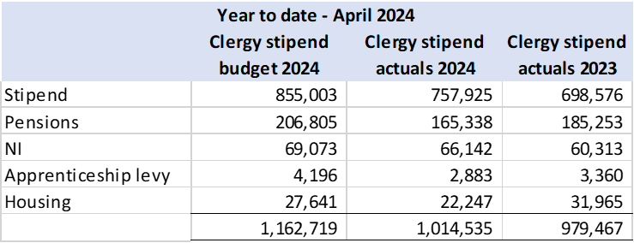
Clergy Remuneration
Notes:
Clergy remuneration continues to run below budget mainly due to headcount being below the budgeted levels year to date. Recruitment continues and some significant appointments have been made so far this year (particularly on the Isle of Wight) and some further appointments have been made for posts with start dates later in the year.

Slide 14
Changes from Budget
Reduction to clergy pension contributions
Reduction in payments for lay staff pensions
Notes:
After the budget was agreed, a reduction to the clergy pension rate was announced bring it down from 28% to 25% from 1st April. This would equate to a reduction of c£60k over the course of the year compared to the budgeted level
We were advised late in 2023 that there was also a surplus on the defined benefit lay staff pension of £424k which can be used to offset lay staff pension contributions. Again this became applicable from April and equates to a reduction in cash outflows for pension of c£162k for the remainder of the year.

Slide 15
Forecast for 2024
Uptake of parish share towards the end of the year in line with historic trends
Further key clergy appointments
Ongoing spend for housing repairs
Reduction in rent income as properties are held vacant for recruitment
Notes:
The budgeted scenarios expected a deficit between £741k (95%) and £1.1m (88%). The current forecast expects us to be in the region of £500k deficit which takes into account the pensions savings detailed on the previous slide. It also assumes the following:
Uptake of parish share in the latter part of the year as we have seen historically, although cautious as we are aware of significant pressures on parish finances
Further clergy appointments by the end of the year to further increase headcount
Ongoing high level of housing repairs and maintenance for appointments as well as the planned quinquennial works

Slide 16
Questions?

