Slide 1
Diocesan Vision, Strategy for Rejuvenation, Plan and SMMI bid
For Diocesan Synod 15th June 2024

Slide 2
VISION
The Diocese of Portsmouth longs to be
a rejuvenating community of Jesus-centered, Kingdom-seeking disciples.

Slide 3
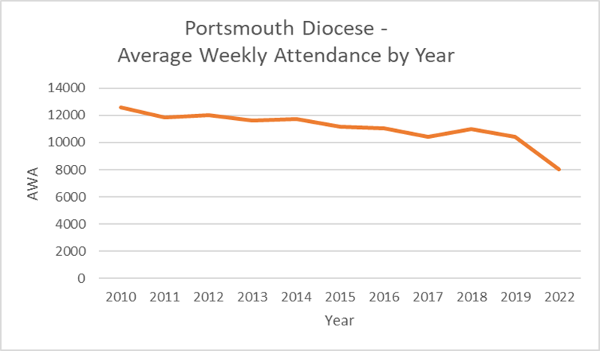
Context
The challenges:
progressively older demographics and an absence of children and young people in our congregations
declining attendances,
generally unfit buildings for mission,
stretched staffing, and
an increasing gap between the costs of our ministry and our contribution towards it.

Slide 4
REJUVENATE
Growing younger
Currently only 10 out of 133 parishes have AWA of 25+ children
25% report NO children
Key priority running through our whole strategy
Targets?
More than double the number of children and young disciples.
Ensure there is a thriving children/youth ministry within reach of every child and young person.

Slide 5
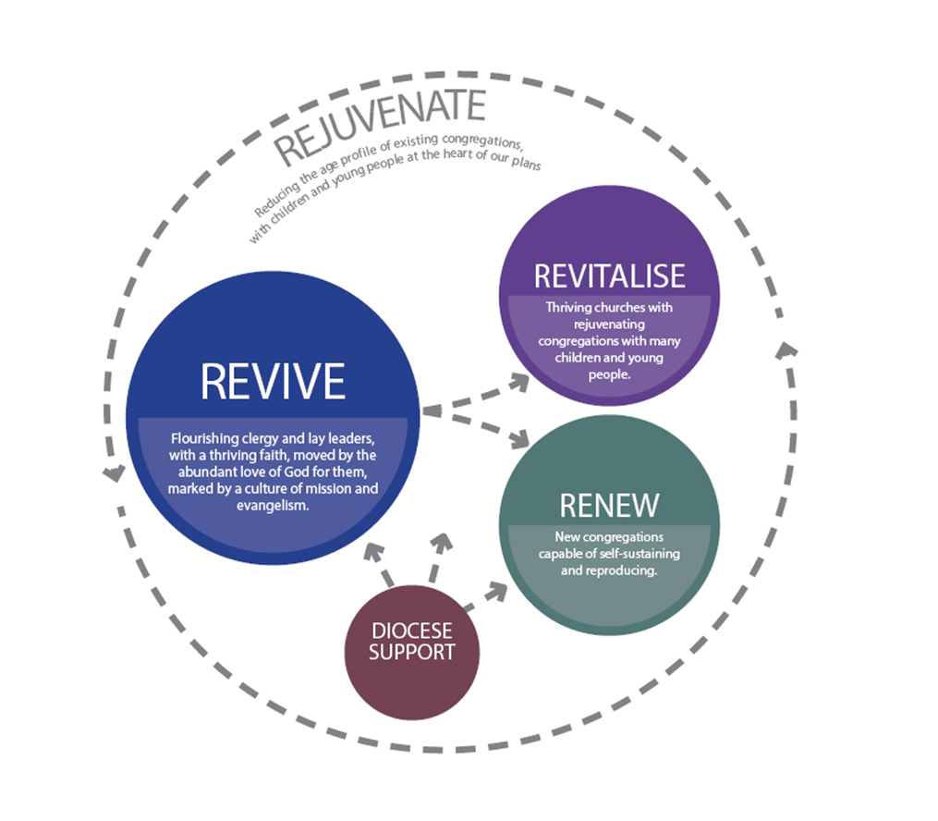
Our STRATEGY is summarised in this diagram

Slide 6
REVIVE
Spiritual leadership
Clergy & lay leaders
Eat together
Pray together
Study together
Year 1 – pilot in 9 networks
Year 2 – launch to cover 40% of our parishes
RESOURCES
Divine renovation - “Moving your parish from maintenance to mission”
https://divinerenovation.org/
Coaching/mentoring support for the network
Conferences/learning sessions

Slide 7
REVITALISE
Growing existing churches
Parish health self-assessment
Pilots – church/school
Choir Church
Flourish
School chaplaincies
iSingPop
Revive →→Revitalise pathway
Invite the 9 Revive networks to join in
Launch to cover 40% of our parishes
Provide targeted support in a few key locations – emphasis on C, F, Y
Grow capacity for Children, Families, Youth work
Youthscape Launchpad
Youthscape Essentials
Share learning
Train more Children, families, youth ministers incl apprenticeships

Slide 8
RENEW
Planting new churches
A couple of major church plants – emphasis on children, families and youth

Slide 9
Havant Deanery
Flourish – Catherington & Clanfield with Horndean Primary
St Faith’s Havant – Choir Church
Leigh Park & Park Community School – opportunity being explored
Revive, revitalization, Youthscape LaunchPad & Essentials
Looking ahead to a further funding bid..

Slide 10
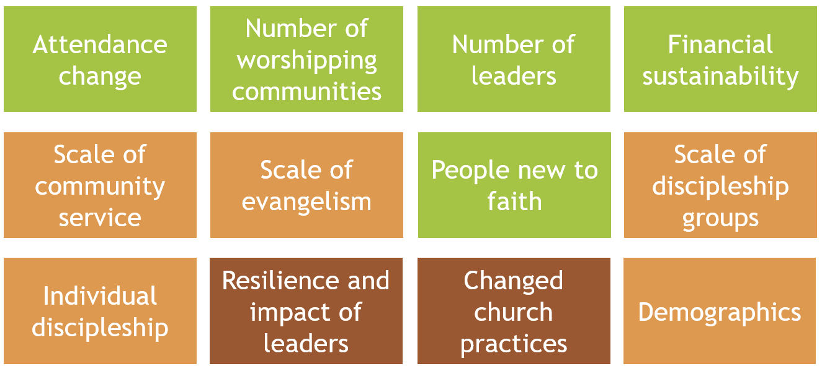
Outcomes– national framework measures

Slide 11
Targets – tentative workings
Workstream | New disciples per participant parish/ group | No. participants | Total new disciples | Notes
Revitalise - enhanced support | 120 | 2 | 240 | Small number of projects with an enhanced level of funding support
Revitalise - moderate support | 60 | 9 | 540
Revitalise - from parish own resources | 10 | 30 | 300 | Assume 30 parishes initiate work as a result of Revive/Revitalise, successfully halting decline and moving to modest growth
Youthscape | 70 | 8 | 560 | 10 cohorts of 10 people over 5 years, 70% of whom will start a youth ministry of 8 young people
Choir Church | 30 | 3 | 90 | Target new worshipping community of 30 people
Flourish | 30 | 4 | 120 | Target new worshipping community of 30 people
Major plants | 300 | 3 | 900
Total new disciples |  | 59 | 2750
Total new children |  |  | 1100 | Assumes 40% of new disciples are children/youth – reasonable considering the level of children/youth focus in the list above. This is more than double the current level.

Slide 12
Timeline to bid
When | What
18/07/24 | Review emerging bid with national church representative
25/07/24 | Additional Bishop’s Council meeting – endorse draft bid ahead of external review
06/08/24 | Design reviews with national church representatives
19/08/24 | Submit SMMI bid for external review
Sept 2024 | Choir Church starts in 3 parishes (DBF funded)
Sept 2024 | Flourish starts in 4 school/church partnerships (national church grant)
10/09/24 | Bishop’s Council meeting – endorse final bid for submission
16/09/24 | Submit final bid
31/10/24 | Decision on SMMI bid

Slide 13
Any questions?

