Slide 1
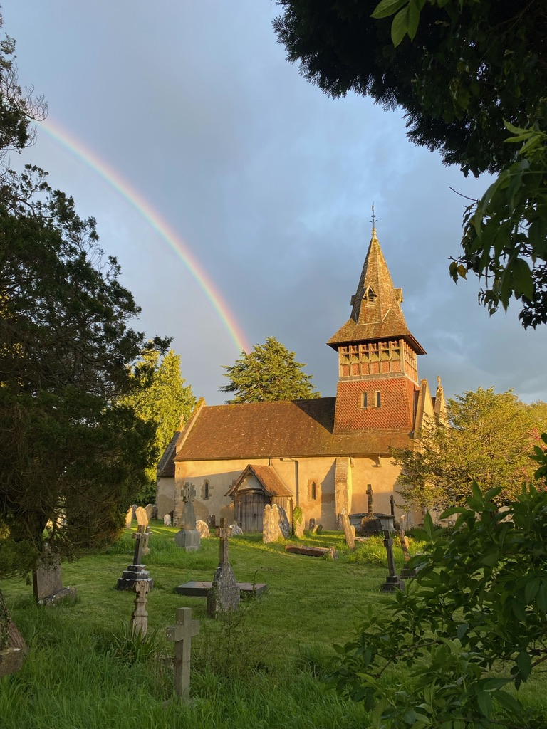
Petersfield Deanery
Progress Up North

Slide 2
Good News for the Northern Shires!
SIX BOLD PRIORITIES
Building Strong Parishes with a Ministry of Presence in Every Community
Refreshing our Worship and Discipleship
Prioritising Ministry to Children, Young People and Schools
Supporting Older People in Need and their Carers, Spiritually and Emotionally
Reaching Out to New People and Under-Served Communities
Developing Lay Ministry

Slide 3
Good News for the Northern Shires!
HOW IT WORKS
Key Lay Involvement
Full-Time Incumbents have 0.3 Deanery Role supporting a MAP priority
Clergy and Parishes adapting to 0.7 Parish responsibility
Clergy development - working across traditions and contexts
Building cooperation between parishes

Slide 4
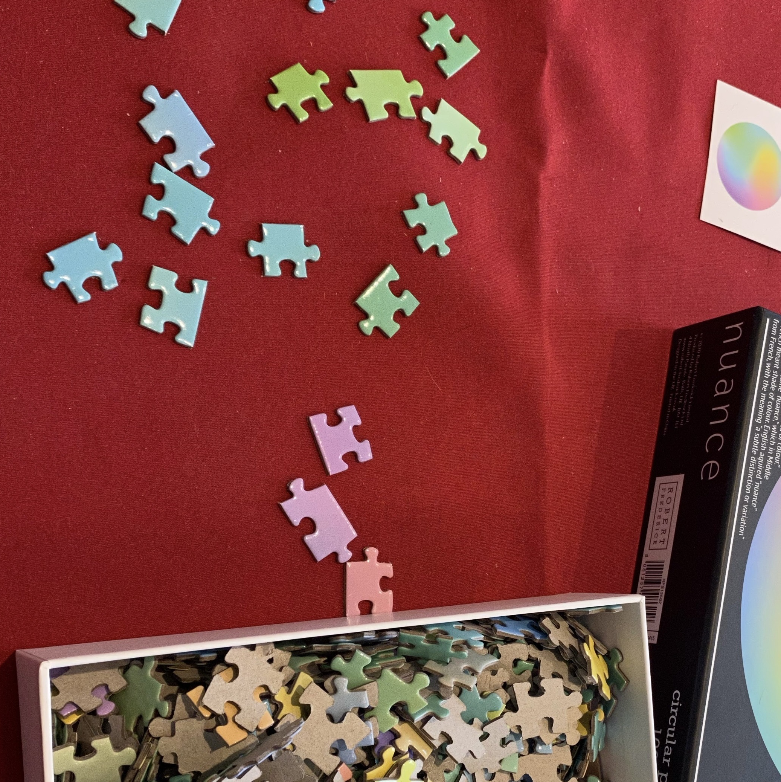
Progressing the Strategy

Slide 5
Progressing the Strategy: Building Strong Parishes
Appointing parish priests
Full-time incumbencies combine with Deanery Lead Roles
Focus for priorities for DMAP mission and ministry
Added value across the Deanery
Some savings
NEXT STEPS:
Supporting parishes develop and implement MAPs

Slide 6
Progressing the Strategy: Worship and Discipleship
Deanery Lead Role (0.3) advocating for discipleship and promoting spiritual and faith development in church communities
Started to identify best practice in the Deanery
NEXT STEPS:
E.g. growing a programme of training and development
Deanery events

Slide 7
Progressing the Strategy: Young people and Families
Deanery Lead Role for ‘Growing Faith’ (0.3)
0.5 Children and families’ leader being recruited
Expanding excellent links with Primary Schools
Experience Easter pilot
Engagement with families of pupils
NEXT STEPS: Senior Schools

Slide 8
Progressing the Strategy: Older Adults
Gently Growing Local Anna Chaplains Network
Parish Ministry to Care Homes
Refreshing and Recruiting Pastoral Assistants
NEXT STEPS:
Supporting and Linking Parishes’ Work with Senior Adults
Growing More Anna Chaplains/equivalent

Slide 9
Progressing the Strategy: Reaching New People
Deanery Lead Role: Mission, Outreach and Evangelism (0.3)
‘How Village Churches Thrive’ – achievable outreach in smaller communities
NEXT STEPS:
Growing ministry and mission in new and under-served communities
Growing confidence in contextually appropriate outreach

Slide 10
Progressing the Strategy: Lay Ministry
Deanery Lead Role for Lay Ministry (0.3)
12 Lay Worship Leaders Trained and Commissioned
9 Occasional Preachers Trained
2 in training for ordination
Networking for CWs and Treasurers
NEXT STEPS:
Review support for Lay Officers in post and recruitment

Slide 11
Helping it Work Well
Investment in lay people
Building the clergy team
Growing relationships
Keep learning, growing and improving
Notes:
Investment in lay people
Engaging Deanery Synod to develop MAP
Support for lay leaders especially in vacant parishes
Building the clergy team:
Appointments with Deanery Roles
Existing Incumbents taking on Deanery Roles
Growing relationships:
Chapter Residential Oct 2023
Frequent lunchtime Chapter meetings
Developing intentional professional and spiritual focus and sharing
Keep learning, growing and improving

