Slide 2

Bishops Waltham Deanery

Slide 3
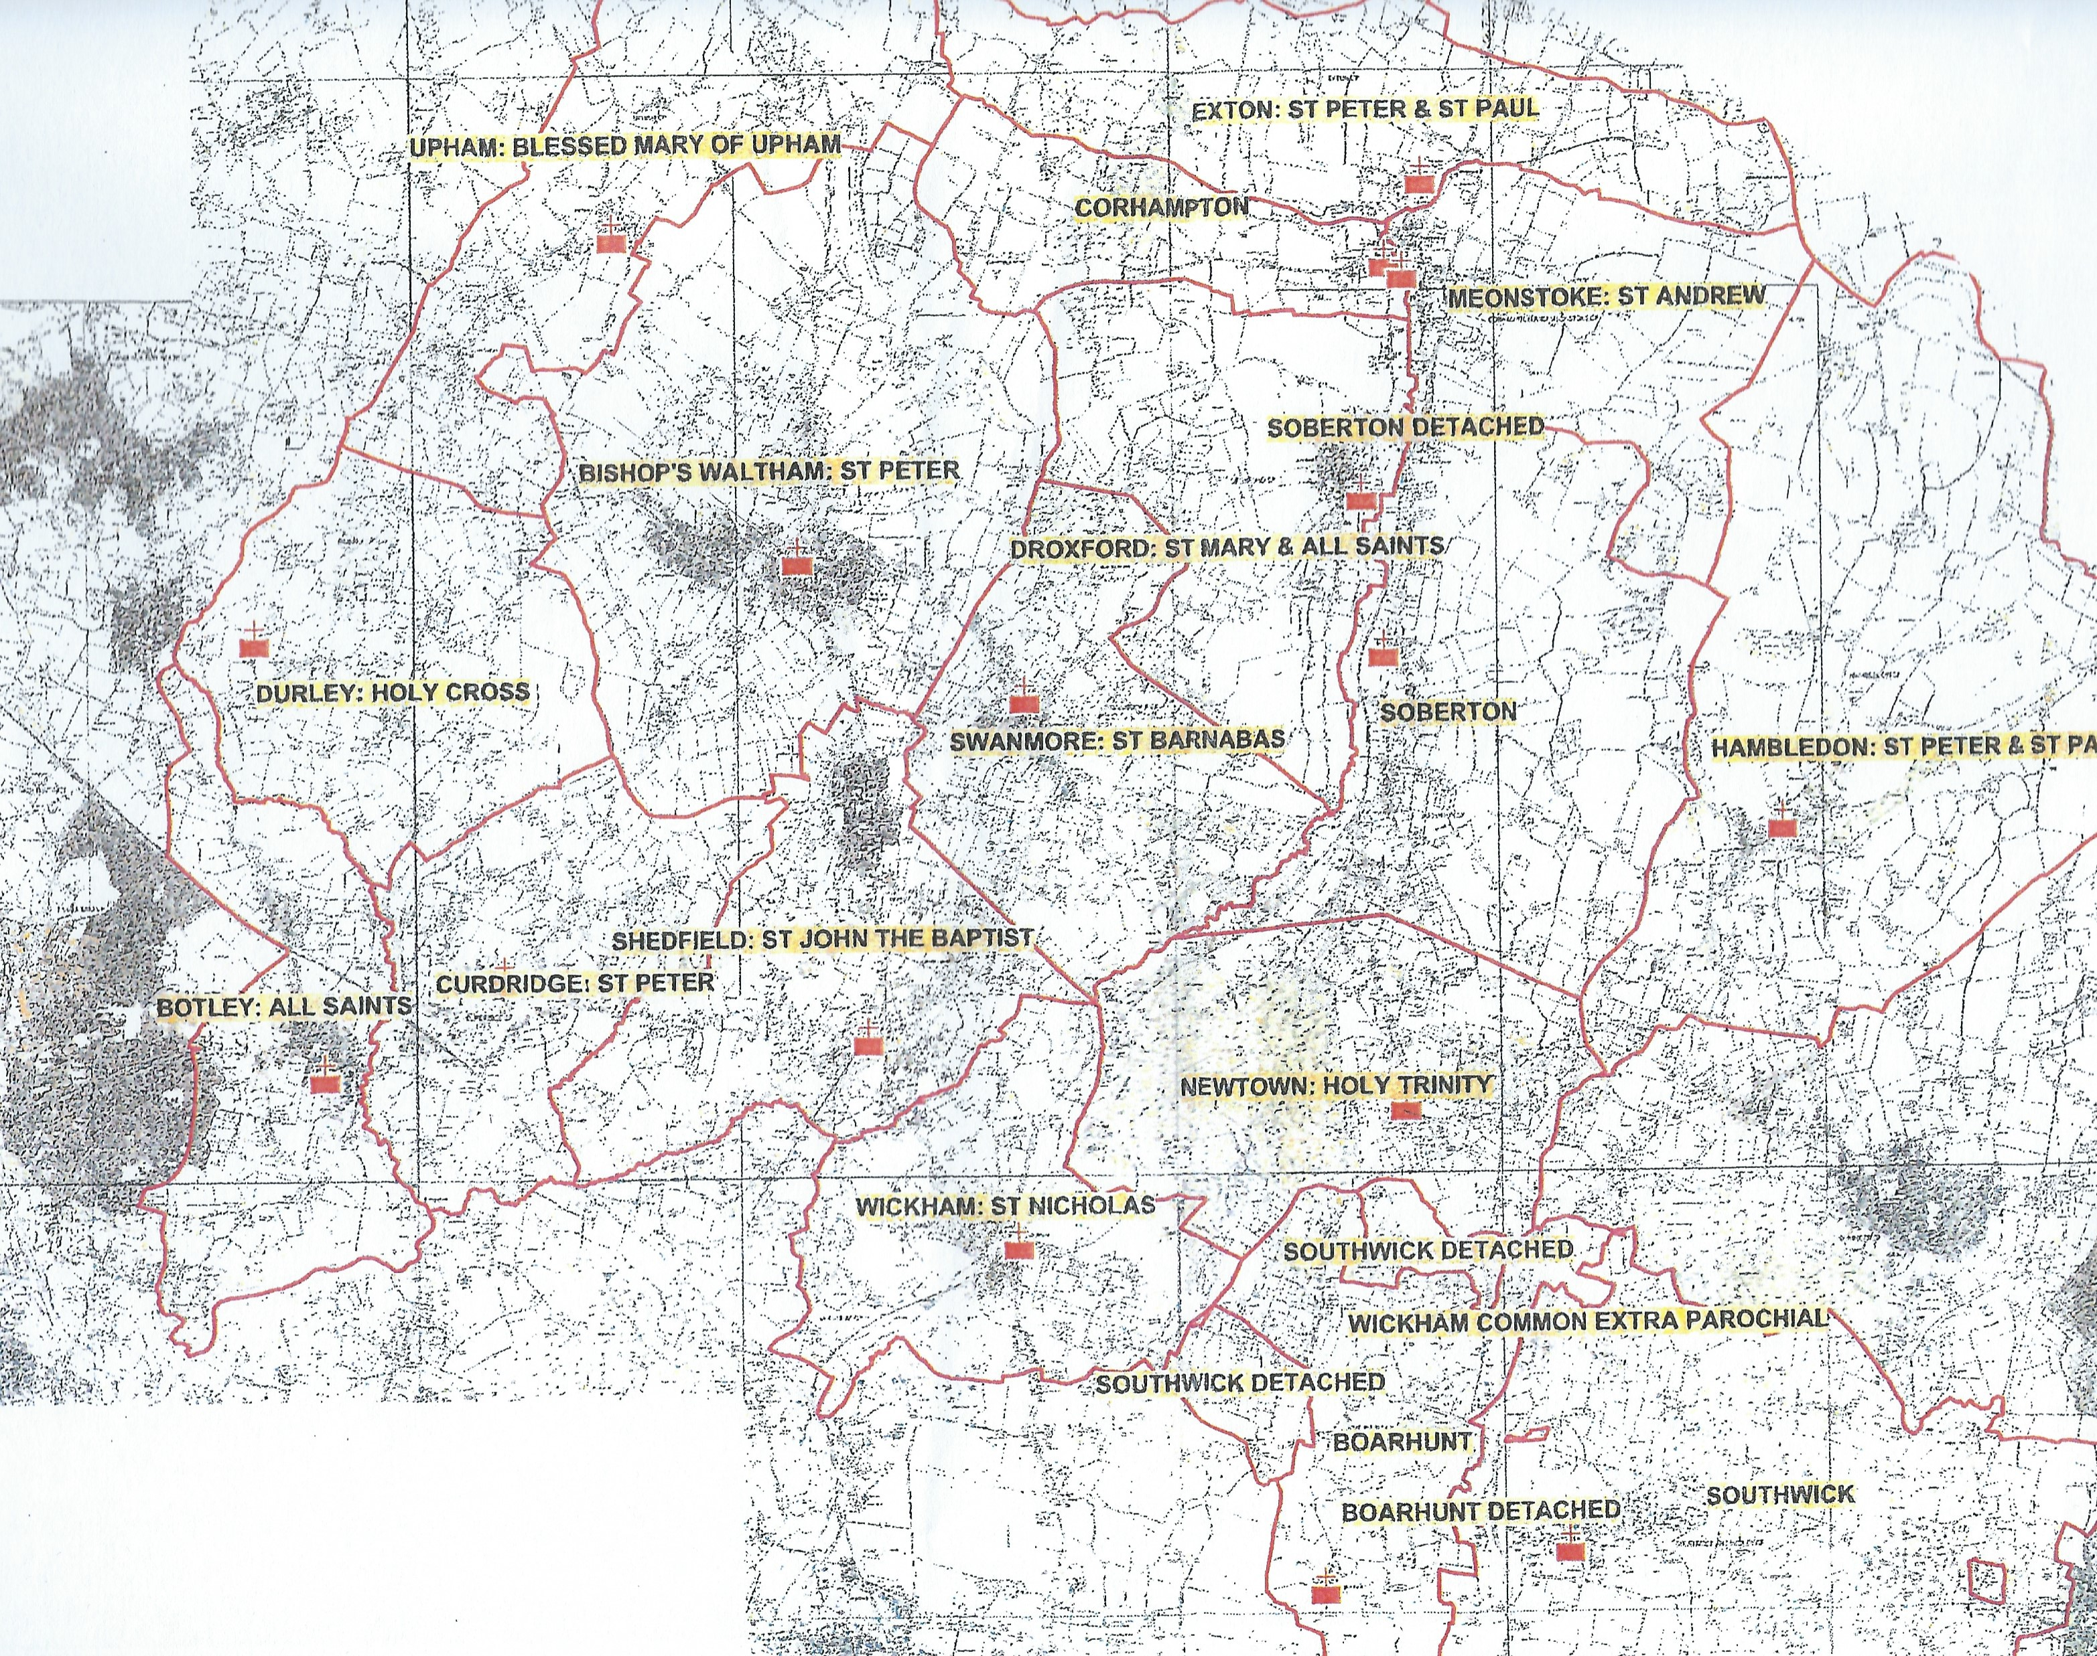

Slide 4
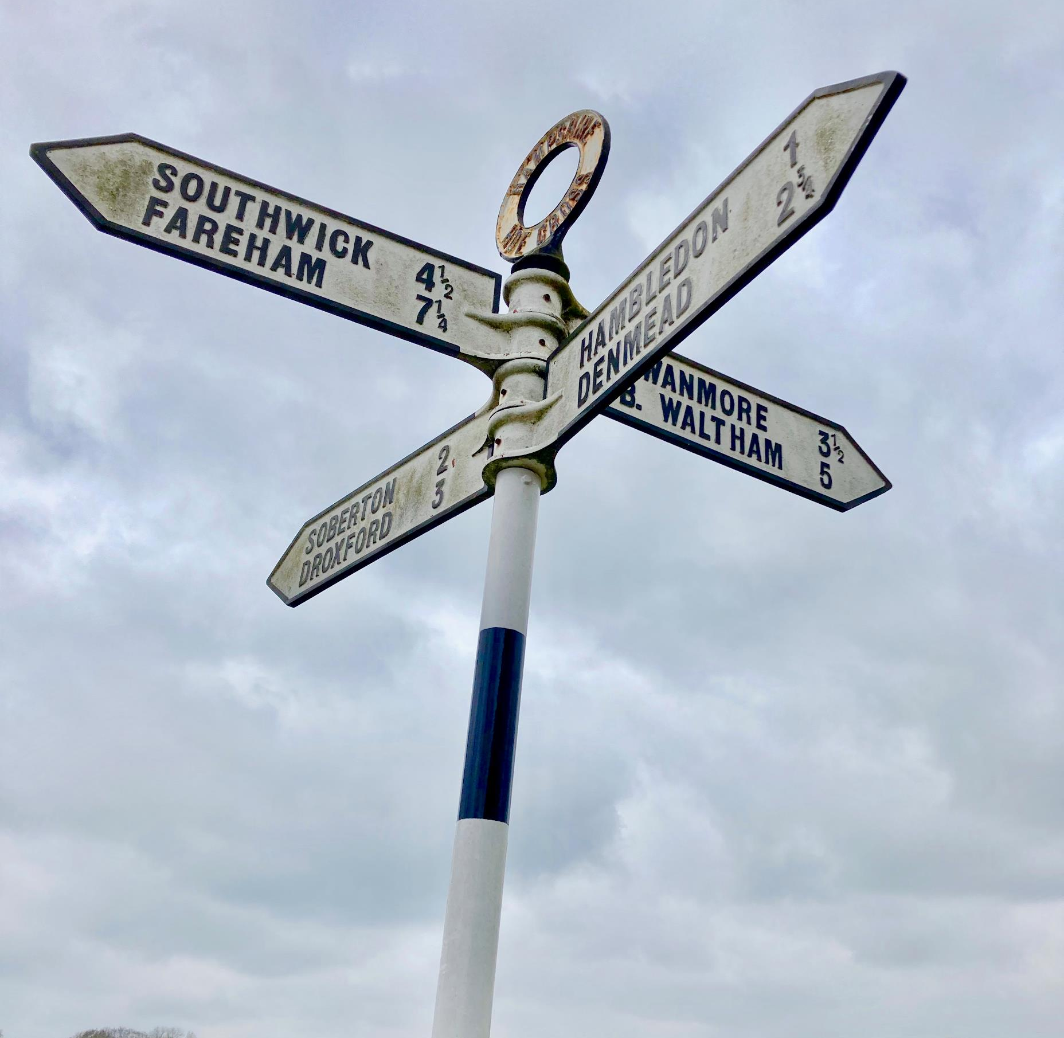

Slide 5
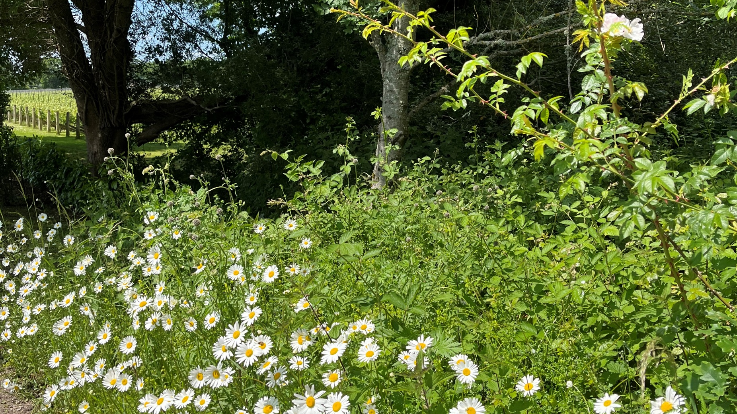

Slide 6
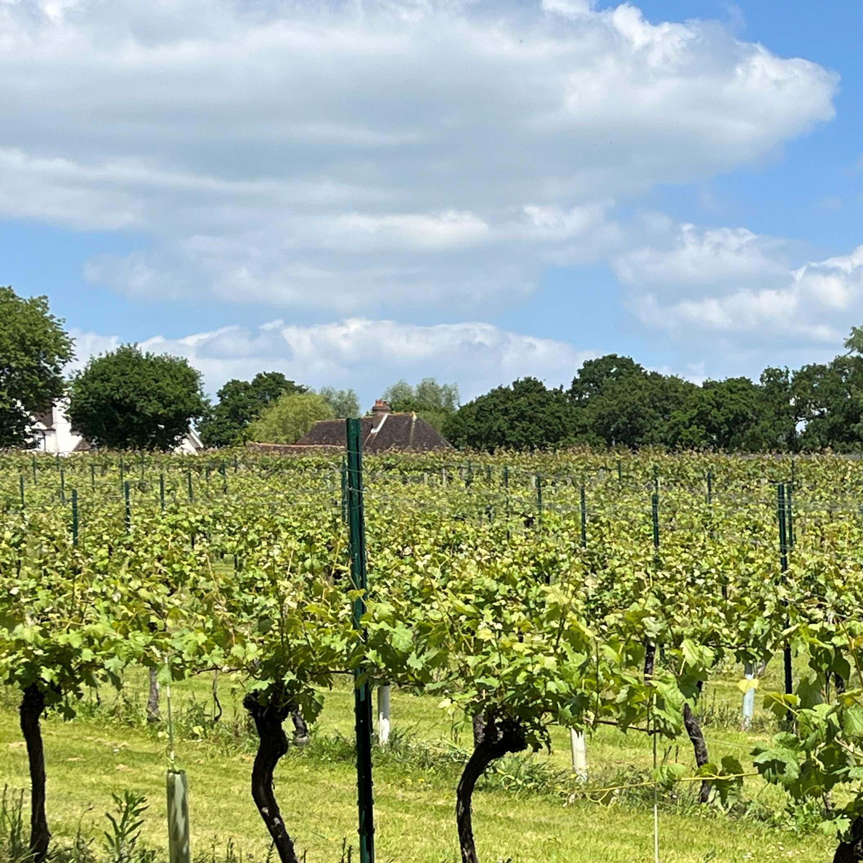

Slide 7
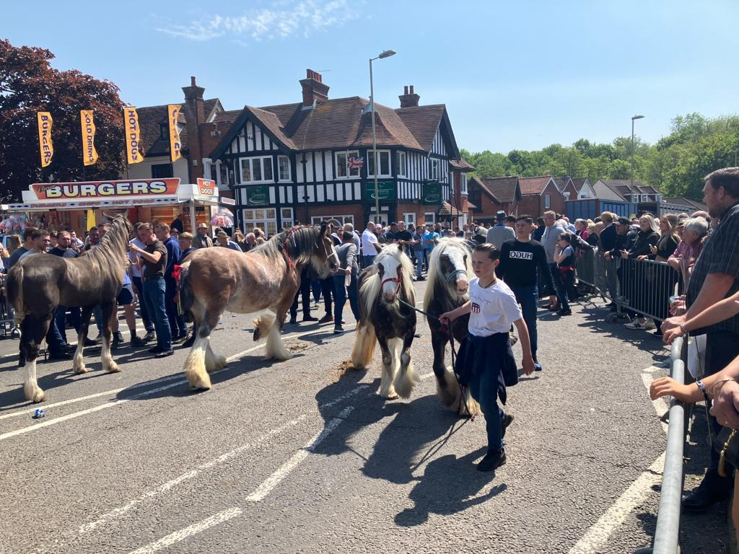

Slide 8
BW
Deanery
+ population data
U
E
7324
C
M
BW
2931
1739
SW
D
D
6371
C
B
S
H
6 benefices
15 parishes
7 church schools
4 incumbents
1 House for duty priest
3 SSM
6 licensed lay ministers
11 lay worship leaders
Winchester Road
A32
SO
6308
2715
W
N

Slide 9
Visionary leadership
Working together in mission
Engaged disciples
Developing resources.

Slide 10
A clear desire to find ways of working together effectively within parishes, between parishes and across the whole deanery
Huge anxiety about and some resistance to being forced to restructure into relationships that are new or not emerging naturally.
A recognition that going on doing or being exactly the same will not work.
An awareness from local experience that ‘growth’ (in depth, impact and number) is both gradual and slowly revealed, through community outreach, and can also be helped by specific work with congregations.
Base future development on the current parish/benefice structure, with a clear, formal commitment to work together.
Detailed work would be needed to clarify processes for collaboration, sharing of personnel and resources, joint funding of staff and projects and framework for accountability

Slide 11
Essential need for local focus for community engagement and impact. Need local priests/ministers – probably unpaid
Need to enable clergy to be able focus on spiritual leadership, and providing teaching and support for key leaders
Slimmed down governance structures – especially PCCs – with shared admin support and finance management for parishes
Access to diocesan specialist skills – buildings, safeguarding
Increase in overall capacity for lay leadership – worship, teaching, administration

Slide 12
Sustainable approach to the level of core activities (eg, Sundays)
Re-structure for hub churches, to maximise chance of support for all. Clergy to work in collaborative framework
Boundaries, of all kinds, need to be permeable or changed.

Slide 13
Implementation Plan Oct 2022
We believe in Jesus Christ as the source of our salvation and our hope. Having received the gift of his Spirit, we are called by him to live and to pray in ways that help us to grow in our faith and deepen our commitment, so that we can serve the world by helping people see and believe in Christ, live good and fulfilled lives and work together in community.

Slide 14
Our aspirations and goals over five years are…
Deeper personal ownership of our life in Christ and confidence in sharing it with others, at every stage of life
Transformational patterns for community worship and personal spirituality
An increased focus on enabling young people to encounter Jesus
Our church buildings re-purposed for wider community engagement, in sustainable and environmental sound ways
Increased contact between church congregations and their local communities

Slide 15
Appropriate resourcing for implementation of these goals,
including authorised ministry in every parish and benefice,
with parishes also reinforcing each other in development
by working with common purpose and commitment
In 4 local collaborative frameworks:
Western, Central, Meon Valley, Southern

Slide 16
Ministry area | Parishes | Resourcing
Western | Botley, Curdridge, Durley | 1 stipendiary priest 1 pioneer minister, (+ general parish role) 1 licensed lay minister
Meon Valley | Exton, Corhampton, Meonstoke, Droxford, Soberton, Newtown, Hambledon, Swanmore | 1 stipendiary priest 3 House for duty/Self-supporting priests 2 licensed lay ministers
Central | Bishops Waltham, Upham, | 1 stipendiary priest 1 youth minister (+general parish role) 2 licensed lay ministers
Southern | Shedfield, Wickham | 1 stipendiary priest, 1 deanery Anna Chaplain (+ general parish role)

Slide 17
Audit & Evaluation

Slide 18

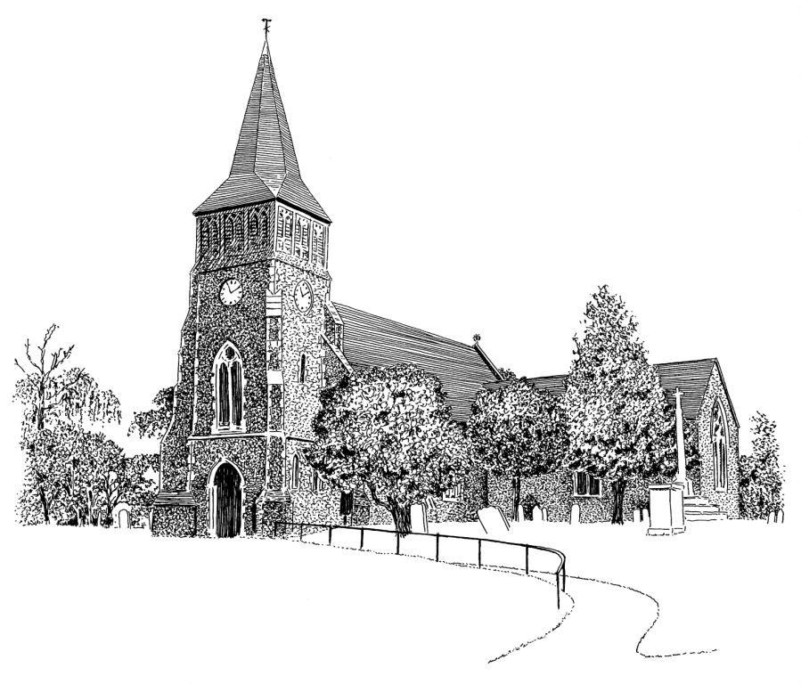
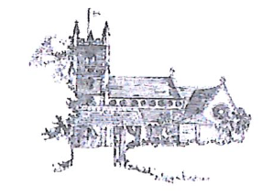


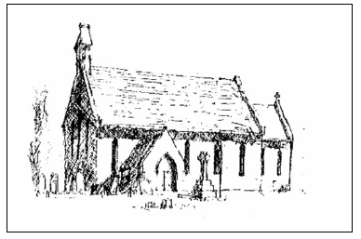

Faith
Place
People
Our Image
Mission

Slide 19
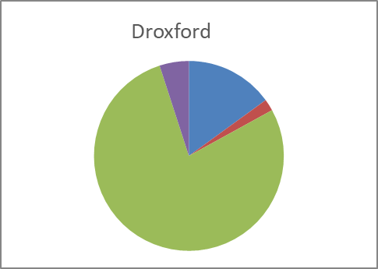
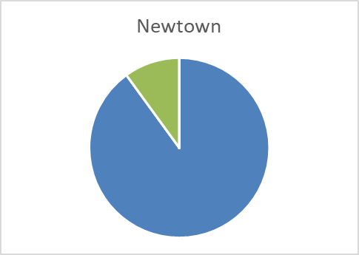
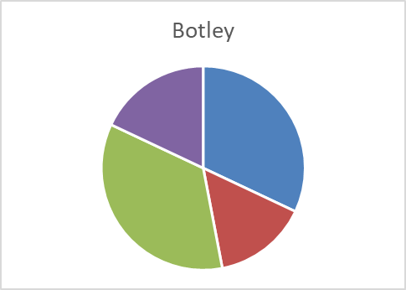
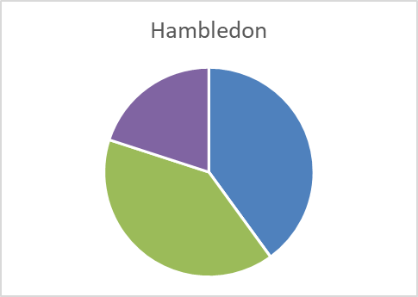
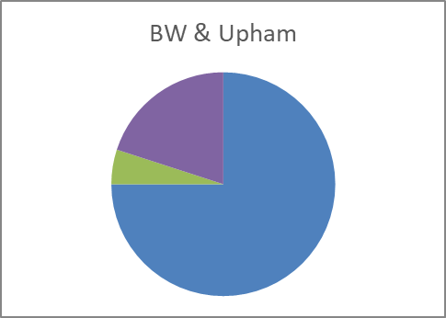
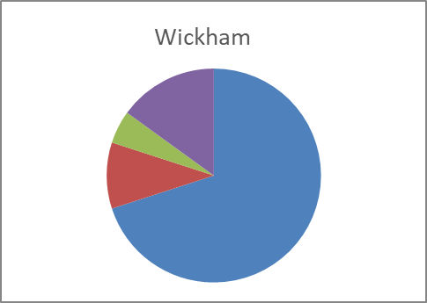
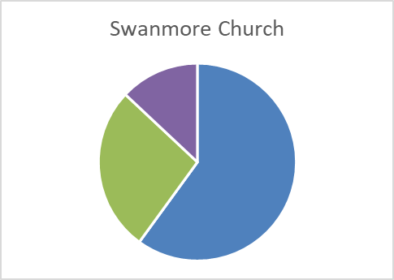
Who uses our Church Buildings? For what?
Data Health Warning: we found this question difficult to interpret and only some parishes answered it. If it is useful, we should clarify and ask it again.
NB non-Church buildings excluded
Life events (baptisms, weddings and funerals) and community usage seem more significant in some parishes than others, suggesting different mission opportunities
Notes:
Not sure about separate buildings being included so this will not be fully accurate
Responses indicate a wide range of differences, not necessarily aligned to a sense of ‘place’
Synod should consider whether it is a useful issue to probe and if so, how better to capture the current position.
NB it was a specific aspiration to have our buildings ‘re-purposed for wider community engagement’ – from whom might we learn on this and who most wants to be educated?

Slide 20
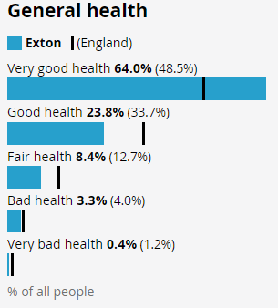
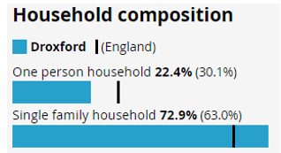
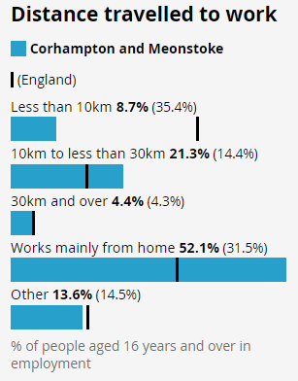
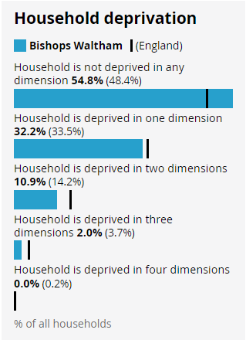
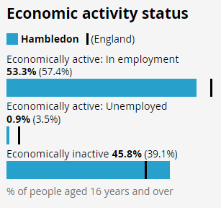
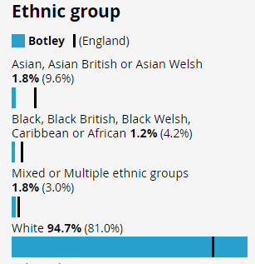
Census 2021 gives us some useful data – slides are available for each parish
Quite High Proportions of Single Households but only BW above national average
Relatively Disconnected from Local Work
Relatively Healthy and Wealthy
Very White, British and Christian
Unemployment Low
Notes:
This is a very general summary and there are slides for each parish with their own data that will be circulated.
It provides us with a sense of our communities and how representative the congregations are

Slide 21
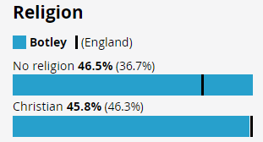
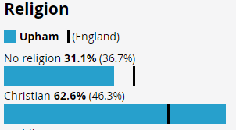

Are We Reaching People?
NB Civil Parish
Minimal Presence of other faith: only Exton registers
Significant proportions of Christians worship at Christmas in this Deanery
In only 3 parishes are a smaller proportion of Christians part of the worshipping community than the national average
Notes:
Comparatively visible compared to national figures
Darker shading indicates higher proportions
Point out civil not ecclesiastical parishes, Knowle village is in these figures but disconnected ecclesiastically – something identified in the Deanery plan we submitted to the Diocese
Possible discussion points:
Is the mission priority to bring Christians into our worshipping community or non-Christians to Christianity?
What differences do these community sizes make to our opportunities, available resources, or needs?
In a population of 132 the probability is that you can make personal contact but you will need to build on your existing skills & look to bring people in
In a population of 4,087 you will need more sophisticated communications tools to reach people but you might hope to train up what you need from local people

Slide 22
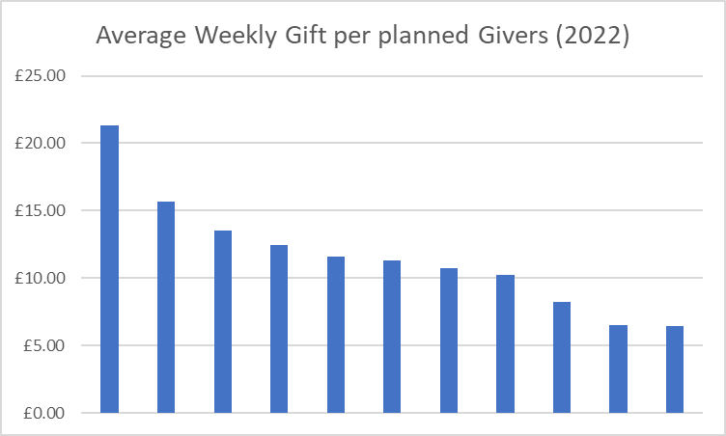
We report being rich: only one parish declared a deficit
But we are not particularly generous: only two parishes have average weekly giving amounts above the national average of £15.50
Numbers of planned givers have dropped in larger congregations but not always in smaller ones
Notes:
The pattern of average giving is not generous and we could almost certainly afford more given that we are rich areas.
Larger parishes have generally seen a gradual reduction in numbers of regular givers but this is not so obvious in smaller ones.
Some have managed to grow the number of regular givers in the last ten years.

Slide 23
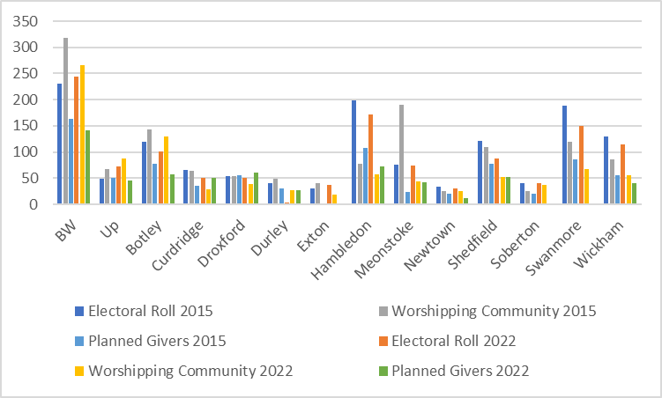
More on electoral roll, fewer givers
More givers than worshippers
Declining
More on electoral roll than worship
Significant growth in worshipping community
Notes:
Key Points
Botley, Hambledon, Newtown & Wickham show pattern of decline
BW reports an increase in electoral roll, Upham an increase in electoral roll and also worshipping community but both have seen a decrease in planned giving
Soberton has stable electoral roll but more worshippers (2015 unusually low worshipping community at 25 and ave over period is 33 with 37 in 2022; electoral roll increased 2019 and has dropped down again)
Electoral roll bigger than worshipping community in Hambledon, Shedfield, Swanmore & Wickham
Hambledon reports big drop in worshipping community (grew until 2020 then dropped from 78-55) but stable electoral role and increase in planned givers
Curdridge and Droxford report more regular givers than worshippers
Meonstoke artificially high in 2015 worshipping and has been reasonably stable around current level since 2016 with slight decline

Slide 24
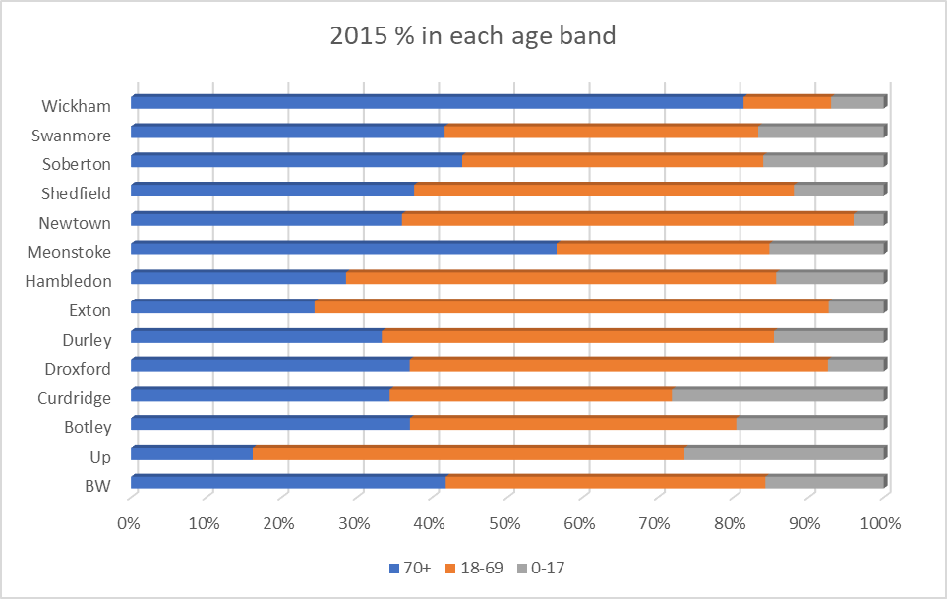
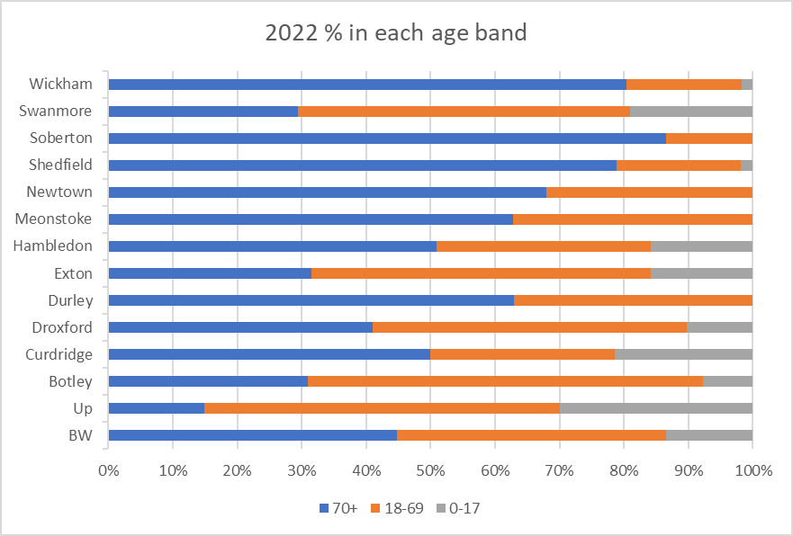
Our Congregations are Less Well Balanced for Age than they used to be
In 3 parishes those 70 or older make up over 75% of the congregation,
More than half of the worshipping are at least 70 in 7 parishes (only 2 parishes in 2015)
Children make up a smaller proportion of our worshipping community than they used to in 8 parishes; but greater in 5
Notes:
Older worshippers 2019, 2 parishes >60%>70; 2022 6 & 2 parishes >80%>70
Younger worshippers 2019 5 parishes >20%<18, 2022 2
In 7 parishes <10% congregation is <18
4 have grown in both number and proportion of YPs; BW, Up, Ex, Ha,
National figures show for 2021: 70+ 36.4% (population 13.6%), 18-69 46.6% (65%), 0-17 17% (21.4%) but this is not representative of the

Slide 25
34,380 Residents
2,495 Christmas Worshippers
933 Worshipping Community
583 Average Sunday Worshippers
18,562 Declared Christians
Christian Service or Conversion?
A Journey to Regular Sunday worship?
Nurturing the Sown Gospel?
Soil quality? Competing Weeds?
Distinct Opportunities or Extension of an Average Sunday?
Resource for Mission or Community to be Serviced?
What Proportion of our Resources should be Targeted Here?
How are our communities defined and sustained?
Parish? Deanery? Life Stage? Work & Leisure interests?
What can be done fewer times and shared?
Notes:
A. We might analyse the challenges in terms of a journey to faith and how to help people make a transition to Sunday regular worship (the directional arrow)
B. But we might think about this segmentation very differently. NB not separate grups - those of us who worship most Sundays are in all these segments.
B.1 Is the outer segment of non-Christians primarily a call to service or target for Evangelism? If service, then do we know what they need?
B.2 suggests there is a large body of local people who see themselves as Christians but do not manifest that in tangible forms of belonging. What is our role for these?
We might reflect on the various parables that Jesus told about how the Kingdom of God flourishes, such as those about sowing seed
Luke’s version of the Parable of the Sower (8:4-15) might help us think about improving the chances of Gospel seed taking root by trying to increase the soil quality in which it lands. How do we make it easier for people to be receptive given the relative lack of religious literacy amongst our neighbours; they see themselves as Christian but are not sure how to act upon that recognition
Or perhaps we should worry with Mark (4:2-20) about the competing pressures that obstruct these self-declared Christians from carrying through their faith intentions
Or maybe with Matthew’s (13:24-30, for the first similar to Luke’s see 13:3-23) second sower parable we should not worry ourselves about separating the weeds from the good plants because trying to gather up the weeds would risk uprooting the wheat.
B.3 The next segment contains people who come to occasional services, measured at Christmas for our national statistics but other examples come through in the returns such as Remembrance, Mothering and Harvest. Perhaps we should consider whether we can offer additional special worship opportunities that better match the spirituality of this group than our ‘standard’ Sunday services. How can we keep in touch with this group? Might there be an opportunity for deanery collaborations gathering our congregations and these ‘occasional’ worshippers together for some ‘festival’ type celebration?
B.4 In most parishes the worshipping community is significantly bigger than average Sunday congregations (exceptions are Curdridge, Droxford, Hambledon, Shedfield, Swanmore, and Wickham). Sometimes it is twice the size (Bishops Waltham, Upham, Exton, Meonstoke, and Soberton). Do we understand what stops them attending more regularly and when we do, what should our response be? E.g. (a) offering something more attractive, suitable or convenient to them; (b) regular personal invitations (digital opportunity); (c) arranging transport….. (this is the model of a community to be served better, through more appropriate services)
B4/5 interface: should we see this as a challenge or an opportunity. We might say that our resource for mission is almost 1,000 strong or even 2.500 as those who are not against us are with us (Mk 9:40 & Lk 9:50; although cf Mtt 12:30) or we could think of this as ‘low hanging fruit’ where it should be relatively easy to encourage more intense Christian awareness, service and worship.
B.5 The returns suggest that most, but not all, of our leadership roles relate to supporting the smallest circles of regular Sunday worshippers (or possibly the worshipping community). We might want to ask whether this uses our resources to best effect.
C. Perhaps it is worth thinking more about how people belong in our communities, including that they will probably associate with multiple communities (village, country, denomination, profession/institution) are we doing enough to amplify recognition of God in those communities?
D. Might we be able to identify areas where economies of scale make things possible that we cannot do alone, or sharing/recycling would deliver more returns for our effort.

Slide 26
Faith
People
Place
…helping people see and believe in Christ, live good and fulfilled lives and work together in community
Mission

Slide 27
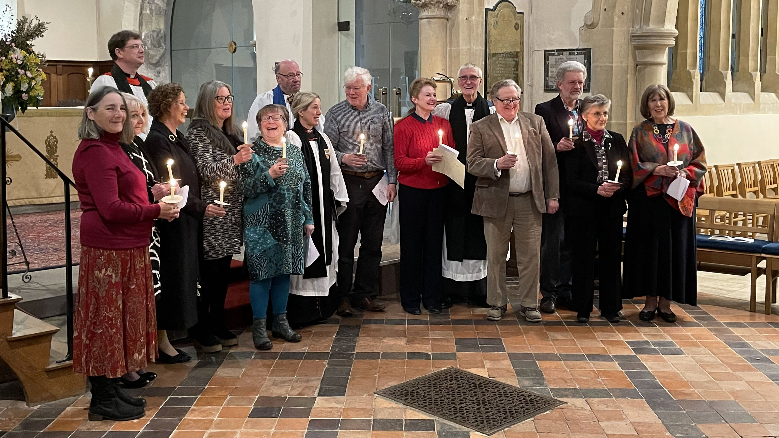

Slide 28
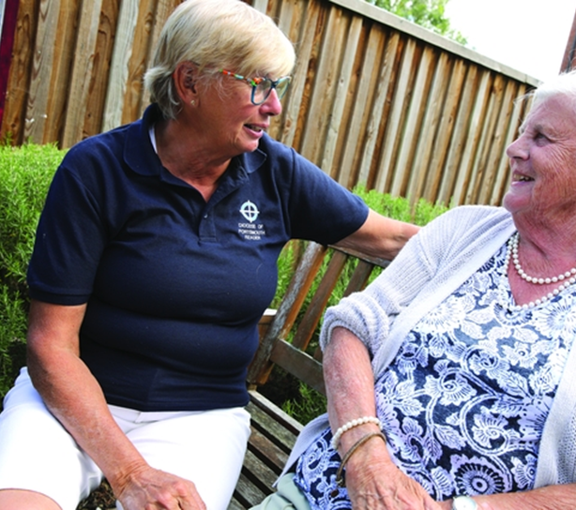
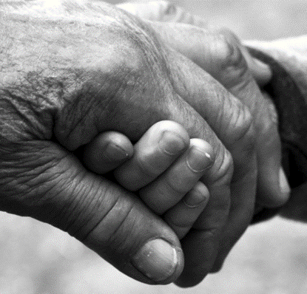

Slide 29

Looking ahead

Slide 30
ENABLING GROWTH IN THE MEON VALLEY PARISHES
Support for integrated ministry and parish mission outreach
by infrastructure provision for collaborative working.
FAMILY, CHILDREN AND YOUTH LEADERSHIP
Enabling co-ordinated mission outreach through focussed development support, in a variety of local contexts.

Slide 31


Slide 32
Implementation Plan Oct 2022
We believe in Jesus Christ as the source of our salvation and our hope. Having received the gift of his Spirit, we are called by him to live and to pray in ways that help us to grow in our faith and deepen our commitment, so that we can serve the world by helping people see and believe in Christ, live good and fulfilled lives and work together in community.

