Slide 1
General Synod Report Agenda Item 5

Slide 2
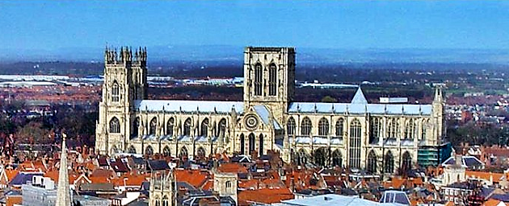
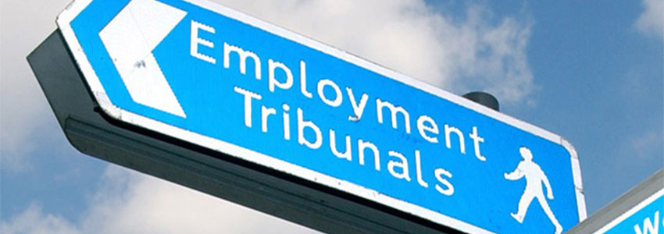
General Synod Report
Mark Emerton (member of the House of Laity for Portsmouth)

Slide 3
What is General Synod?
Who represents you?
What, where and when?
What’s coming up in York?

Slide 4
What is General Synod?
“The Church of England is episcopally led and synodically governed”

Slide 5
What is General Synod?
“The Church of England is episcopally led and synodically governed”
Before 1919: Act of Parliament (and Convocations of Canterbury and York)

Slide 6
What is General Synod?
“The Church of England is episcopally led and synodically governed”
Before 1919: Act of Parliament (and Convocations of Canterbury and York)
1990-1970: Church Assembly

Slide 7
What is General Synod?
“The Church of England is episcopally led and synodically governed”
Before 1919: Act of Parliament (and Convocations of Canterbury and York)
1990-1970: Church Assembly
Synodical Government Measure 1969: General Synod from 1970 onwards

Slide 8
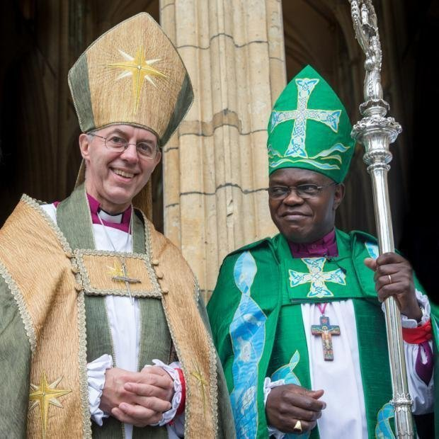
What is General Synod?
Who comprises General Synod?

Slide 9
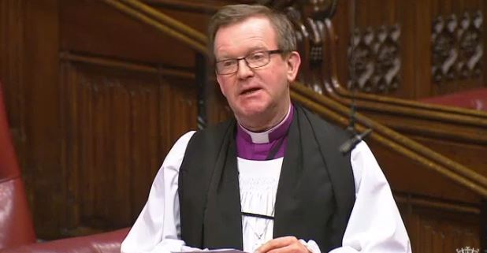
What is General Synod?
House of Bishops – 42 diocesan bishops plus some suffragan bishops

Slide 10
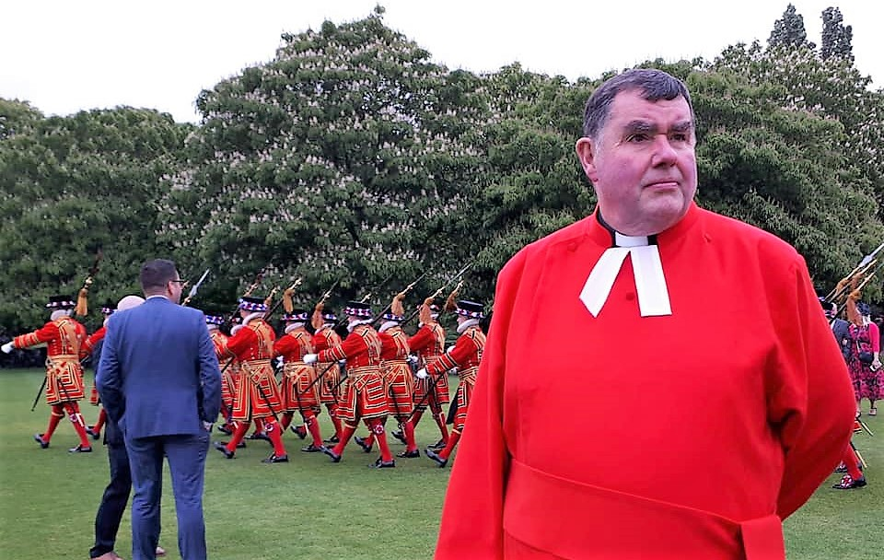
What is General Synod?
House of Clergy – 197 clergy

Slide 11
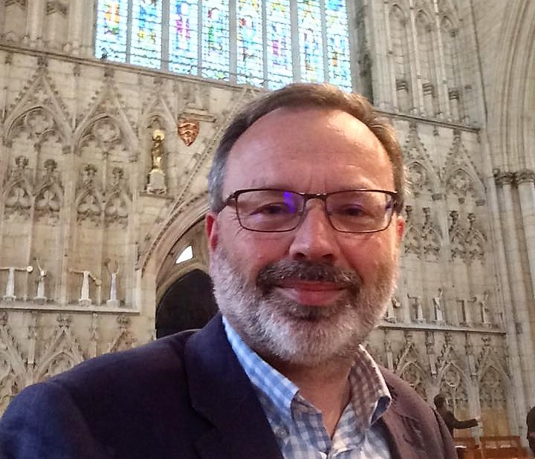
What is General Synod?
House of Laity – 260 laity

Slide 12
Who represents you?
Bishop Christopher
Clergy:
The Venerable Gavin Collins gavin.collins@portsmouth.anglican.org
The Rev Canon Bob White vicar@portseaparish.co.uk
The Rev Canon Peter Leonard peter.leonard@portsmouthcathedral.org.uk

Slide 13
Who represents you?
Laity:
Mrs Emily Bagg emily.bagg@hotmail.co.uk
Mrs Lucy Docherty lucy@docherty1.co.uk
Mr Mark Emerton mark.emerton_generalsynod@yahoo.com
These representatives were elected to General Synod in 2015. Please feel welcome to contact any of them about any matter of interest or concern

Slide 14
Who represents you?

Slide 15
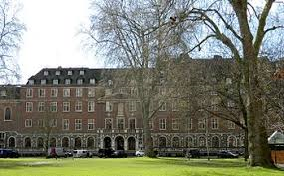
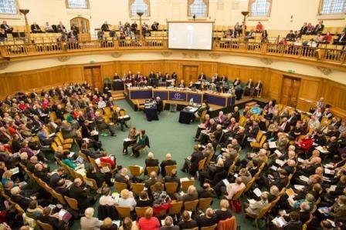
What, where and when?
London: February (and sometimes November)

Slide 16
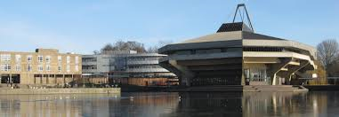
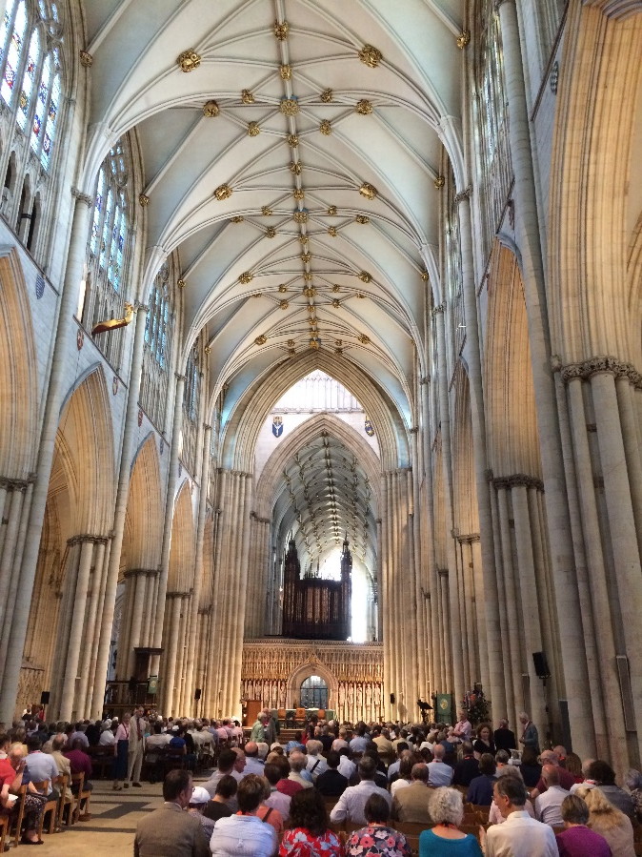
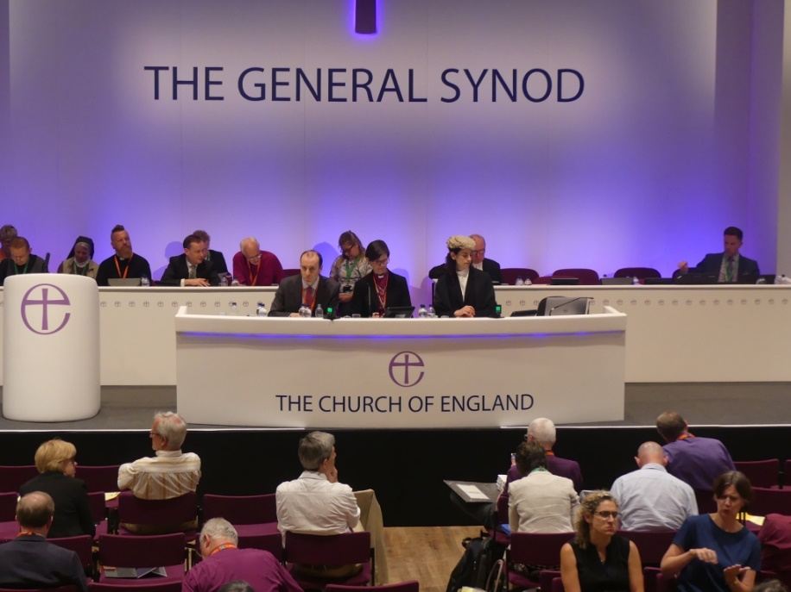
What, where and when?
York: July

Slide 17
What, where and when?
legislation:
to pass measures dealing with the government of the church and its institutions,
to pass canons, determining doctrine and the form of worship,
to approve the liturgy and make other rules and regulations through Acts of Synod,[
to regulate relations with other churches,
to consider and express their opinion on any other matters of religious or public interest, and
to approve or reject the annual budget of the church

Slide 18
What’s coming up in York?
Fellowship
Service in York Minster
Renewing acquaintance with old friends and colleagues
Fringe meetings
Diocesan meal (with the Royal Navy)
Bishop Christopher answers difficult questions on clergy remuneration and conditions of service

Slide 19
What’s coming up in York?
Business:
Address from Danish Bishop
Presentation from Mothers’ Union
Presidential address
Presentations/debates include:
Youth violence
Clergy wellbeing
Safeguarding
Same sex relationships
Refugees
Mission
Crown Nominations Commission
Legislation –Lots of it!

Slide 20
Please pray for your team in York 5-9 July 2019

