Slide 1
2025 Annual Report and Accounts
and
Update on 2026 Finances

Slide 2
Audit Overview
Audit has been completed by Crowe – first year
Unmodified audit opinion
No concerns re key areas:
  Recognition of income including grants and parish share
  Valuation of properties
Comfortable with going concern approach
A couple of recommendations around process which are being addressed

Slide 3
2025 Annual Report and Accounts
Overview – All Funds
Notes:
Majority of increase in both income and expenditure is restricted funding eg SMMI money for Rejuvenate of £860k income, £843k expenditure
Also some additional funding towards stipends that started during 2025
Other cost increases inflationary and further increases in numbers of appointments

Slide 4
2025 Annual Report and Accounts
Overview – General Funds
Notes:
Main movement in income is the reduction in rental income – properties held for appointments and impact of Renter’s Rights bill
Expenditure impacted by increased clergy headcount, inflationary increase in costs
Housing cost increases above inflation
New NI rates

Slide 5
General Fund – budget reconciliation
* The budgeted deficit was based on the assumption 100% collection of parish share was achieved.
NB other transfers between funds are shown separately in the statutory accounts
Notes:
2025 budget showed 100% collection as the headline, with 2 scenarios for other collection rates.
Result if collection rate of 88% - £1,284k deficit. £175k shortall against this, largely due to collection rate 84.5%.
All parish contributed to PS or made commitment to, with payment being received in 2026
Transfers against gen fund costs eg use of designated fund or investment income on other funds improved position by £298k. £154k of designated funds – short term benefit but not sustainable longer term

Slide 6
2025 Annual Report and Accounts
Year end one-off adjustments:
  Investments and land valuations increased by £2.3m across all funds
    CCLA investment portfolio saw reduction in value
    Increase in glebe values – particularly Wickham Glebe
  Property valuations increased by £909k across all properties (DBF, parsonages and glebe/investment properties)
  Small loss on disposal of investments - £25k
  No revaluation movements to pension schemes as they remain in surplus
Notes:
CCLA underperformance being monitored. Have seen some improvement in 2026 – under review until September
Sale of land at Wickham glebe expected to complete by Autumn so revalued to reflect expected sales value. Funds will be applied to stipend capital fund with income supporting stipends
Property valuation changes – usual 5 year cycle of revaluations

Slide 7
2025 Annual Report and Accounts
Summary of movements in reserves – All Funds
Notes:
Summary of all funds with movements from start to end of year. Healthy balance sheet of £89.4m. £68.8m of this is tied up in land and buildings, so more liquid funds total £20.7m. Amounts in endowments can’t be easily used

Slide 8
Free Reserves and Cashflow
Free reserves – unrestricted funds not tied up in assets total £2,516k
Designated funds - £2,068k
Cash reserves equate to c13 weeks expenditure, our policy is 6 weeks
Cashflow forecasts suggest have sufficient cash until mid 2027 without having to sell any investments

Slide 9
Where did the money come from?
Notes:
Greater proportion of grant income due to introduction of new grants in year including rejuvenation. Although small increase in cash received for parish share, makes up a smaller proportion of our overall income. Other elements remained relatively consistent

Slide 10
Where did the money go?
Notes:
Again shift due to the new grant funded projects under Rejuvenate
Mission support costs fallen in monetary terms and as % of total
Clergy remuneration and housing both increased in monetary terms compared to previous year

Slide 11
Questions?

Slide 12
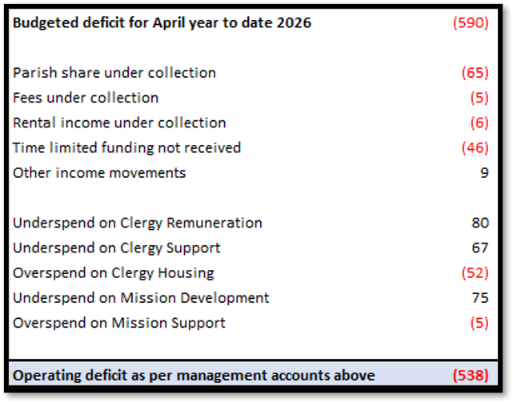
2026 Finance Update
Notes:
Parish share under collection budgeted is based on payment trends for previous year so current under collection may be recovered. Lack of consistent payment makes hard to accurately predict
Time limited funding – time limited support agreed by NCI as part of package of changes. Originally expected first installment in April, now expected in June
Clergy remuneration running below budgeted headcount of average of 73 due to some retirements and some posts not being recruited as quickly as expected
Clergy housing – timing of spend, working with property to understand expectations for rest of year – some works moved forward from future year due to appointments, some delayed as a result. Still seeing above inflationary increases
Mission development underspend – some timing differences, some vacant staff posts, some contributions from other grants towards budgeted costs, use of pension surplus

Slide 13
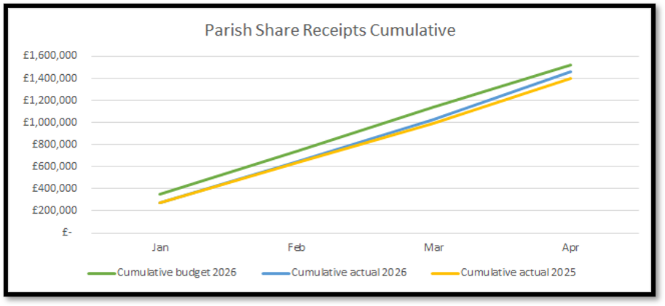
Parish Share
Budget figure is based on 88% collection rate
Notes:
Consistently up on last year from Jan-Apr
Very mixed position between deaneries
A few parishes now paying more regular small contributions with catch up payments periodically

Slide 14
Parish Share
Parish share shows a consistent improvement on the same period for 2025
  Similar pattern to last year but mixed picture within this
Some parishes still to make their first payment of the year
Parishes continuing to request conversations
Just under 88% currently allocated
BUT can meet 88% with late payments from previous years
And Parish share letters encouraged parishes to pay more if they feel able
Notes:
Improvement in parish share collection is critical to moving towards a more sustainable financial position – this would need above inflationary increases
Strongly encourage conversations about whether a greater contribution could be afforded – either to move towards calculation quicker, or if on calculation if have excess income and would like to support others less able to pay
At the moment we have just 1 parish making and additional payment – a LINC funded parish

Slide 15
Changes from Budget
Use of pension surplus from January – mid April of £65k – now fully utilised
Clergy pension contributions reduced from 22% to 21% - impacting from April 26 –expect saving c£21 this year vs budget
Other savings due to delay in appointment of some staff and clergy posts, leavers and retirements
Increased to HMRC approved mileage rates from April 2026
Increase to clergy housing costs
  Previous quinquennial works carried forward – were expected to complete in 2025 but delayed
  Some future quinquennial works moved to 2026 and completed alongside vacancy works
  Still impacted by above inflationary cost increases
Notes:
Pension surplus – may be more but unlikely to know until September at the earliest, can’t be relied upon longer term

Slide 16
Forecasts
Forecasts expect year end position to be in line with budget – underspends on staffing and clergy offsetting overspends on housing
  Budgeted deficit at 88% share collection - £1,237k
  Current forecast deficit - £1,222k
Collection for parish share forecast at 88% (84.5% achieved in 2025)
Other restricted and designated fund transfers may improve this position
  Budget included £168k designated funds and £216k restricted funds – not included in the forecast deficit

Slide 17
Questions?

