Slide 1
Annual Report and Accounts for Diocesan Synod
10th June 2023

Slide 2
2022 Annual Report and Accounts:
Key points – General Fund
Total Income: £6,780,051 (2021: £6,660,348)
Total Expenditure: £6,924,494 (2021: £6,505,560)
Balance: Deficit £144,443 (surplus £154,788)

Slide 3
Finance Update
Overview of 2022 Annual Report and Accounts
Operational surplus of £350k but mixed results across funds
Overall surplus for the year of £7.9m after all revaluation adjustments. These include:
£350k investment gains
£6.9m of property gains
£89k of gains on remeasurement of the pension scheme deficit – now cleared

Slide 4
Where did the money come from in 2022 compared to 2021?

Slide 5
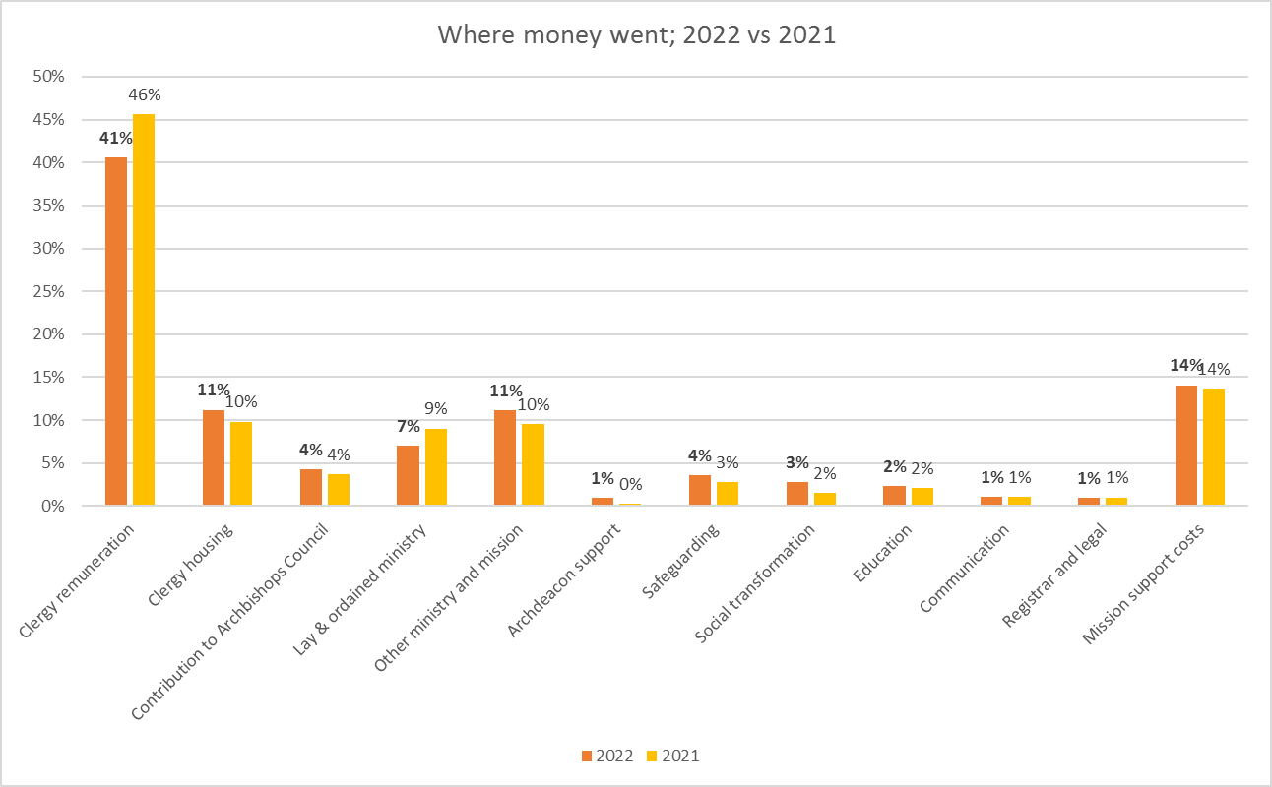
Where did the money go in 2022 compared to 2021?

Slide 6
2022 Annual Report and Accounts:
Variations from General Fund Budget to Final Accounts
*NB transfers are shown separately in statutory accounts

Slide 7
2022 Annual Report and Accounts:
Movement in Balance Sheet – all funds
*NB brackets for the net movement in funds for the year represents a deficit

Slide 8
Any questions?

