Slide 1
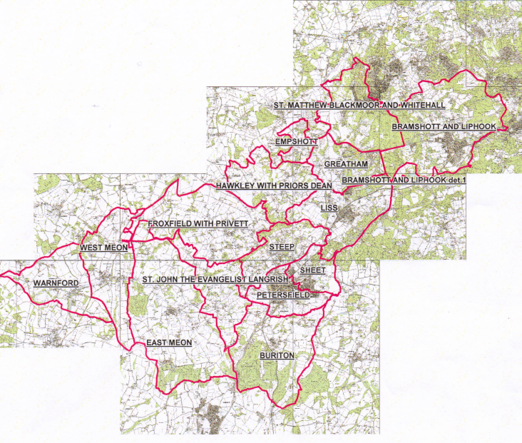
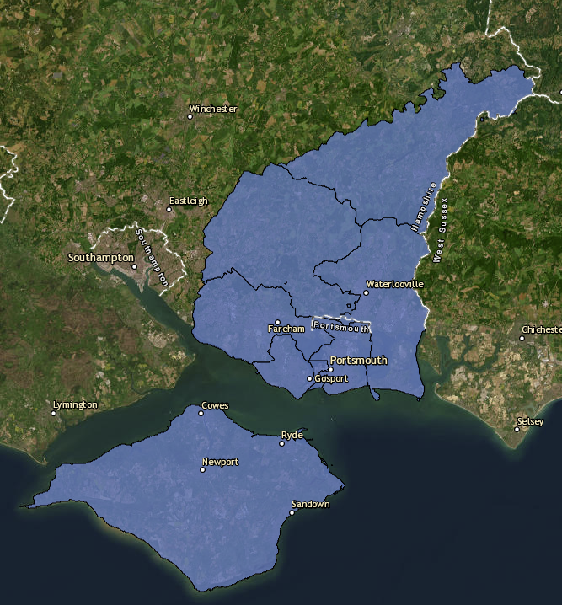
Petersfield deanery
Collaboration and Deanery lead roles
Revd Dr Susie Collingridge, Area Dean
Vanda Leary, Lay Chair
IL
P
Notes:
(Introduce Susie & Vanda)
Here’s Petersfield Deanery
In the North of the Diocese
Not that far from Portsmouth but very different in nature
A rural Deanery
The largest town, Petersfield, the “urban area” has a population of 15,000 compared with approx. 238,000 for Portsmouth.
15 parishes
Different styles/churchmanship
Serving very different communities
We’re going to talk about our approach to collaboration and the use of Deanery lead roles.

Slide 2
Our priorities
Young people & schools
Developing lay ministry
Outreach to new & under-served communities
Building strong parishes
Refreshing worship & discipleship
Support for Older people
Our churches will be
praying communities
embedded in the life of our towns and villages:
growing in faith,
welcoming all,
and caring for our neighbours and communities.
Notes:
Here’s our deanery vision, and the Deanery priorities for implementing that vision. I know that these will be familiar to you and overlap strongly with your own Deanery priorities.
We were happy with these as priorities, but were struggling to see how best to resource them
How could we make this a platform for significant and lasting change?
Especially how to balance the desire for real ministry of presence in our parishes, with a strong and sustainable lead across the Deanery.
So we hit on the idea of shared parish and deanery roles for these priority areas

Slide 3
Deanery Lead Role
Attention! Clergy Wellbeing!
70%+30%=100%
NOT 100% +30% = 130%
Deanery
30%
Key tasks/responsibilities
Leading across the Deanery, including to:
Research
Set out a strategy
Work with parishes, connecting with existing work where possible,
Develop lay ministry to further the work.
Respect different church traditions and encourage a diversity of approach
Parish
70%
Notes:
Each full time stipendiary clergy has a dual role – parish at 70% of their time and energy
The Deanery contribution is at 30% to make it a real and significant part of the role for an incumbent.
No timesheets or formal recording – in practice the amount of time spent will vary
But the Deanery part is NOT optional – important part of role
There is a really important point about clergy well-being – we are NOT asking for a full time parish role and Deanery on top. Each parish understands that they must give up some of their own clergy time, but in return they get the support of clergy elsewhere in the Deanery.
The roles are not fixed for all time – we anticipate reviewing and adjusting role allocations every 3 years or so – as priorities change, and to re-energise and keep the impetus fresh.
So what are they doing in practice?
(all the stuff in the blue box)

Slide 4
Our priorities
Young people & schools
LISS
Developing lay ministry
Hawkley w. Priors Dean, Empshott, Greatham
Outreach, mission, evangelism
SHEET
Building strong parishes
Refreshing worship & discipleship
Support for Older people
Accountability
To Deanery Synod
To Diocese as part of Deanery implementation plan
Benefits
Sustainability
Collaboration and mutual support
Development opportunities – clergy and laity
Notes:
Well that’s the idea – so how far have we got with implementing it?
For the initial lead roles we chose areas that would
Make a real difference to our capacity – especially important due to the number of vacancies in the Deanery
And make a very visible difference in areas where we had been collectively less active
It’s important that we make an impact and set the tone for change
As a Deanery, we prioritised Liss and Sheet for new appointments
The 0.3/0.7 split was highlighted in the application pack. ALL shortlisted applicants commented that the Deanery Lead role was a major part of what drew them to apply.
Interviews were over the last week or so and announcements will bemade in due course about
A new incumbent for Liss, who will take the Deanery Lead role for Growing Faith – children & their families
And a new incumbent for Sheet, who will take the Deanery Lead role for Mission & Evangelism
With the new appointments we have the freedom to shape the role from the outset, but we are also retro-fitting this to current incumbent roles.
Peter Sutton in Hawkley has started with the lead on Developing Lay Ministry.
Peter and the others will be accountable to Deanery Synod, to present their plans, progress and so on.
And collectively we’ll be accountable to the Diocese as this way of working allows us to deliver on on Deanery Mission Action Plan.
There will be a lot to learn, it will be a new way of working for everybody.
We hope to see benefits of sustainability, mutual support, and development opportunities
We are expecting great things as we work together to grow the Kingdom

Slide 5
THANK YOU!
Any questions or feedback?

