Slide 1
Peace
John 14:27 Peace I leave with you; my peace I give you. I do not give to you as the world gives. Do not let your hearts be troubled and do not be afraid.
Proverbs 3:5 Trust in the Lord with all your heart and lean not on your own understanding;
Notes:
https://www.youtube.com/watch?v=fKKd15f5XWY – PEACE by Hillsong Young and Free OR https://www.youtube.com/watch?v=uW6xcmqfiY4 – ‘Peace’, Bethel Music feat. We The Kingdom

Slide 2
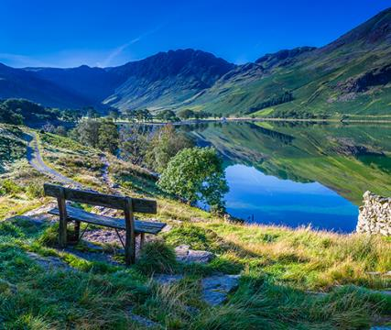
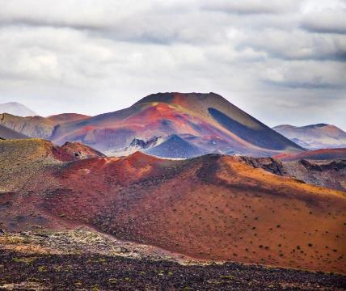
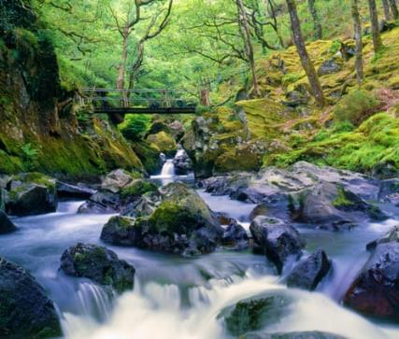
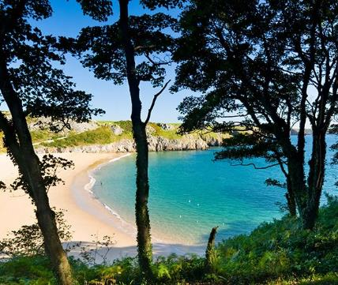
In which tranquil place would you most like to spend time?
Notes:
Discuss what makes these places appealing. Why is being in a peaceful place good for you? Would anyone feel more peaceful in a different kind of place?

Slide 3
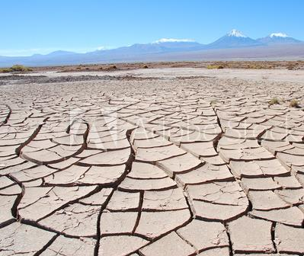
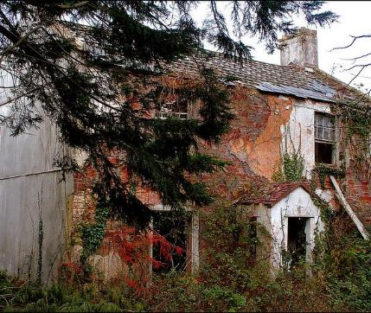
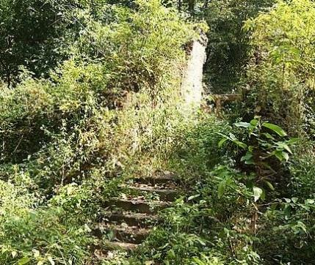
In contrast, what is your reaction to these places?
Notes:
Are these places as appealing? Probably not! How do these places make you feel?

Slide 4
“This garden is your soul. This mess is you! Together, you and I, we have been working with a purpose in your heart. And it is wild and beautiful and perfectly in process. To you it seems like a mess, but I see a perfect pattern emerging and growing and alive—a living fractal.” ― Wm. Paul Young, The Shack
Proverbs 3:5 Trust in the Lord with all your heart and lean not on your own understanding;
Notes:
NB A Fractal is a type of mathematical shape that is infinitely complex.

Slide 5
https://www.youtube.com/watch?v=H-7qYf6cTeo
Dear Lord and Father of humankind, Forgive our foolish ways; Re-clothe us in our rightful mind, In purer lives Thy service find, In deeper reverence, praise.
In simple trust like theirs who heard Beside the Syrian sea The gracious calling of the Lord, Let us, like them, without a word, Rise up and follow Thee.
O Sabbath rest by Galilee, O calm of hills above, Where Jesus knelt to share with Thee The silence of eternity, Interpreted by love!
Drop Thy still dews of quietness, Till all our strivings cease; Take from our souls the strain and stress, And let our ordered lives confess The beauty of Thy peace.
Breathe through the heats of our desire Thy coolness and Thy balm; Let sense be dumb, let flesh retire; Speak through the earthquake, wind, and fire, O still, small voice of calm.
- John Greenleaf Whittier
Notes:
Either listen to or sing the hymn – Dear Lord and Father of Mankind. Perhaps spend a short amount of time discussing the meaning of the words and how they relate to the theme of inner peace.

Slide 6
Prayer
Dear Lord
Thank you that you have a purpose for us all – that we are loved and valued by you.
We acknowledge that we are both wild and beautiful inside. Help us to develop our beauty to become the people you created us to be.
Work within us to help us experience your peace and contentment and enable us to serve one another to your glory.
In Jesus’ name,
Amen

