Slide 1
NZC Update – Diocesan Synod 7th March 2026
Matt Lockwood
NZC & Communications Officer

Slide 2
NZC Conference 2026
Saturday 17th January
St John Stoke, Guildford
Bishops from Portsmouth, Dorking, Lewes, Southwark;
Archdeacon of Winchester
Julian Atkins & Steve Collins, national NZC team
Young people from Haslemere Parish
Breakouts from A Rocha, Christian Aid, Diocesan teams
Exhibitors from Ecclesiastical, Climate Stewards, local environment groups
Over 150 in attendance

Slide 3
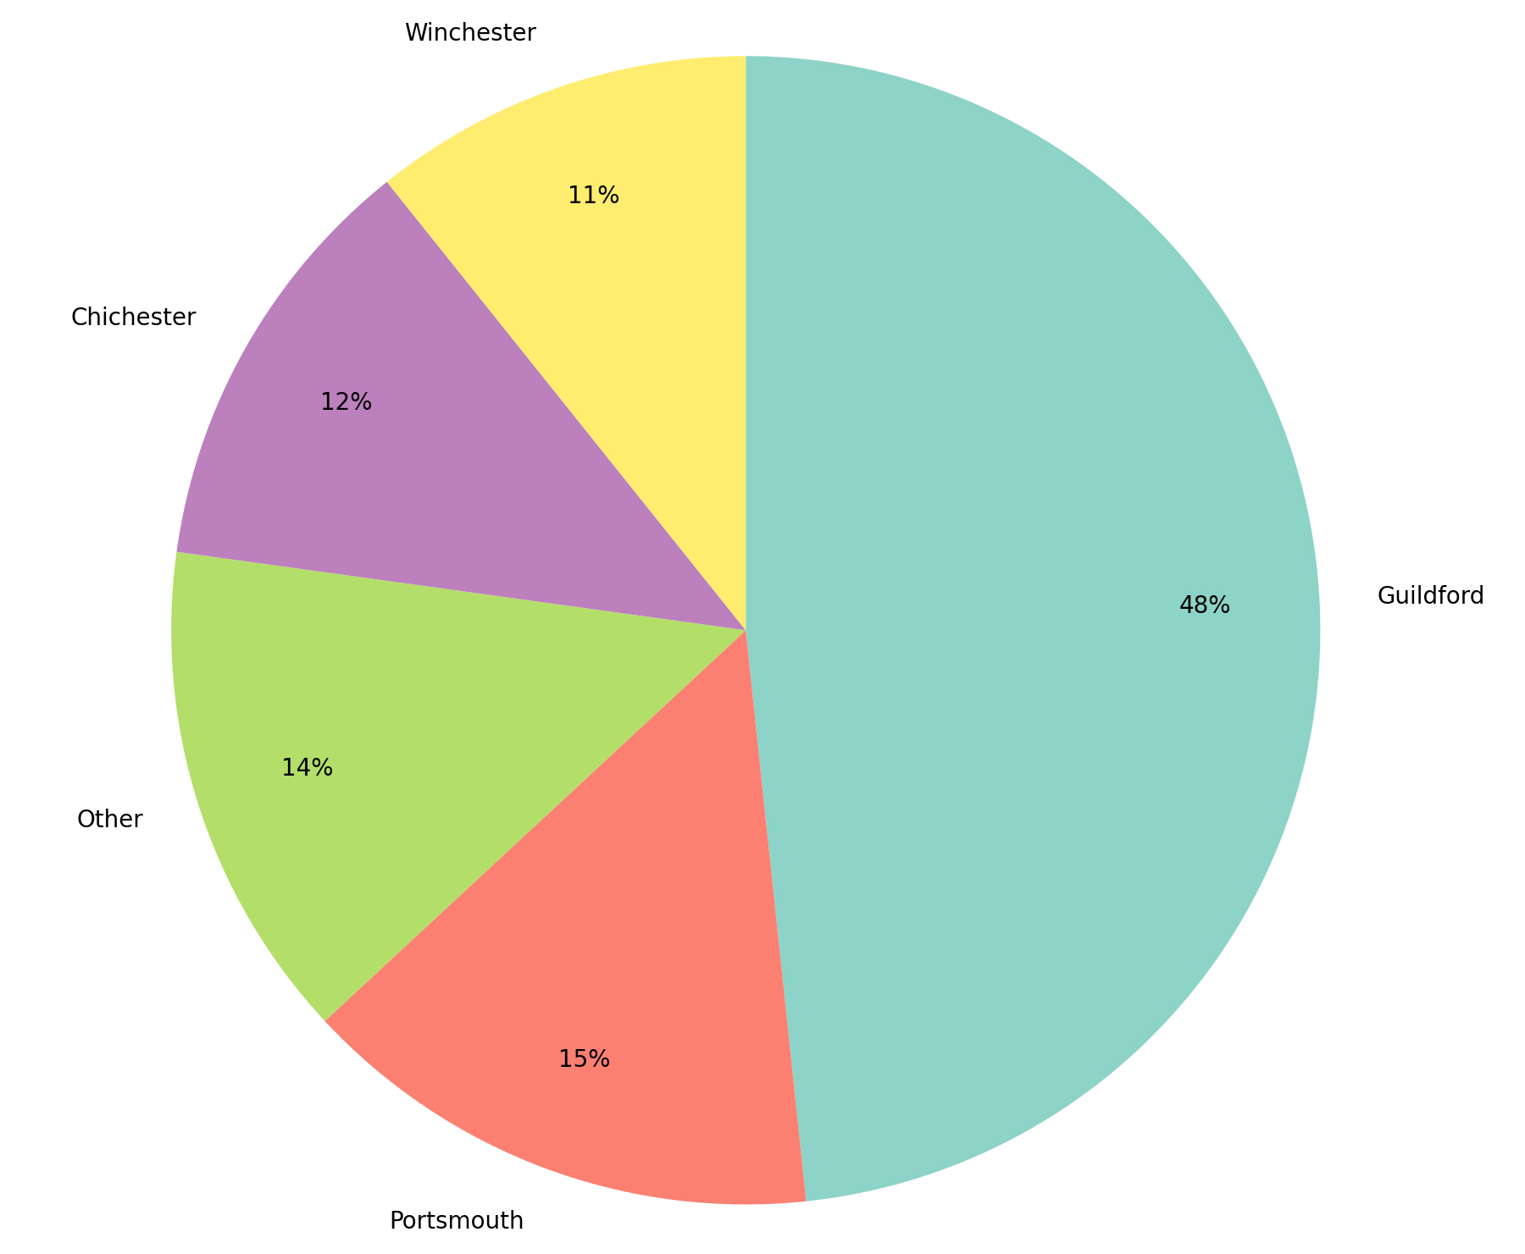
NZC Conference 2026
Guildford, 48%
Portsmouth, 15%
Chichester, 12%
Winchester, 11%
OTHERS:
Salisbury
Rochester
Ely
Oxford
Organisations like:
  A Rocha
  Christian Aid
  Climate Stewards
  National NZC team
  Ecclesiastical

Slide 4
NZC Conference 2026
“I came away enthused and energised to reboot our Net Zero journey and was so inspired to see all that St Johns Stoke had managed to do already and the way they’re planning and working towards their goals. Lots of takeaway ideas...a great day!”
“Great content from the break-out session on Communications”
“Please do it again! I like the ‘Guildford Declaration’ - a very good outcome.”
“Great to hear bishops also ‘get it’”
“Just a very big ‘Thank you!’ for such a stimulating and encouraging day – well worth attending.”
“I appreciate the opportunity to work together on the Climate issues.”

Slide 5
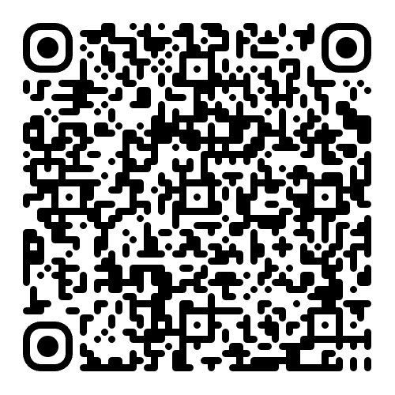
NZC Conference 2026 – Guildford Declaration
“Given the Church of England’s commitment to Net Zero 2030 and the increasing urgency of meeting this commitment, this Conference requests the Church Commissioners to commit, in the next triennium (2029-31) and following, to provide the dioceses with sufficient funds and resources to support parishes in bringing church buildings’ heating footprint to Net Zero.”
Sent to John Worth, Chief Executive of the Church Commissioners, and Alistair Hammond, Deputy Head of Comms for CC, February 5th.

Slide 6
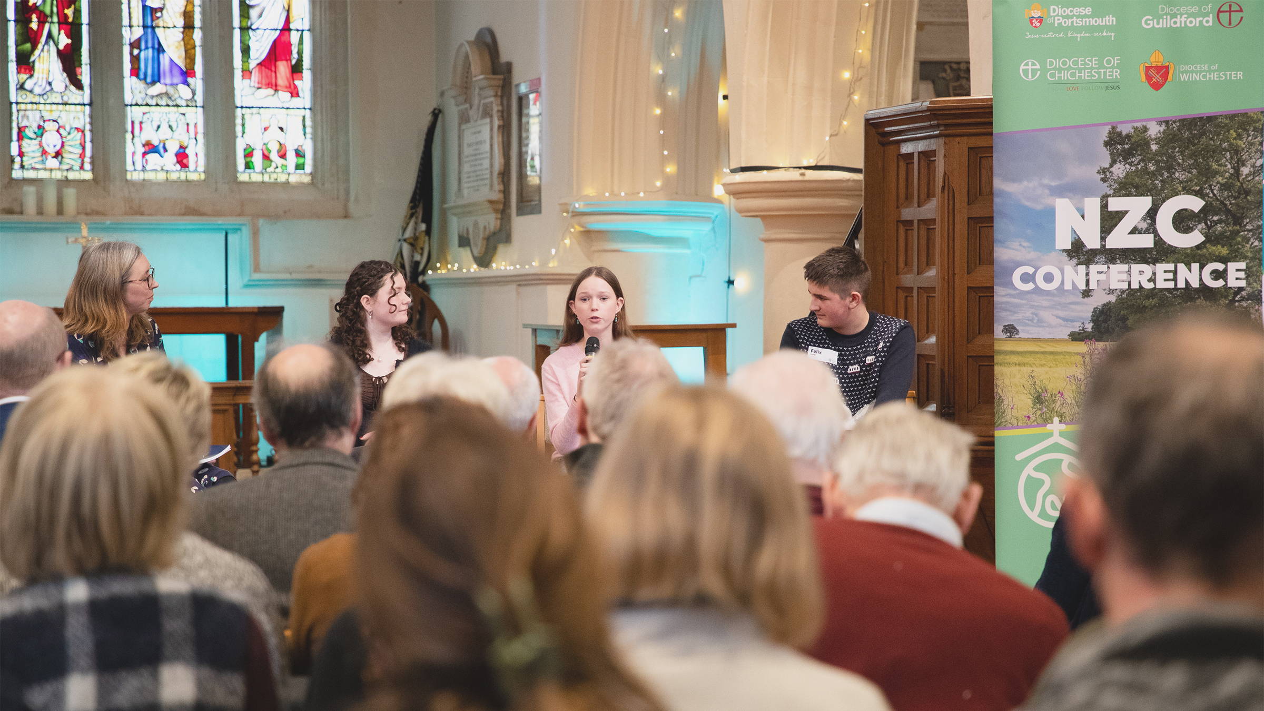
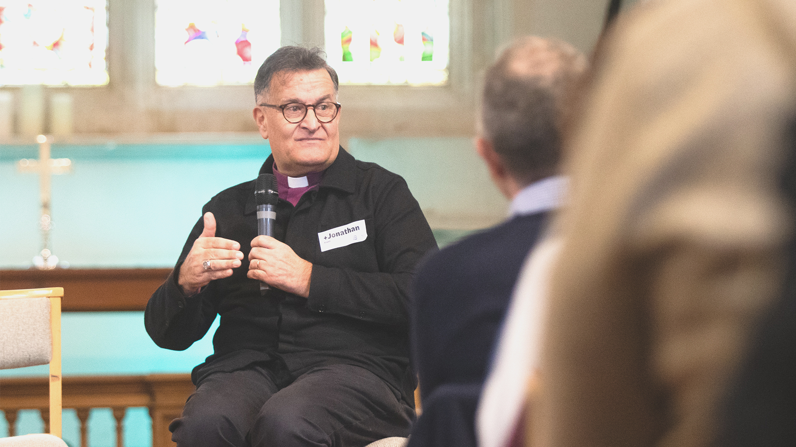
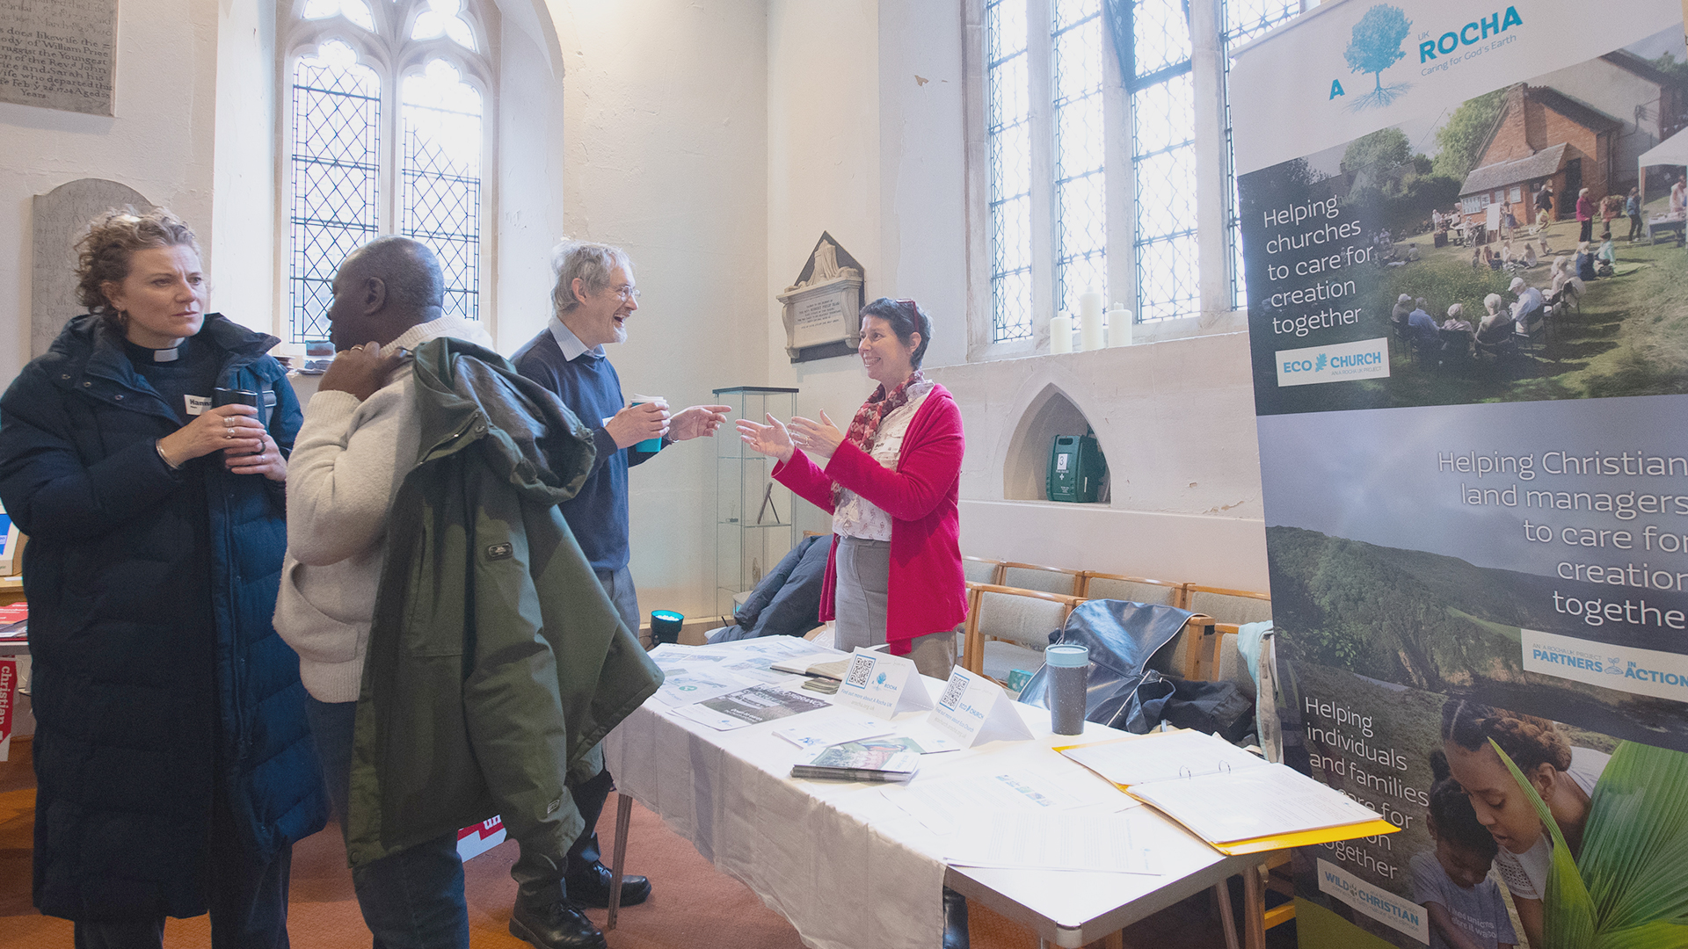
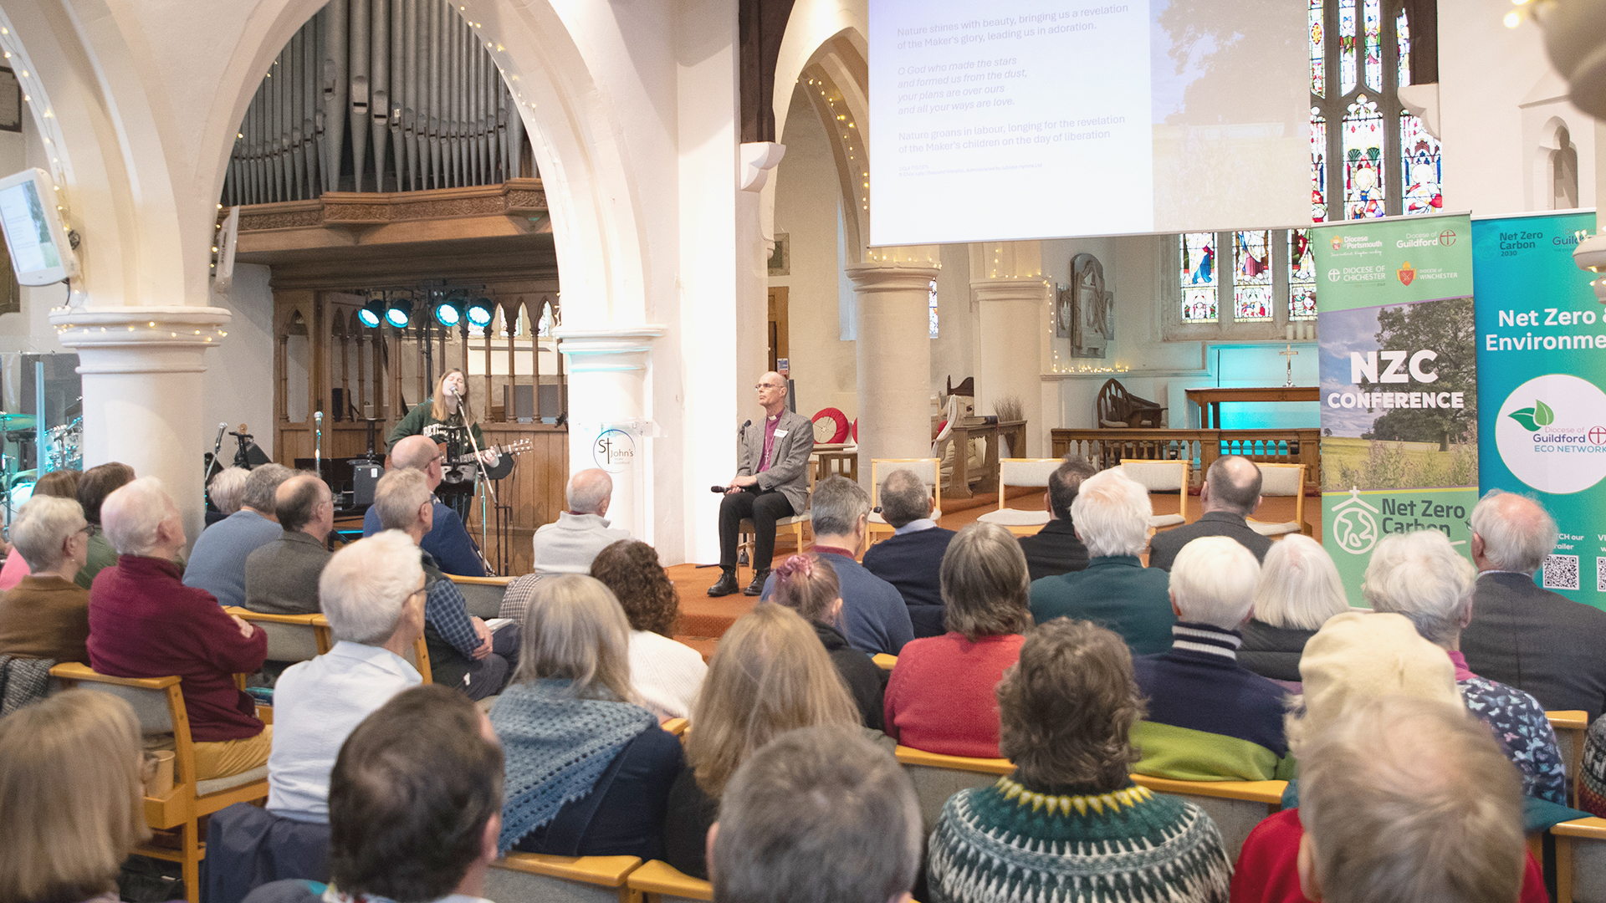
NZC Conference 2026

Slide 7
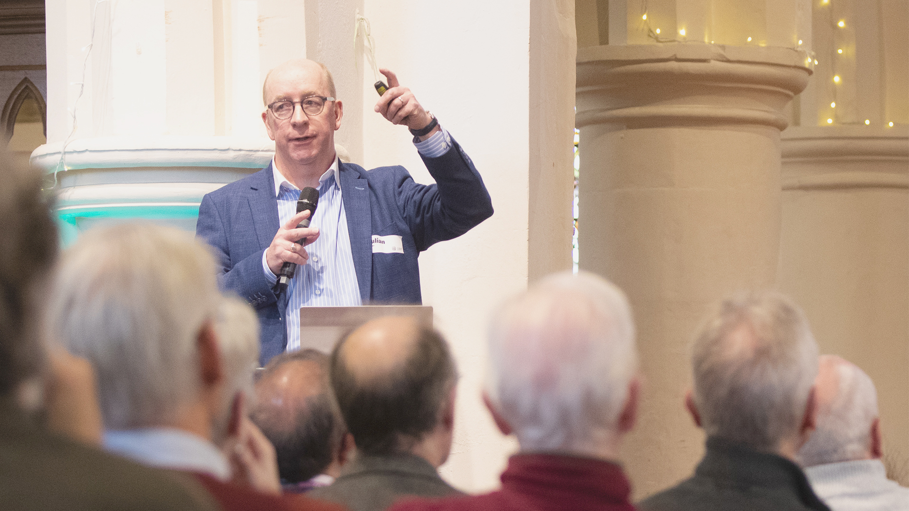
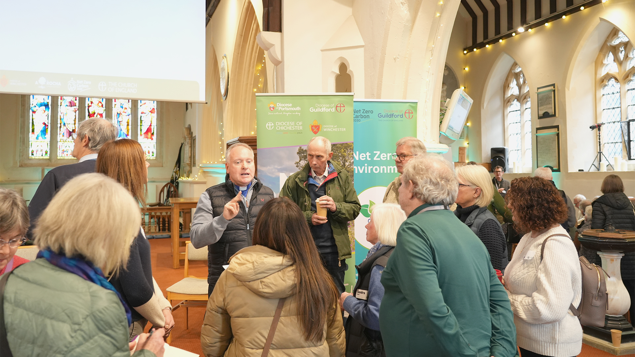
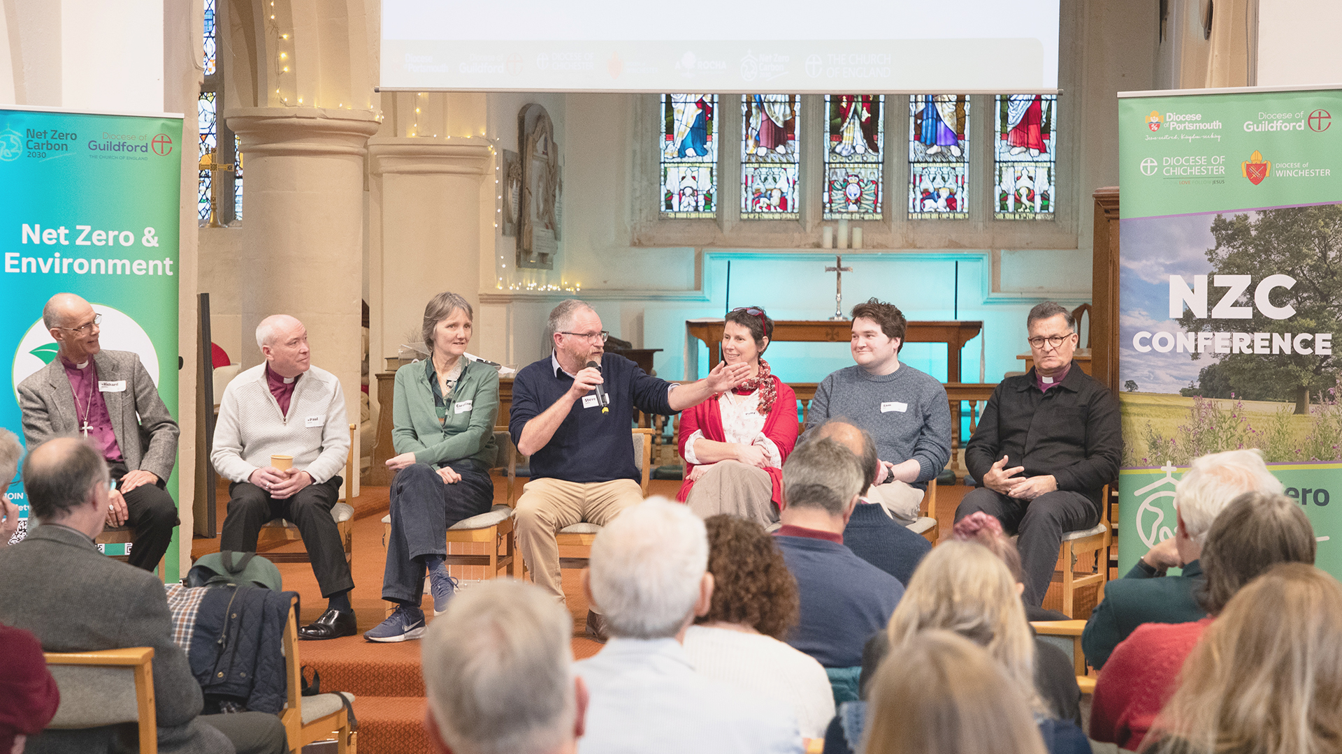
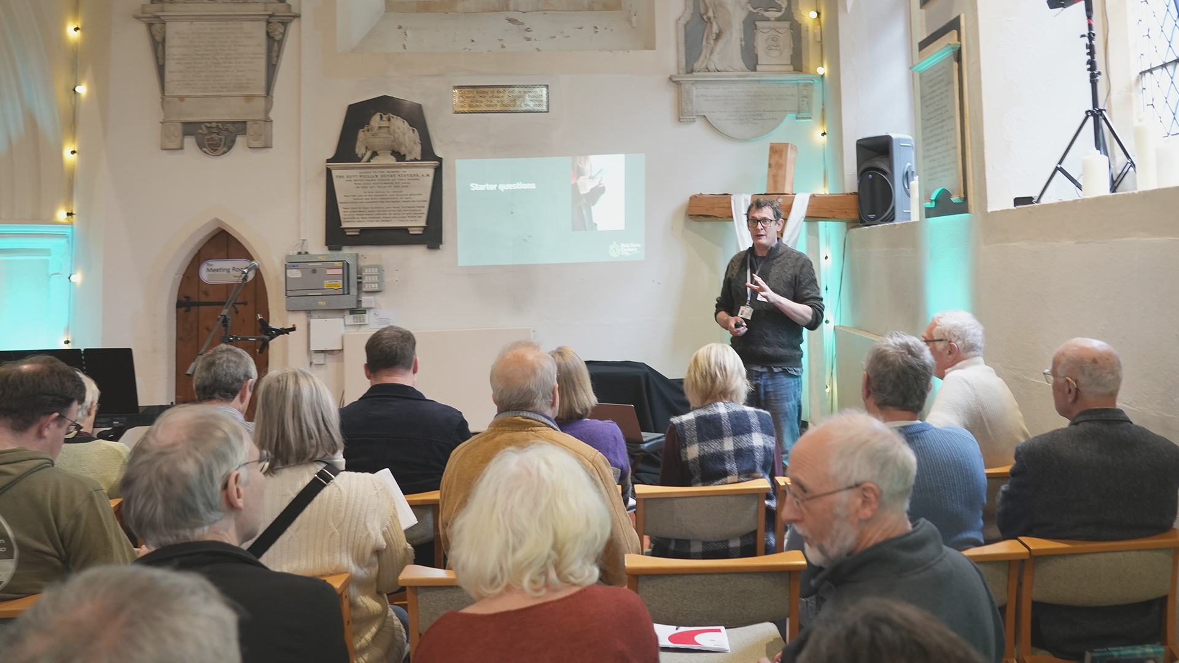
NZC Conference 2026

Slide 8
NZC Conference 2027
Chichester’s turn to host
Potential for two conferences in Southern Dioceses area:
  West: Portsmouth, Guildford, Winchester, Salisbury
    A church in Winchester diocese, February 2027
  East: Chichester, Rochester, Canterbury
    A church in Chichester diocese, January 2027
Still in planning stage, promotion starts Autumn 2026

Slide 9
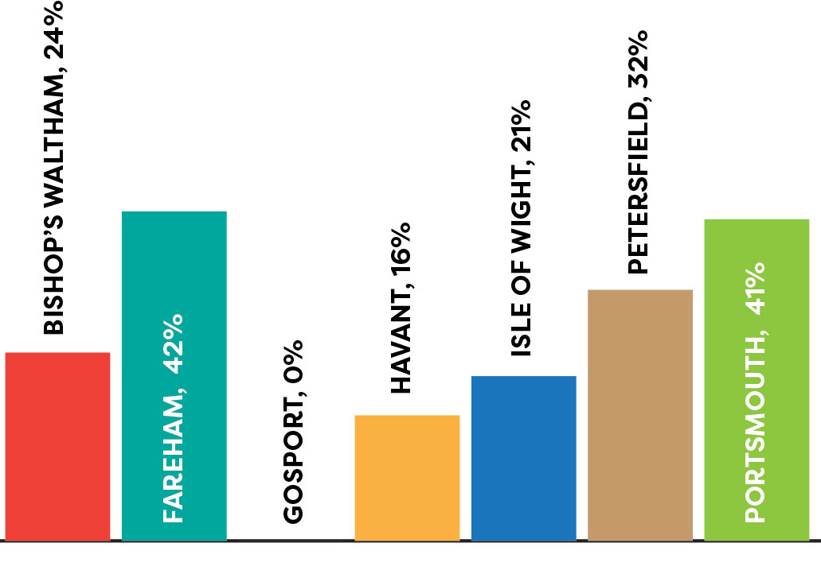
Energy Footprint Tool
Current overall submissions: 25%
Deadline: June 30th

