Slide 1
Meet Some of Our Diocesan Staff Agenda Item 7

Slide 2
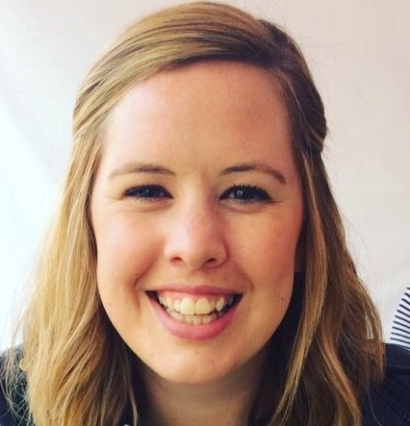
Bethan Fogell, children and youth work adviser
My job: Support for parishes and C of E schools in engaging with children and young people, and equipping them in ministry
‘I enjoy it because…
I’m meeting people who are doing ministry in a range of different contexts and seeing the difference they are making in the lives of children and young people.’

Slide 3
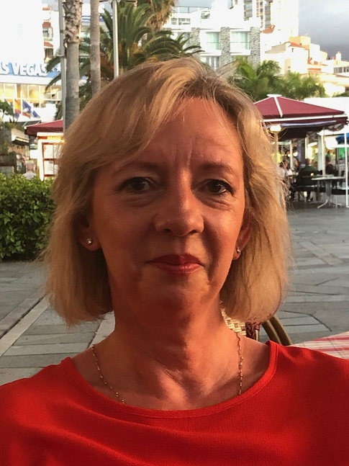
Karen Stubington, schools building assistant
My job: Assisting with capital projects in church schools across Portsmouth and Winchester dioceses
‘I enjoy it because…
I love spreadsheets and working with figures. There’s a sense of achievement and purpose about doing something worthwhile, alongside some lovely people.’

Slide 4
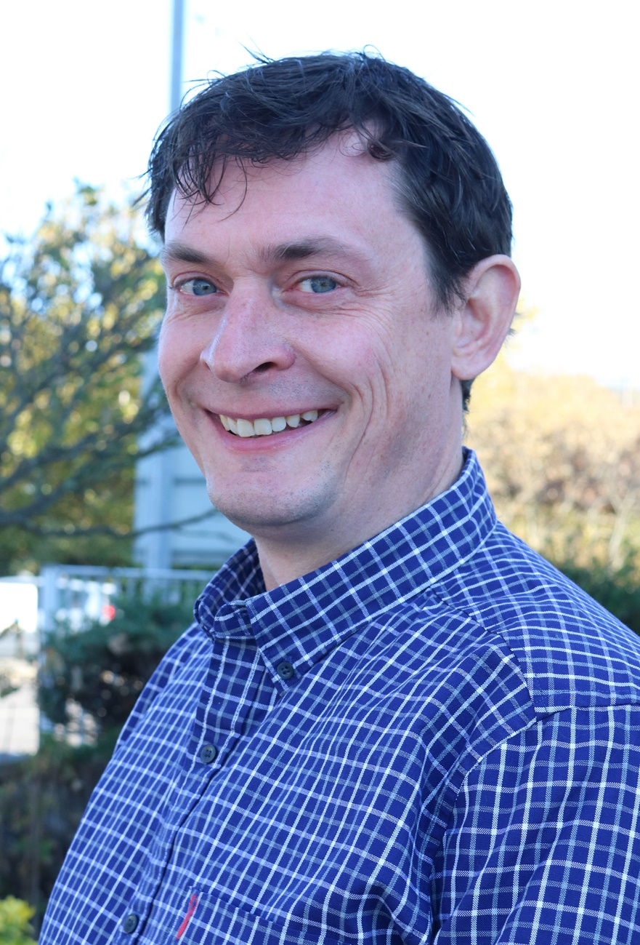
Matt Lockwood, diocesan webmaster
My job: Updating and editing the diocesan website, creating & distributing the eBulletin, managing social media, graphic design
‘I enjoy it because…
I love being part of something that has such a strong sense of mission and purpose, and I like the opportunity to use my skills to help further that mission.’

Slide 5
Elaine Allman, finance assistant
My job: Dealing with invoices, sales ledgers, parish share payments, parochial fees, paying Gift Aid to parishes, and dealing with accounts for the Council for Social Responsibility, Good Neighbours Network, diocesan property and school building projects
‘I enjoy it because…
of the variety involved. I can be dealing with PCC treasurers, building contractors, specific parishes and anyone in the diocesan office’

