Slide 1
Meet some of our diocesan staff

Slide 2
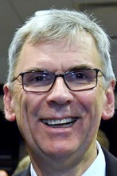
Chris Parker, stewardship adviser
My job: Helping parishes to promote stewardship campaigns, gift aid schemes and effective Christian giving
‘I enjoy it because…
I’ve only just started, but I’m looking forward to supporting parishes in their mission by advising them about stewardship and planned giving.’

Slide 3
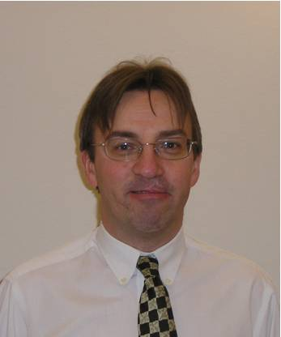
David Marles, regional IT manager
My job: Helping diocesan staff with hardware and software requirements across Portsmouth, Winchester and Guildford dioceses
‘I enjoy it because…
I’m helping everyone else in the diocesan, bishops’ and archdeacons’ offices to be able to do their jobs .’

Slide 4
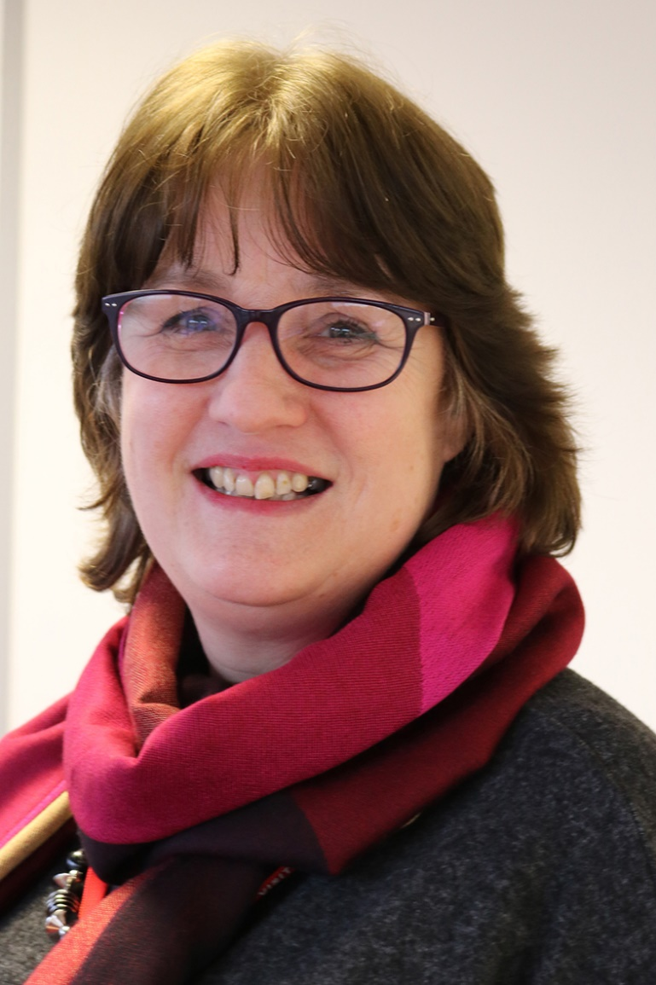
Jane Kelly, RE consultant and SIAMS co-ordinator
My job: Advising schools and academies about the teaching of Religious Education, and Statutory Inspection of Anglican and Methodist Schools (SIAMS), which looks at their ethos as church schools
‘I enjoy it because…
I love the variety of my job, I have met so many inspiring teachers across the diocese. The thing I love best about RE is finding interesting ways for children to explore big questions.’

Slide 5
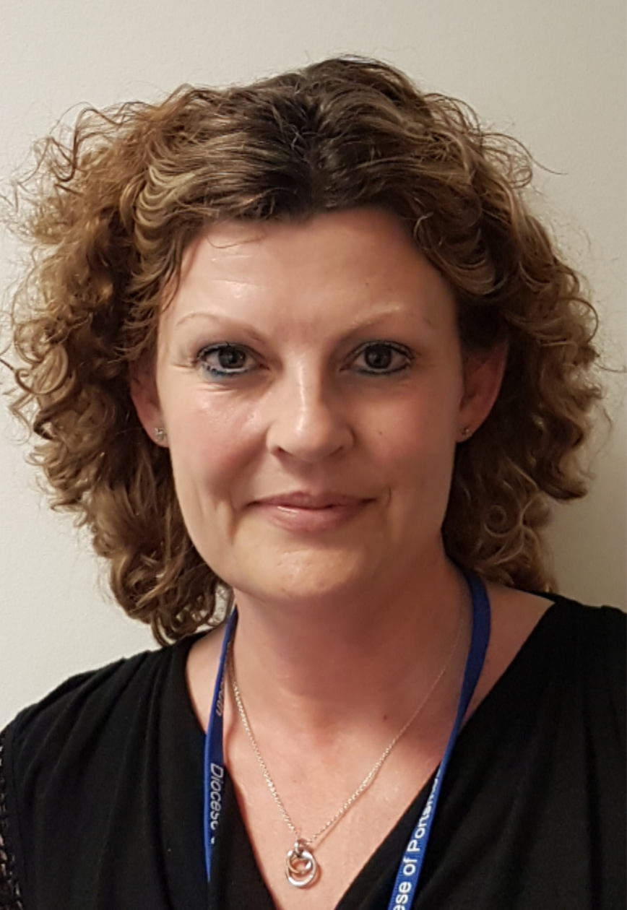
Jill Kingston, safeguarding trainer
My job: Runs safeguarding training in various locations around the diocese and advises parishes on safeguarding issues
‘I enjoy it because…
I want people to meet Jesus, so I feel called to help parishes get things right behind the scenes. That will encourage people to come to church and help parishes to move forward with their mission to others.’

