Slide 1
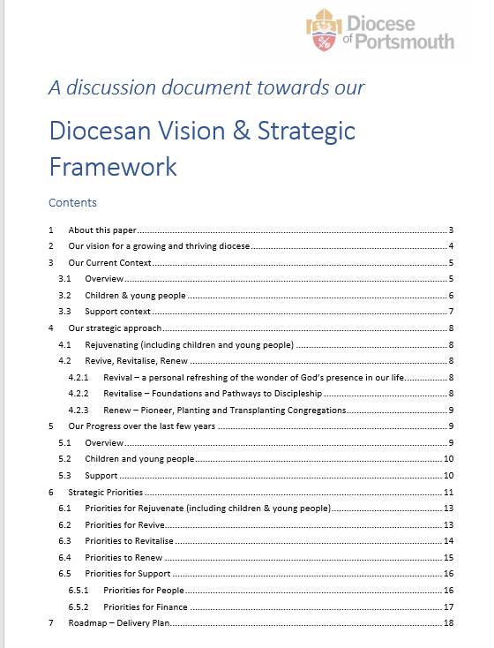

Slide 2
Our vision for a growing and thriving diocese is to be
a rejuvenating community of
Jesus-Centred,
Kingdom-Seeking
disciples

Slide 3
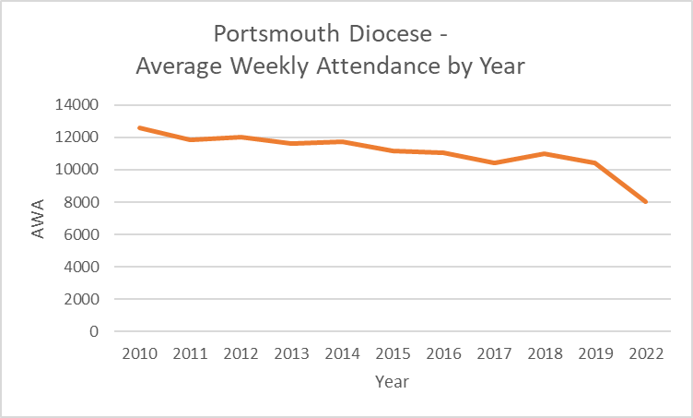

Slide 5
Our Challenges
we have declining attendances,
progressively older churches and a general absence of children and young people in our congregations
buildings that are often below par for mission
stretched staff, and
a gap between the costs of our ministry and our income.

Slide 6
Our Strategic Framework…
with children and young people at the heart of plans to
Revive
Revitalise
Renew
our leadership and churches

Slide 7
Our Strategic Framework…
with children and young people at the heart of plans to
Revive
Revitalise
Renew
our leadership and churches

Slide 8
REJUVENATE - children & youth at heart of our plans
Revitalise
àThriving churches with rejuvenating congregations
Renew
àNew congregations capable of self-sustaining and reproducing
Revive
àFlourishing clergy, working with other, with a thriving faith, overwhelmed by God’s love, marked by a prayerful and missional culture
Diocesan Support

Slide 9
REJUVENATE - children & youth at heart of our plans
Revitalise
àThriving churches with rejuvenating congregations
Renew
àNew congregations capable of self-sustaining and reproducing
Revive
àFlourishing clergy, working with other, with a thriving faith, overwhelmed by God’s love, marked by a prayerful and missional culture
Diocesan Support

Slide 10
Clusters
no one alone in ministry
collaborative ministers who:
  Pray, eat, laugh, lament… and do a bit of work together

Slide 11
who would be in a cluster?
shaped by Area Deans and their Parish colleagues:
Phase 1 – Clergy
Phase 2 – Clergy and Lay Leaders

Slide 12
REJUVENATE - children & youth at heart of our plans
Revitalise
àThriving churches with rejuvenating congregations
Renew
àNew congregations capable of self-sustaining and reproducing
Revive
àFlourishing clergy, working with other, with a thriving faith, overwhelmed by God’s love, marked by a prayerful and missional culture
Diocesan Support

Slide 13
REJUVENATE - children & youth at heart of our plans
Revitalise
àThriving churches with rejuvenating congregations
Renew
àNew congregations capable of self-sustaining and reproducing
Revive
àFlourishing clergy, working with other, with a thriving faith, overwhelmed by God’s love, marked by a prayerful and missional culture
Diocesan Support

Slide 14
Revitalise
develop a skill-base of people to come alongside
health & vitality
pathways of discipleship
UNCONNECTED | FRINGE | CONGREGATION | COMMITTED

Slide 15
Revitalise
choir church
school chaplains in partnership with our CSR
invest in areas of extraordinary potential
invest in areas of disadvantage
develop pipe-lines for leadership

Slide 16
REJUVENATE - children & youth at heart of our plans
Revitalise
àThriving churches with rejuvenating congregations
Renew
àNew congregations capable of self-sustaining and reproducing
Revive
àFlourishing clergy, working with other, with a thriving faith, overwhelmed by God’s love, marked by a prayerful and missional culture
Diocesan Support

