Slide 1
Clergy & Lay Conference 2021
Our Missional & Financial Context
Notes:
Point out that the slides will be circulated and the narrative will be cover the points so don’t worry about making notes.

Slide 2
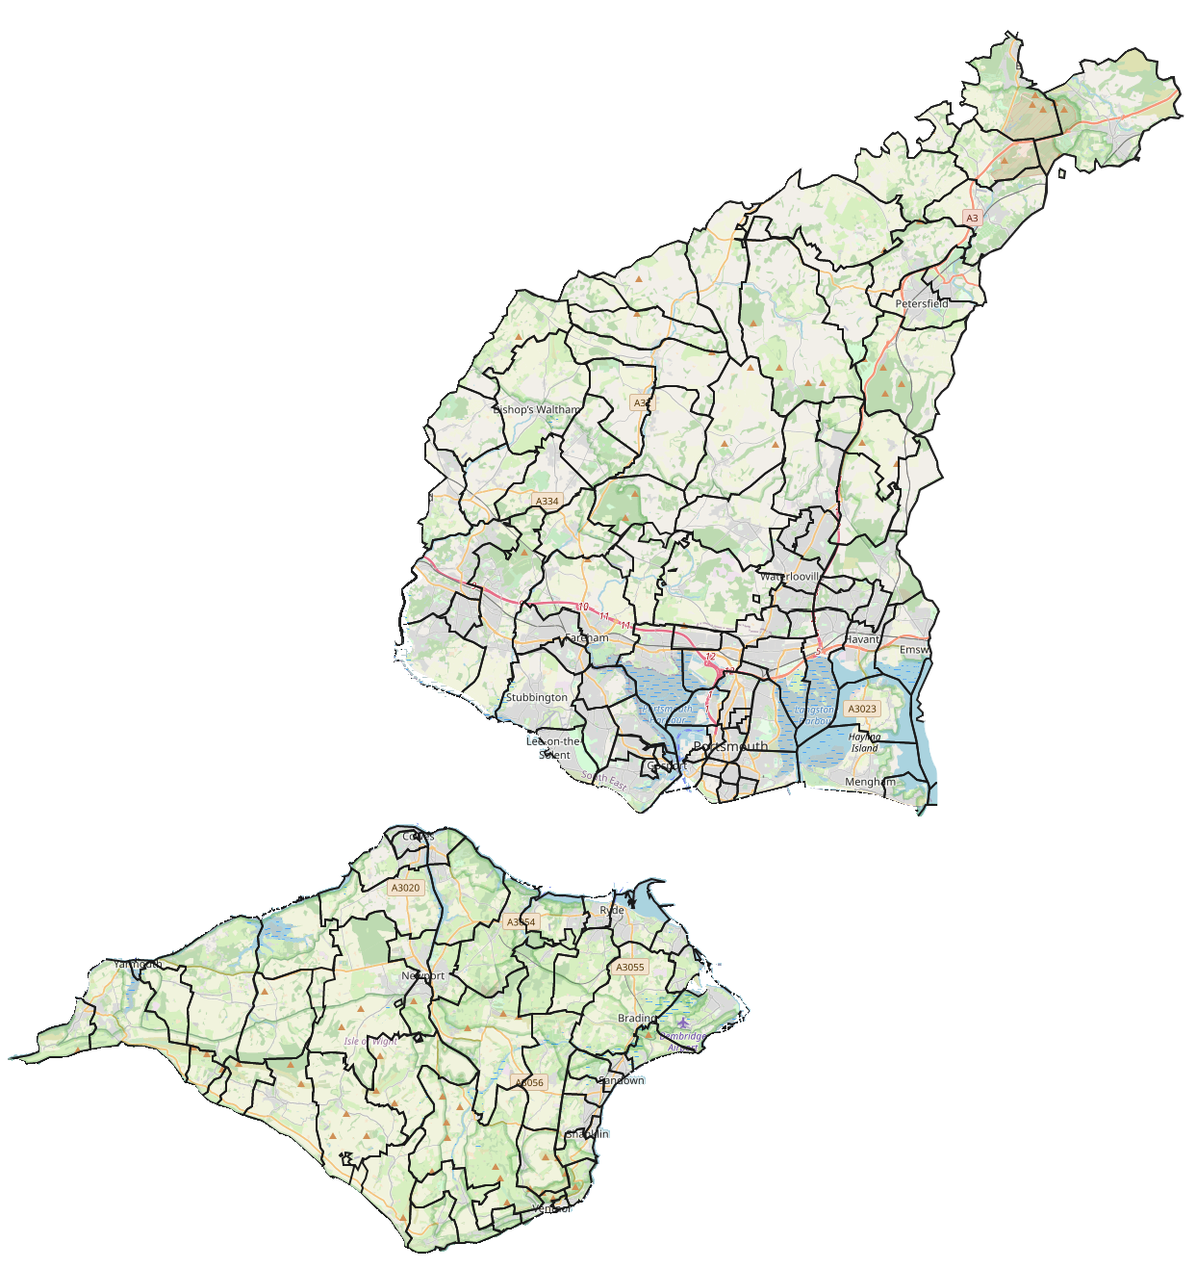
Our context
1989
Population: 694,000
Attendees: 16,200
Clergy: 138
Parishes: 137
Church Buildings: 172
Clergy per 10,000 People: 2.0
2019
Population: 790,000
Attendees: 8,900
Clergy: 86
Parishes: 133
Church Buildings: 167
Clergy per 10,000 People: 1.1
Change
+14%
-45%
-38%
-3%
-3%
-45%
Just cutting clergy has not made the diocese more sustainable as the number of givers has declined faster
The diminishing number of clergy have been spread across a broadly static number of parishes and buildings
A diminishing number of attendees are required to fund the historic ministry structures
Notes:
Talk through the slide
Then focus on clergy numbers
Our diminishing number of incumbents (95 to 85 from 2010 to 2018) and laity, worship leaders and officers have been continually stretched further and further to maintain and fund historic ministry structures. Churches are finding it harder to find suitably experienced and knowledgeable people to fill governance roles, with many unable to elect full PCCs or fill key statutory roles: 19% of our parishes only have one churchwarden, while a further 2% have no churchwarden at all; 8% of our parishes do not have a PCC Secretary; and 2% of PCC Treasurer posts are vacant.

Slide 3
Ageing Congregations
Notes:
The 2018 British Social Attitudes survey stated that only 1% of people aged 18 – 24 identify as Church of England, and even in those over the age of 75 only one in three identify as Church of England. In Portsmouth Diocese a 71-year-old is eight times more likely to go to church than a 15-year-old. Portsmouth Diocese has 155,000 children but only 1,900 of these are church going (0.6%) which is below the national average.

Slide 4
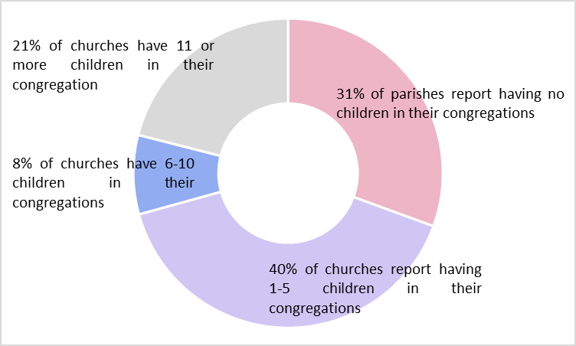
Ageing Congregations

Slide 6
The Current Financial Challenge
Notes:
Covid has had a significant impact on the finances of our parishes and diocese. For the year ended 31 December 2020 the general fund had a deficit of £351k, prior to consideration of exceptional one off Covid related income. Furlough claims received from the government totalled £164k and reduced the deficit to £187k. This is compared to a budgeted deficit of £226k (2019: deficit of £311k).
The diocese was generously supported the Archbishop’s Council with a sustainability grant of £600k in 2020. This has been transferred to a designated fund so that it can be used in the future to match expenditure that has been deferred from 2020 to future years due to Covid e.g. quinquennial repairs.
A shortfall of £187k for the year 2020 was achieved through:
i. parishes surpassing collection rates at 89.8% compared to the initially anticipated best case
of 65% (projected best case increased to 85% towards the end of the year)
ii. a much-reduced level of activity and closely managed expenditure giving rise to savings of £995k.
iii. significant use of the government furlough scheme and some non-furloughed staff members making voluntary salary sacrifices. The furlough reclaim from the government totalled £164k in 2020 (our use of the scheme ended after restructure of diocesan office November 2020).
These expense savings are one off and not expected to reoccur in 2021 at this level of magnitude
now restrictions are lifted and normal activity resumes.
The diocesan budget for 2021 was set on the following principles:
• Total parish share request would be set based on actual parish share payments received in 2019. (Reduction of £248k from 2020 total parish share request)
• No clergy or lay staff cost of living increases for 2021.
• Clergy housing budget held at 2020 levels, pending a review of the property portfolio.
• Bishop’s Council agreed to re-designate some designated funds to meet funding gap: Car Loan Fund; Diocesan Loan Fund; Office Repair Fund see Appendix 5 below for more details.
The 2021 budget has an operating deficit expected of £972k. However, over the first 7 months the parish share payments received have been between 1% and 2% lower than the same months in 2020. While this is showing signs of improvement, it is still lagging behind the same time last year.

Slide 7
Parish Share v Inflation
Notes:
Efforts have been made to keep parish share in line with CPI. There have been years when increases were below CPI and others where it has been above, but it has broadly been inline for the last ten years.

Slide 8
History of Parish Share Receipt
Notes:
Despite the efforts to track inflation and keep the increases each year within that range, over the past two years we have seen an increase in the gap between the ask and receipt. Clearly this gap increases the challenge on the DBF to meet essential costs of clergy and staff
• Vacancy rate increases - The vacancy rate has increased from 7.7% to 11% from 2010 to 2016 and has been maintained at that level.
• Reduction in clergy numbers - Sheffield numbers required a reduction in 5 stipendiary posts in 2011 and a further 2.5 in 2012. A further 1.5 posts on the IOW were reduced in the 2018 budget.
• Stipend levels - In 2012, there was a significant national minimum stipend (NSM) increase of 4.6% but the cost of this to parish share was offset by the reduction in clergy numbers above. With this exception all of the clergy stipend annual cost of living increases have been between 1% and 2% over the rest of the period from 2011 to 2020.

Slide 9
Parish Ability to Pay Parish Share 2021
Responses from Deanery Parishes to date (7 July 2021)
Deanery Response Rate (%) Allocation Prediction % of Allocation
Bishop's Waltham 100% 464,444 464,444 100.00
Fareham 100% 791,118 748,826 94.65
Gosport 75% 373,026 272,285 72.99
Petersfield 93% 571,748 504,218 88.19
Havant 91% 988,042 817,749 82.76
Portsmouth 89% 646,775 578,031 89.37
Isle of Wight 94% 1,042,265 664,973 63.80
Totals 92% 4,877,418 4,050,525 83.05
We might also reasonably expect full payments from the some of the non-responsive Parishes (to date):
Total 47,707
Revised Estimate 4,098,232 84.02

