Slide 1
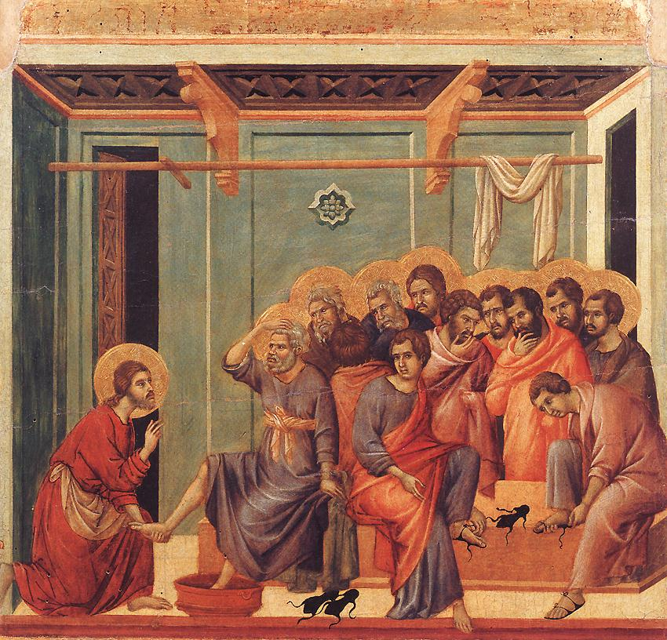

Slide 2
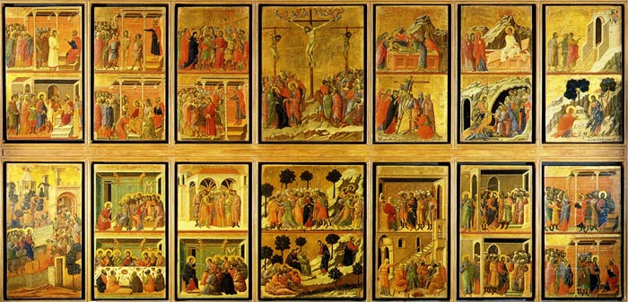

Slide 3
Jesus wrapped a towel round his waist and filled a basin with water. Then he started to wash his friends’ feet. Normally a servant would wash the dust from their feet before they sat down to a meal. Jesus knew how strange it would seem to his friends that he was doing it now.
‘I won’t let you wash my feet,’ said Peter, as Jesus prepared to do just that.’
‘Peter if I don’t wash your feet, you cannot be my friend.’
‘Then don’t just wash my feet – wash all of me!’ said Peter.
‘There’s no need,’ Jesus replied, ‘Only your feet are dirty.’
When Jesus had finished, he returned to the table with his disciples.
‘Do you understand what I have just done?’ Jesus asked them. ‘I am your teacher, but I have just done the job of a servant. I want you to treat each other with the same love and respect. Follow my example.’
Barnabas Schools’ Bible.

Slide 5
