Slide 1
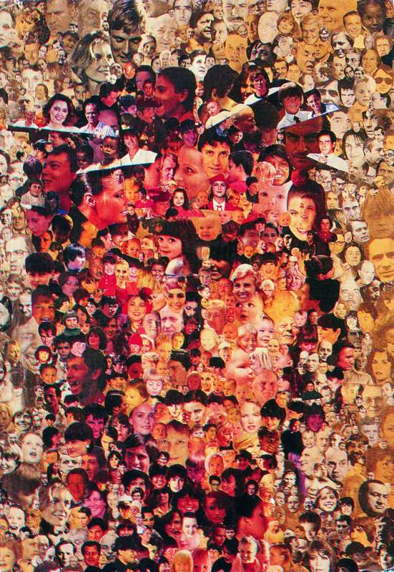
‘Je Cherche ton Visage.’
(I search for your face.)
Anonymous

Slide 2
Do you agree that we can see God
in other people?
What does this mean?
Do you think we would treat people differently if we believed we could find
God in them?
In what way?

Slide 3
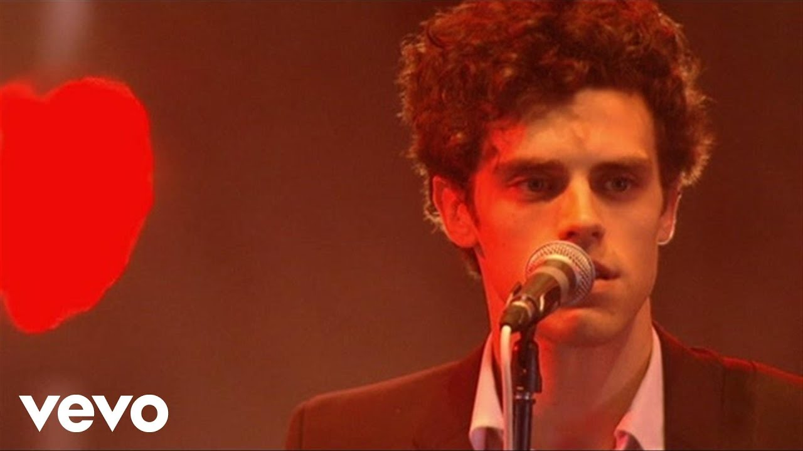
‘Give a little love.’ Noah and the Whale.

Slide 4
‘If you give a little love, you can get a little love of your own.’
What do you think this means?
What could you do to ‘give a little love’ to people around you?

