Slide 1
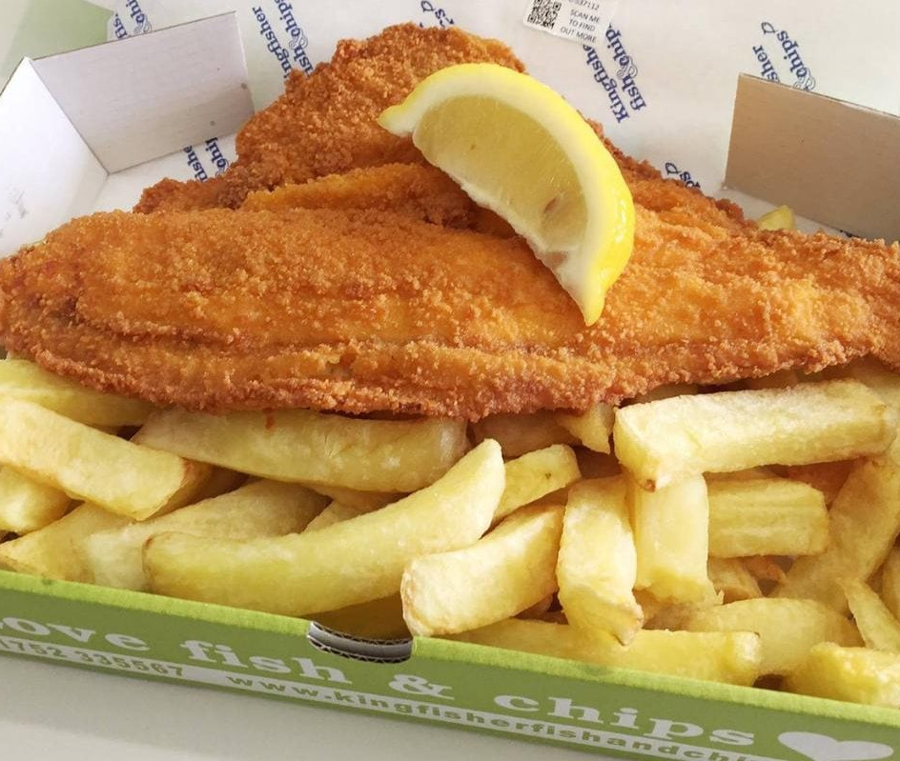
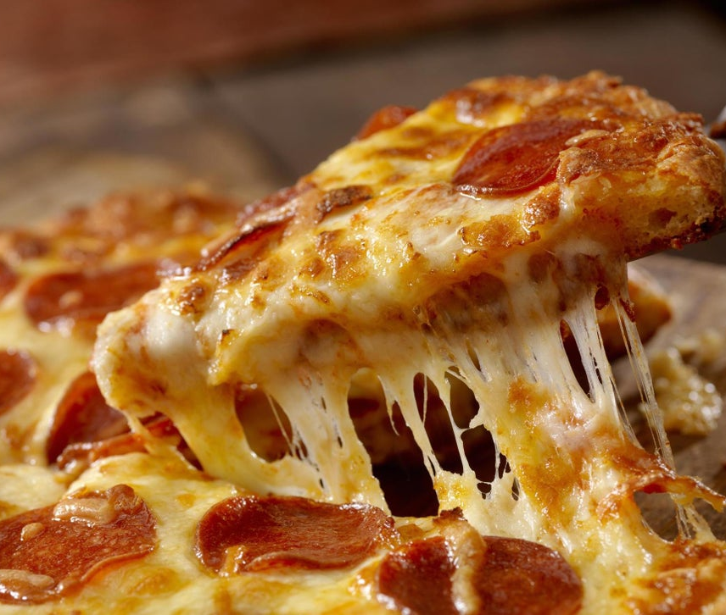

Slide 2
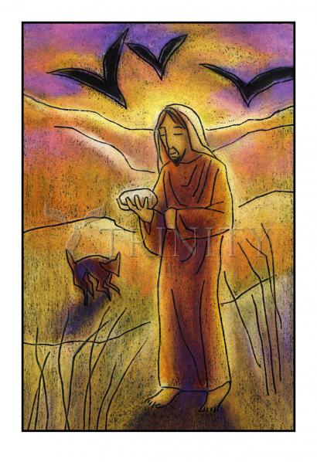
What do you think is happening in this picture?
What do you think Jesus is thinking or feeling?
What would be a good title for the painting?
What do you think the artist is trying to say about Jesus in the wilderness?
‘Christ in the Desert’
Julie Lonneman

Slide 3
After his baptism, Jesus was led by God’s Spirit into the desert. He went without food for forty days and at the end of this time Jesus was weak and very hungry.
God’s enemy, the devil, tried to test Jesus.
‘You need food,’ he said. ‘If you are God’s Son, you can make this stone turn into bread.’
‘Life is more than just food,’ replied Jesus, quoting God’s law.
The Barnabas Schools’ Bible

Slide 4
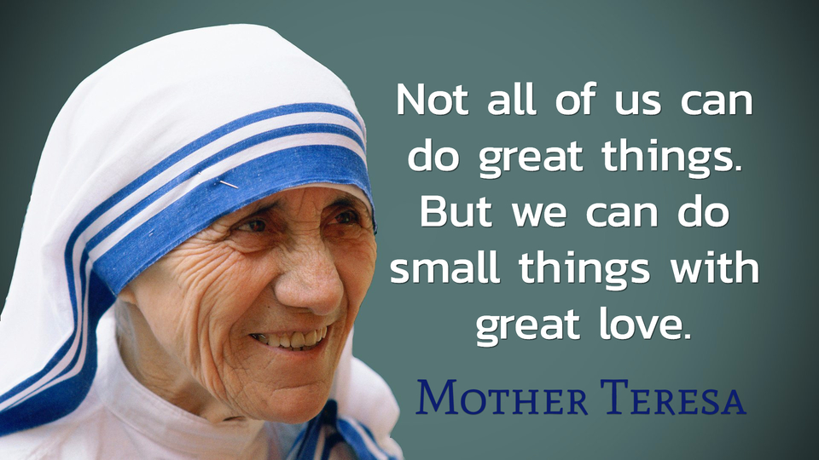

Slide 5
