Slide 1
Reimagining Lay Ministry in the Diocese of Portsmouth

Slide 2
Locally Recognised Lay Ministry
Authorised
Lay Ministry
Licensed Lay Ministry

Slide 3
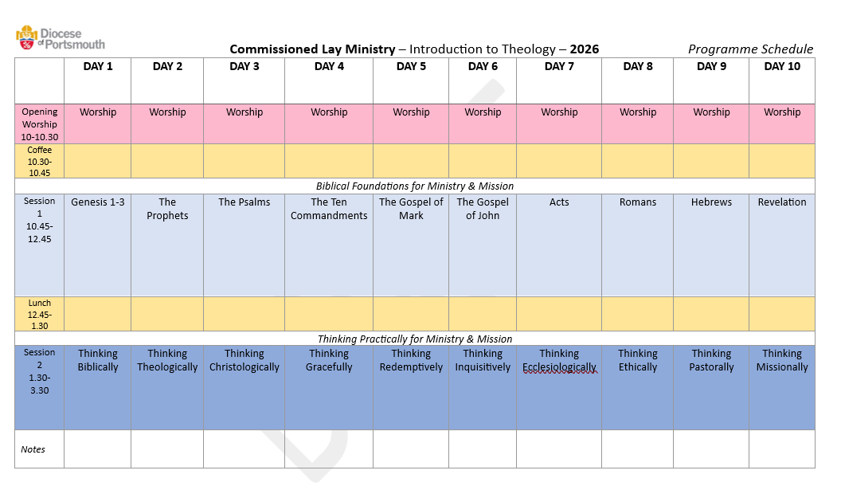
Authorised Lay Ministry – Introduction to Theology

Slide 4
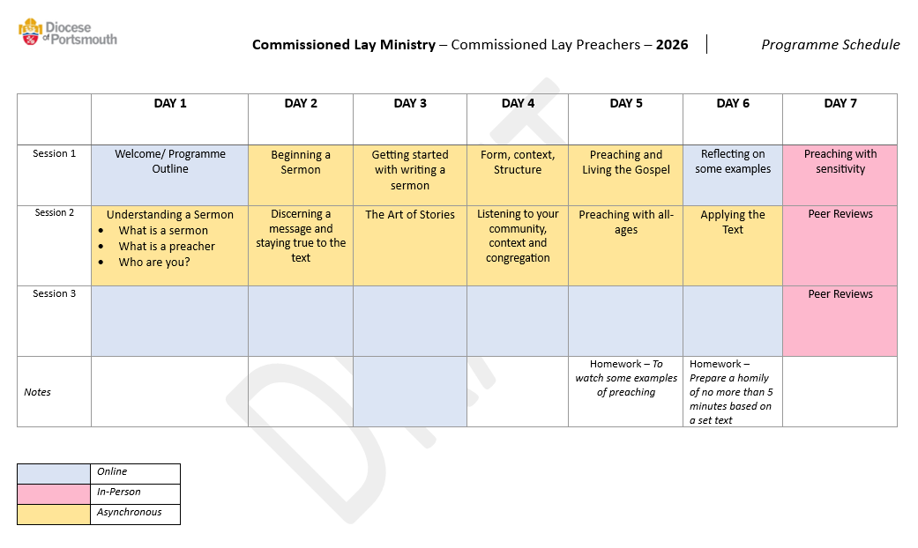
Authorised Lay Ministry – Authorised Lay Preacher

Slide 5

Shaping of content – including recommendations/requests for training needs
Teachers, Tutors, Facilitators
Any Questions?

