Slide 1
Informal Consultations on draft proposals

Slide 2
COMMITMENTS FOR TODAY’S MEETING
holding each other before God in prayer
praying for the presence and guidance of the Holy Spirit
learning together from Scripture and from each other
enabling everyone to speak, making space for those whose voices have not yet been heard to contribute, without putting people on the spot if they don’t wish to speak
avoiding interrupting each other, instead acknowledging what others say before moving on to have our say
keeping confidential anything personal that is shared
taking care about how we speak about others who are not in the room
looking out for and being sensitive to people’s feelings
giving each other time to reflect before sharing with others
learning together how we can live more fully in the way of Christ

Slide 3
This slide has been kept in to ensure the numbering of the slide pack in the guidance remains correct.

Slide 8
PROPOSAL ELEMENTS: ALL IN DRAFT
PLF opt-in under Canon B5
private use: regular worship: bespoke services
Pastoral reassurance through a form of delegated episcopal ministry
Clarity on timeline and process for consideration of removing restrictions clergy in SSM
Three-year period of discernment monitoring and reflecting on use of the PLF and take up of pastoral reassurance

Slide 9
HOW TO DECIDE TO OPT-IN TO THE USE OF PLF?
HIGH LEVEL SUMMARY - MORE DETAIL IN DRAFT GUIDANCE
A minister may decide
to consider using the
Prayers (in bespoke
services). This can be
prompted by pastoral
need or an active
request.
Minister & PCC have
conversation about
the use of the Prayers,
consulting the wider
church community
if desired.
Depending on the
outcome of the
conversation, a
minister can decide to
go ahead with bespoke
use of the Prayers and
registers this with the
Diocesan Bishop.
Optional: The church
adds a ‘PLF’ tag to
its account on
AChurchNearYou.com
Alternatively,
the minister does not
opt-in to the use of the
Prayers and no further
action is needed.

Slide 10
REQUESTING PASTORAL REASSURANCE
HIGH LEVEL SUMMARY - DETAILS IN DRAFT CODE OF PRACTICE
A PCC may request Pastoral Reassurance. The PCC should first speak to their diocesan bishop to understand different perspectives, ministerial needs, and concerns.
A PCC may request PR based on the bishop’s action taken or statements made, not on what a bishop is alleged to think. If a PCC wishes to proceed after step 1, they can make a decision by simple majority, following consultation with the wider worshipping community.
A PCC may then write to their diocesan bishop requesting Pastoral Reassurance, detailing their grounds for the request. The diocesan bishop responds within four to six weeks.
Pastoral Reassurance may be granted and the PCC’s request
may be made public alongside the bishop’s agreement.

Slide 12
Scales shown in Menti are: 1 (strongly agree), 2 (agree), 3 (neither agree nor disagree), 4 (disagree) to 5 (strongly disagree):

Slide 15
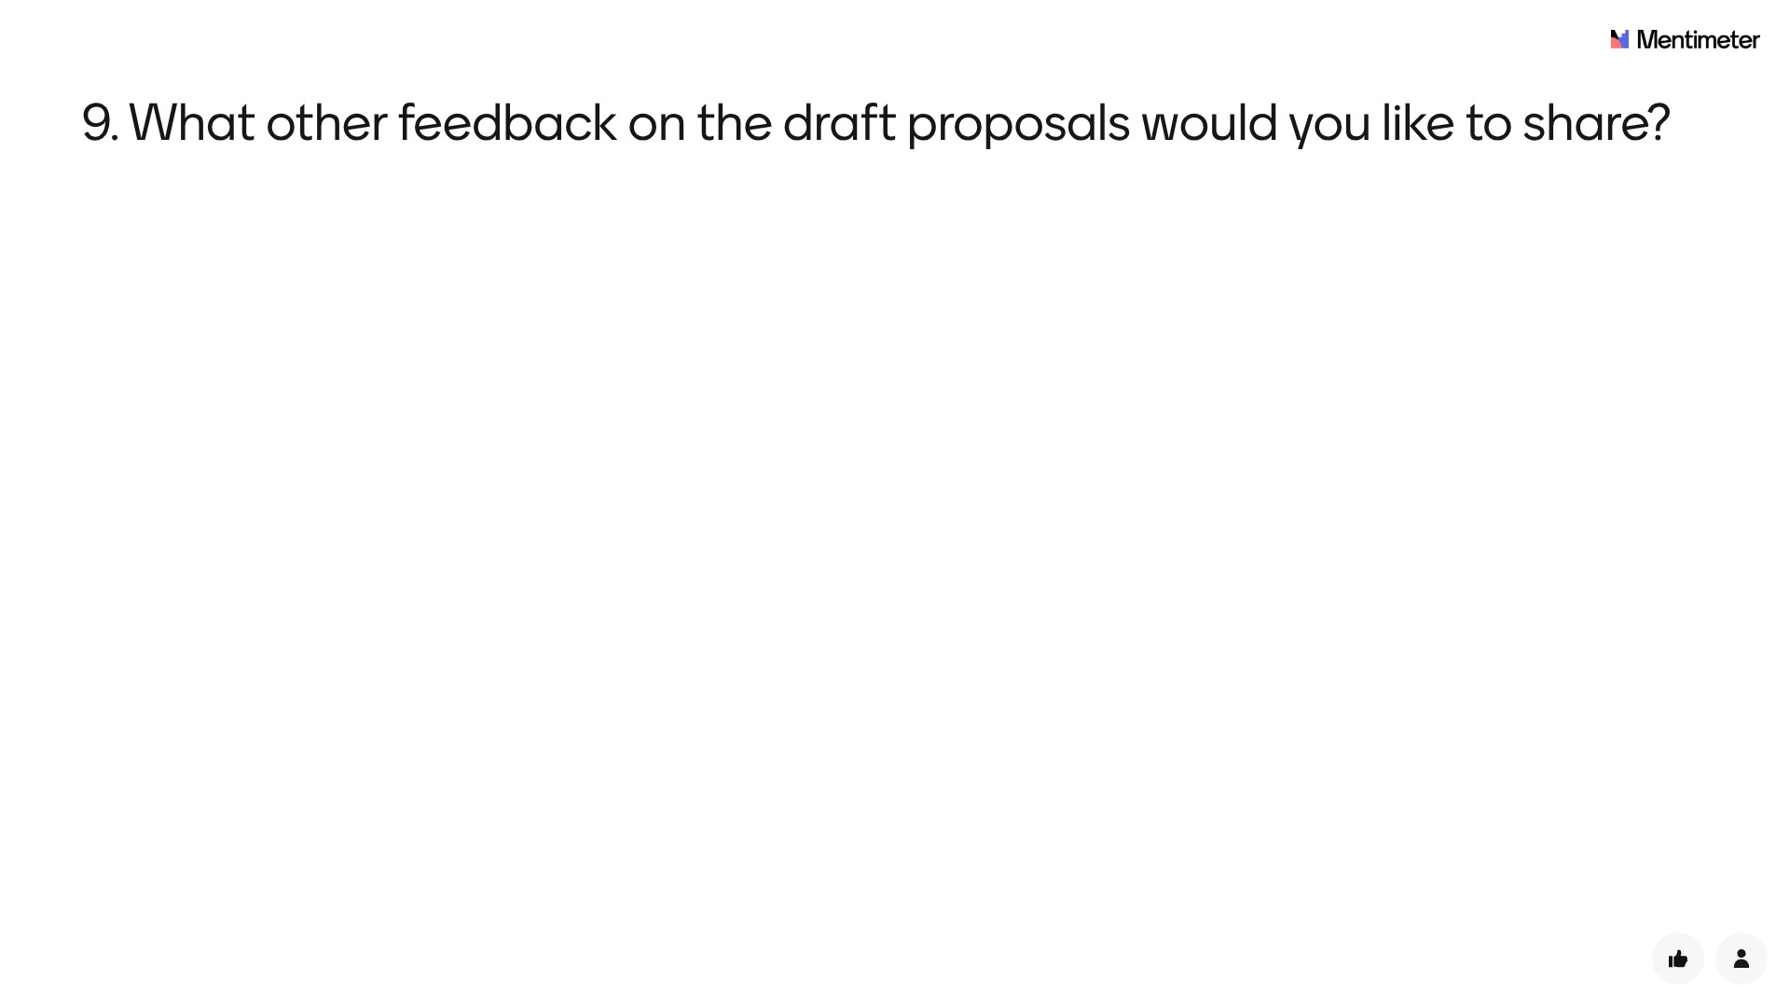

Slide 16
WHAT HAPPENS NEXT?
The feedback submitted will be used by the LLF Team & Programme Board to make any initial changes to the draft proposals for clarity.
A fuller report on the feedback will accompany any further draft proposals as these are considered by the House of Bishops and, if supported by the HoB, by General Synod.
Feedback gathered via Mentimeter is anonymous. Individuals or specific churches cannot be named and it is not possible to connect individual respondents to specific answers. High level, aggregated, data will be drawn together and reported by Diocese.

Slide 17
PLANNED TIMELINE

Slide 18
QUESTIONS AND FEEDBACK
The LLF team will host Zoom webinars for General & Diocesan Synod members to clarify any factual enquiries about the proposals:
Wednesday 11 June, 11am and 7pm
Wednesday 23 July, 11am and 7pm
Wednesday 17 September, 11am and 7pm
Please contact llf@churchofengland.org to register for the webinar or with any further feedback or questions.

Slide 19
Thank you for participating in this session

