Slide 1
Deprivation in the Diocese of Portsmouth (or isn’t data fantastic?)
Nick Ralph, Executive Director CSR

Slide 2
The Index of Multiple Deprivation
Is a Measure of relative wealth across England calculated since 2000
Based on 33,755 neighbourhood areas called Super Output Areas (SOAs). Previously based on 32,844 areas so not directly comparable.
Every area is ranked from 1 (most deprived) to 33,755 (least deprived).
Usually updated every 3- 4 years but none since 2019.
The latest data was published on 30th Oct 2025.
It is used by government and grant funders to determine areas in the top 10% and 20% of disadvantage that qualify for more grants and support than other places.

Slide 3
IMD and Domains
IMD is the overall score (100%). It is split into 7 domains:
1. Income Deprivation Domain 22.5%
2. Employment Deprivation Domain 22.5%
3. Education, Skills and Training Deprivation Domain 13.5%
4. Health Deprivation Domain 13.5%
5. Crime Domain 9.3%
6. Barriers to Housing and Services Domain 9.3%
7. Living Environment Domain 9.3%

Slide 4
Sub Domains
The Income domain has two sub-domains:
Income Deprivation Affecting Children Index (IDACI)
Income Deprivation Affecting Older People Index (IDAOPI)
These two do NOT add up to the whole Income domain.
The Education Domain has two sub domains:
Children and Young People (mainly lack of attainment at KS 2, 4, and absence)
Adult Skills (no qualifications/English)
There are some others, but these are most useful ones.

Slide 5
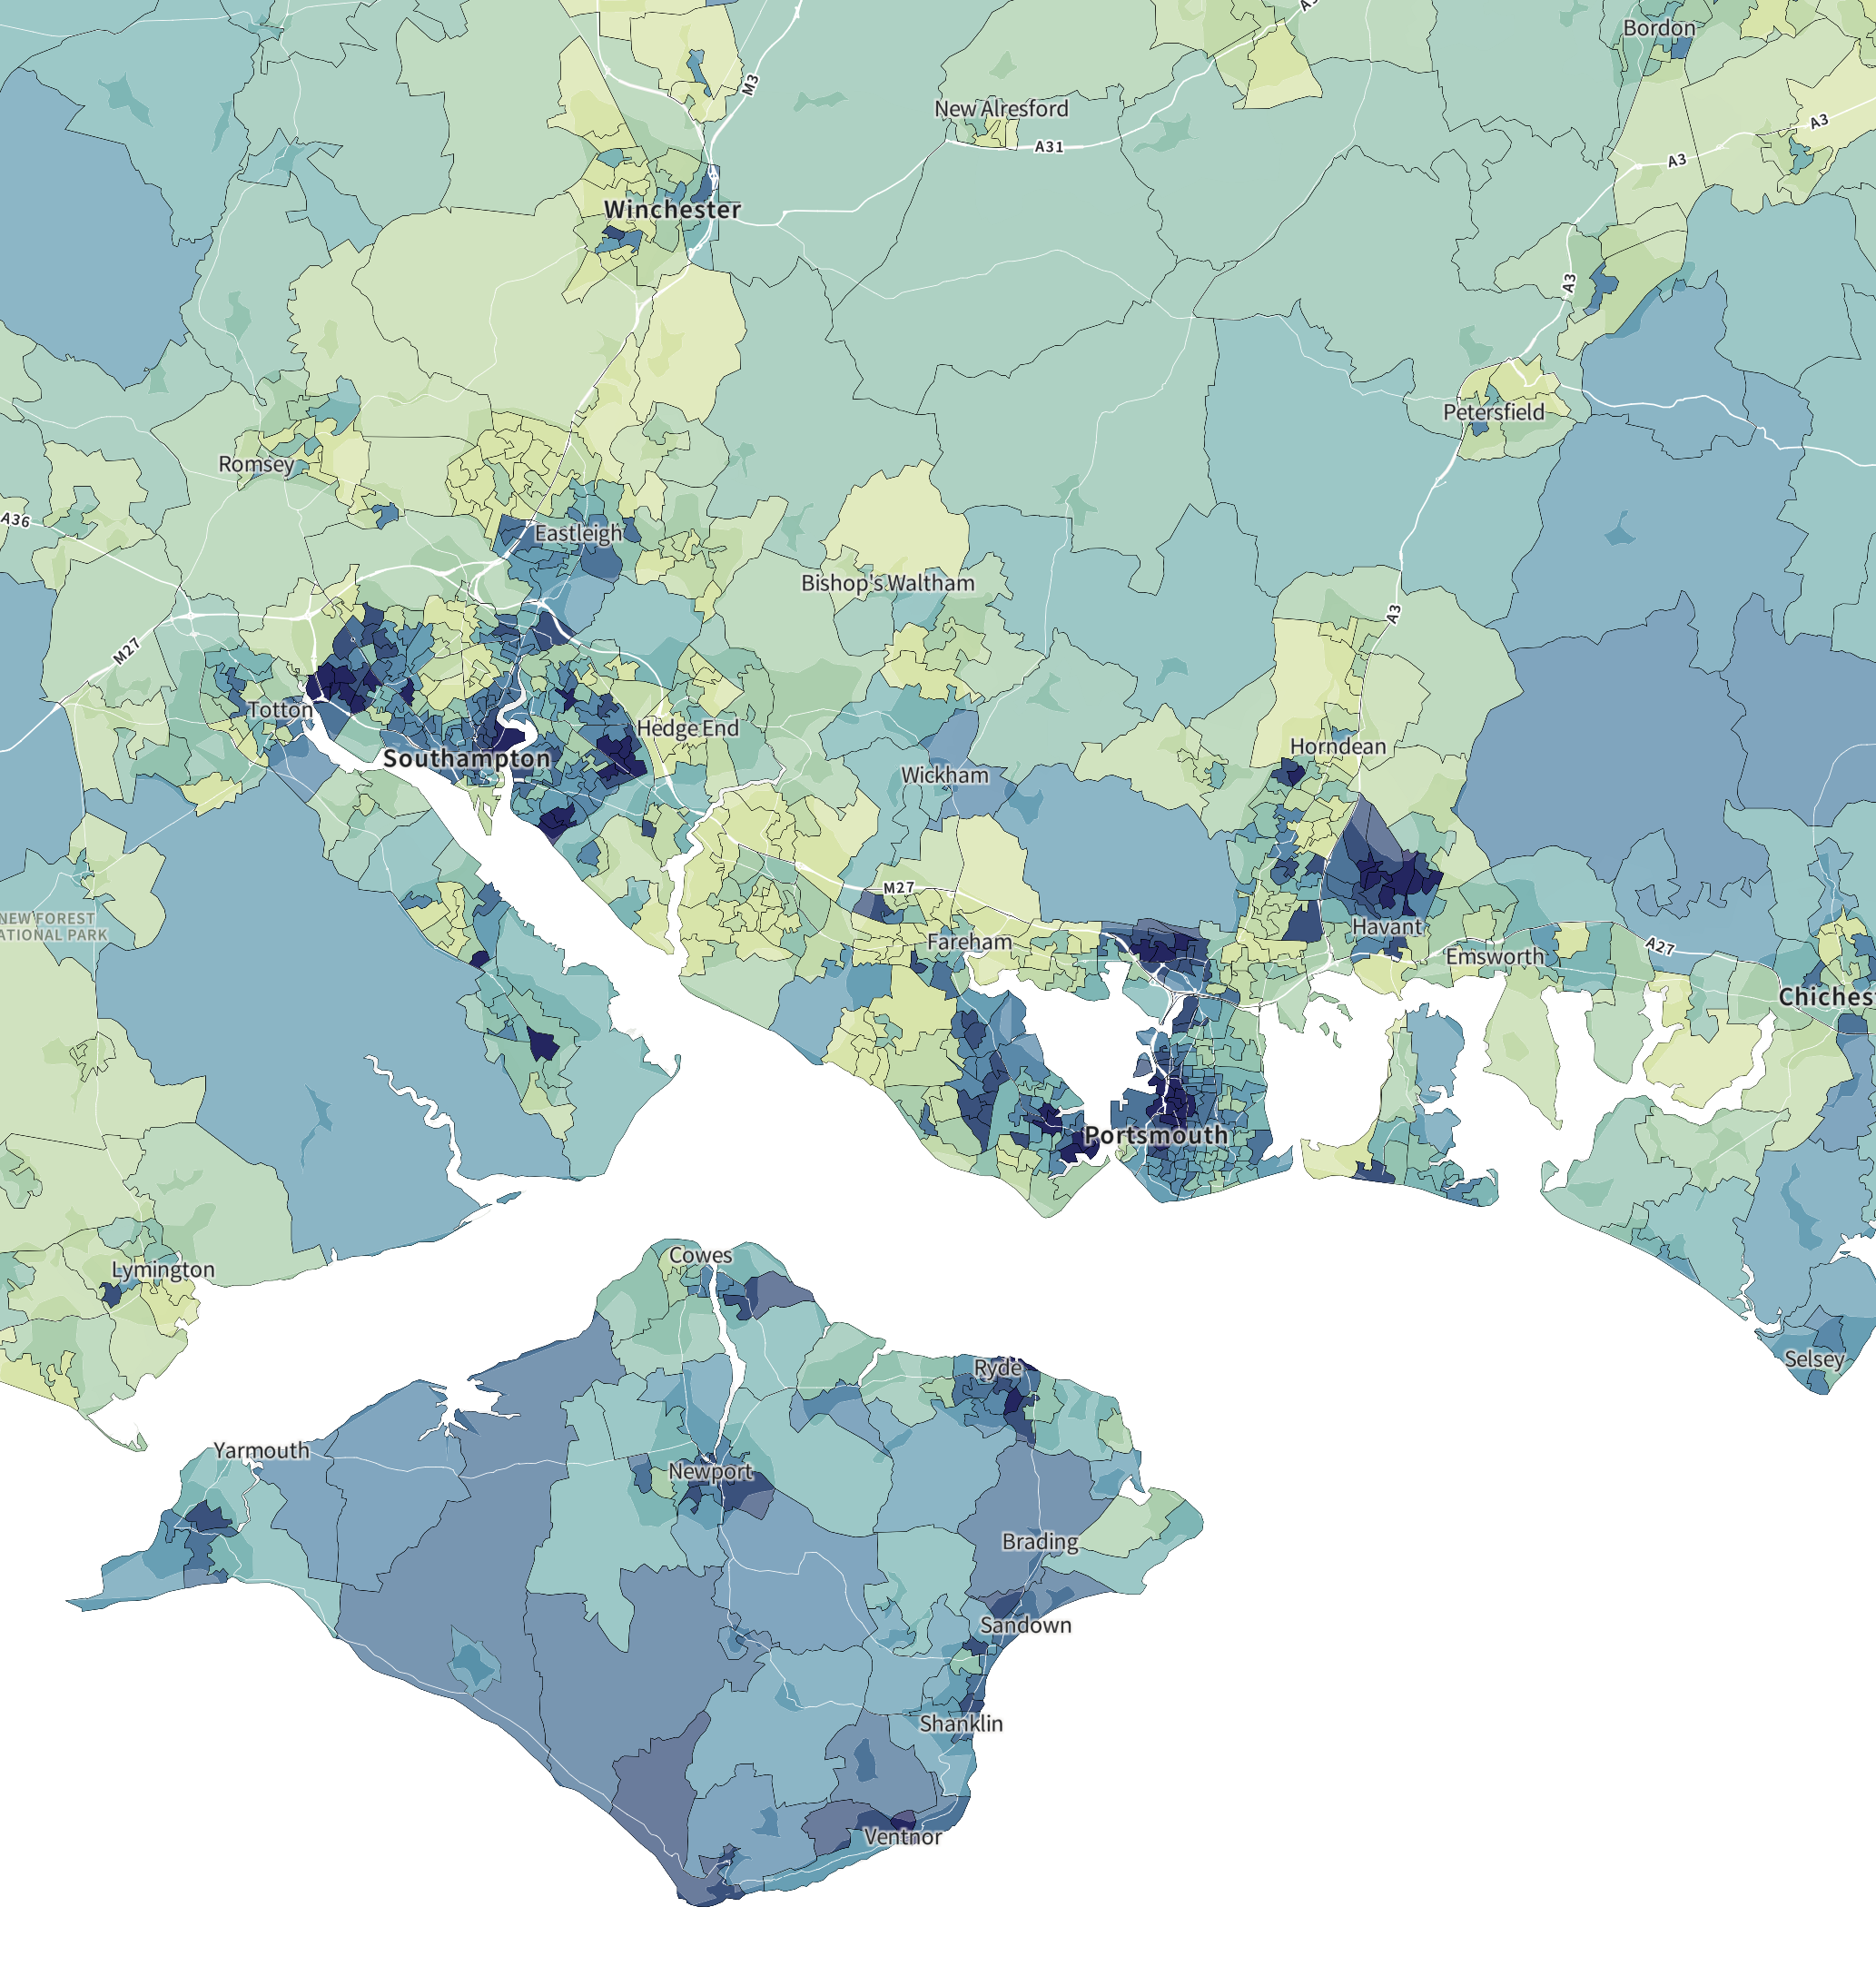
Local IMDs
Darker = more deprived
32 SOAs in top 10%
- of those 5 are in the top 1% of disadvantage.
52 in 10-20%

Slide 6
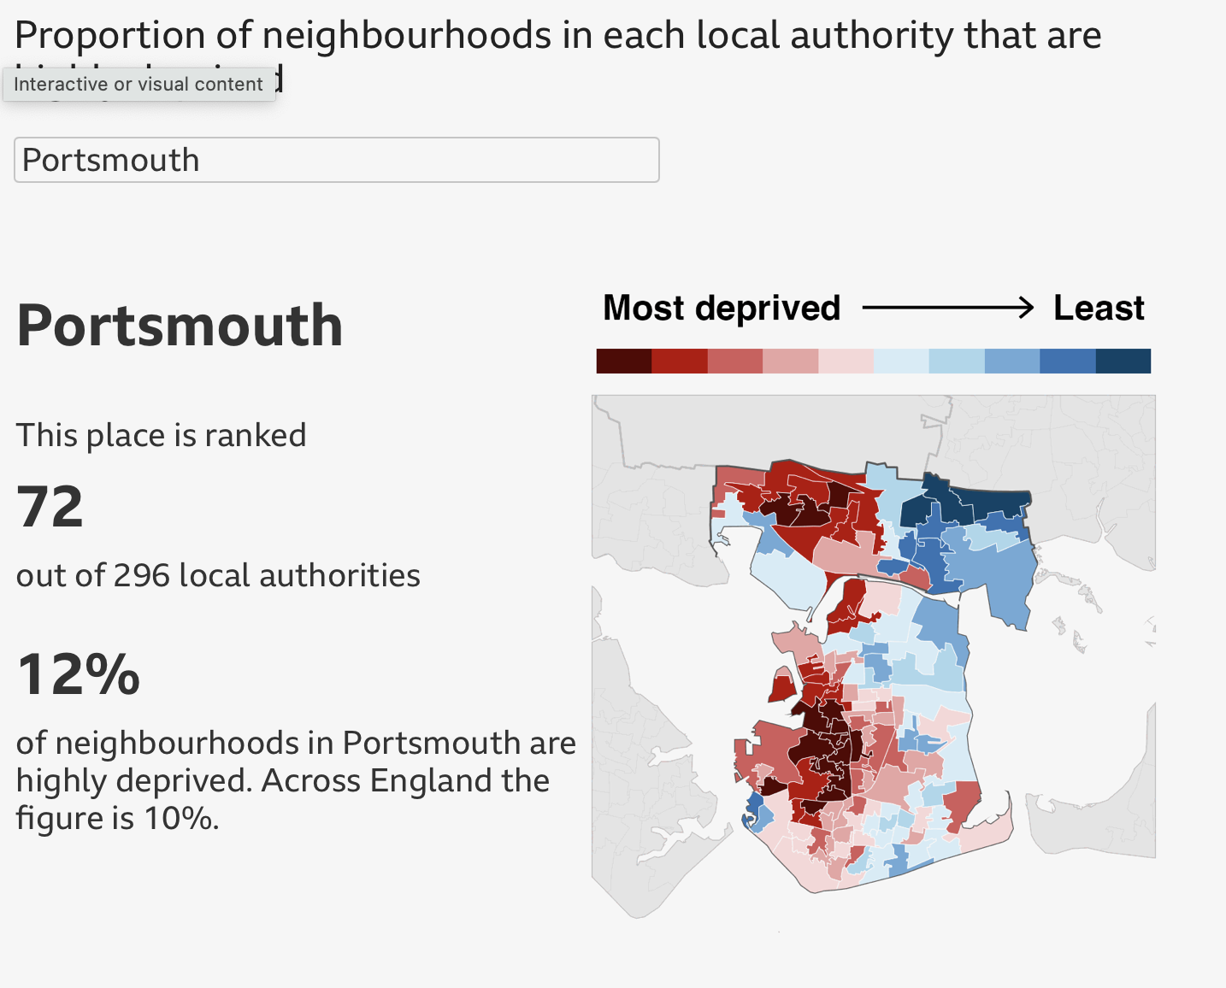
IMDs for Portsmouth City

Slide 7
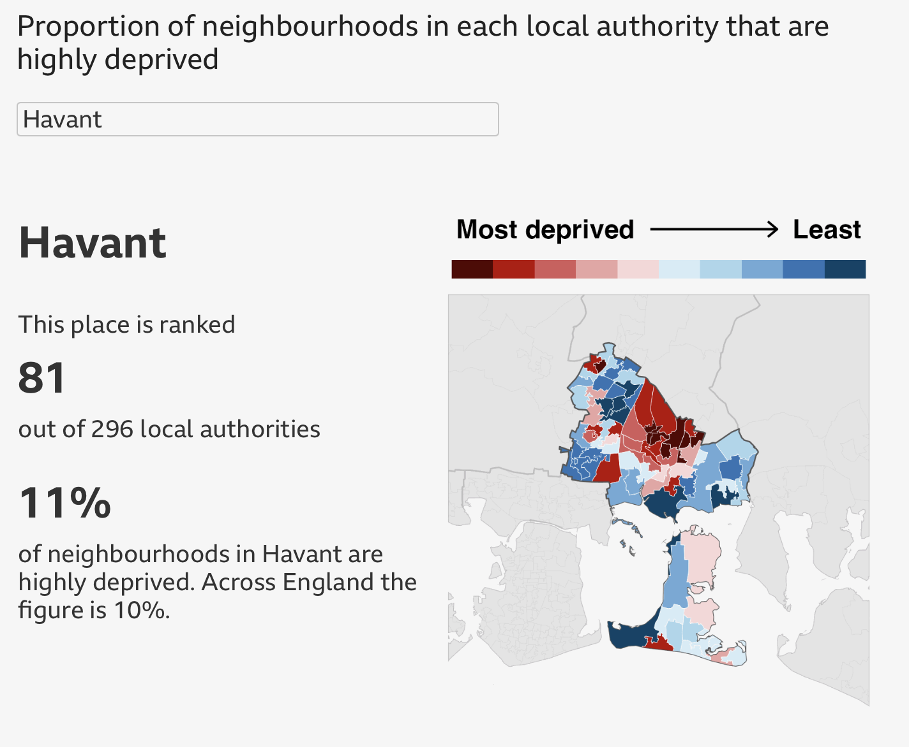
IMDs for
Havant Borough

Slide 8
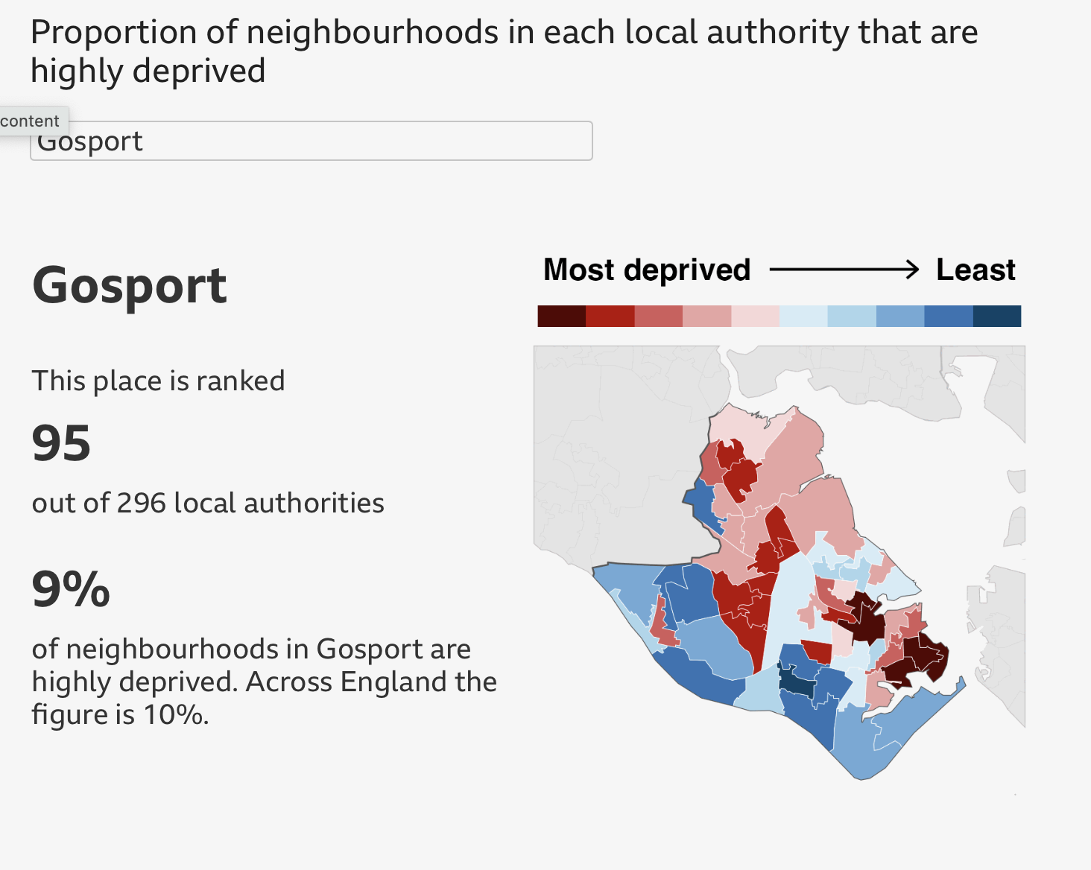
IMDs for
Gosport Borough

Slide 9
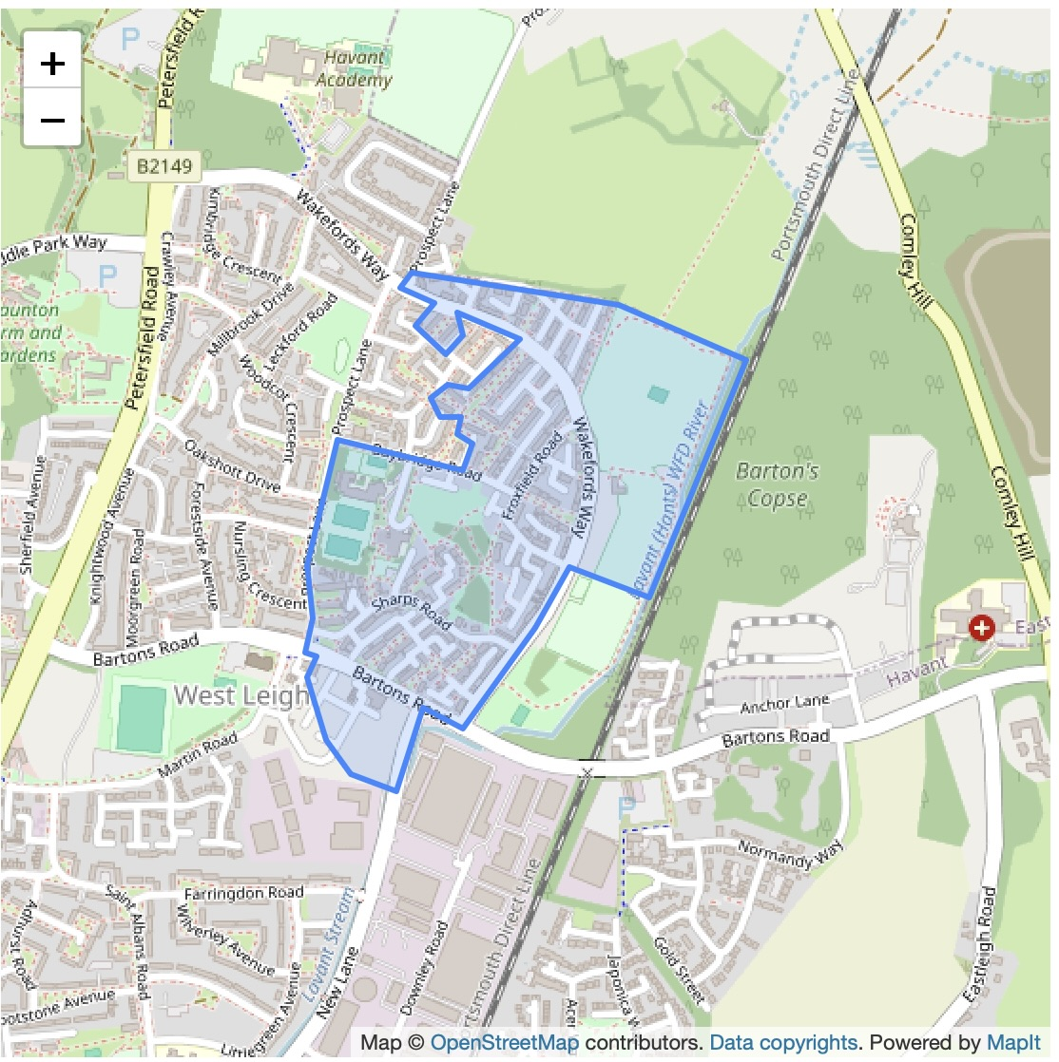
Havant (009C) in West Leigh is the 12th most deprived nationally on IDACI, our 33,755 SOAs.

Slide 10
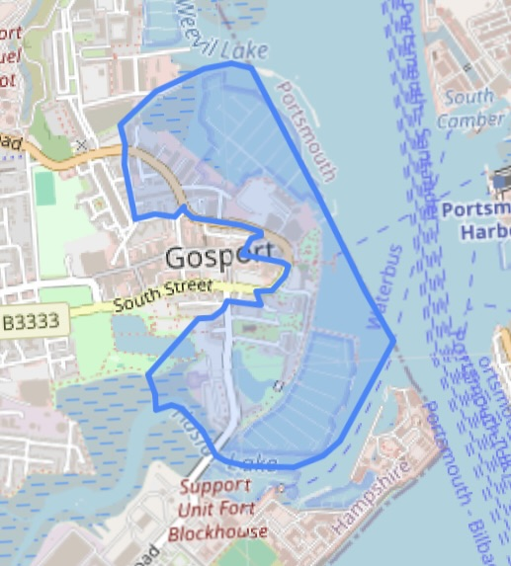
Gosport (008G) 57th most deprived on Children and Young People’s Sub domain out of 32,755 nationally

Slide 11
Some Issues to note:
The CofE calculates parish IMD scores which are an average of all the IMDs in your parish. Parish scores hide the individual extremes and for most grants, you will want to highlight the highest scores not the average.
LINC areas have been identified from parish Income Deprivation data (a domain within IMD, not IMD itself) based on the 2019 data but is also dependent on Diocesan average income. Not all dioceses with disadvantaged parishes receive LINC funding
My impression is that our area is relatively more deprived than it was.

Slide 12
Useful Deprivation Data:
Index of Multiple Deprivation 100%
Income Deprivation Domain 22.5%
+ Income Deprivation Affecting Children
+ Income Deprivaation Affecting Older People
Employment Deprivation Domain 22.5%
Education, Skills and Training Deprivation Domain 13.5%
+ Children and Young People
+ Adult Skills
Health Deprivation Domain 13.5%
Crime Domain 9.3%
Barriers to Housing and Services Domain 9.3%
The Living Environment Deprivation Domain 9.3%

Slide 13
Pride in Place Funding
Government funding of £20m over 10 years for ‘left behind neighbourhoods.
Phase 1 funding already allocated to Ryde
In Phase 2, it is going to:
Paulsgrove
Fratton West
Rowner
Leigh Park
Cowplain East (Hartplain/Wecock Farm)
Managed by Neighbourhood boards , co-created with local people deciding the plan, with community-led delivery by year 3.

Slide 14
Useful Links
Map of IMDs for England: https://deprivation.communities.gov.uk/maps?type=imd&geog=lsoa#6.12/52.512/-5.135
Simpler map but in 25% categories:
https://imd.localinsight.org/#/
Maps comparing 2015 and 2019 data:
https://dclgapps.communities.gov.uk/imd/iod_index.html#
Church Urban Fund – Poverty Look Up tool (every parish listed):
https://cuf.org.uk/lookup-tool
Government IMD Website:
https://www.gov.uk/government/statistics/english-indices-of-deprivation-2025/english-indices-of-deprivation-2025-statistical-release

Slide 15
Contact Details
I have a table with all the data for the Diocese of Portsmouth by SOA for the IMD and all domains. (The maps are needed to work out the relevant SOA codes for each parish.)
nick.ralph@portsmouth.anglican.org

Slide 16
