Slide 1
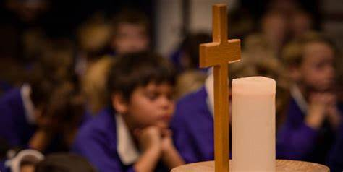
Welcome to worship
KS2 Reflection 1
Bruno Mars - Count on Me (Official
Lyric Video) – Bing video

Slide 2
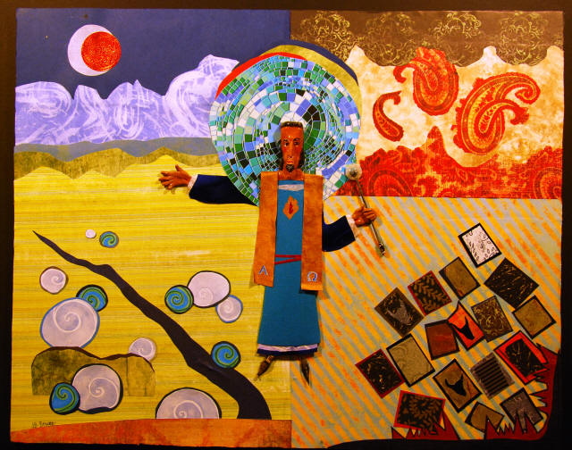

Slide 3
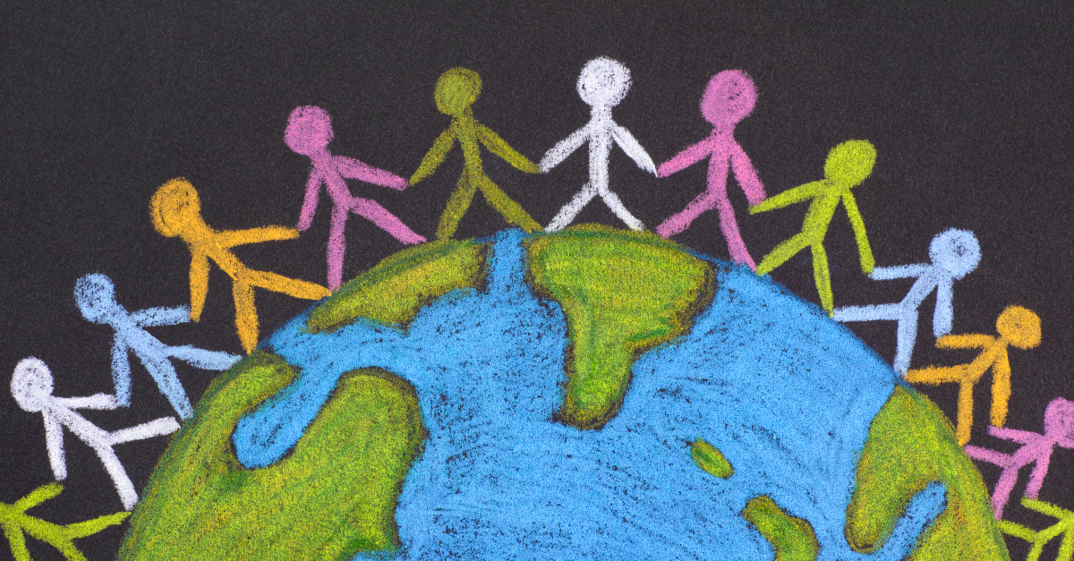
Made in the image of God

Slide 4
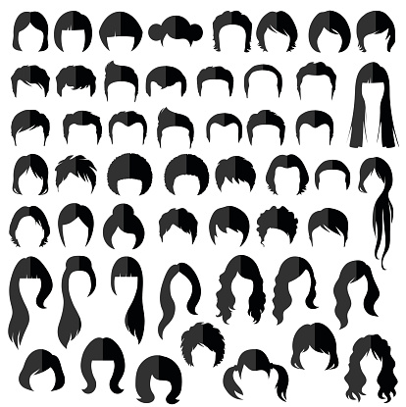

Slide 5
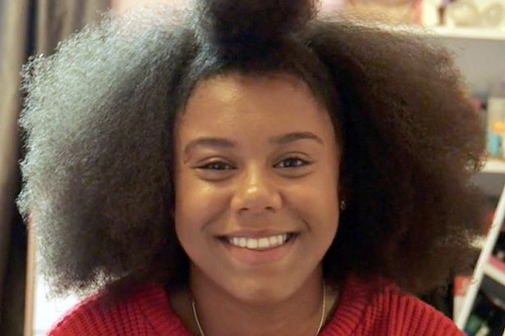
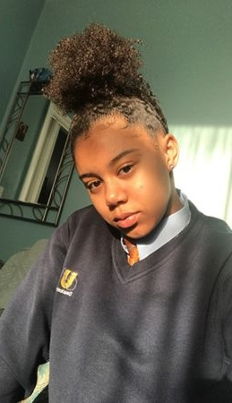

Slide 6
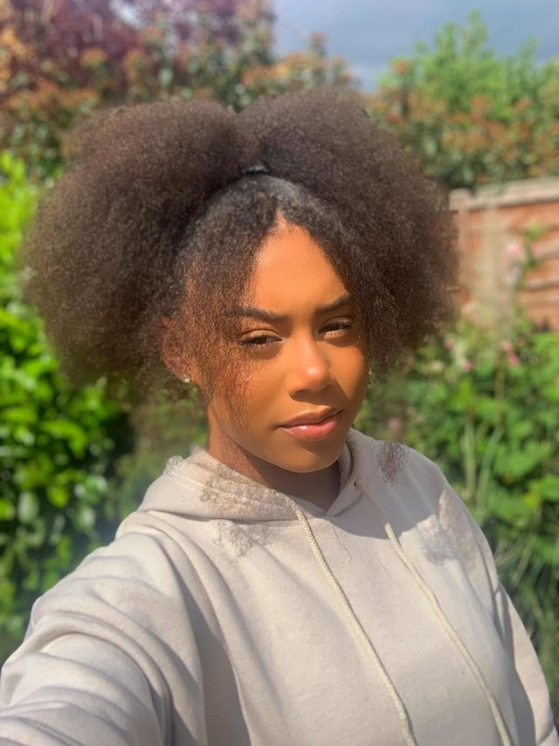
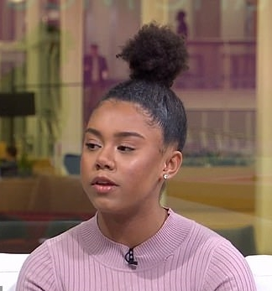
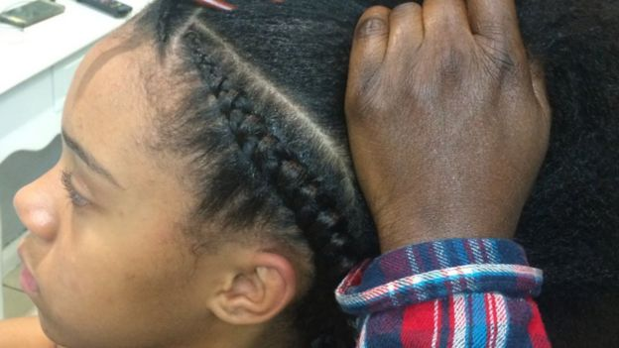

Slide 7
Dear God,
Thank you that you made us all unique and that we all look different and have different personalities and different talents.
Help us to treat other people as if they’re made in your image.
Help us to be more like you and to show love and fairness towards other people.
Help us to make the world a fairer place.
Amen.

