Slide 1
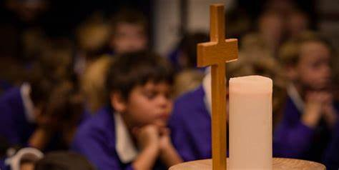
Welcome to worship
KS1 Reflection 2
Bruno Mars - Count on Me (Official
Lyric Video) – Bing video

Slide 2
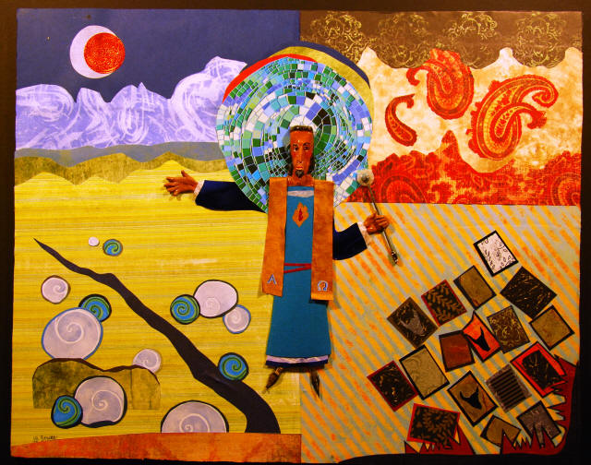

Slide 3
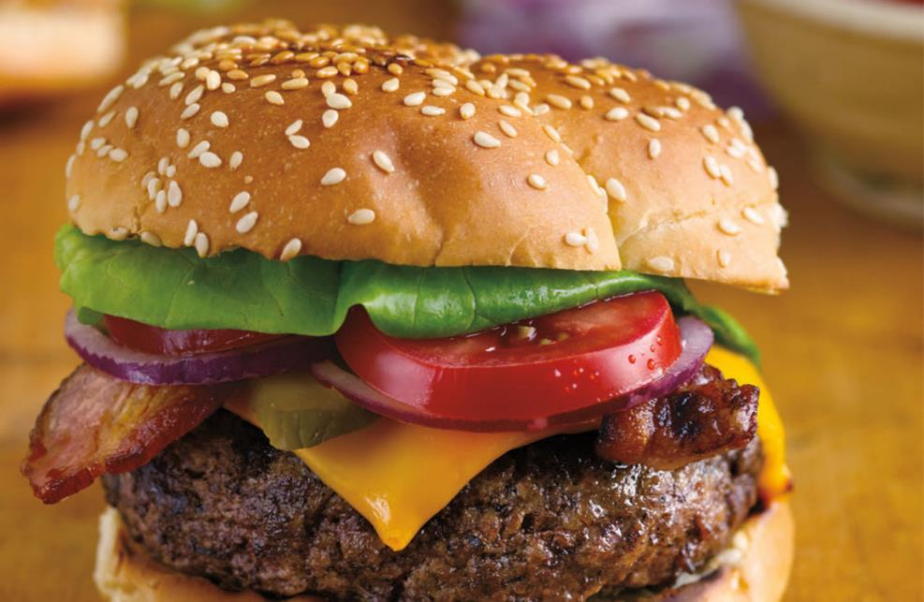
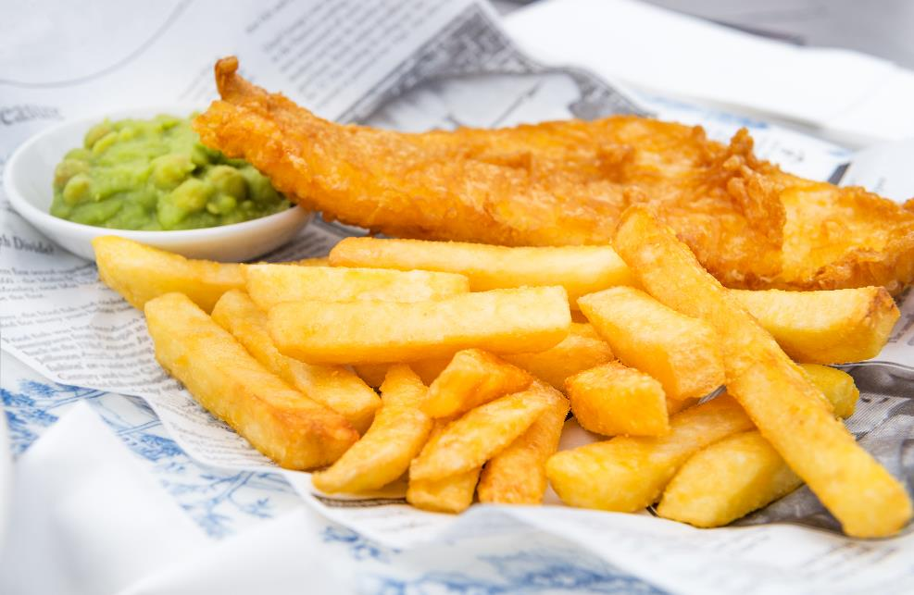
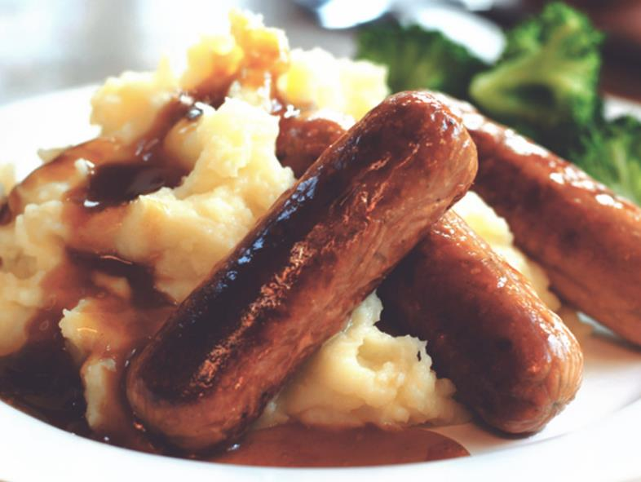
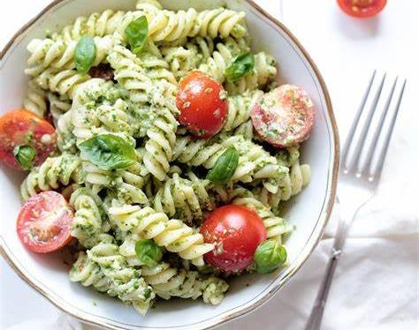

Slide 4
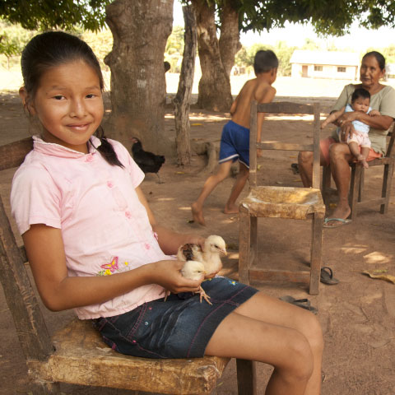
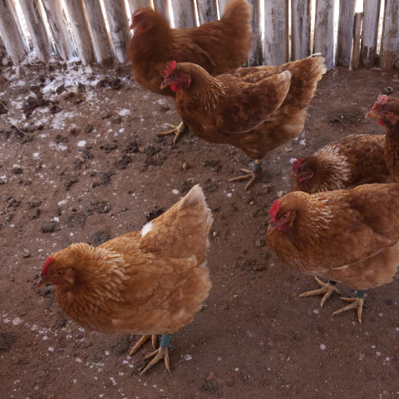
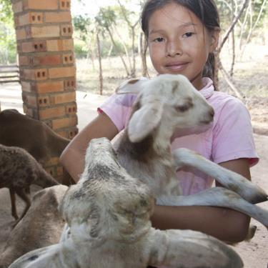

Slide 6
Dear God,
Thank you for all the lovely food that most of us enjoy.
Please help people like Ivana and her family to have enough food and to eat healthily.
Thank you for charities like Christian Aid that look after people round the world who don’t have enough to eat.
Please help us to be generous and to help other people.
Amen.

