Slide 1
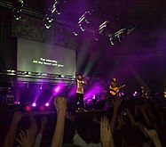
Key Stage 2 Reflection 2 - Hope
My hope is built on nothing less Than Jesus' blood and righteousness
https://youtu.be/izrk-erhDdk
This Photo by Unknown Author is licensed under CC BY-SA

Slide 2
My hope is built on nothing less Than Jesus' blood and righteousness
I dare not trust the sweetest frame But wholly trust in Jesus' name
My hope is built on nothing less Than Jesus' blood and righteousness
I dare not trust the sweetest frame But wholly trust in Jesus' name Christ alone, cornerstone
Weak made strong, in the Saviour's love
Through the storm He is Lord, Lord of all
When darkness seems to hide His face I rest on His unchanging grace
In every high and stormy gale My anchor holds within the veil
My anchor holds within the veil
Christ alone, cornerstone
Weak made strong, in the Saviour's love
Through the storm He is Lord, Lord of all He is Lord, Lord of all Christ alone, cornerstone
Weak made strong, in the Saviour's love Through the storm He is Lord, Lord of all Christ alone, cornerstone
Weak made strong, in the Saviour's love
Through the storm He is Lord, Lord of all
Then He shall come with trumpets sound Oh, may I then in Him be found
Dressed in His righteousness alone Faultless, stand before the throne

Slide 3
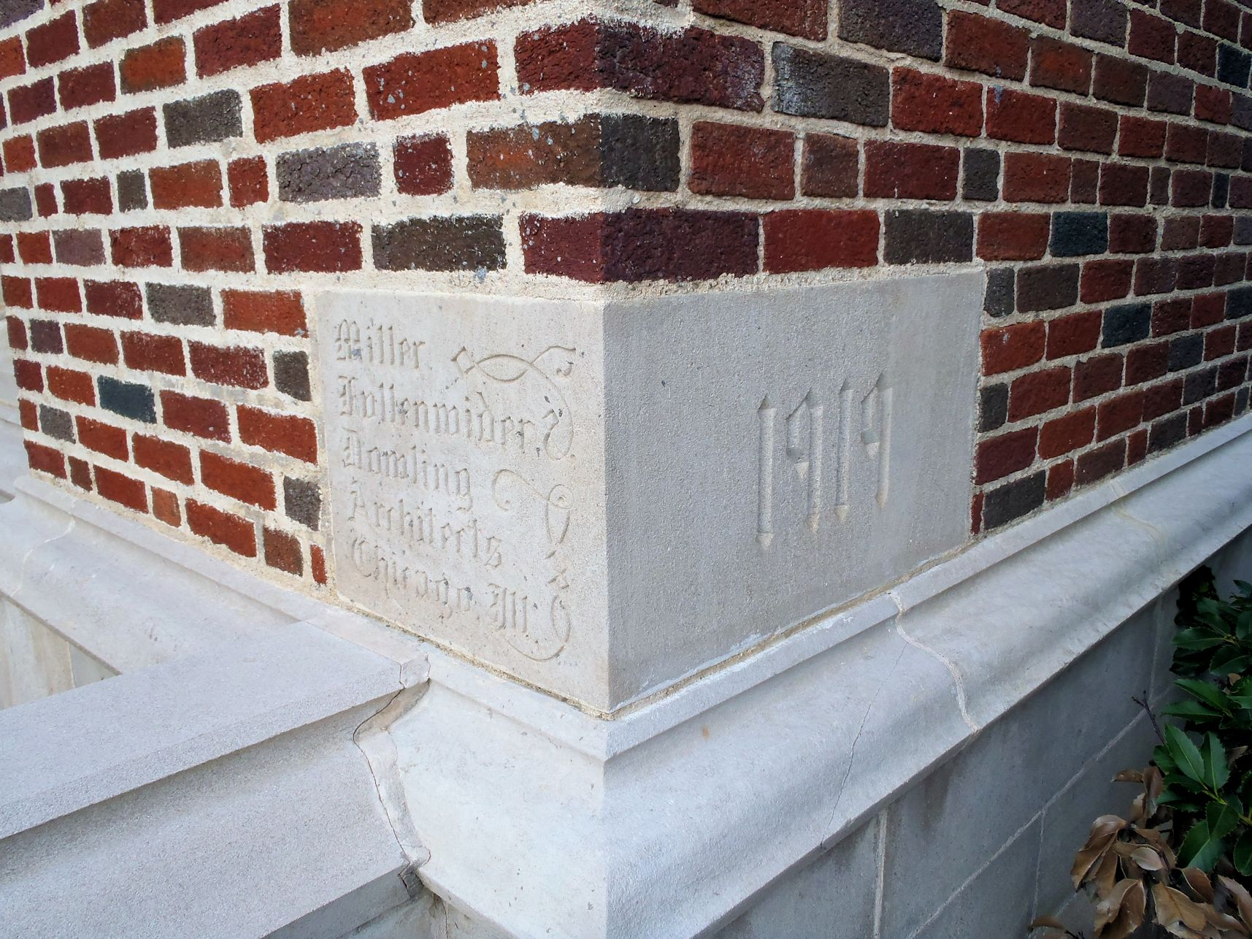
A Cornerstone
The cornerstone (or foundation stone) is the first stone set in the construction of a building. All other stones or bricks will be set in according to this stone which decides the position of the entire structure.
Some cornerstones are on the outside of a building, with an inscription on the stone indicating the construction dates of the building or maybe the names of the architect, or builder. Some cornerstones include time capsules from the time a particular building was built.

