Slide 1
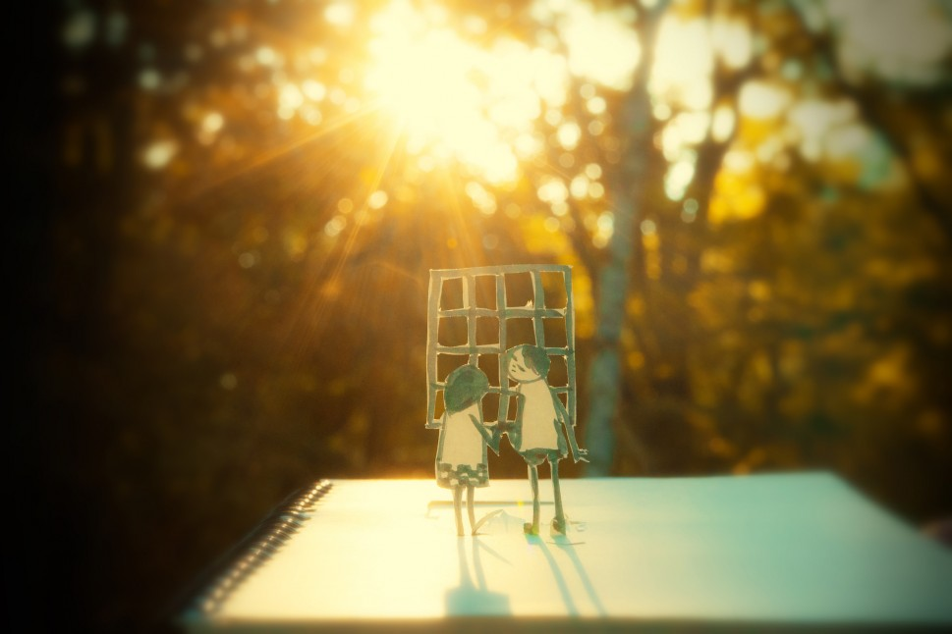
Hope Key Stage 2 Reflection 1
Look out of you window
What do you see?
Do you see what I see?
Do you see the savannah?
An endless sea of sand
Or sheets of ice?
Do you see sky meeting
Land
Like two brushstrokes
One of blue
And one of green?
Do you see Wide open spaces
From your tiny box;
Endless possibilities
Of footsteps
Yet to be trodden
Air yet to be breathed.
And oceans crossed?
You do?
I do, too.
For this is hope
And hope becomes
Reality
When the window
Becomes a door
And you can throw it wide.

Slide 2
