Slide 1
collective worship
Her majesty queen Elizabeth ii
Notes:
Begin the worship with your usual gathering liturgy (candles lighting, prayer, etc).

Slide 2
Her majesty queen Elizabeth ii
21st April 1926 - (DoD)
Notes:
Most of you will by now have heard the sad news that Queen Elizabeth 2 has died. As you may have heard on the news Queen Elizabeth died……(fill in details).
Everyone reacts differently to news like this and some us will feel more sad than others. Whether you feel deeply sad, just a bit thoughtful, or anything in between, that is fine.
In our worship today, we want to give thanks for Queen Elizabeth’s long life and service to our country and to remember what a special and important person she has been in our country’s history.

Slide 3
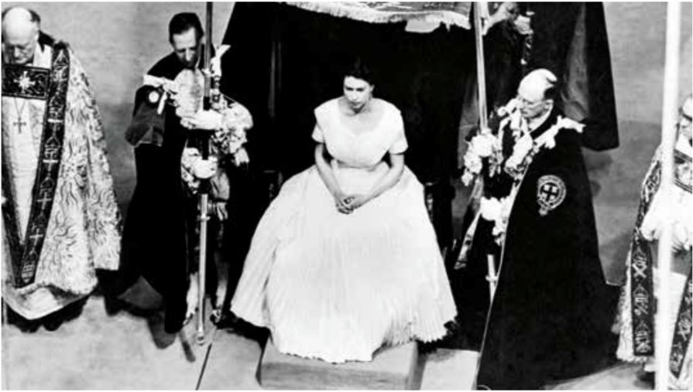
Notes:
Queen Elizabeth was Queen of the United Kingdom of Great Britain and Northern Ireland, and the Head of many other countries, for the whole of your lives, as well as the whole lives of all the staff in the school, and your parents, and most of your grandparents. None of us have known anyone different as monarch, as queen or king.
In fact, Queen Elizabeth was the longest reigning monarch in British history. Do you know long she was Queen? The answer is over 70 years. This is a picture of her being made the Queen in Westminster Abbey in 1953

Slide 4
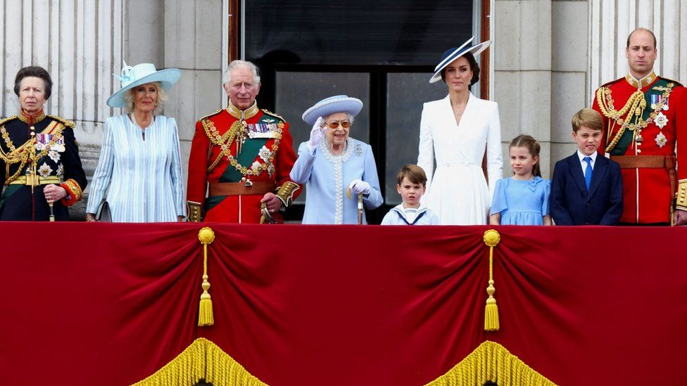
Notes:
And here is a picture that you may remember of her waving to the crowds at her platinum jubilee celebrations.

Slide 5
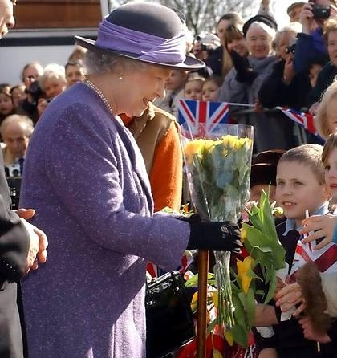
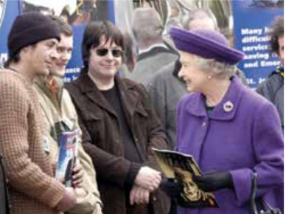
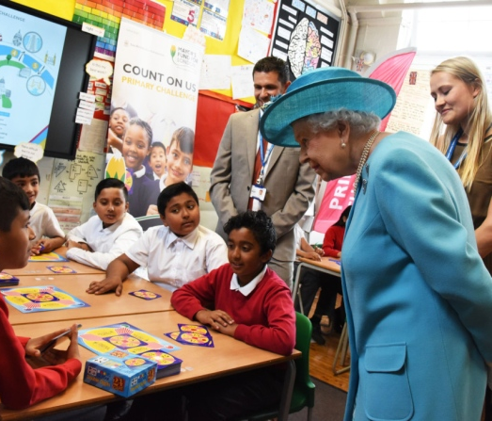
Notes:
Almost every day throughout all of those years, The Queen travelled all around our country meeting ordinary people, helping them to know that they are important and valued. She always particularly enjoyed the opportunity to visit children in their schools.

Slide 6
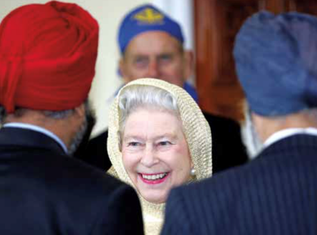
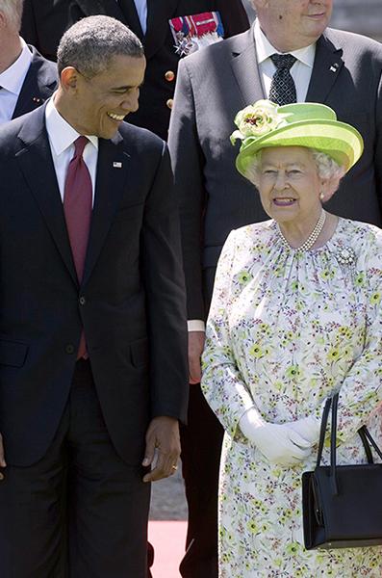
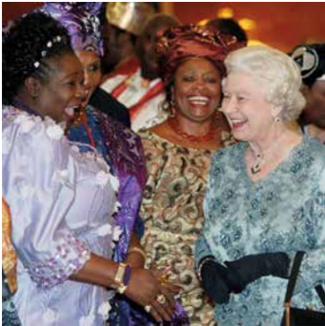
Notes:
She also met with leaders and important people from almost every other country on their visits to the United Kingdom, and she travelled around the world, year after year, helping to develop positive, peaceful relationships between our country and others.

Slide 7
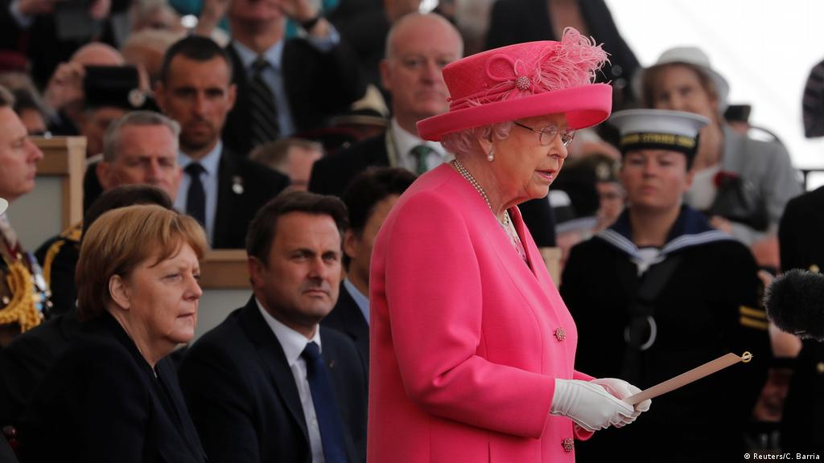
Notes:
Queen Elizabeth actually visited Portsmouth many times to take part in important ceremonies. Here she is giving a speech in front leaders from around the world to commemorate the 75th anniversary of D Day (which was the invasion that began the end of World War 2).

Slide 8
"For me, the life of Jesus Christ, the Prince of Peace, whose birth we celebrate today, is an inspiration and an anchor in my life. A role model of reconciliation and forgiveness, he stretched out his hands in love, acceptance and healing. Christ's example has taught me to seek to respect and value all people, of whatever faith or none."
Christmas message, 2014
Notes:
In her lifetime, the Queen worked with 14 different Prime Ministers, the first one being Winston Churchill. She met with each Prime Minister every single week to discuss what was going on in the country.
And every day of the year (apart from Christmas and Easter) she read a big box of papers from the government, and asked important questions of the country’s leaders that affected the way that the country has been run.
Every night, before she went to sleep, she would write down in her diary all of the things that she had done that day. Her diary is kept locked in a special black box. Imagine all of the stories that it must contain!

Slide 9
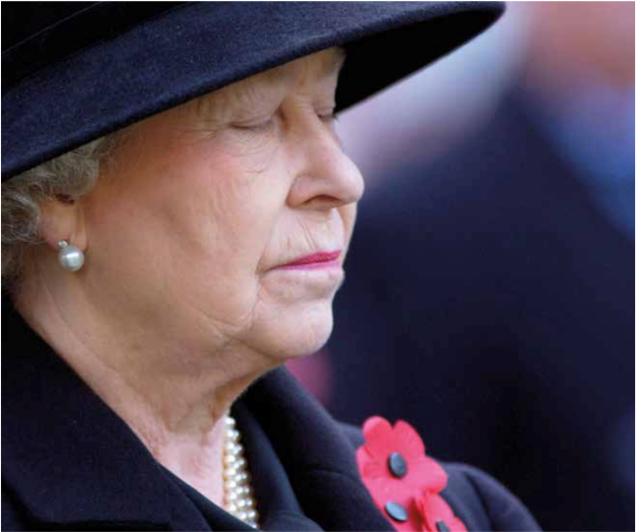
“I know just how much I rely on my faith to guide me through the good times and bad.
Each day is a new beginning.
I know that the only way to live my life is to try to do what is right, to take the long view, to give of my best in all that the day brings, and to put my trust in God!”
(2002)
Notes:
Most people in our country who have a paid job, retire in their sixties, and then have more choice about how they spend their time.
The Queen carried on with her duties, sometimes even working 40 hours a week until well into her nineties.
I wonder how tired you feel after a busy week at school? I wonder how the Queen felt after her weeks of work?
Did you know that the Queen personally spoke with 2000 people each year?
I wonder how many people you haven’t met before that you speak to each year? Do you find it easy or hard to speak to people who are new to you?
The Queen was invited to so many events, some of which reflected her hobbies and interests, but she also went to many events which would not have been so interesting for her. Can you imagine how many speeches she listened to? Yet, she accepted all kinds of invitations, as she knew how important it was, in her role as Queen, to be present at public events, both happy and sad, to show the interest and concern of the royal family.

Slide 10
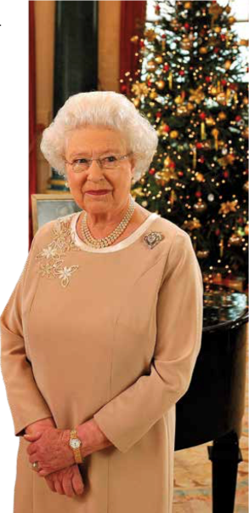
“THIS IS THE TIME OF YEAR WHEN WE REMEMBER THAT GOD SENT HIS ONLY SON ‘TO SERVE, NOT TO BE SERVED’. HE RESTORED LOVE AND SERVICE TO THE CENTRE OF OUR LIVES IN THE PERSON OF JESUS CHRIST.” SHE WENT ON TO SAY, “THE CAROL, ‘IN THE BLEAK MIDWINTER’, ENDS BY ASKING A QUESTION OF ALL OF US WHO KNOW THE CHRISTMAS STORY, OF HOW GOD GAVE HIMSELF TO US IN HUMBLE SERVICE: ‘WHAT CAN I GIVE HIM, POOR AS I AM? IF I WERE A SHEPHERD, I WOULD BRING A LAMB; IF I WERE A WISE MAN, I WOULD DO MY PART. THE CAROL GIVES THE ANSWER, ‘YET, WHAT I CAN, I GIVE HIM – GIVE MY HEART’.”
Notes:
I wonder why she carried out her role in such a way? The Queen worked so hard because she is committed to service. She made firm and serious promises when she was crowned in 1953, and she kept her promise faithfully to serve the country.
This also came from her Christian commitment to follow the way of Jesus.
Every year, Queen Elizabeth would give a short talk on the television to everyone in the country and here is an important thing that she said in her Christmas speech in 2012 (see slide):

Slide 11
Notes:
Queen Elizabeth’s favourite story from the Bible was the story Jesus told about the Good Samaritan. Lots of you already know this story (briefly tell the story). Can you see here (bottom right of slide) what Queen Elizabeth said about that story……
That’s why Queen Elizabeth always paid honour to the those who make a contribution to their communities, in all walks of life, and in unexpected places.
She praised people who served others in their jobs and she also thanked people who gave service in their spare time, volunteering to make life better for others, especially those who do things quietly and without fuss.

Slide 12
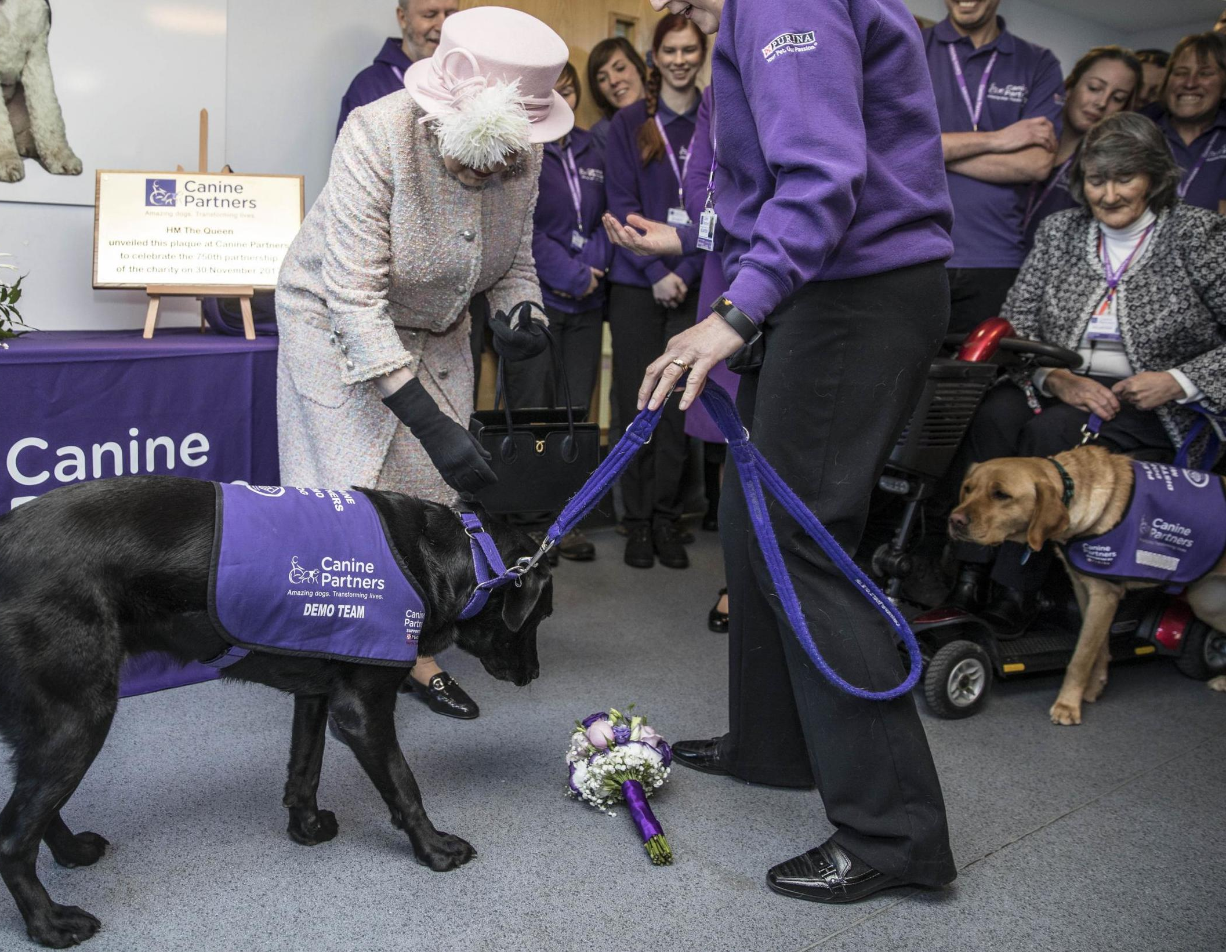
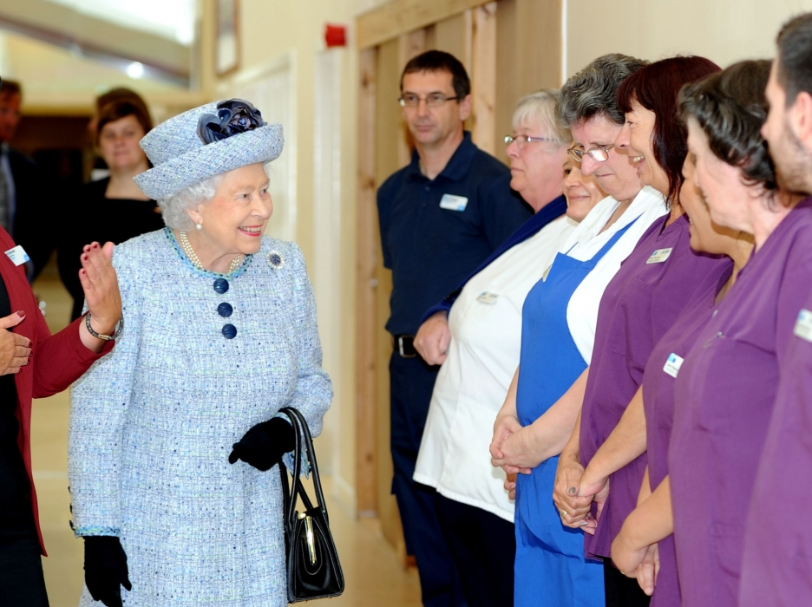
how can i serve?
Notes:
I wonder what ideas you have about the Queen and her life?
I wonder what you do to help others, in the way that the Queen talked about? Let’s pause for a moment to reflect on that for ourselves.
Prayers of thanks
The children may have been invited to prepare a prayer or expression of thanks for something the Queen has done. A representative from each class or year group could come up and light a candle by a portrait of the Queen on the worship table as they say their prayer.
Or
I am going to say a prayer now, and invite you to listen to it, and to make it your prayer too, if you wish, by saying Amen at the end:
Almighty God,
We thank you so much for the life, service and example of Queen Elizabeth
We thank you for her long life of serving others, and serving our country.
We thank you for all that she did to make this country, and the world, a better place.
Amen
It would be good to end the prayers by saying the Lord’s Prayer together in whichever form the children are familiar with using.
Sending As you leave, I wonder what you will remember about Queen Elizabeth.
You may want to talk about the Queen in your classrooms. You may want to write in a book of remembrance. You may want to respond by writing a poem or drawing a picture making something for the reflection corners in your classrooms.
Teachers to follow up in class perhaps make this PowerPoint available so that children can look at the pictures again.

