Slide 1
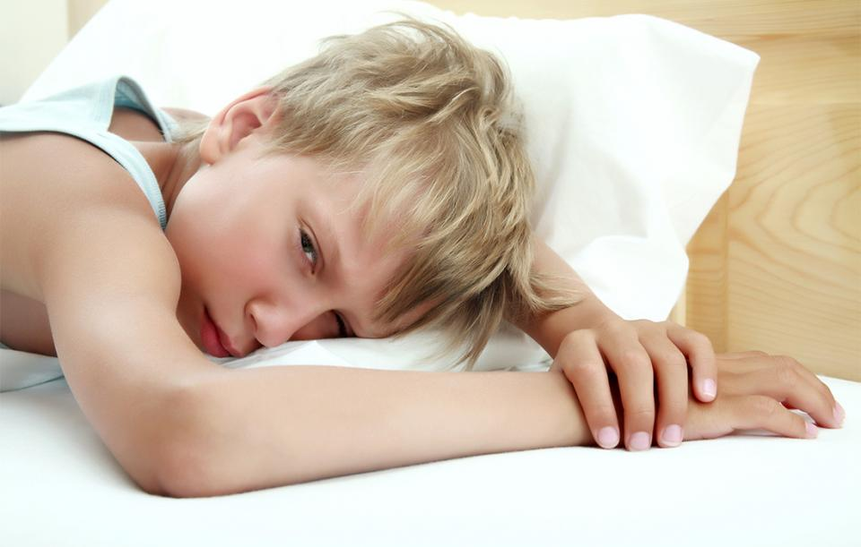

Slide 3
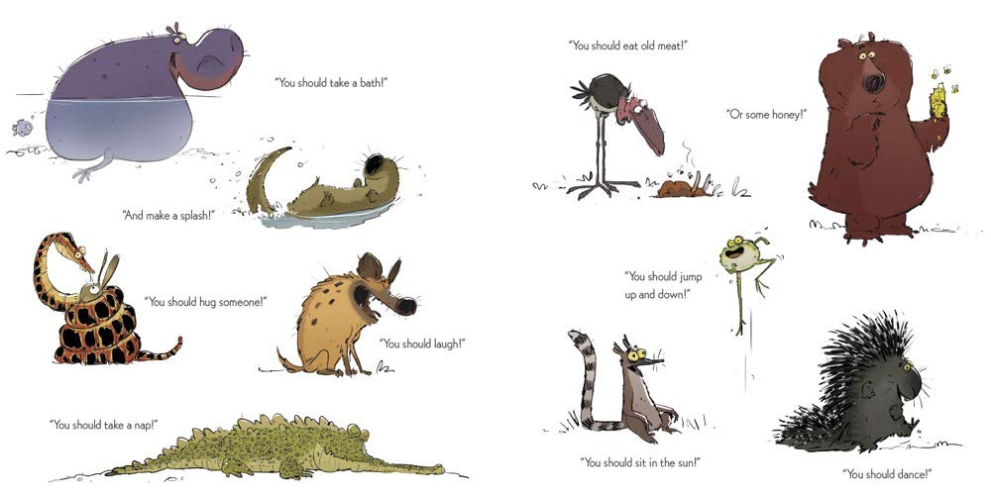

Slide 4
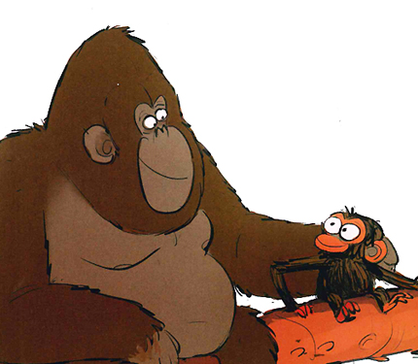

Slide 5
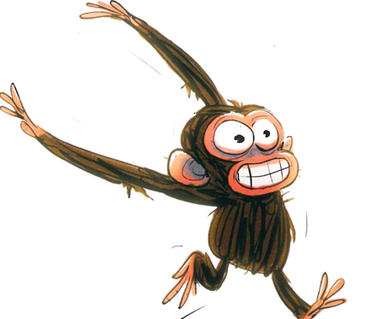

Slide 6
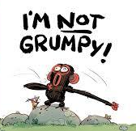
What advice would you give to Jim?
What advice would you give to his friends?
What could you tell yourself, next time you’re feeling grumpy?

Slide 7
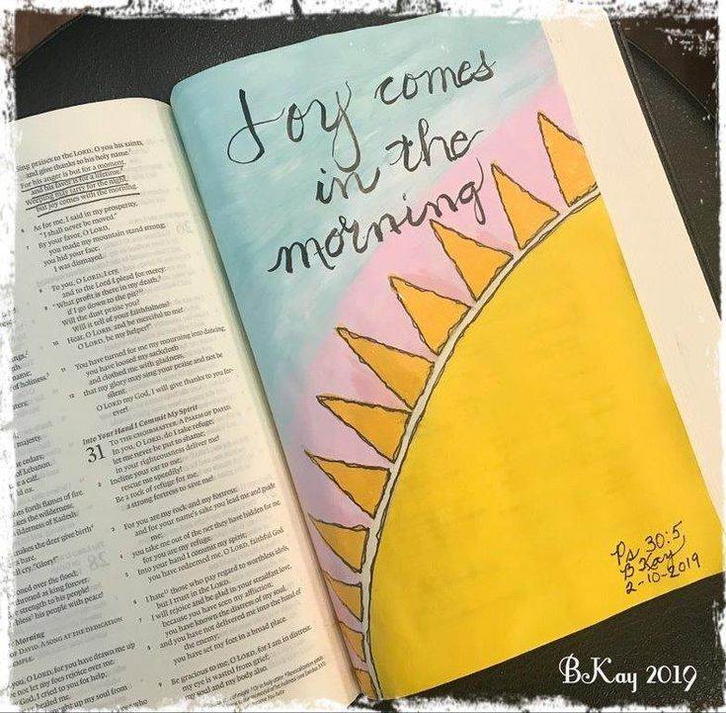

Slide 8
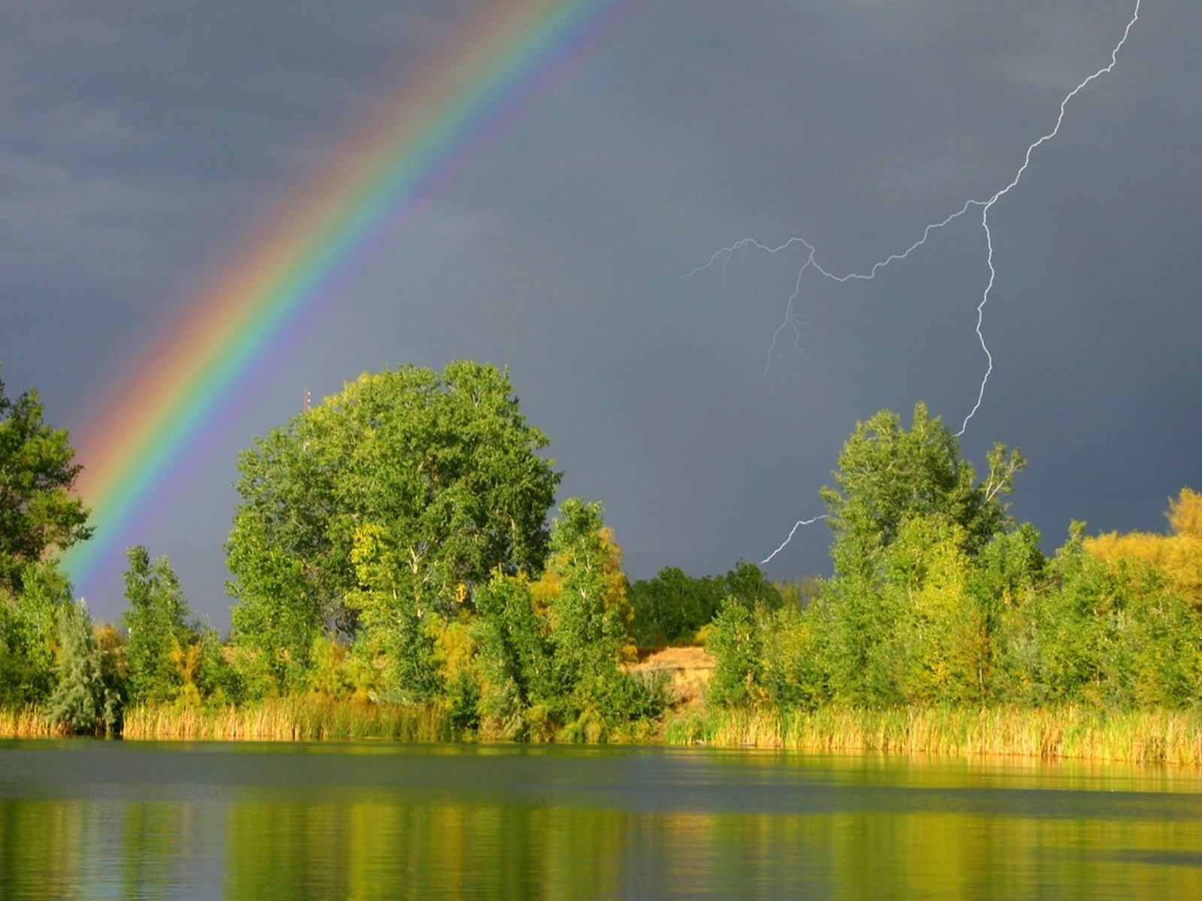
Dear God, thank you for our emotions.
Thank you for all the times we feel happy, peaceful, calm or excited.
Please help us to recognise when we’re feeling sad or grumpy or anxious,
And to find ways to deal with it.
Amen.

