Slide 1
Do we always learn from our mistakes?
What is your honest answer to this question?

Slide 2
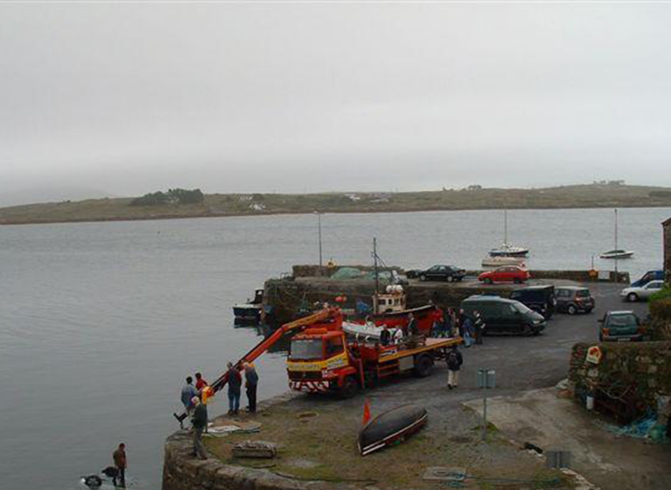
What is happening here?

Slide 3
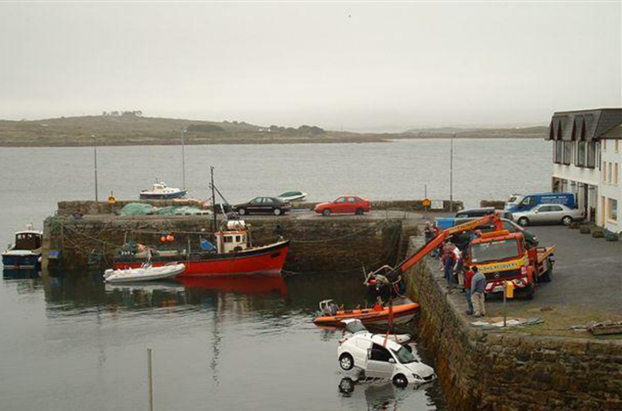
What happens next?

Slide 4
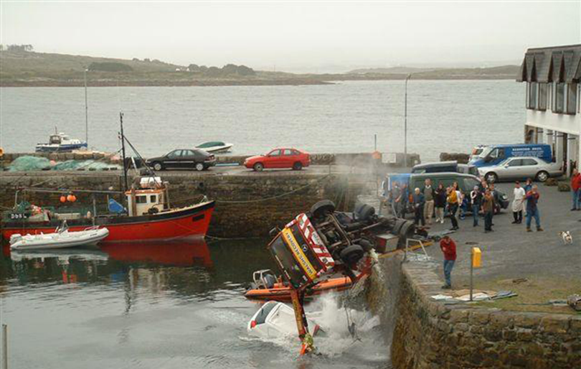
Oh no! What now?

Slide 5
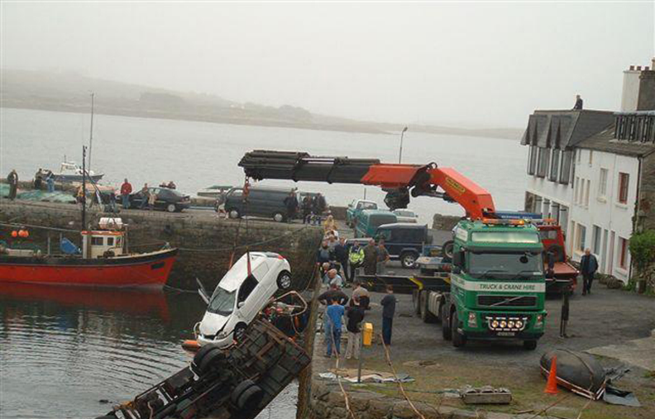
Let’s try again with a larger, stronger crane…

Slide 6
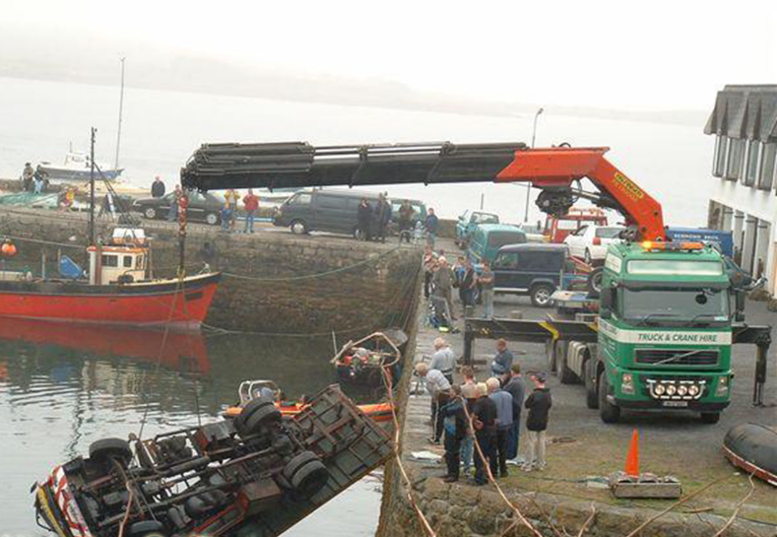
The car is recovered….now for the lorry….

Slide 7
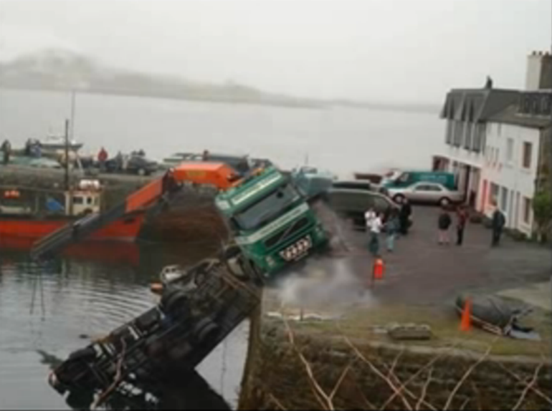
Oh no! Not again!!

Slide 8
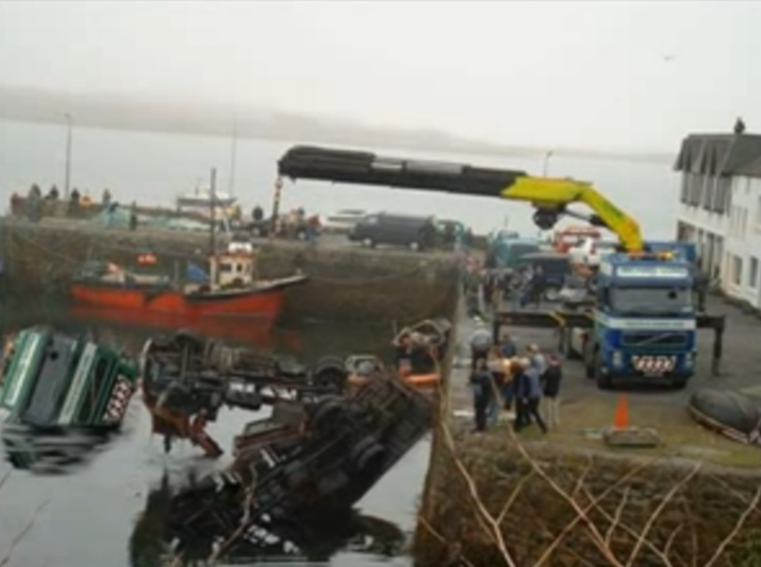
Now an even larger crane! Have they learnt from their mistakes?

Slide 9
Do you ever make mistakes?
We all do, don’t we?
Do you ever repeat the same mistakes?
We all do, don’t we?
Do we sometimes regret the choices we make?
We all do, don’t we?
Do we need forgiveness when those choices hurt others?
We all do, don’t we?

Slide 10
Matthew 18:21-22
²¹Then Peter came to Jesus and asked, "LORD, how many times shall I forgive my brother or sister who sins against me? Up to seven times?" ²²Jesus answered, "I tell you, not seven times, but seventy-seven times.
Forgiveness is not always easy is it?
Do we want to be forgiven for what we do?
Therefore, should we try to forgive others?

Slide 11
Forgiveness

Slide 12
Prayer:
Our Father in heaven, hallowed be your name. Your Kingdom come, your will be done,
on earth as in heaven.
Give us today our daily bread.
Forgive us our sins, as we forgive those who sin against us.
Lead us not into temptation,
but deliver us from evil.
For the kingdom, the power and the glory are yours. Now and for ever.
Amen.

