Slide 1
Peace
Do you feel happy inside?
Notes:
Entry music suggestion: I Giorni – Einaudi or Air on a G String – JS Bach; Worship song suggestion: Be Still for the Presence of the Lord

Slide 2
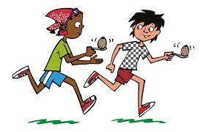
Friends
Family
Pets
Nature
Fun and games
Notes:
Entry music suggestion: I Giorni – Einaudi or Air on a G String – JS Bach; Worship song suggestion: Be Still for the Presence of the Lord

Slide 3
Dear Jesus
Help me to feel happy inside and to help others feel happy too.
Please be my friend and helper.
Amen
Notes:
Entry music suggestion: I Giorni – Einaudi or Air on a G String – JS Bach; Worship song suggestion: Be Still for the Presence of the Lord

