Slide 3
Now the way the world is run Too many people looking after number one Don't seem to notice The damage that they do
Though it's not widely understood There is a greater good Do unto others as you would have them do to you Do unto others as you would have them do to you

Slide 4
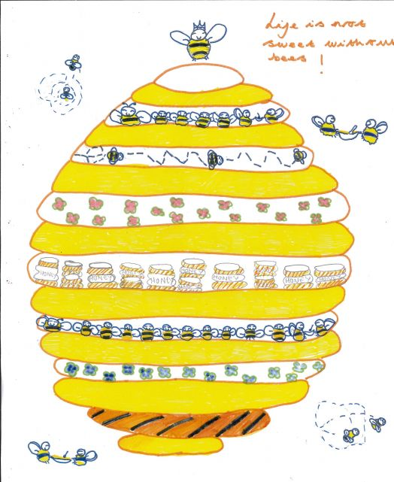
Golden Rule
Grace Eldridge (10)
I drew a bee hive because bees work together and not one isn’t helping. This picture inspired me because bees collect honey by themselves and then share the honey they collected. Bees are always busy collecting honey but not just for themselves for everyone.

Slide 5
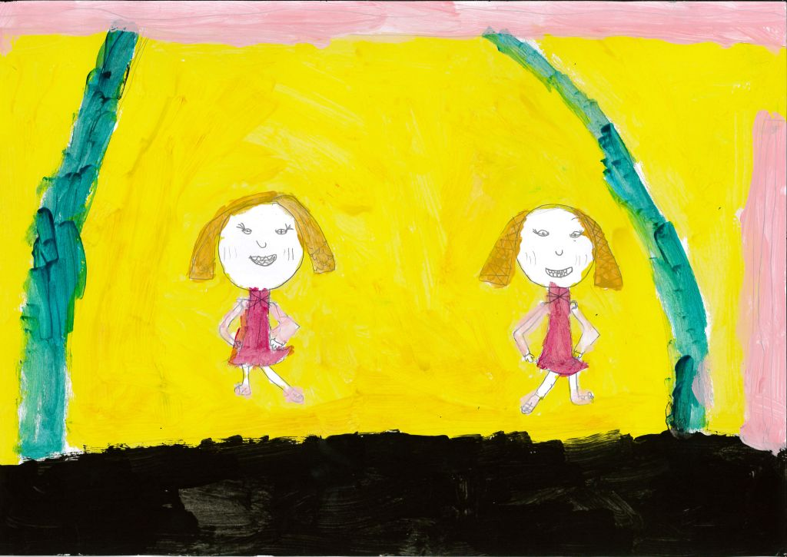
Cooperation
Gracie Robinson (7)
I chose cooperation because if you didn’t cooperate you wouldn’t be able to do things with your best friend or any friends. To cooperate you need to talk to each other. While I was making this I thought a lot about me and Sophie working together as a team to dance a duet.

Slide 6
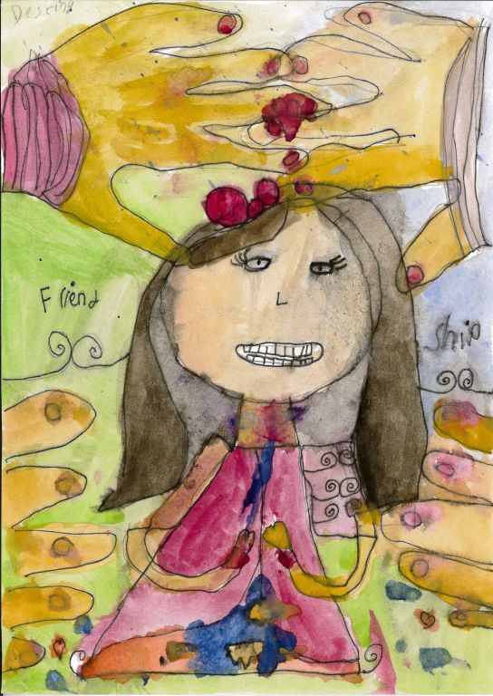
Golden Rules
Destiny (7)
The hand in my painting represents the golden rule of being friends with one another. The girl is praying to God for a kind friend because the others weren’t being nice to her. I wrote friendship because it is always important to stay friends.

Slide 7
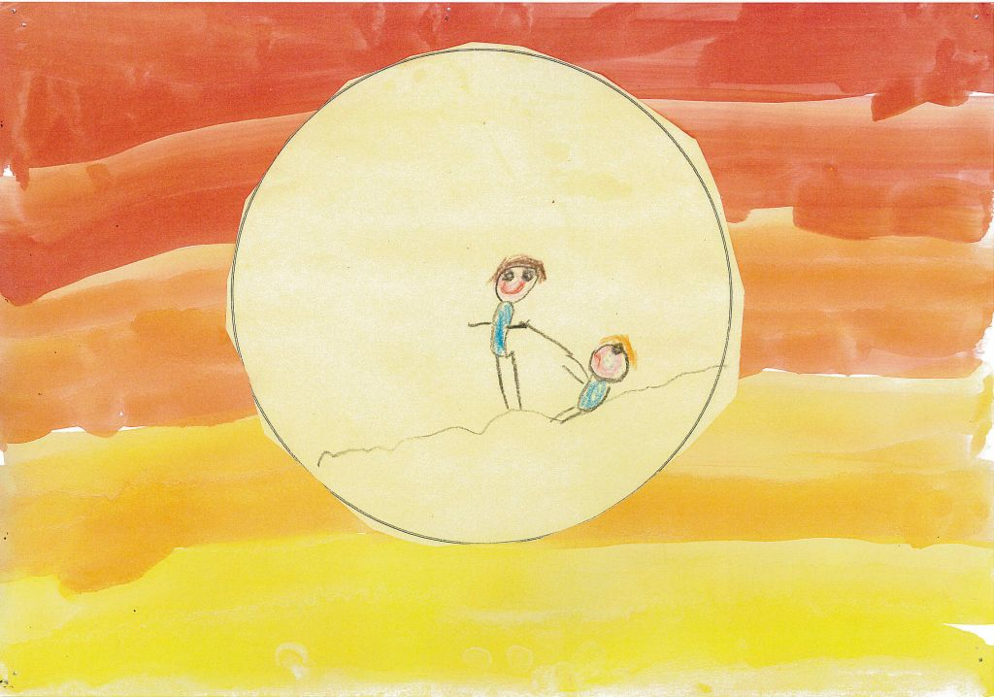
The Golden Rule
Freddie Baker (5)
In my picture you can see help in sumbodee up.

Slide 8
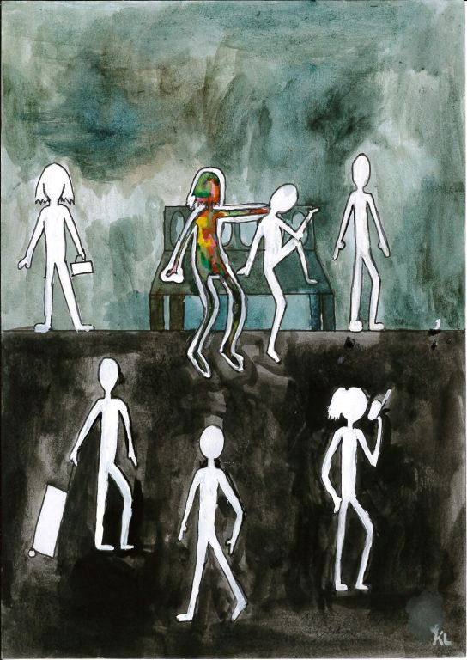
The Golden Rule
Kristin Light (12)
My picture shows how the human race can be so blind to other people’s feelings. The picture is quite literal – people are a blank canvas. The person sitting on the bench is full of colour because they are kind and have a personality, they enjoy life and don’t blankly walk around. They know that if they were upset, they would want someone to help them. They treat others how they would like to be treated. The reason that none of these people have facial features is that they could be anyone. This could be any society or any community. They could be a random group of strangers, or a group of close friends. One of them could be you.

Slide 9
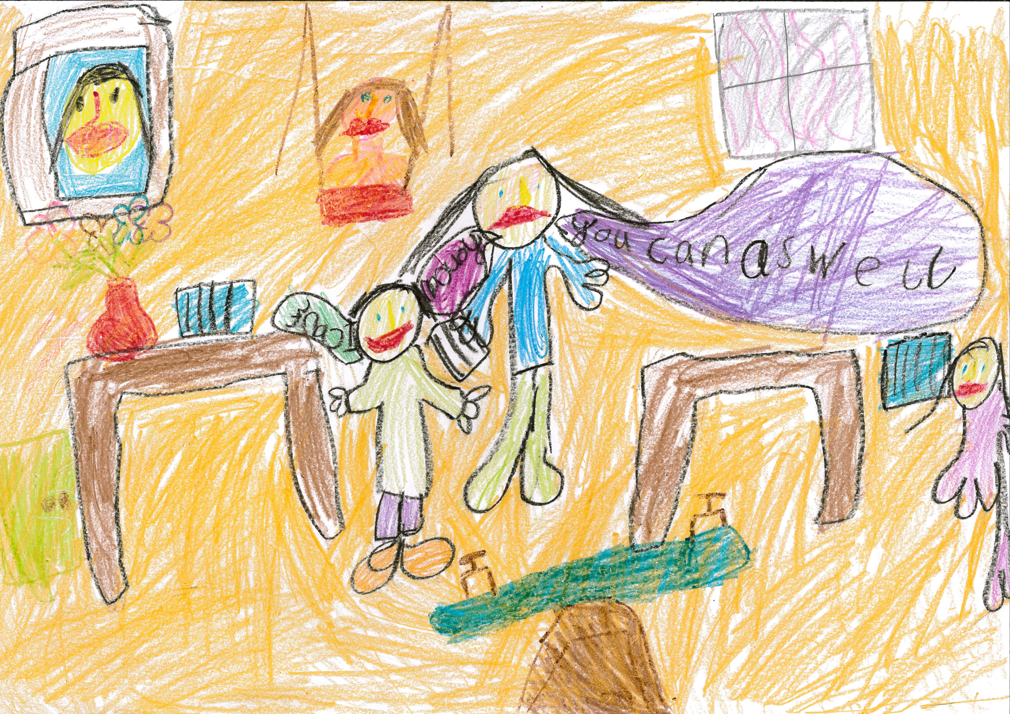
You Can Do it !
Mariam Faisal (6)
There is a little boy who says “I can’t do it.” Then this is me saying “yes you can”, because I want to be an encourager. I want to teach people how to do science so that they can make medicines and if someone has an infection they can give the medicine.

Slide 10
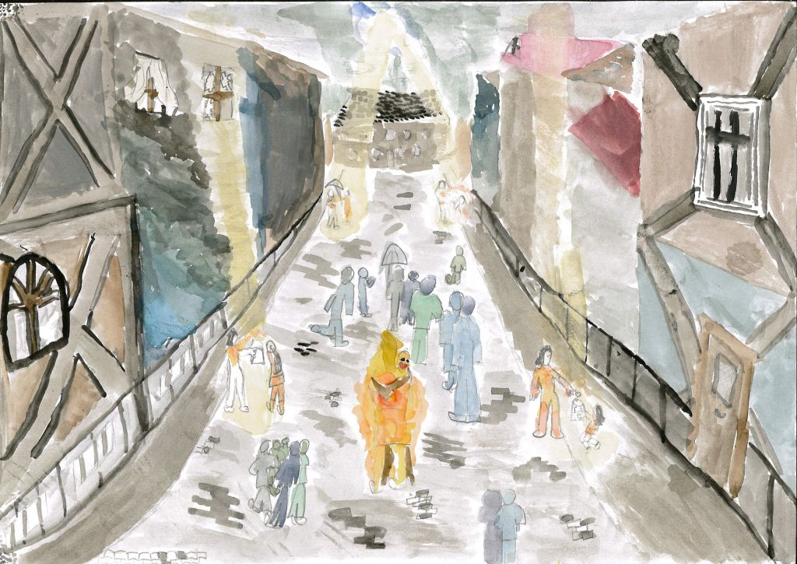
My Spirited Art
Louise Etherington (12)
I felt that anyone could live by the golden rule; this is the main theory behind work. I decided to put my image in a street as everyone can relate to this location. In my image there are two types of people, the ones who are sinners, and the ones who embody the golden rule. I painted the sinners in mute, dark colours with little detail because they are of little interest in god and the world. The ones who live by the golden rule are seemingly on fire and are filled with happiness.
I walk to school on a variety of busy roads, often filled with commuters who are so absorbed in themselves that they ignore the beggers and the less fortunate. But then I notice the ones who do help, and they out a smile on my face. Then after I thought I realised that god must see them and smile too. This is my main inspiration.

Slide 11
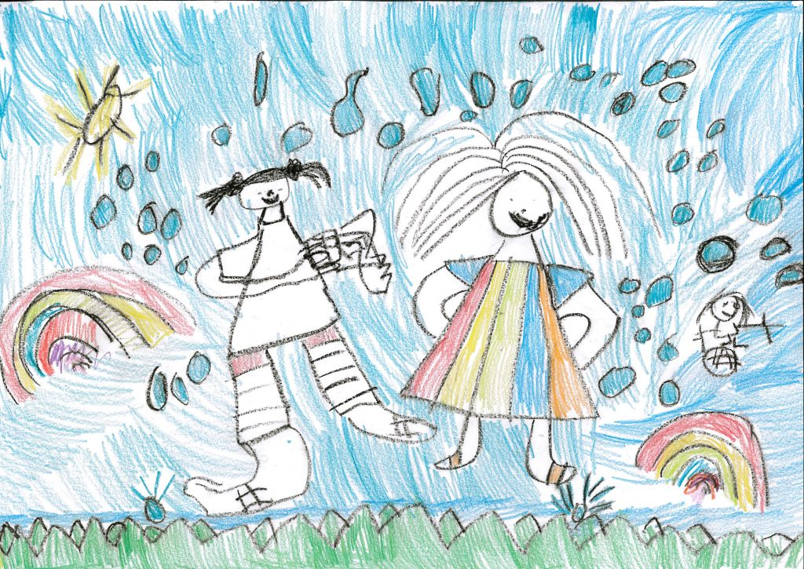
No matter what’s the weather
Grace Timothy (6)
I want to be a kind person. In my picture there is sunshine and rain. The picture shows people still helping in the good times and the bad times.

Slide 12
Which picture is best at expressing the golden rule? Why?
How would you represent the golden rule?

