Slide 1

Diocesan Synod
Saturday 2nd March 2019

Slide 2

Meet Some of Our
Diocesan Staff
Agenda Item 4

Slide 3
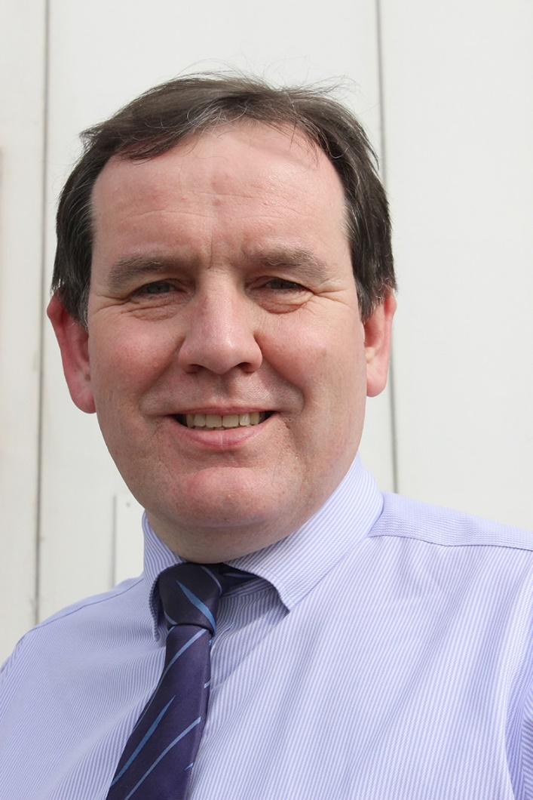
Chris Pride, property manager
My job: Looking after and maintaining
clergy housing and glebe land throughout the diocese
‘I enjoy it because…
I can make a difference to the lives of our clergy and their families’

Slide 4
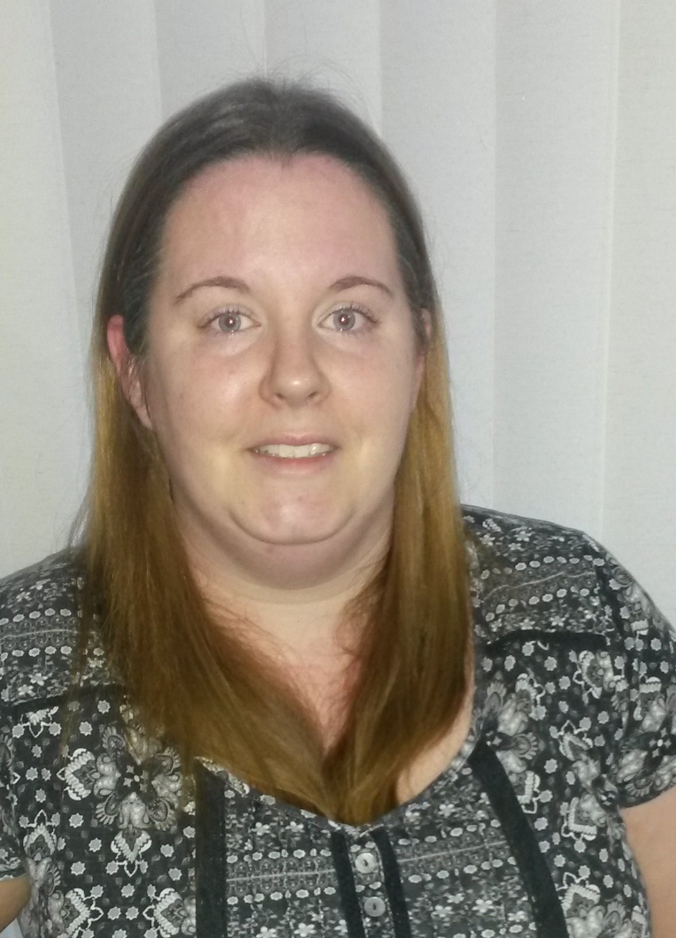
Helen Young, pioneer project evaluation co-ordinator
My job: Collecting and analysing data
to evidence the impact of the
diocese’s Pioneer Project.
‘I enjoy it because…
I enjoy finding out about the stories behind the data that reveal new worshipping communities.’

Slide 5
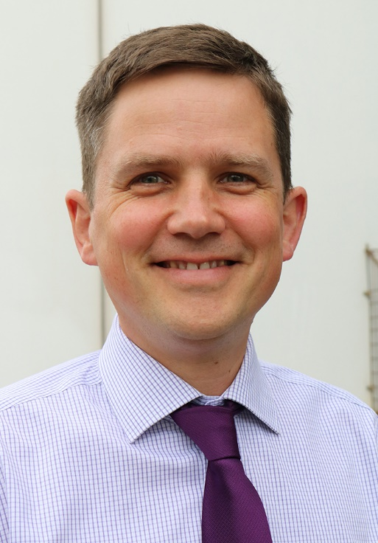
Rob Sanders, deputy director of education
My job: Supporting the director in driving the vision of the education team with schools and parishes; managing the day-to-day work of the office team
‘I enjoy it because…
There is such a huge variety in the work that we do’

Slide 6
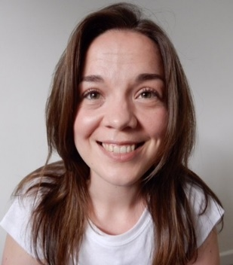
Lisa O’Clee, Good Neighbours Network adviser
My job: The network supports 120+
voluntary care groups in Hants, and I’m one of three advisers. We help groups to set up, recruit volunteers and deliver help to their neighbours
‘I enjoy it because…
People have incredible worth, so it’s great to invest in groups that share acts of kindness.’

Slide 7
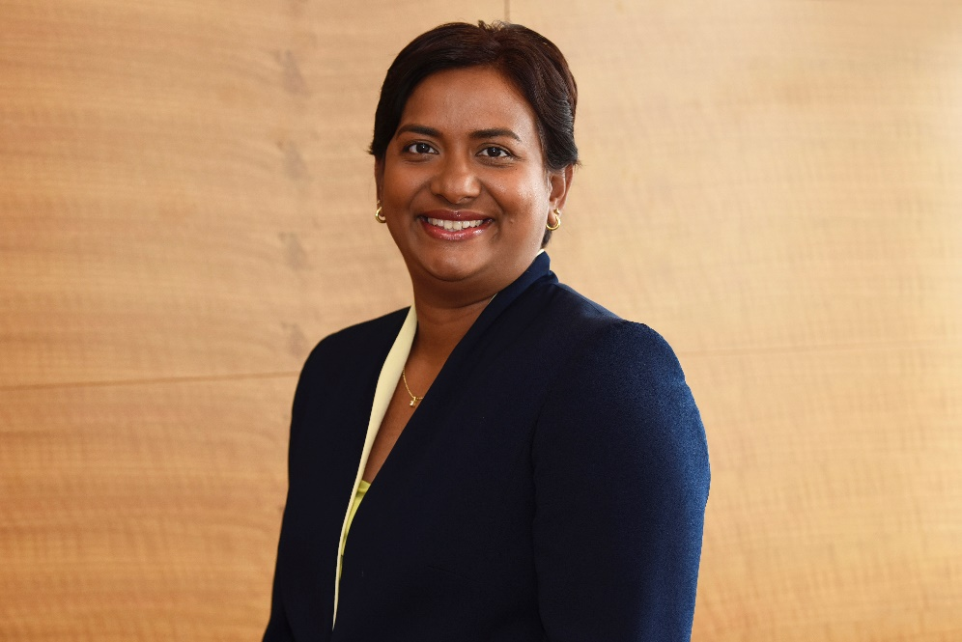
Lisa Streeter, Finance Director
My job: Strategic finance lead for the Dioceses of Portsmouth and Winchester
‘I am looking forward to my new role because…
I am very excited to be part of a non-profit organisation where I can maximise all the gifts that I have been given for the direct benefit of others and the community as a whole ’

Slide 8
Diocesan Synod
Saturday 2nd March 2019
Agenda Items 5 & 6

Slide 9
Coffee
Please return 11.15am

Slide 10
Resourcing Growth and Proposed Pastoral Reorganisation
What Has Changed Since November?

Slide 11
Key Developments Since November
Extensive feedback from parishes and communities in the informal consultation stages
Constructive Meetings with PCCs and DMPC Representatives
Bishop Christopher recommended to Bishop’s Council that the decision as to whether to proceed to formal consultation should not take place on 5th December 2018, to allow more time for the responses to be fully digested and considered.
28th January 2019 Bishop’s Council discussed the draft Schemes at length

Slide 12
What was the Impact of the Informal Consultation?
The Consultation has significantly reshaped some of the proposed schemes
The draft schemes are now different in two out of three areas

Slide 13
Isle of Wight

Slide 14
Havant

Slide 15
Gosport

Slide 16
Gosport

Slide 17
Parish Reorganisation – Formal Consultation
February 2019
29th March 2019
3rd April 2019
Formal consultation letters and draft proposals sent to legally interested parties
Closing date for written responses
Statements of view and draft proposed changes presented to Bishop’s Council
5th April 2019
Draft Scheme Submitted to the Church Commissioners

Slide 18

Pastoral Reorganisation - Publication
Copies of the draft schemes will be served on the legally interested parties and the Commissioners
Notice will be given that written representations may be made to the Commissioners by a set date (not less than 28 days after service of the notice.
‘Church Door’ notices will be arranged

Slide 19
The Church Commissioners’ Pastoral Committee
Any representations would be heard by the Church Commissioners’ Pastoral Committee in their July of September meetings (depending on their workload)

Slide 20
When would the Schemes come into effect?
If the Schemes are made, we would expect them to come into effect by the end of 2019 or early 2020
There is a 6 month period between the Schemes being made and their coming into effect.

Slide 21

Why do we need to do this?
Some deaneries have seen 20% decline in Sunday attendance over the last ten years.
Parish share giving in this diocese is extremely generous – thank you – but many parishes tell us that they are dipping into reserves to pay each year. With fewer people, the burden is heavier.
Some of our projects are working well and we want to do more of what works. We are being encouraged by the Church Commissioners to ask for their funding to make this possible.

Slide 22
Why do we need to do this?
We want more people to know the love of God and to follow Jesus as his disciples. Because of our baptism, we are called and sent out to make new disciples.
We want younger generations, who are currently under represented in our congregations, to be disciples and to find a place in our churches.
We want to grow our churches and grow new congregations.

Slide 23
Questions and Discussion
Agenda Item 7

Slide 24
Peer Review
Agenda Item 8

Slide 25
Budget Process

Slide 26
How we Intend to Prepare
Jan -March
Live|Pray|Serve aims and goals
March - April
Prioritising Activity linked with intended outcomes
May-June
Deanery Conversations with Standing Committees
Input from Investment Advisory Group

Slide 27
Governance & Consultation
8 July 2019
First Draft to Diocesan Finance Committee
End July
Budget and Supporting Papers Circulated
Early – Mid September
Consultation Meetings
Deadline for Parishes responses to allow time for consideration, replies and any changes

Slide 28
Governance & Consultation
30th September
Final Draft to Diocesan Finance Committee
7th October
Budget to Bishop’s Council
9th November
Budget to Diocesan Synod

Slide 29
Dates of the Next Meetings
15th June 2019
9th November 2019

