Slide 1
Diocesan Synod
Saturday 25 June 2022

Slide 3
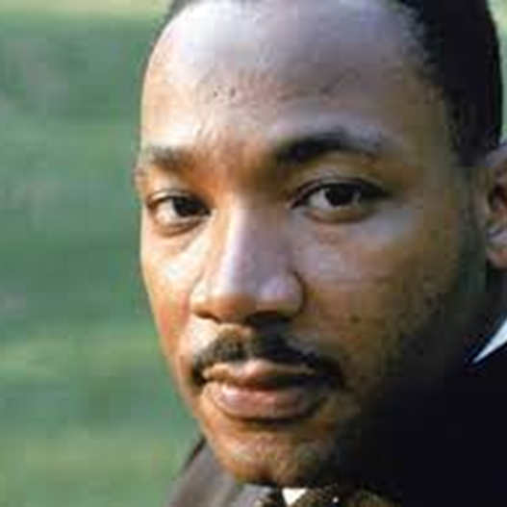
Martin Luther King
‘A letter from Birmingham Jail’ (1963)
‘…over the last few years I have been gravely disappointed with the white moderate… who is more devoted to ‘order’ than to justice… who paternalistically feels that he can set the timetable for [other people’s] freedom.
…Shallow understanding from people of good will is more frustrating than absolute misunderstanding from people of ill will.’

Slide 4
Five priority areas
Each with a set of actions:
1. Participation (including appointments) 2. Education 3. Training and Mentoring 4. Young People 5. Structures and Governance

Slide 5
Seven workstreams
For the ongoing work of the Archbishops’ Racial Justice Commission
Theology
Slavery (including monuments)
History and Memory
Culture and liturgy
Complaints handling
Participation
Patronage

Slide 6
Participation
(including appointments)
Sixteen identified actions. Two refer to ‘dioceses with UKME/GMH populations of national average or above’. Does this apply to the Diocese of Portsmouth?
Collect and use data on racial diversity to inform accountability and good practice.
Diocesan bishops to nominate at least one UKME/GMH candidate for every SDLP

Slide 7
Participation
(including appointments)
Build recruitment process for every level and context which includes racial diversity. Every shortlist should include one appointable UKME/GMH candidate, including senior appointments.
Every Bishop’s Council should include at least three UKME/GMH members.
Cathedral Chapters should recruit at least on UKME member of Chapter
Work with HE institutions to actively increase the number of UKME/GMH chaplains

Slide 8
TEIs and authorised training pathways
Promote intercultural placements and mark Black History Month, celebrating diverse saints and models.
Diversify curriculum and bibliographies, anti-racism learning for staff, participation in modules on Black Theology or Theologies in Global Perspective to be compulsory for all ordinands.
Demographic audit of tutors, lecturers and governing bodies, with workable plan for increasing diversity.U
Use liturgical resources to reflect the diversity of the Anglican Communion

Slide 9
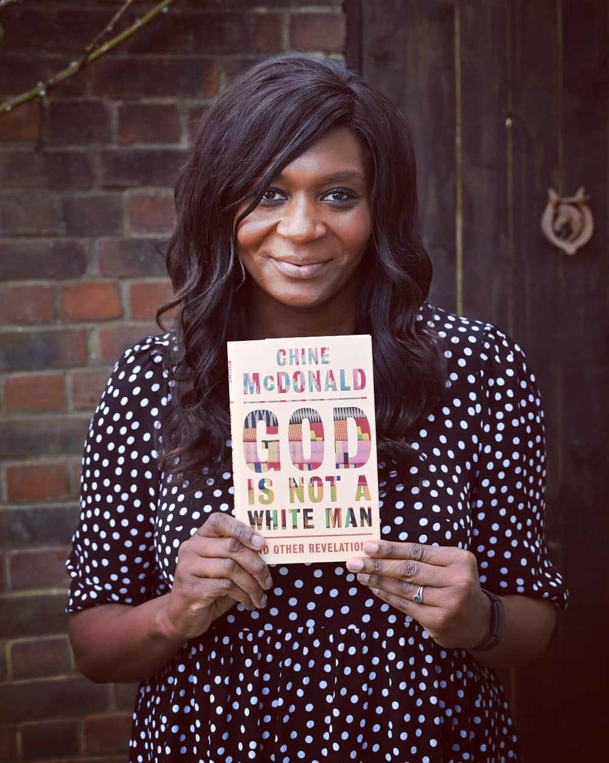
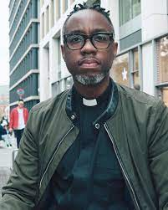
Azariah France-Williams Racial Justice Sunday 2023
Chine McDonald
2023 Robert Dolling Lecture

Slide 10
Martin Luther King
‘A letter from Birmingham Jail’ (1963)
‘…over the last few years I have been gravely disappointed with the white moderate… who is more devoted to ‘order’ than to justice… who paternalistically feels that he can set the timetable for [other people’s] freedom.
…Shallow understanding from people of good will is more frustrating than absolute misunderstanding from people of ill will.’

