Slide 1
Update

Slide 2
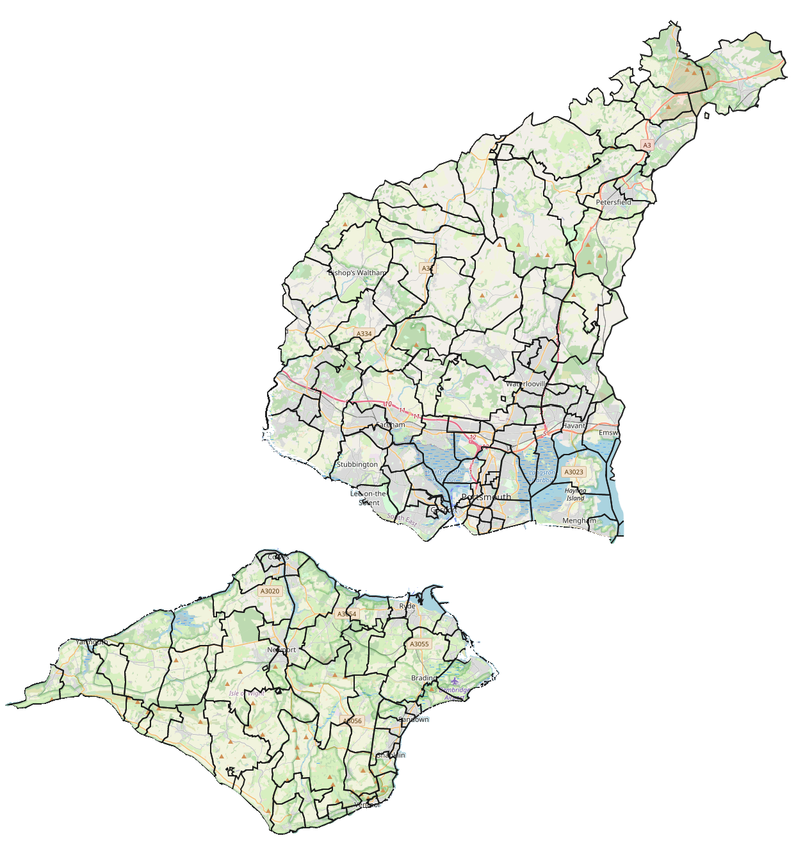
Our context
1989
Population: 694,000
Attendees: 16,200
Clergy: 138
Parishes: 137
Church Buildings: 172
Clergy per 10,000 People: 2.0
2019
Population: 790,000
Attendees: 8,900
Clergy: 86
Parishes: 133
Church Buildings: 167
Clergy per 10,000 People: 1.1
Change
+14%
-45%
-38%
-3%
-3%
-45%
Just cutting clergy has not made the diocese more sustainable as the number of givers has declined faster
The diminishing number of clergy have been spread across a broadly static number of parishes and buildings
A diminishing number of attendees are required to fund the historic ministry structures

Slide 3
Our vision
Live
the Good News of God in Jesus Christ.
Pray
on our own and in community to know God’s will.
Serve
the people among whom we live and work.

Slide 4
Our purpose
Is to grow in depth, impact, and number, so that…
…more people love the Lord their God with all their heart, mind, soul, and strength; more people love their neighbours as themselves; and more people join us in going out to make new disciples and to make disciples of all nations.

Slide 5
Our values

Slide 6
Vision Transformation Journey
Ongoing engagement with governance structures
Visioning Exercises – Vision of a Thriving Diocese
(Bishops Senior Staff, Bishop’s Council, Area Deans & Lay Chairs, and HoDs
Ongoing regular conversations
Clergy, Bishop & Archdeacons, individual and collective
Ongoing regular diocesan communications
Finance
DBF Restructure
Priority-led budgets
Income and expenditure analysis
Potential parish share review
Deanery Plans Parish structures and ministry deployment
Strengths
Stakeholder Interviews
Focus Groups
Questionnaire
Key Elements
Deanery Presentations & ongoing discussions
Visionary Leadership
Teams on a Mission
Communities of Kingdom Building Disciples
Growth Enabling Structures
Shaping of Lay & Ordained Ministry Roles
Diocesan Strategic Plan
Implementation over the next 5 years

Slide 7
Deanery Feedback - High Level Overview
It is clear from all of the deanery proposals that there is much common ground. There is an acceptance of the need for significant change to the way that we have approached our structures and deployment, common themes included:
Clear shared leadership
Focal leadership at a congregational and/or church level
Clear and purposeful local identity
Mix of lay and ordained, stipendiary and self-supporting ministry
Shared simplified growth enabling governance
Need further consultation in each deanery and with local parishes to determine exact make up of groups
Equally we recognise the fear and concerns around:
loss of local identity and focus
perceptions around inequality and takeovers
watering down of theology and churchmanship to the lowest common denominator

Slide 8
Our benefices currently look like:
Incumbent
Single stipendiary priests
Multiskilled and multitasking
Ministry Team (Example)
PtOs
Lay Readers
1
Incumbent
Ministry Team of
1-2 people
1 Benefice
with 1-3 PCCs
An average benefice has…
1-3 Churches
Governance & Admin
Multiple PCCs to manage buildings, finance, safeguarding and other statutory issues and admin issues
Congregations
Multiple Traditional Services
Possibly a fresh expression
4-10 Schools
5,000-25,000 People
Community Engagement
Toddler Groups
Lunch Clubs
Foodbanks in some places
Engagement with schools
Assemblies
Foundation Governor Support

Slide 9
Our benefices could look like:
Team Rector
Focussed Leadership
Team enabling and development
Ministry Teams
Stipendiary clergy & lay ministers
SSM clergy & lay ministers
Commissioned lay preachers/ worship leaders/pastoral workers
Shared Governance & Admin
Joined up leadership to shape vision and give focus
Simplified governance to release clergy and lay to focus mission
Focussed subcommittees with delegated authority to work in local contexts to keep local identity and autonomy
Shared CMS/Admin/Finance Systems
1
Team Rector
Ministry Team of
6-12 people
Simplified Governance Structure
An average benefice will have…
4-8 Churches
Mixed Ecology of Congregations
Local Identity and purpose
Traditional Services
New Worshipping Communities
Eco-churches
Cafe Church
Messy Churches
4-10 Schools
15,000-45,000 People
Greater engagement with schools
Chaplaincy Service
Assemblies, Lesson Support
Schools Pastors
Free school lunch support – during holidays
Foundation Governor Support
Increased community engagement and impact
Foodbanks, Debt Support, Job Clubs
Preschools & Toddler Groups
Creative Artistic Expressions/Groups
Eco and Gardening/Allotments
Sports & Wellbeing Groups
Other Community Groups

Slide 10
Our benefices could look like:
Visionary Leadership
Team Rector
Focussed Leadership
Team enabling and development
Ministry Teams
Stipendiary clergy & lay ministers
SSM clergy & lay ministers
Commissioned lay preachers/ worship leaders/pastoral workers
Shared Governance & Admin
Joined up leadership to shape vision and give focus
Simplified governance to release clergy and lay to focus mission
Focussed subcommittees with delegated authority to work in local contexts to keep local identity and autonomy
Shared CMS/Admin/Finance Systems
1
Team Rector
Ministry Team of
6-12 people
Simplified Governance Structure
An average benefice will have…
4-8 Churches
Mixed Ecology of Congregations
Local Identity and purpose
Traditional Services
New Worshipping Communities
Eco-churches
Cafe Church
Messy Churches
4-10 Schools
15,000-45,000 People
Greater engagement with schools
Chaplaincy Service
Assemblies, Lesson Support
Schools Pastors
Free school lunch support – during holidays
Foundation Governor Support
Increased community engagement and impact
Foodbanks, Debt Support, Job Clubs
Preschools & Toddler Groups
Creative Artistic Expressions/Groups
Eco and Gardening/Allotments
Sports & Wellbeing Groups
Other Community Groups

Slide 11
Our benefices could look like:
Teams on a Mission
Team Rector
Focussed Leadership
Team enabling and development
Ministry Teams
Stipendiary clergy & lay ministers
SSM clergy & lay ministers
Commissioned lay preachers/ worship leaders/pastoral workers
Shared Governance & Admin
Joined up leadership to shape vision and give focus
Simplified governance to release clergy and lay to focus mission
Focussed subcommittees with delegated authority to work in local contexts to keep local identity and autonomy
Shared CMS/Admin/Finance Systems
1
Team Rector
Ministry Team of
6-12 people
Simplified Governance Structure
An average benefice will have…
4-8 Churches
Mixed Ecology of Congregations
Local Identity and purpose
Traditional Services
New Worshipping Communities
Eco-churches
Cafe Church
Messy Churches
4-10 Schools
15,000-45,000 People
Greater engagement with schools
Chaplaincy Service
Assemblies, Lesson Support
Schools Pastors
Free school lunch support – during holidays
Foundation Governor Support
Increased community engagement and impact
Foodbanks, Debt Support, Job Clubs
Preschools & Toddler Groups
Creative Artistic Expressions/Groups
Eco and Gardening/Allotments
Sports & Wellbeing Groups
Other Community Groups

Slide 12
Our benefices could look like:
Communities of Kingdom Building Disciples
Team Rector
Focussed Leadership
Team enabling and development
Ministry Teams
Stipendiary clergy & lay ministers
SSM clergy & lay ministers
Commissioned lay preachers/ worship leaders/pastoral workers
Shared Governance & Admin
Joined up leadership to shape vision and give focus
Simplified governance to release clergy and lay to focus mission
Focussed subcommittees with delegated authority to work in local contexts to keep local identity and autonomy
Shared CMS/Admin/Finance Systems
1
Team Rector
Ministry Team of
6-12 people
Simplified Governance Structure
An average benefice will have…
4-8 Churches
Mixed Ecology of Congregations
Local Identity and purpose
Traditional Services
New Worshipping Communities
Eco-churches
Cafe Church
Messy Churches
4-10 Schools
15,000-45,000 People
Greater engagement with schools
Chaplaincy Service
Assemblies, Lesson Support
Schools Pastors
Free school lunch support – during holidays
Foundation Governor Support
Increased community engagement and impact
Foodbanks, Debt Support, Job Clubs
Preschools & Toddler Groups
Creative Artistic Expressions/Groups
Eco and Gardening/Allotments
Sports & Wellbeing Groups
Other Community Groups

Slide 13
Our benefices could look like:
Growth Enabling Structures
Team Rector
Focussed Leadership
Team enabling and development
Ministry Teams
Stipendiary clergy & lay ministers
SSM clergy & lay ministers
Commissioned lay preachers/ worship leaders/pastoral workers
Shared Governance & Admin
Joined up leadership to shape vision and give focus
Simplified governance to release clergy and lay to focus mission
Focussed subcommittees with delegated authority to work in local contexts to keep local identity and autonomy
Shared CMS/Admin/Finance Systems
1
Team Rector
Ministry Team of
6-12 people
Simplified Governance Structure
An average benefice will have…
4-8 Churches
Mixed Ecology of Congregations
Local Identity and purpose
Traditional Services
New Worshipping Communities
Eco-churches
Cafe Church
Messy Churches
4-10 Schools
15,000-45,000 People
Greater engagement with schools
Chaplaincy Service
Assemblies, Lesson Support
Schools Pastors
Free school lunch support – during holidays
Foundation Governor Support
Increased community engagement and impact
Foodbanks, Debt Support, Job Clubs
Preschools & Toddler Groups
Creative Artistic Expressions/Groups
Eco and Gardening/Allotments
Sports & Wellbeing Groups
Other Community Groups

Slide 14
Ministry Focus
What we might
think happens
Focal
Minister
Church
Planter
Incumbent
D
I
N
A
D
I
N
A
?
D
I
N
A
Team
Rector
Evangelist
Ops
Manager
D
I
N
A
What often
actually happens
D
I
N
A
D
I
N
A
D
I
N
A
Incumbent
Social
Action
Social
Enterprise
D
I
N
A
D
I
N
A
D
I
N
A

Slide 15
Ministry Team Transitions
Team Rector
Team Rector
Team Vicar
Existing
Congregations
Team Rector
Team Vicar
Existing
Congregations
Incumbent
Team Vicar
Existing
Congregations
Team Vicar
Existing
Congregations
Commissioned
Worship Leader
Commissioned
Preacher
Team Vicar
Existing
Congregations
Commissioned
Preacher
Commissioned
Preacher
Team Vicar
New
Congregations
Commissioned
Worship Leader
Commissioned
Preacher
Commissioned
Preacher
Incumbent
Commissioned
Preacher
Commissioned
Worship Leader
Team Vicar
Existing
Congregations
Operations
Manager
Commissioned
Worship Leader
Commissioned
Worship Leader
Team Vicar
Existing
Congregations
Operations
Manager
Lay SSM
New
Congregations
Team Vicar
New
Congregations
Team Vicar
New
Congregations
Lay SSM
New
Congregations
Lay SSM
New
Congregations
Commissioned
Preacher
Commissioned
Preacher
Incumbent
Commissioned
Worship Leader
Commissioned
Preacher
Operations
Manager

Slide 16
Next Steps
Archdeacons have fed back high level thoughts on deanery plans
Discuss in-depth consultation approach with Area Deans and Lay Chairs to agree best way forward
Present high-level model principles and deanery plans with Bishop’s Council for discussion and agreement, including timeline for consultation with parishes
Begin the implementation journey

Slide 17
Lord our God, You make all things new.
Inspire our lives with your spirit
Renew our prayer with your grace
Transform our service with your love.
In the renewal of our life may your kingdom flourish
and your church thrive
so that all may come to know and love you
in your Son Jesus Christ.
Amen

