Slide 1
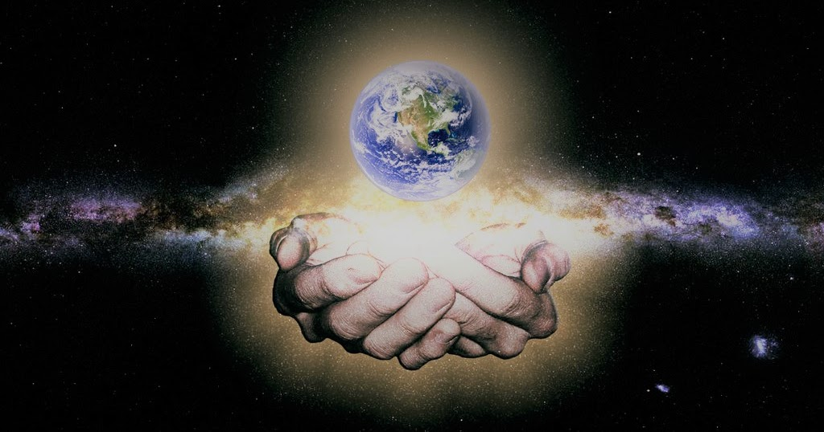
A class reflection based on ‘How we show love for the planet’ by Bethany Pennington, Year 6, Pilgrims Cross Church of England Primary School, Andover

Slide 2
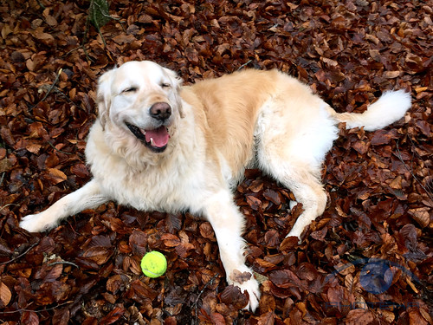
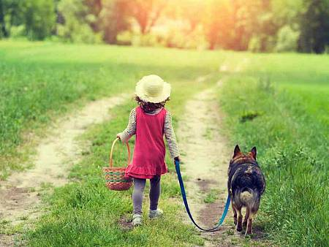
Slide 1

Slide 3
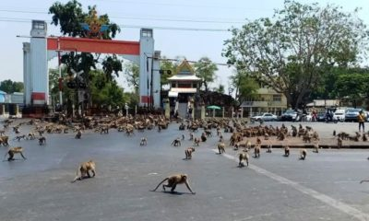
Slide 2
https://youtu.be/78EvLw2hs2U

Slide 4
Slide 3
Let’s have a look what the Bible tells us about the creation of the Earth, right at the beginning when pollution was not part of life.
https://youtu.be/yZ1Fd_SPC18

Slide 5
Slide 4
What does God want us to do?
Christians believe that God cares for the world and that God wants us to care for it too. Look at what the Bible says:
And God said, "See, to you I give every plant which grows on all the earth, and every tree which bears fruit with its own kind of seed. It shall be food for you. And to every wild beast and to every bird of the sky and to every thing that crawls on the earth and is alive, I give every green herb for food." And it was done.

Slide 6
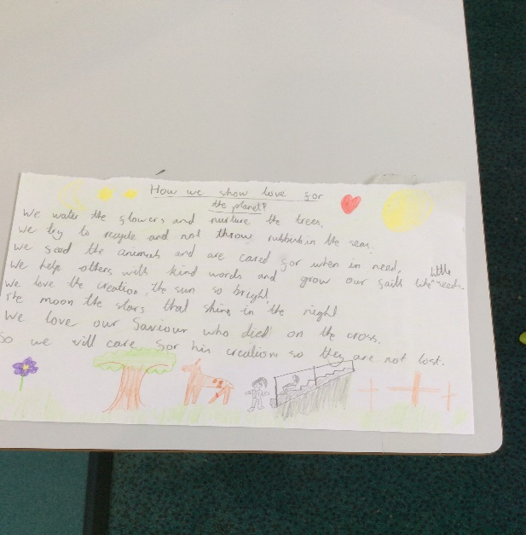
Slide 5
‘How we show love for the planet’ by Bethany Pennington
Year 6, Pilgrims Cross Church of England Primary School, Andover
How we show love for the planet
‘We water the flowers and nurture the trees
We try to recycle and not throw rubbish in the sea
We feed the animals and are cared for when we need
We help others with kind words and grow our faith like little seeds
We love the creation, the sun so bright, the moon, the stars that shine in the night
We love our saviour who died on the cross so we will care for his creation so they are not lost.

Slide 7
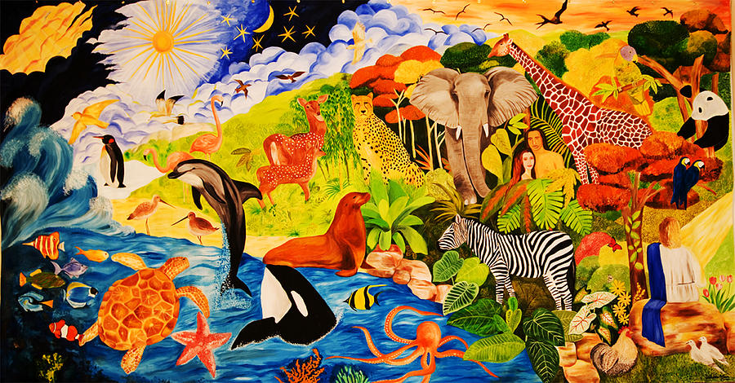
Slide 6

