Slide 1
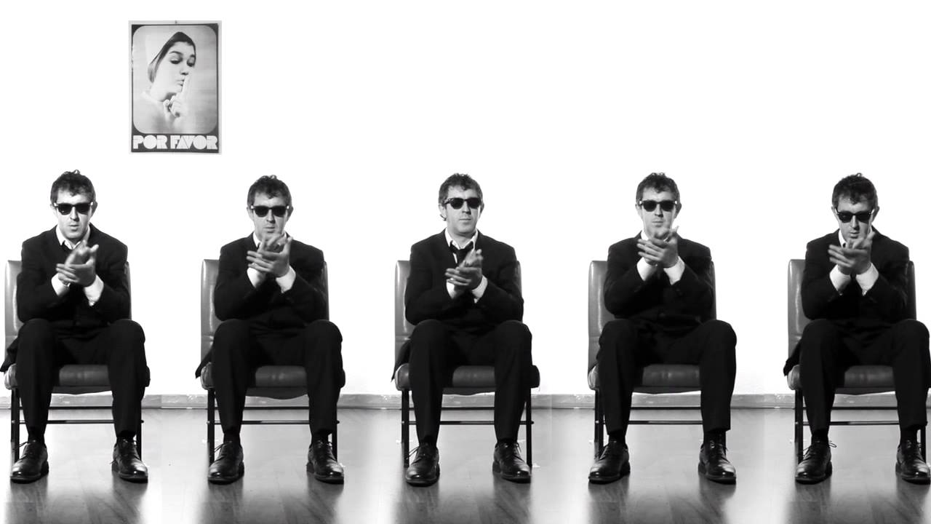
Clapping Music, Steve Reich

Slide 3
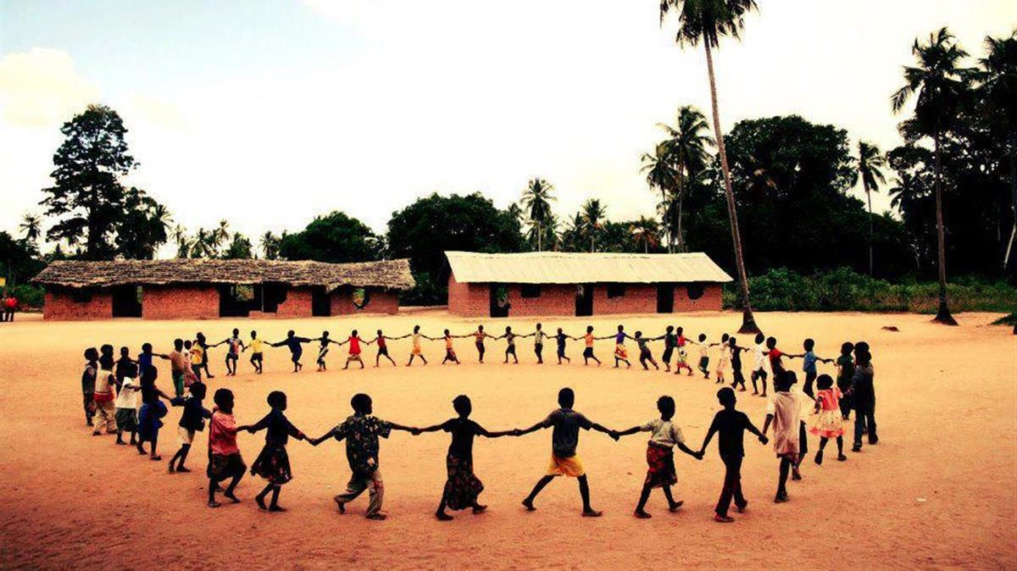

Slide 6
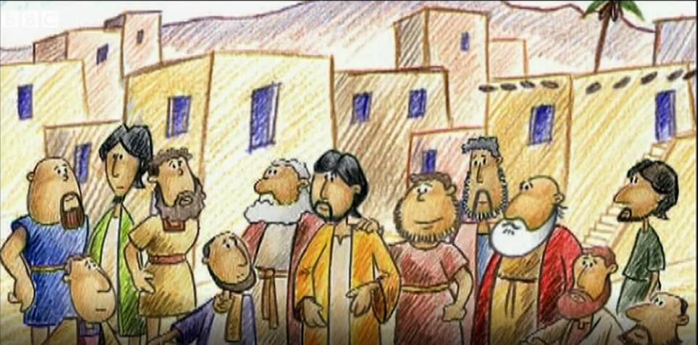

Slide 7
Dear God,
Thank you for the idea of Ubuntu,
That we need other people.
Thank you for putting us in communities.
Help us to show Ubuntu,
to love our neighbour in school,
in our local community and in the wider world.
Amen.

Slide 8
Life is Always Better (Fullness of Life)
https://www.popuk.org/life-is-always-better

Slide 9
Clapping Music, Steve Reich

