Slide 1

Portsmouth Diocesan Council for
Social Responsibility (CSR)
Nick Ralph
Executive Director

Slide 2
How does our faith inform what we do?
The Church has a mission, - Jesus talked about good news to the poor, release to the captives, sight to the blind, and freedom for the oppressed in Luke 4 (quoting Isaiah 61)
Parables: Sheep and Goats, Good Samaritan
The Lord’s Prayer, ‘Thy kingdom come’
‘Love your neighbour as you love yourself’
‘Seek the welfare of the city where I have sent you into exile, and pray to the Lord on its behalf, for in its welfare, you will find your welfare.’ (Jeremiah 29.7)
Building the common good - ‘To each is given the manifestation of the Spirit for the common good.’ (1 Cor 12.7)
More detailed theological basis set out in the document sent out with Synod papers

Slide 3

CSR Background
Records go back to at least 1920. (The 1920 Lambeth Conference called for the creation of ‘Councils for Moral Welfare’.)
Ran a home for unmarried mothers in Purbrook and Newport along with an adoption service until 1976.
Was involved in running a probation hostel from around the 1960s until 1993 when it was sold to the Probation Service.
Has been running the Good Neighbours Network since 1976.

Slide 4
CSR Charity
Charitable Company (registered at Charity Commission and Companies House).
Objects:
  education and training for people to undertake voluntary work for community benefit;
  the promotion of research into the moral and social welfare needs of the community;
  community capacity building for the relief of need including the provision of counselling; and
  the provision of information, advice, instruction and other services in any Diocese of the Church of England.

Slide 5
CSR Board
Prof Sir Jonathan Montgomery (chair) Appointed by the Bishop
Edward Phillips (vice chair) Elected by CSR Board
Philip Poulter Ex Officio
Elaine Coe Nominated by PDBF
Emily Hassan Nominated by PDBF
Nicki Youern Elected by CSR Board
Prof Andrew Bradstock Elected by CSR Board
Robert Solomon Elected by CSR Board
2 vacancies + up to 2 Co-options

Slide 6
5 Marks of Mission
To proclaim the Good News of the Kingdom (Tell)
To teach, baptise and nurture new believers (Teach)
To respond to human need by loving service (Tend)
To transform unjust structures of society, to challenge violence of every kind and pursue peace and reconciliation (Transform)
To strive to safeguard the integrity of creation, and sustain and renew the life of the earth (Treasure)
As defined by The Anglican Consultative Council 1984-1990

Slide 7
CSR’s Vision and Mission
CSR offers targeted encouragement, training, coaching, infrastructure support, investment, and other resources to aid active partnerships (both Anglican and with wider communities), to achieve this vision by:
Providing a platform for social action programmes in targeted communities with a priority on those in areas of disadvantage.
Through churches and beyond, working with people to co-produce solutions which transform their communities in ways that matter to them and resonate with them.
Making our work as sustainable and resilient as possible through social enterprise approaches and innovation which engages and empowers local people.

Slide 8
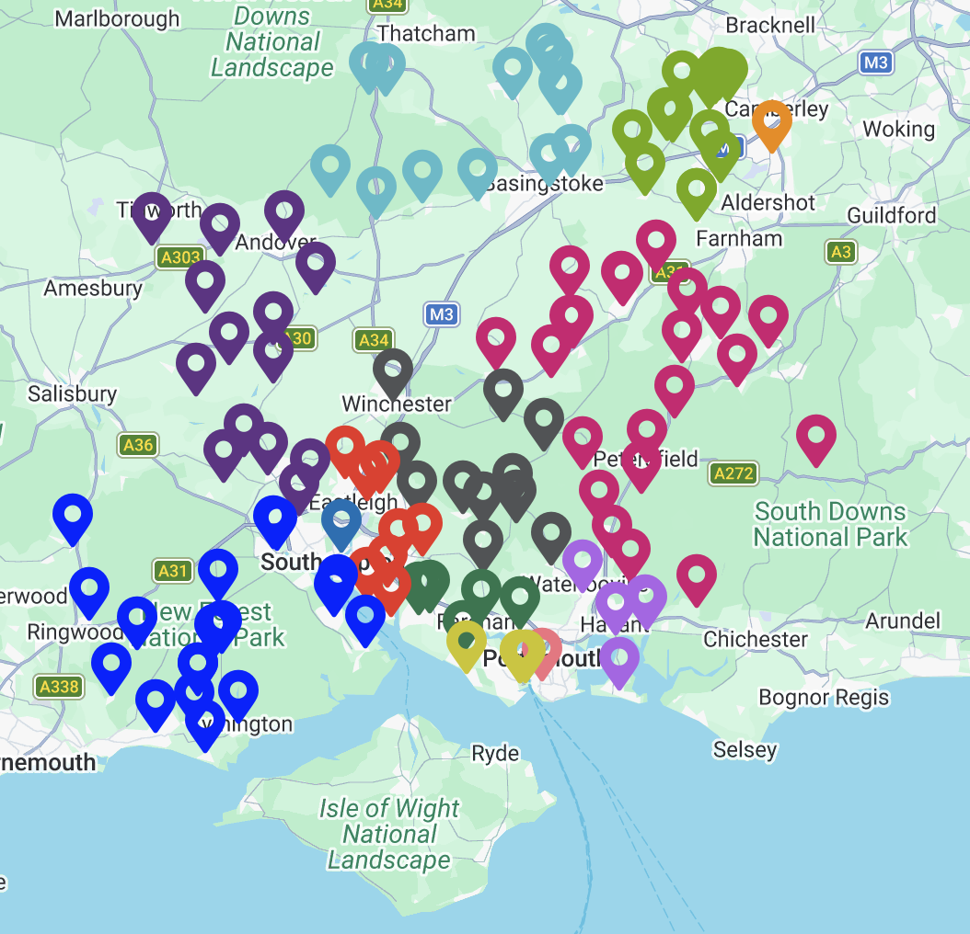
CSR Work – Good Neighbours Network
116 Independent local groups
4000+ volunteers
161,000 tasks –
  Transport to healthcare
  Social activities
  Shopping
  Lunch clubs
  Coffee mornings
  Befriending
  Small DIY tasks
Each group decides its own priorities.
Impact valued at £9.7m (2025)
www.goodneighbours.org.uk

Slide 9


Mental Health 1: Counselling
Run by volunteers
Based at All Saints, Portsmouth
Came under CSR’s umbrella in 2018/19.
Been running for over 30 years
Charges based on ability to pay
www.allsaintscounselling.org.uk
Run by staff – the only independent staffed service in Portsmouth
Based at Portsmouth Central Library
New service, still developing.
Charges based on ability to pay
www.compasscounselling.uk
Both services conform to the BACP Ethical Framework.

Slide 10

Mental Health 2: Children and Young people
CSR board commissioned a report in 2023 by Andrea King, formerly UK Clinical Director of the Anna Freud Foundation.
Made recommendations about how we could make a useful difference.
Took on a full-time Emotional Health and Wellbeing Programme Manager, Lydia Galloway, who has set up work in Charter Academy and a young people’s podcast.
Making an impact on YP’s health and wellbeing
https://www.youtube.com/watch?v=sOK7bwjLjs8
https://open.spotify.com/show/61ugMr3A0Pcw0pMIGUL1nA

Slide 11
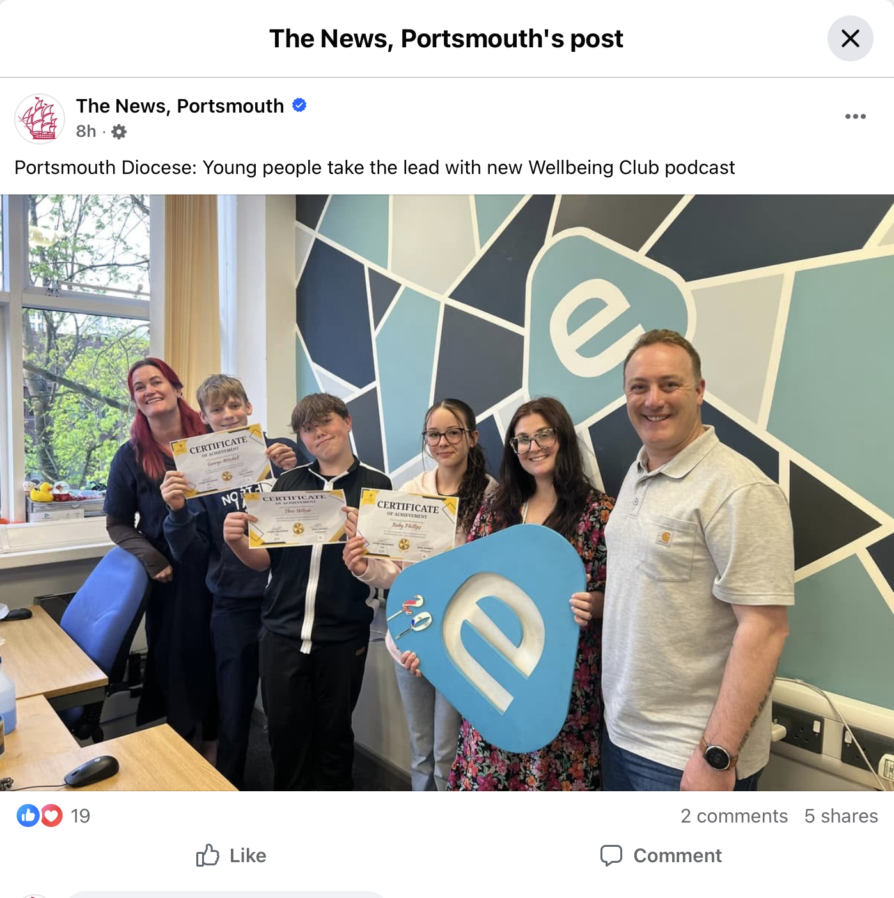
Link to The News Article here.

Slide 12
Other Activities
Rapid Development Programme – Workshop-based programme helping parishes to look outward at how they can serve their communities. Starts with outward realities, not inward problems.
  Been run in 28 parishes in 5 dioceses.
  Asset-Based Community Development approach (ABCD) – Key question!
  Evidence led approaches including using Census, IMD, and Experian data
Supporting Social Enterprise approaches to activities
  People, Planet, Profit
  Trading for social impact and using unrestricted funds to cover other work
Creative Leadership
  Kaospilots School in Denmark
  Generational Theory
Supporting new approaches to developing social housing on glebe and other land, working with modern methods of construction.
Support LINC Parishes and we do data / evidence
All to help Create Social Resilience

Slide 13
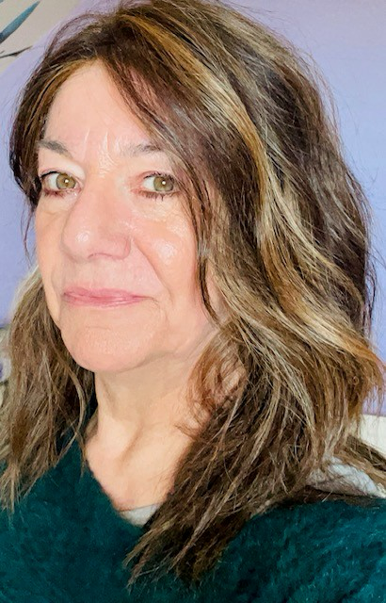
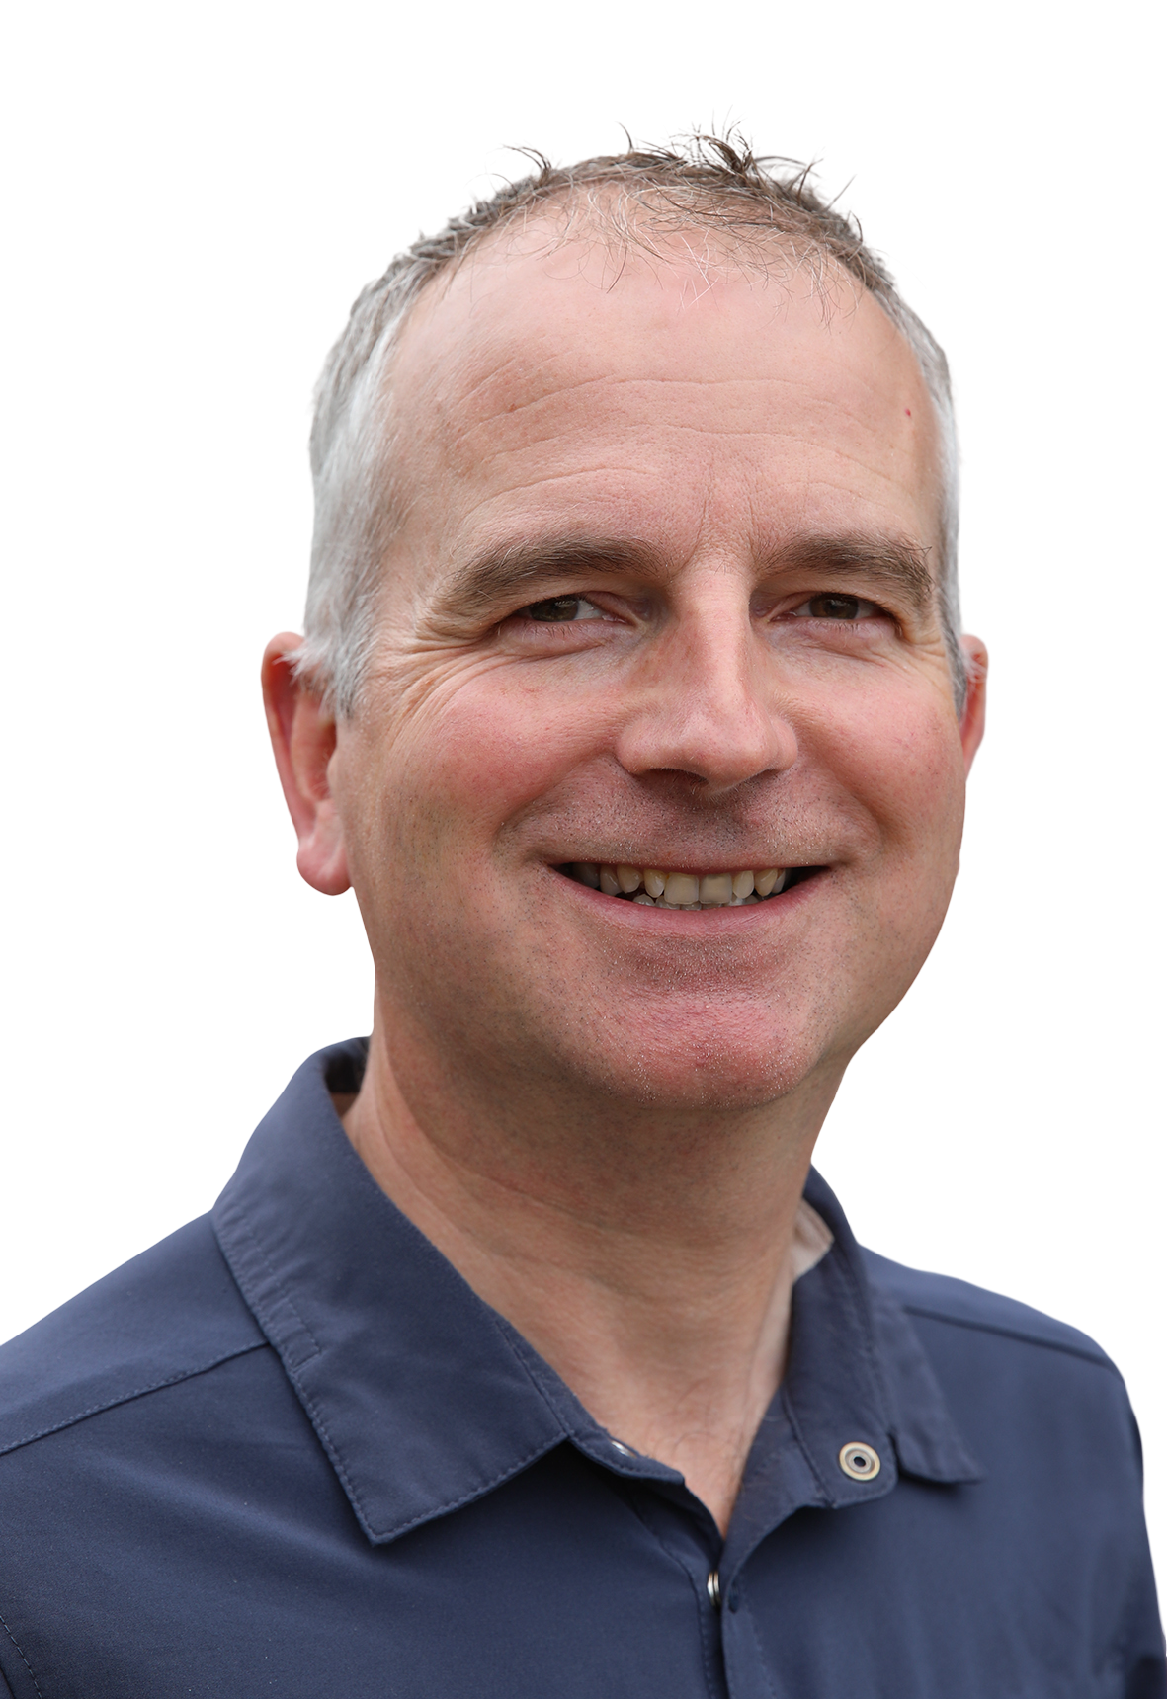
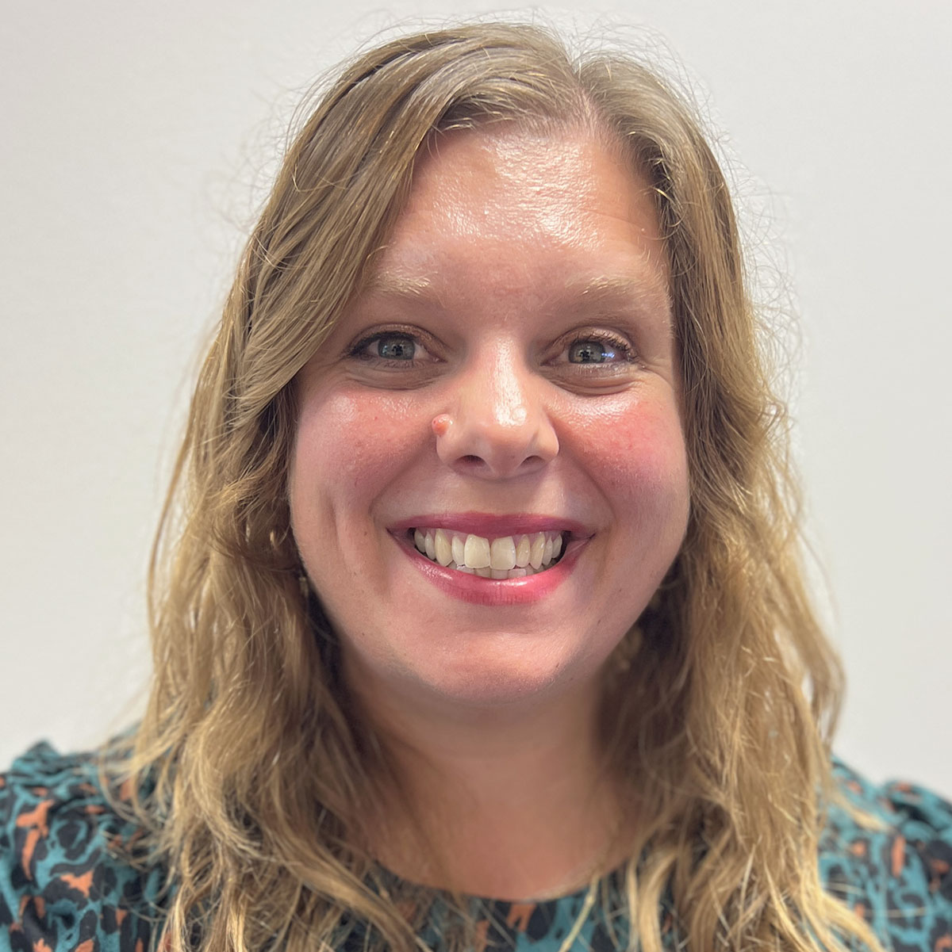
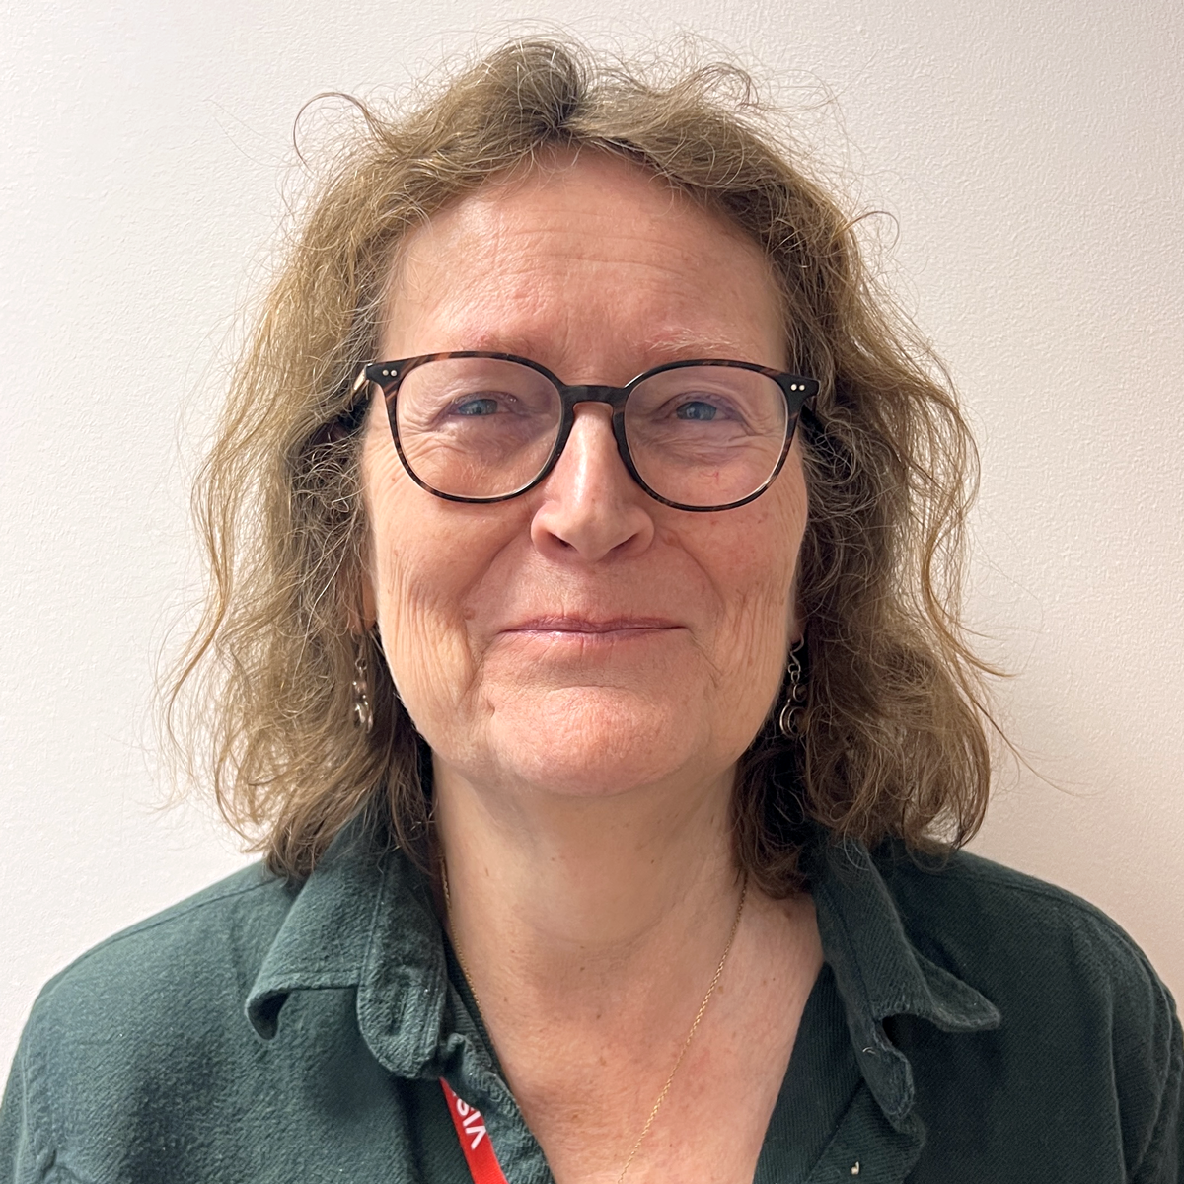
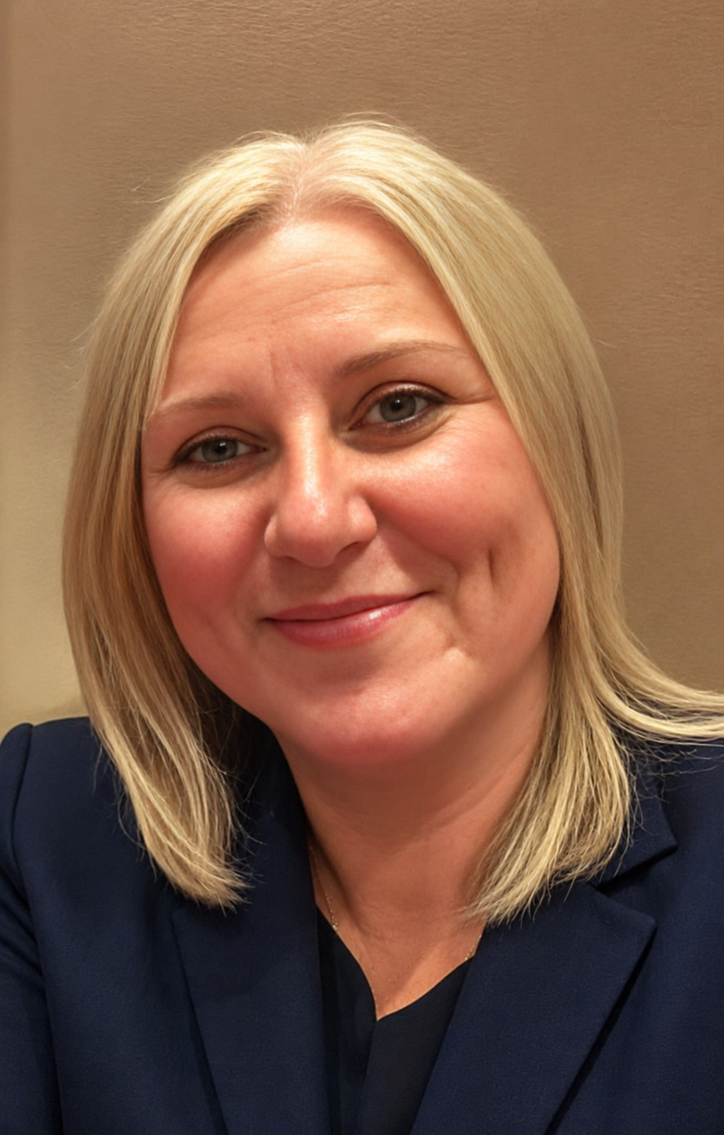
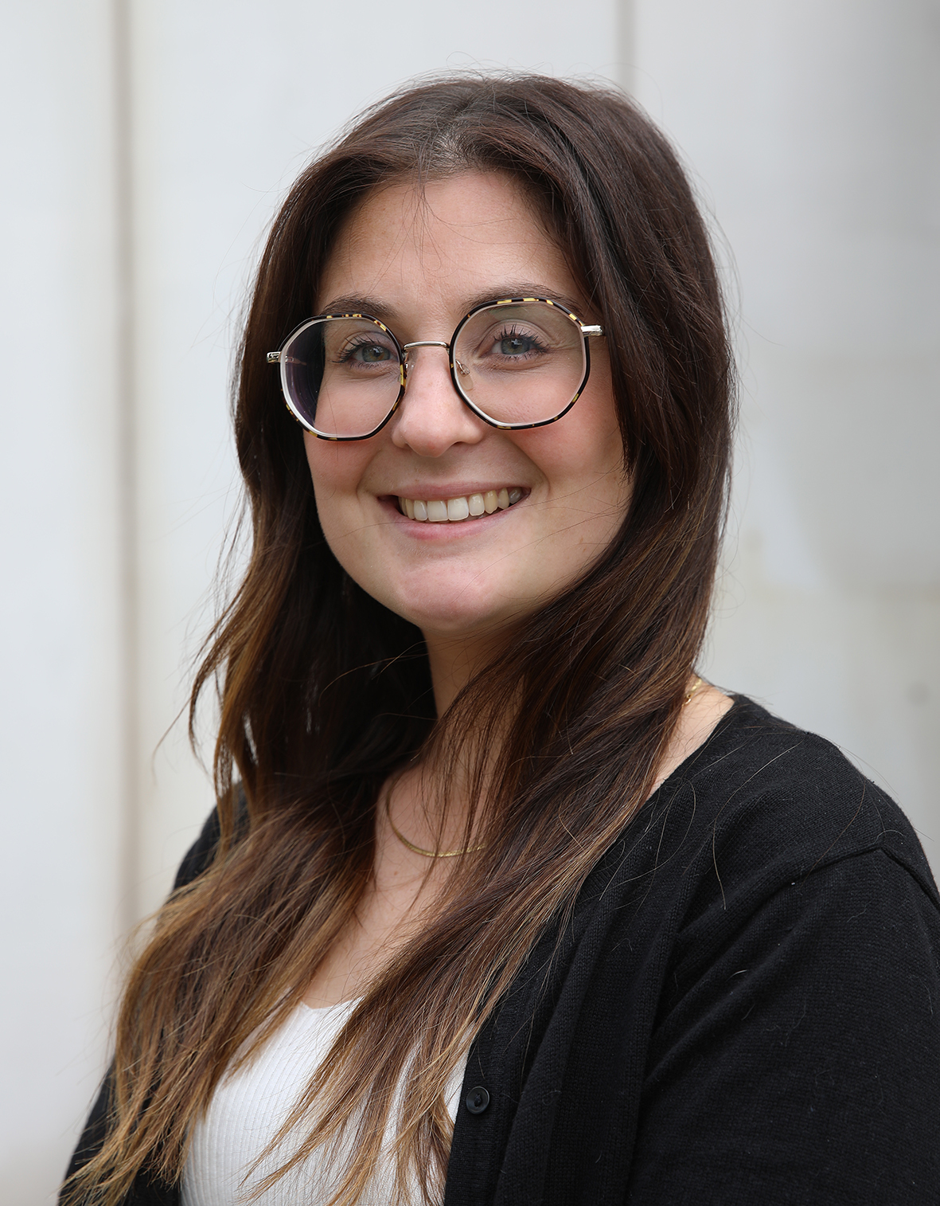
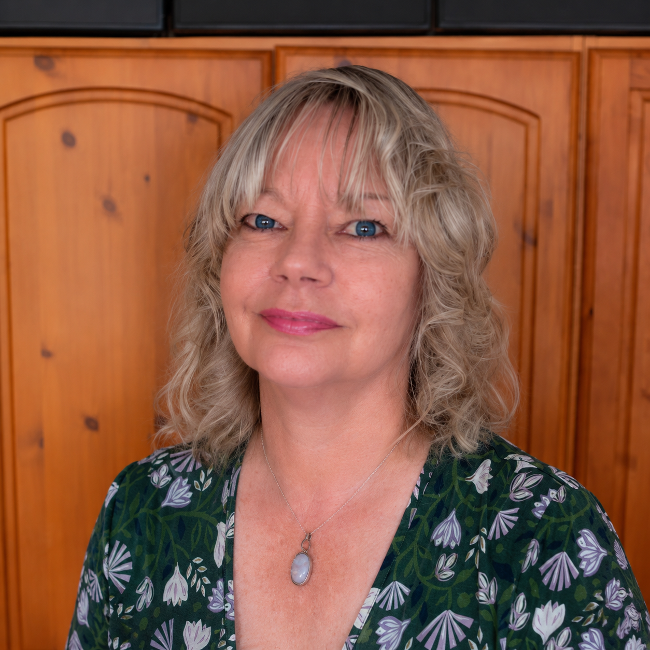
CSR Staff
GNN
  Team leader: Karen Jordan (100%)
  Adviser: Stephen Dominy (80% to end of 2026)
Counselling
  Service Manager: Siobhan Butt (50%)
  Counselling Superviser: Sally Knight (50%)
Emotional Health and Wellbeing Manager
  Lydia Galloway (100%)
Fundraising Manager
  Vanessa Eden (100%)
PA
  Sam Powell (10%)
Executive Director
  Nick Ralph (40%)

Slide 14
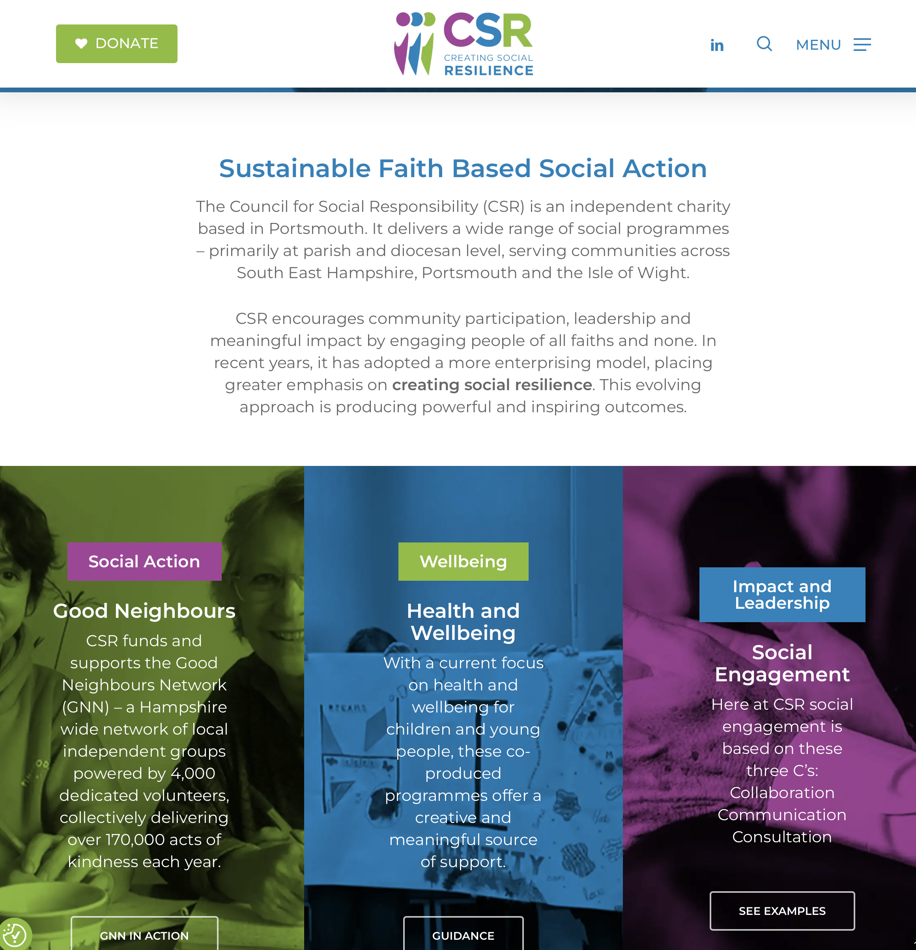
www.csrnet.org.uk
Nick.ralph@Portsmouth.Anglican.org

