Slide 1
Strategic update and
SMMIB December 2026 Bid
June 2026

Slide 2

Vision of the Church of England
One vision
A Church for the whole nation which is Jesus Christ centred, and shaped by, the five marks of mission. A church that is simpler, humbler, bolder.
Three priorities
To become a church of missionary disciples where all God’s people are equipped to live the Christian life, wherever we spend our time Sunday to Saturday.
To be a church where mixed ecology is the norm – where every person in England has access to an enriching and compelling community of faith by adding new churches and new forms of Church to our parishes, cathedrals, schools and chaplaincies.
To be a church that is younger and more diverse

Slide 3
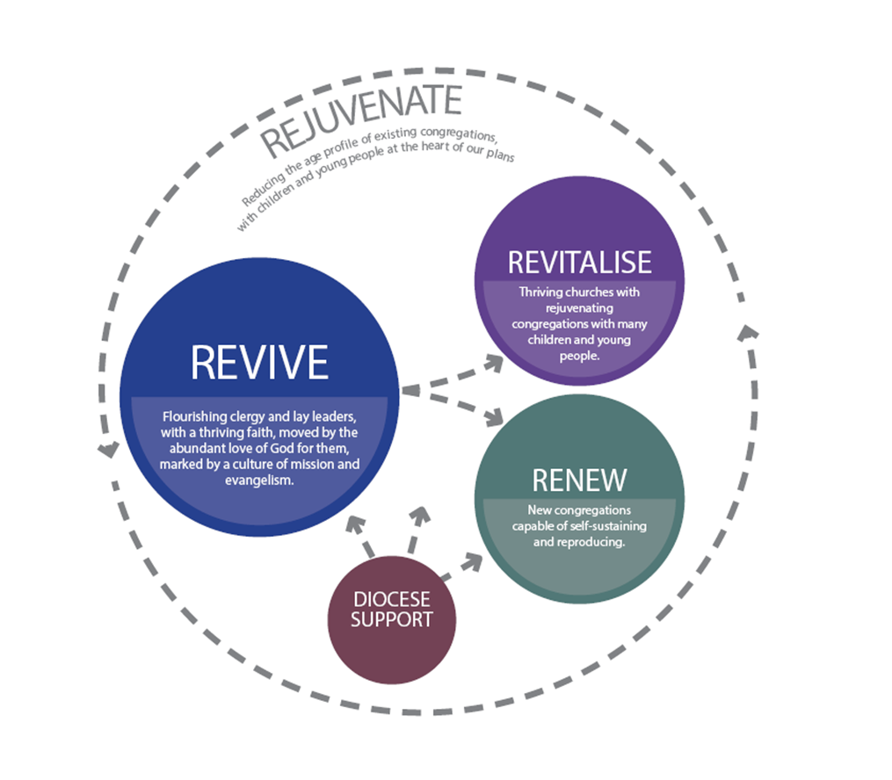
Vision:
The Diocese of Portsmouth longs to be a rejuvenating community of Jesus-centred, Kingdom-seeking disciples.
Strategy:

Slide 4
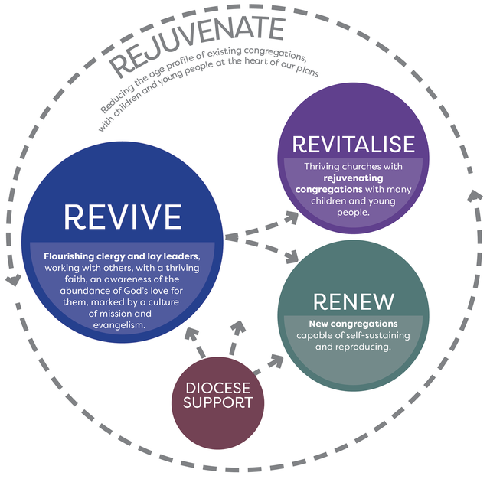
Our next funding bid
Continuing with the current vision and strategy
Learning from our current work
Further developing our ideas/priorities within deaneries
2025
2024
2025
2026
2026
SDF3 funding concluding September 2026
2025
2026
2027
2028
2029
Current SMMI funding £5.3m over 5 years
2027
2028
2029
2030
2031
Max £2m 27/28
Max £3m 29/30/31
Indicative maximum £5m over 5 years
Plus £500k Time Limited Funding

Slide 5
Revive
Maintain Lead for Revive role
Expand Cairns to be available to all clergy and lay leaders
Other support continues, funded by DBF and other grants:
  Continuing Ministerial Development and Ministerial Development Reviews
  Training and support for Lay Ministry

Slide 6
Revitalise
Maintain Lead for Revitalise role
Specific Parish Revitalisation projects
Package of support for Children, Youth and Families Ministry
Parish Revitalisation Fund - £500,000 to be made available in small grants to support Parish mission projects

Slide 7
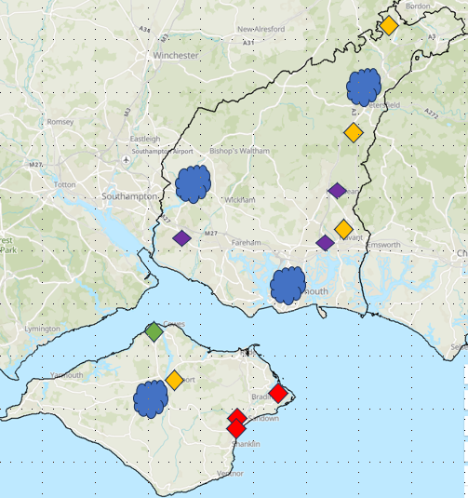
Children’s, Youth and Families projects
Flourish
Choir Church
Deanery projects
Parish Revitalisation Project
Parish Revitalisation Fund
Examples

Slide 8
Renew
Maintain Lead for Renew role (part of a larger role)
Specific Parish Renew projects
  Some have been clearly identified, with a full design, ready to start in 2027
  Others have a broader design, likely to be started later in the funding period

Slide 9
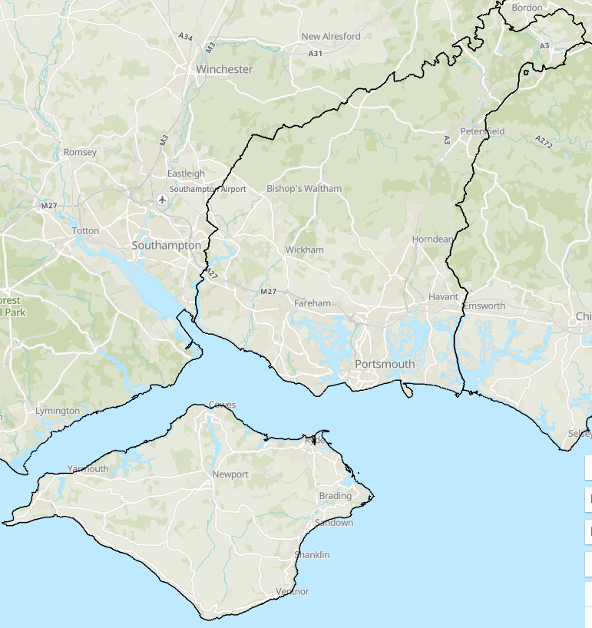
Cosham and Wymering
Barn Church
St. John’s, Forton, Gosport
Berewood, Havant Deanery
Boorley Green, Bishop’s Waltham Deanery
Welborne, Fareham Deanery
A further church plant

Slide 10
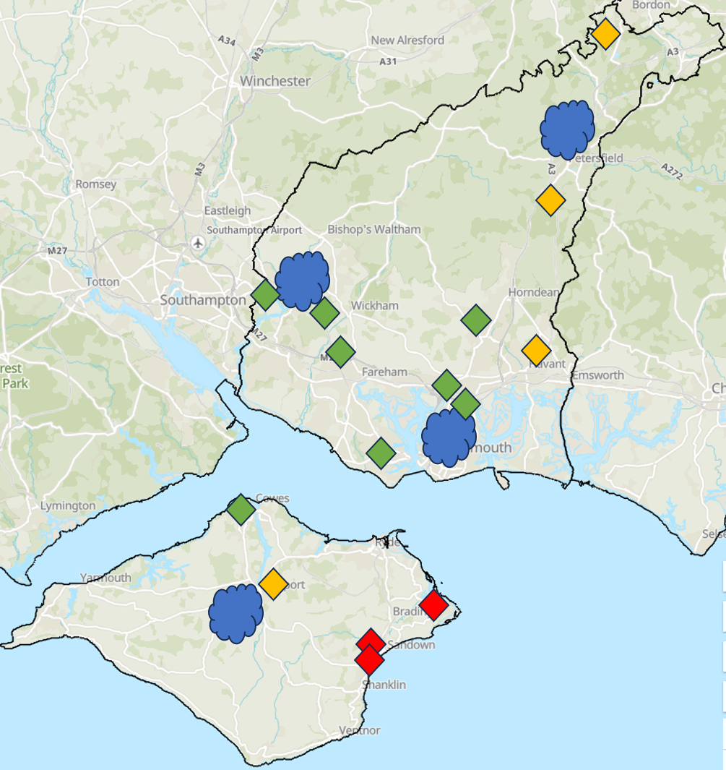
Overall Picture
Projects proposed in every Deanery
Broad range of contexts and traditions – a mixed ecology
Some ready to start, and others ready later in the 5 year period

Slide 11
Strategic Programmes Team
Currently funded by a number of different grants
Extend roles from 2028 to 2031

Slide 12
Overall Picture – adding in:
Existing SMMI projects
SDF3 projects (mostly closing by September 2026)

Slide 13
Outcomes
Parish Health – more Parishes being missionally and financially strong
Thriving Children and Youth Ministries (>25 yp) – aiming for 50 Parishes
More disciples – measured through Average Weekly Attendance
Number of Baptisms / Confirmations
Number of new lay leaders and volunteers / new vocations
Number of Alpha (and similar) attendees
Number of people attending small groups
Number of community outreach activities
Number of planned givers and amount given

Slide 14
Example of Outcomes
This Bid Previous Bid
Growth – adults: 1640 1500
Growth – children: 830 900
Total 2470 2400
This would equate to Diocese growth of:
2.7% growth in adults per year (2025 was 3.3% growth)
166 additional children per year (100 in 2025)

Slide 15
Financial summary
Revive £100,000
Revitalise £2,100,000
Renew £2,300,000
Programme Team £500,000
Total £5,000,000

Slide 16
Key dates
March 7th – Diocesan Synod feedback on initial bid outline
May 21st – Review with Archdeacons and Area Deans
June 8th – Bishop’s Staff Team review
June 13th - Diocesan Synod endorse bid key points
July 9th - Bishop’s Council approve main bid
Sept 24th – submit near final draft to SMMIB for evaluation
Oct 22nd – submit final bid
Dec 9th – SMMIB meets – decision given verbally and then officially
1st Jan 2027 – Funds available if the bid is successful

Slide 17
Motion to Synod
‘This Synod takes note and reaffirms the Diocesan Vision and Strategic Approach’

