Slide 1
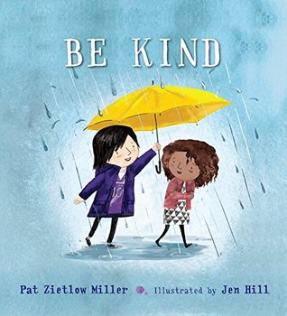
Click here for a link to the story being told on YouTube.

Slide 2
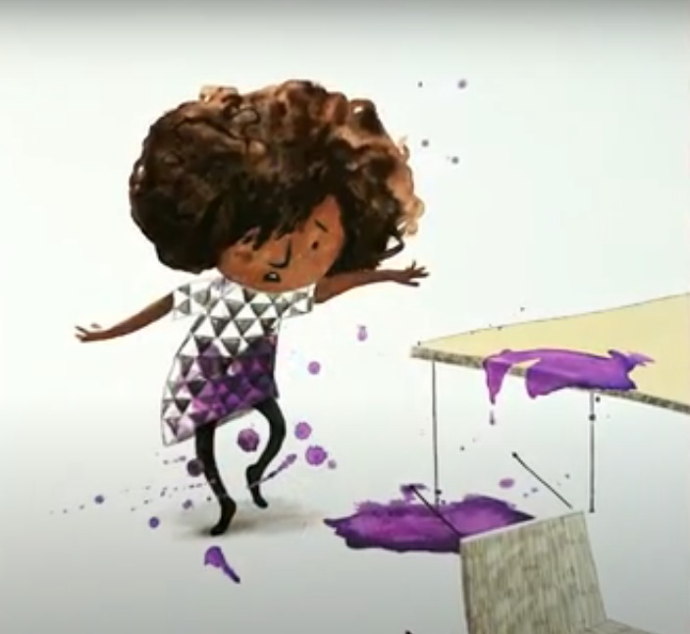
How did the teller of the story try to be kind?
What examples of being kind were shared throughout the story?
Does she solve the problem for Tanisha?

Slide 3
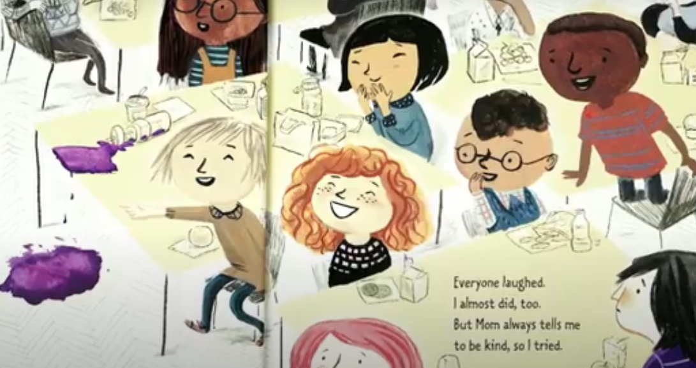
How many of the behaviours in the story do you do? How many have been done to you (both good and bad)?
How does it make you feel when people laugh at you?
How does it make you feel when people try to help and make you feel better?

Slide 4
It is interesting how one example from the story talks about the importance of using someone’s name. Why do you think this is good to do?

Slide 5
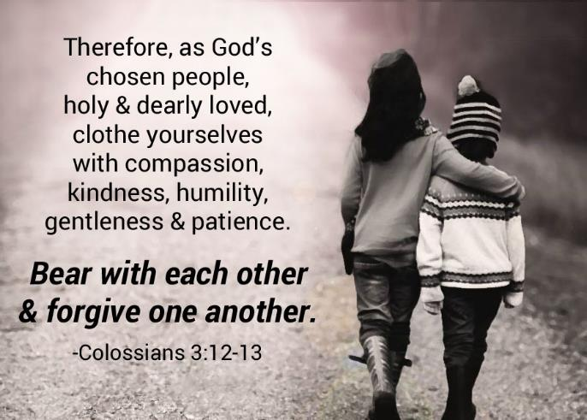
Kindness is referred to in the Bible as one of the ‘Fruits of the Spirit’. In St Paul’s letter to the Colossians it is also mentioned as something we should ‘clothe’ ourselves with:
Kindness is something we should be trying to show all the time, although it is not always easy is it?

Slide 6
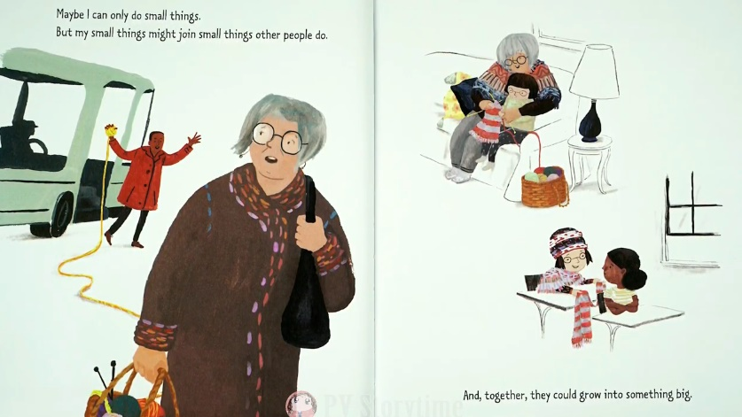
We can all do small things to help. As the story says, these can all add up to have a big impact – we can’t solve the world’s problems all on our own! But we can make our own very valuable contributions. It is a bit like……..

Slide 7
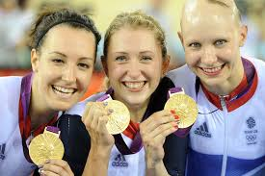
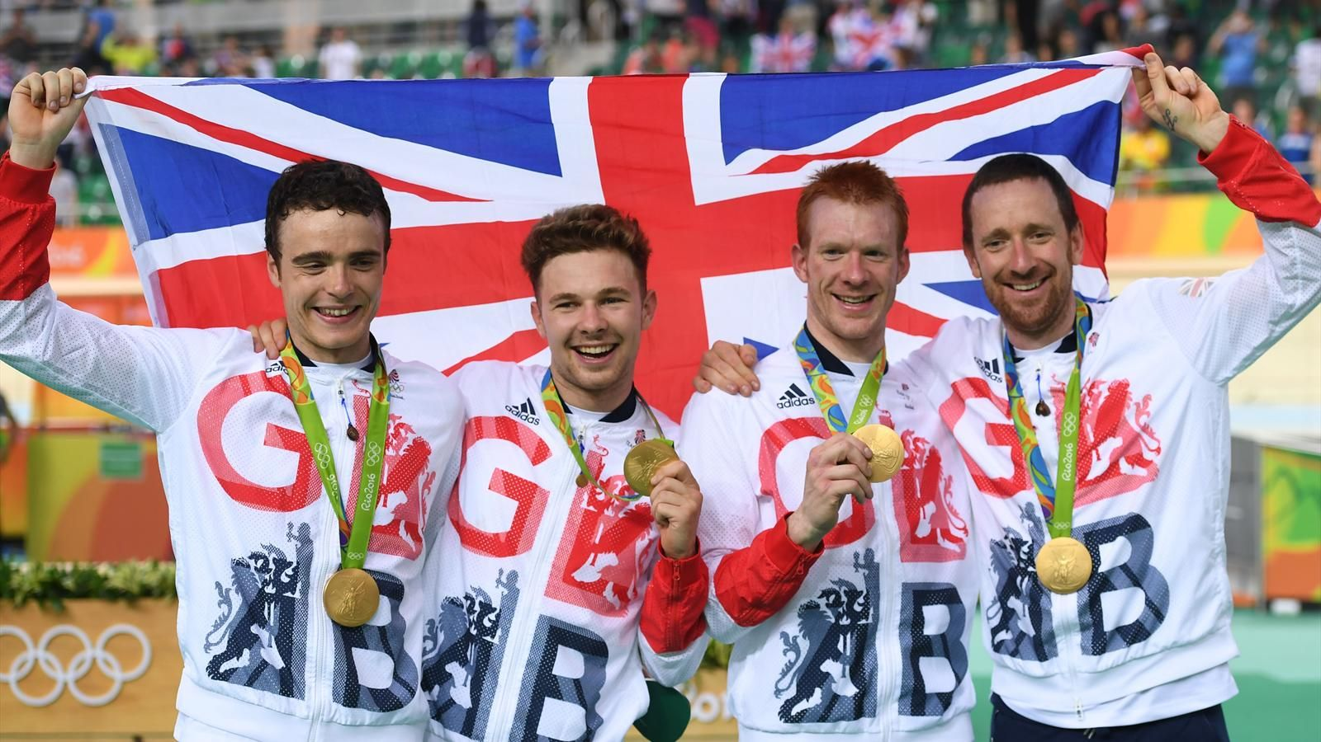
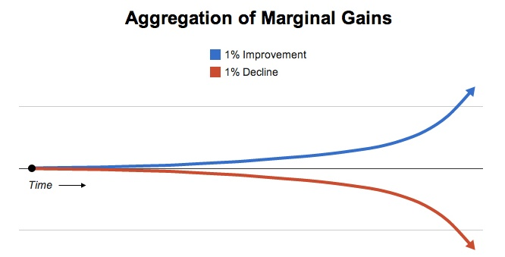
The British Olympic cycling team discovered that making small changes, bit by bit, over time, can have a very large impact. It is the same with kindness……

Slide 8
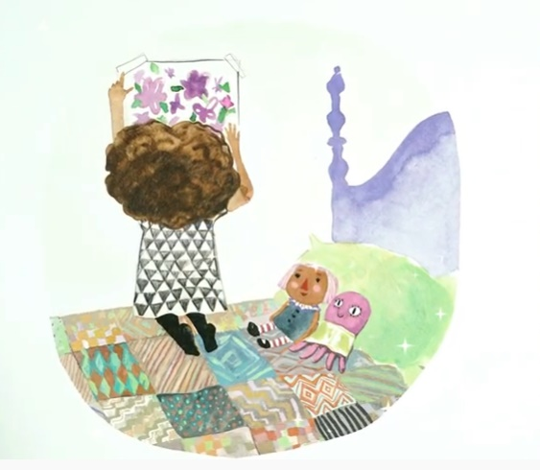
Dear God,
Help me to be kind and to recognise opportunities each day when kindness is needed, even when I don’t feel like it or when I don’t think the other person deserves it.
Thank you for your kindness to us and help us to feel clothed and surrounded by it, and to help others feel the same.
Help us to make our school a place where kindness abounds.
Amen.

