Slide 1
2024 Annual Report and Accounts
and
2025 Financial Update

Slide 2
Audit Overview
Audit has been completed by HaysMac
Unmodified audit opinion
One control issue relating to our accounts system
No adjustments made to the numbers
Detailed review of property valuations
Audit tender unway

Slide 3
2024 Annual Report and Accounts
Key points – all funds

Slide 4
2024 Annual Report and Accounts
Key points – general funds

Slide 5
General Fund – budget reconciliation
* The budgeted deficit was based on the assumption 100% collection of parish share was achieved.
NB other transfers between funds are shown separately in the statutory accounts

Slide 6
2024 Annual Report and Accounts
Year end changes:
  Investment valuations increased by £504,427 across all funds
  Property valuations increased by £1,602,877 across all properties (DBF, parsonages and glebe/investment properties)
  No revaluation movements to pension schemes as they remain in surplus

Slide 7
2024 Annual Report and Accounts
Summary of movements in reserves – all funds

Slide 8
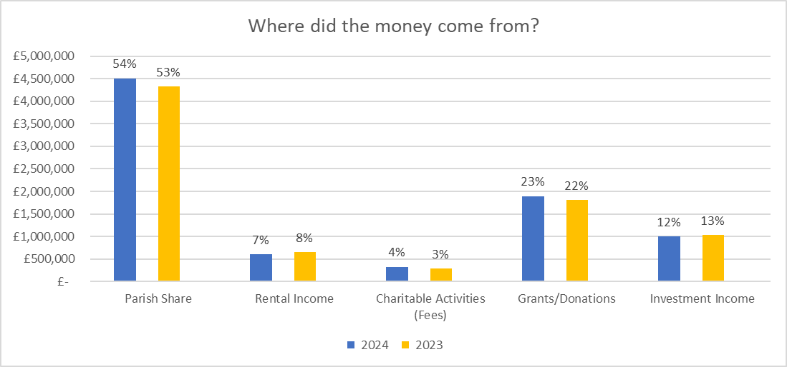
Where did the money come from?

Slide 9
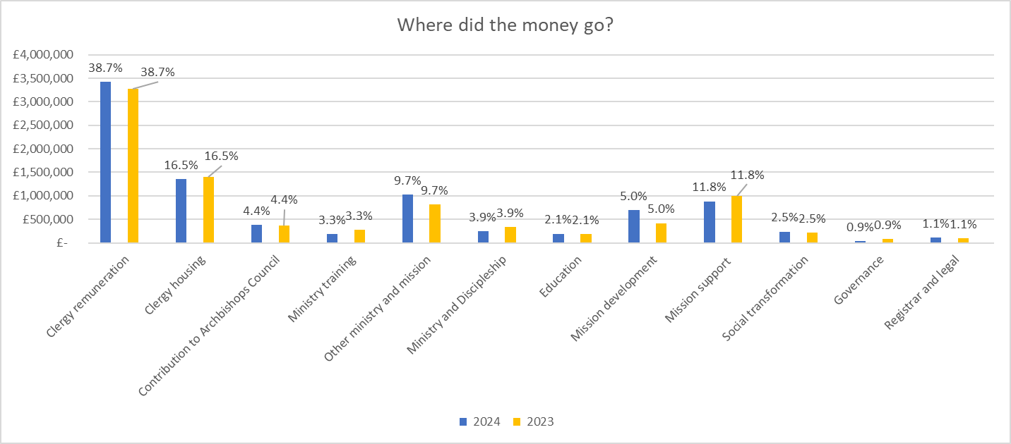
Where did the money go?

