Slide 1
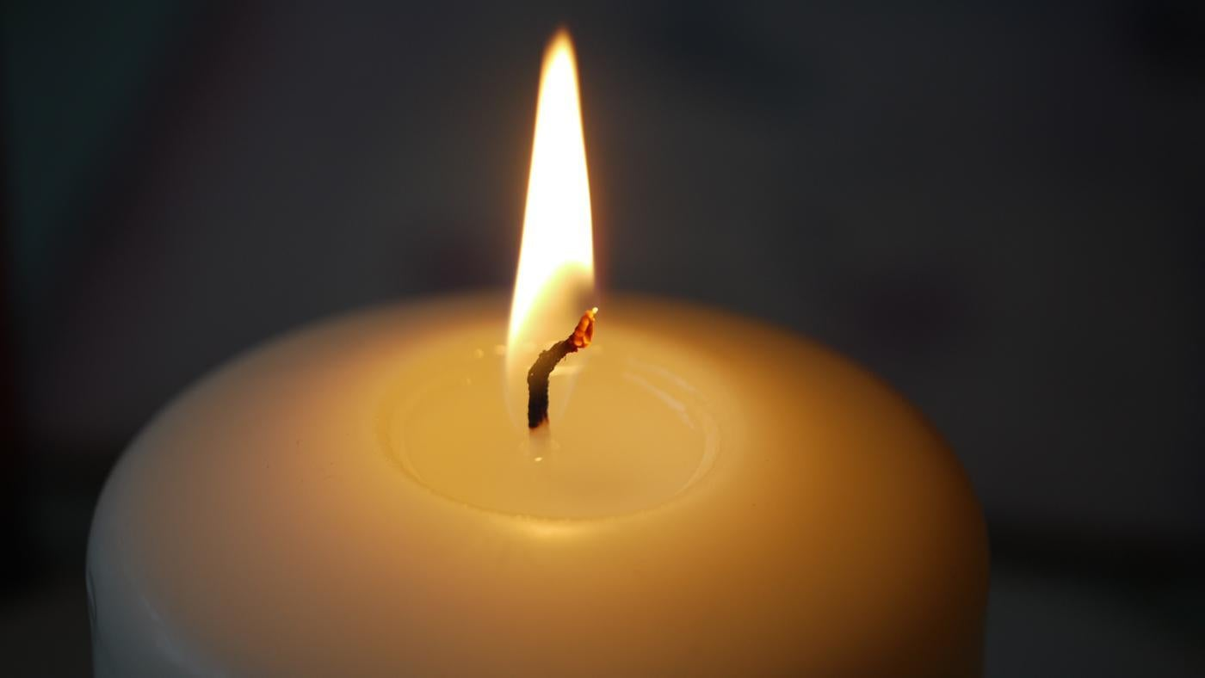
Welcome to worship
https://www.youtube.com/watch?v=0wxjb397lyk

Slide 5
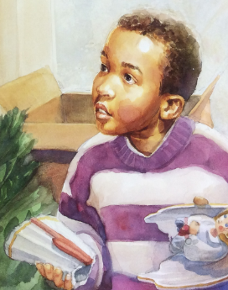

Slide 6
Dear God,
Thank you that you made us all different. Thank you that we look different from each other, that we like different things and we have different personalities.
Sorry that sometimes we leave people out or think that their ideas don’t matter, if they are not the same as us.
Please help us to be friendly to everybody and to enjoy the diverse, multicoloured world that you made.
Amen

