Slide 1
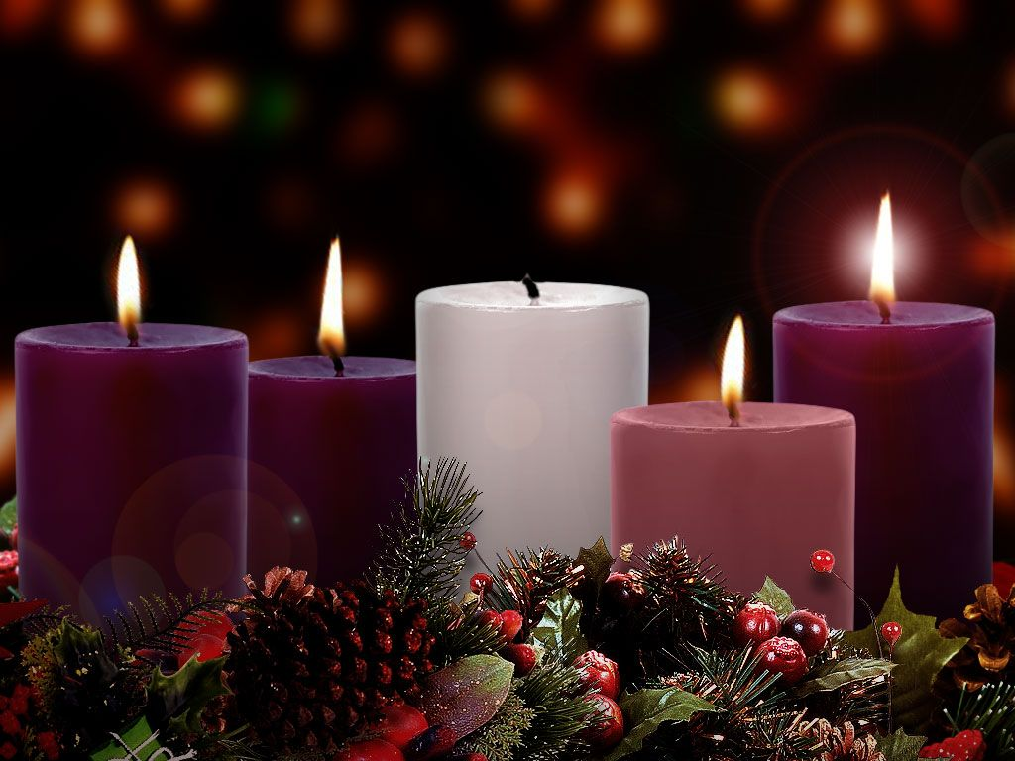
Advent Week 4 – The Candle of Joy

Slide 2
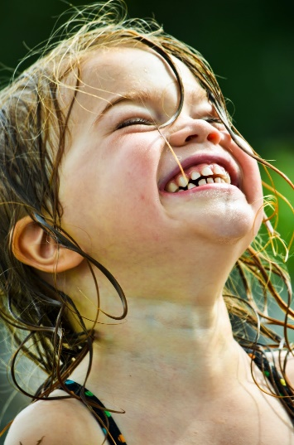
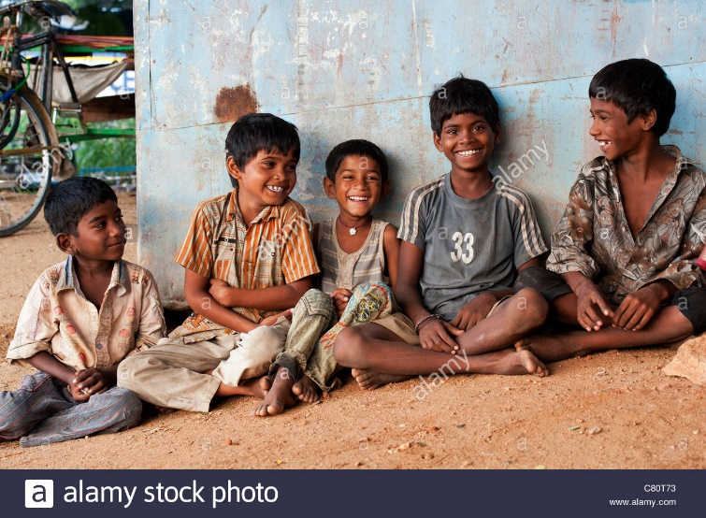
Happiness…. Or joy?

Slide 3
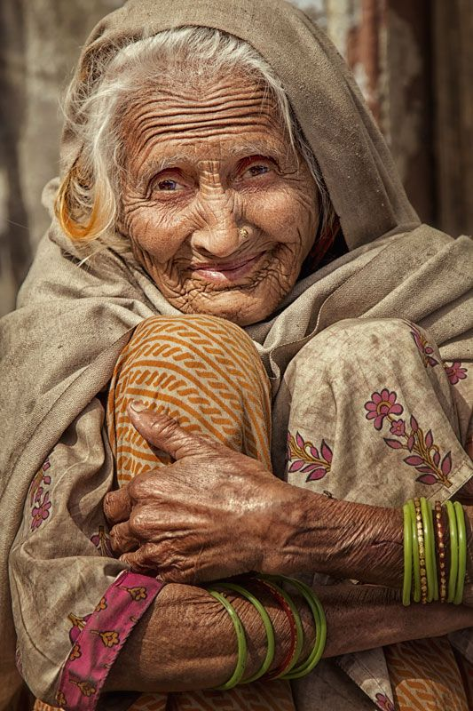
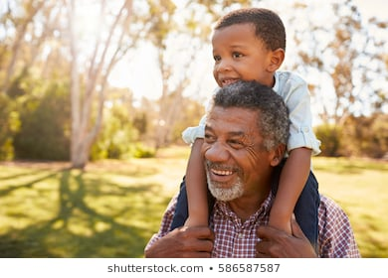
Happiness…. Or joy?
Is there a difference?
What do you need to be joyful?
What don’t you need?

Slide 5
What made Augustus smile?
Do we agree that these things bring us joy?
Is it possible to be joyful all the time?

Slide 6
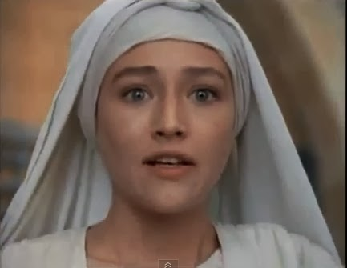
“God has remembered his promises… I’m the luckiest person alive!”

Slide 7
Dear God,
Thank you that we can find joy and laughter in ordinary, everyday things.
Thank you that Mary trusted you and was glad that you had chosen her.
We pray for people who don’t feel joyful at the moment and ask that you will help them find smiles in unexpected places.
Amen.

