Slide 1
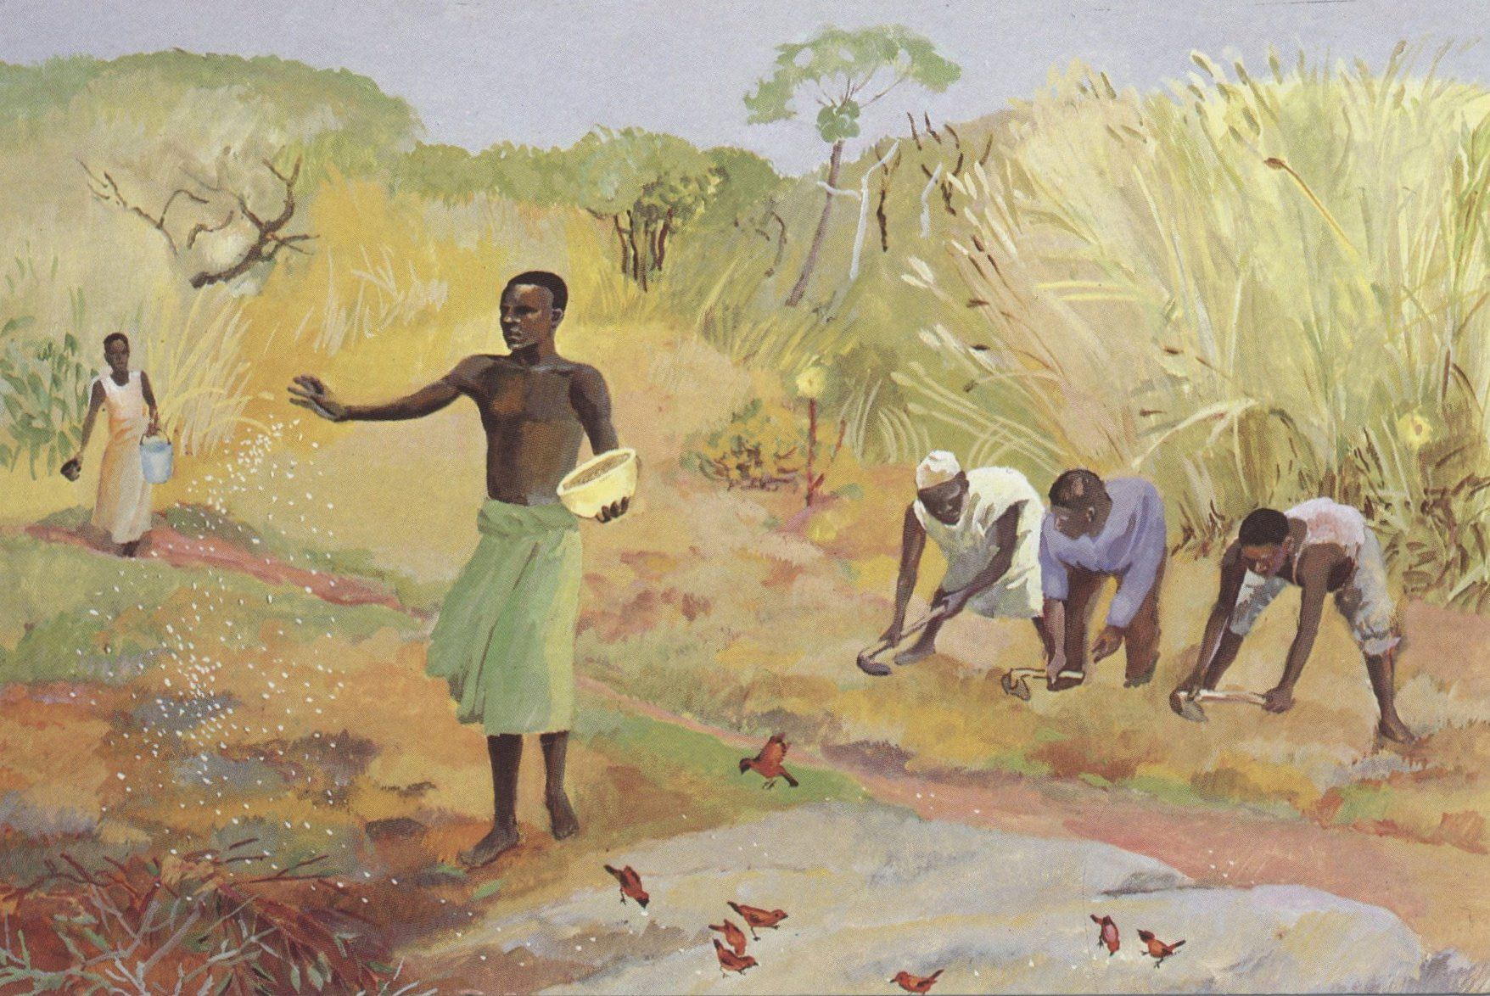

Slide 2
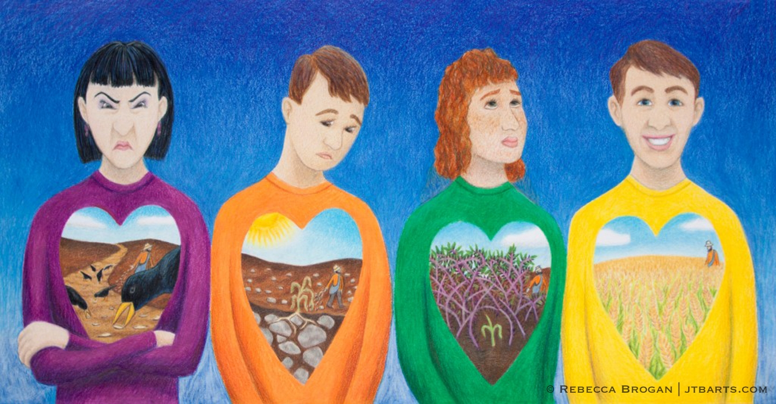

Slide 3
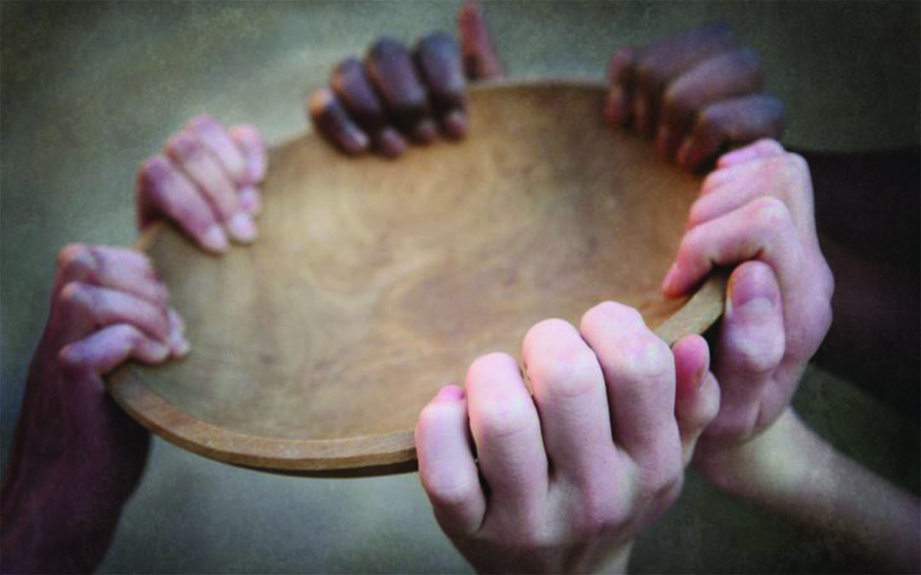
All babies together, everyone a seed Half of us are satisfied, half of us in need Love's bountiful in us, tarnished by our greed When will there be a harvest for the world
A nation planted, so concerned with gain As the seasons come and go, greater grows the pain And far too many feelin' the strain When will there be a harvest for the world
Gather everyman, gather everywoman Celebrate your lives, give thanks for your children Gather everyone, gather all together Overlooking none, hopin' life gets better for the world
Dress me up for battle, when all I want is peace Those of us who pay the price, come home with the least Nation after nation, turning into beast When will there be a harvest for the world

Slide 4
