Slide 1
Diocesan Vision,
Strategy & Plan for Rejuvenation,
For Diocesan Synod 2nd Nov 2024
Andrew Hargreaves, Interim Director of Mission & Discipleship
Vanda Leary, Strategic Programme Manager

Slide 2
VISION
The Diocese of Portsmouth longs to be
a rejuvenating community of Jesus-centred, Kingdom-seeking disciples.

Slide 3
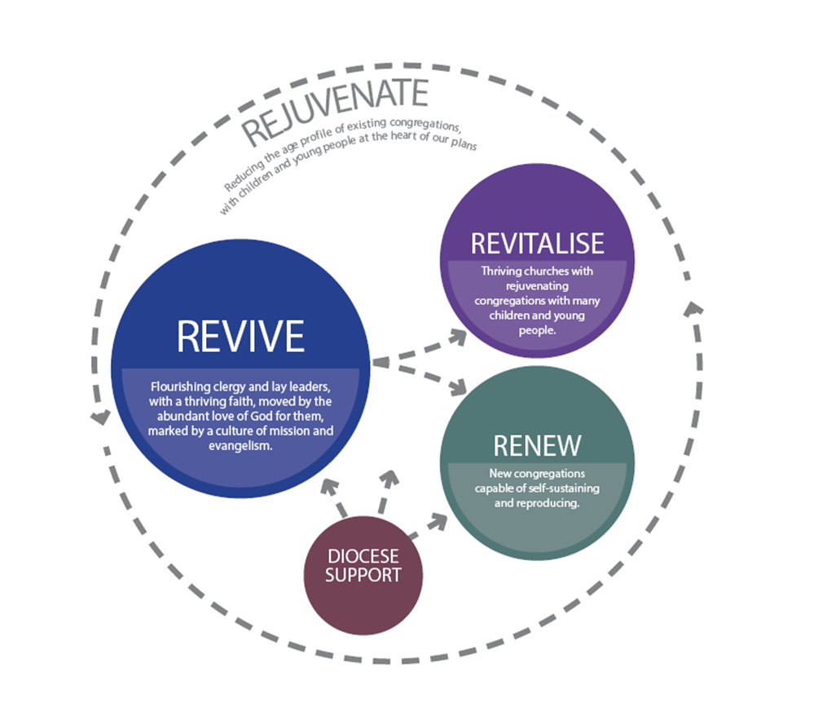
Our STRATEGY is summarised in this diagram

Slide 4
REVIVE
We want the faith of all in spiritual leadership in our diocese to be vibrant, growing, deep, and attractive.
Therefore our key priorities over the next two years will be to:
support all clergy in deepening and refreshing their own faith
develop a common vision throughout our diocese and invite deaneries and parishes to create their own strategies and plans for revival and revitalisation.
recruit gifted and experienced Diocesan Ministry and Mission Leaders, to support parish leaders to develop their own strategies and plans for revival and revitalisation.
Pilot meaningful Benedictine-style networks of clergy and lay leaders (“Cairns”), in nine networks which we would support with encouragement, advice, finance and coaching training.
Learning from pilots, launch Cairns across the diocese

Slide 5
REVITALISE
We want to help churches develop and grow disciples
Use health assessments (based on missional leadership, energy, demographics etc) to inform priorities for Diocesan and parish plans
Support churches to put credible discipleship pathways in place, where every leader and church member seeks to engage with the world in loving service and action, evangelise in words and deeds, establish disciples firmly centred in Jesus and equip them for mission.
Put in place resources and processes to equip the nine pilot networks (“Cairns”) for revitalisation
Learning from pilots, roll out Revitalise across the Diocese
Initiate a range of projects to deliver growth and learn what works well before adopting more widely
  Run a pathfinder project in Paulsgrove parish to learn how to support mission and growth in a working-class estate communities
  Run a pathfinder in Leigh Park with Park Community School, working towards a thriving children & youth community
  Pilot new ways of working in partnership between schools and churches, including Choir Church in 3 parishes
  Continue with existing grant-funded projects in Newport and North Gosport, especially sharing learning to other parishes.
Grow capacity for children, families and youth work across all deaneries
  Run established training for clergy and volunteers – Youthscape LaunchPad & Essentials
  Identify a formal training route for children & youthworkers (develop for 2026 bid)
  Recruit Children and Youth Lead to facilitate and coordinate CYF work across the diocese, sharing learning.

Slide 6
RENEW
Major growth where there are gaps - Planting to reach Children, Youth & Families
Continuation of planting projects already underway at:
  Haven Church Gosport
  Ryde Isle of Wight
  Four Flourish pilots – church school partnerships with aims each to deliver a thriving children and youth community
Major plants each delivering 300 new worshippers, and a thriving children and youth community
  St Peter & St Paul Fareham, to be gathered and sent from St John’s Fareham
  Harbour Copnor & Harbour City, to be resourced from Harbour church
“Myriad” training to equip parish teams for intra-parish planting
Development of plans for inclusion in a 2026 bid, 4-5 major plants in accordance with our planting strategy, each re-planting from our current successful plants
Sustainable operating models for all plants

Slide 7
Funding to enable mission
The Church of England SMMI Board considered our funding bid on 31st October.
Approved fully, with no conditions
£5.31m over 5 years
Average of ~£1m/year

Slide 8
Next steps
Continue with good work already underway
Recruit to key new posts to enable new work – from 4th Nov
  Lead for Revive – including clergy wellbeing and CMD
  Lead for Revitalise – revitalisation of parish mission & discipleship
  Lead for Renew – church planting & new worshipping communities
Phased start up of new projects – prep to start from 2nd Jan
Start work towards next bid (Jun 2026) – prep to start work from 2nd Jan
We’ll be in touch directly with those leading named local projects
Info to follow on expressing interest for training etc

Slide 9
Looking ahead to next funding proposal
Our next proposal (June 2026) is likely to include:
Targeted parish revitalisation support, drawing on learning from our first few years of the Revive/Revitalise pathway
An apprenticeship/formal training programme, drawing on national church resources, to further build our pipeline of children and youth workers
4-5 major plants in accordance with our planting strategy, re-planting from our current thriving plants
Further implementations of church/school partnerships such as Flourish, Choir Church, informed by learning from our pilots
Programme team support in line with the enhanced programme of work
Additional opportunities that may arise from our learning

